Slide 1
Energy transition: interaction of policy making and energy system analysis incl. modelling
Alessia De Vita
6.07.2023

Slide 2
Topics
Energy and climate policy context: worldwide and EU
How are laws prepared in EU, in the field of energy and climate?
How/Why are energy system models used for policy making?
What kind of energy system models exist, for what scope?
Who uses energy system models?

Slide 3
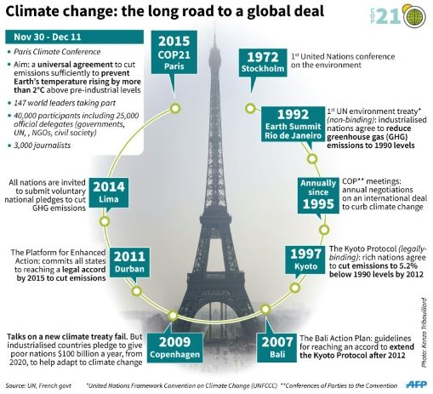
Climate change negotiations

Slide 4
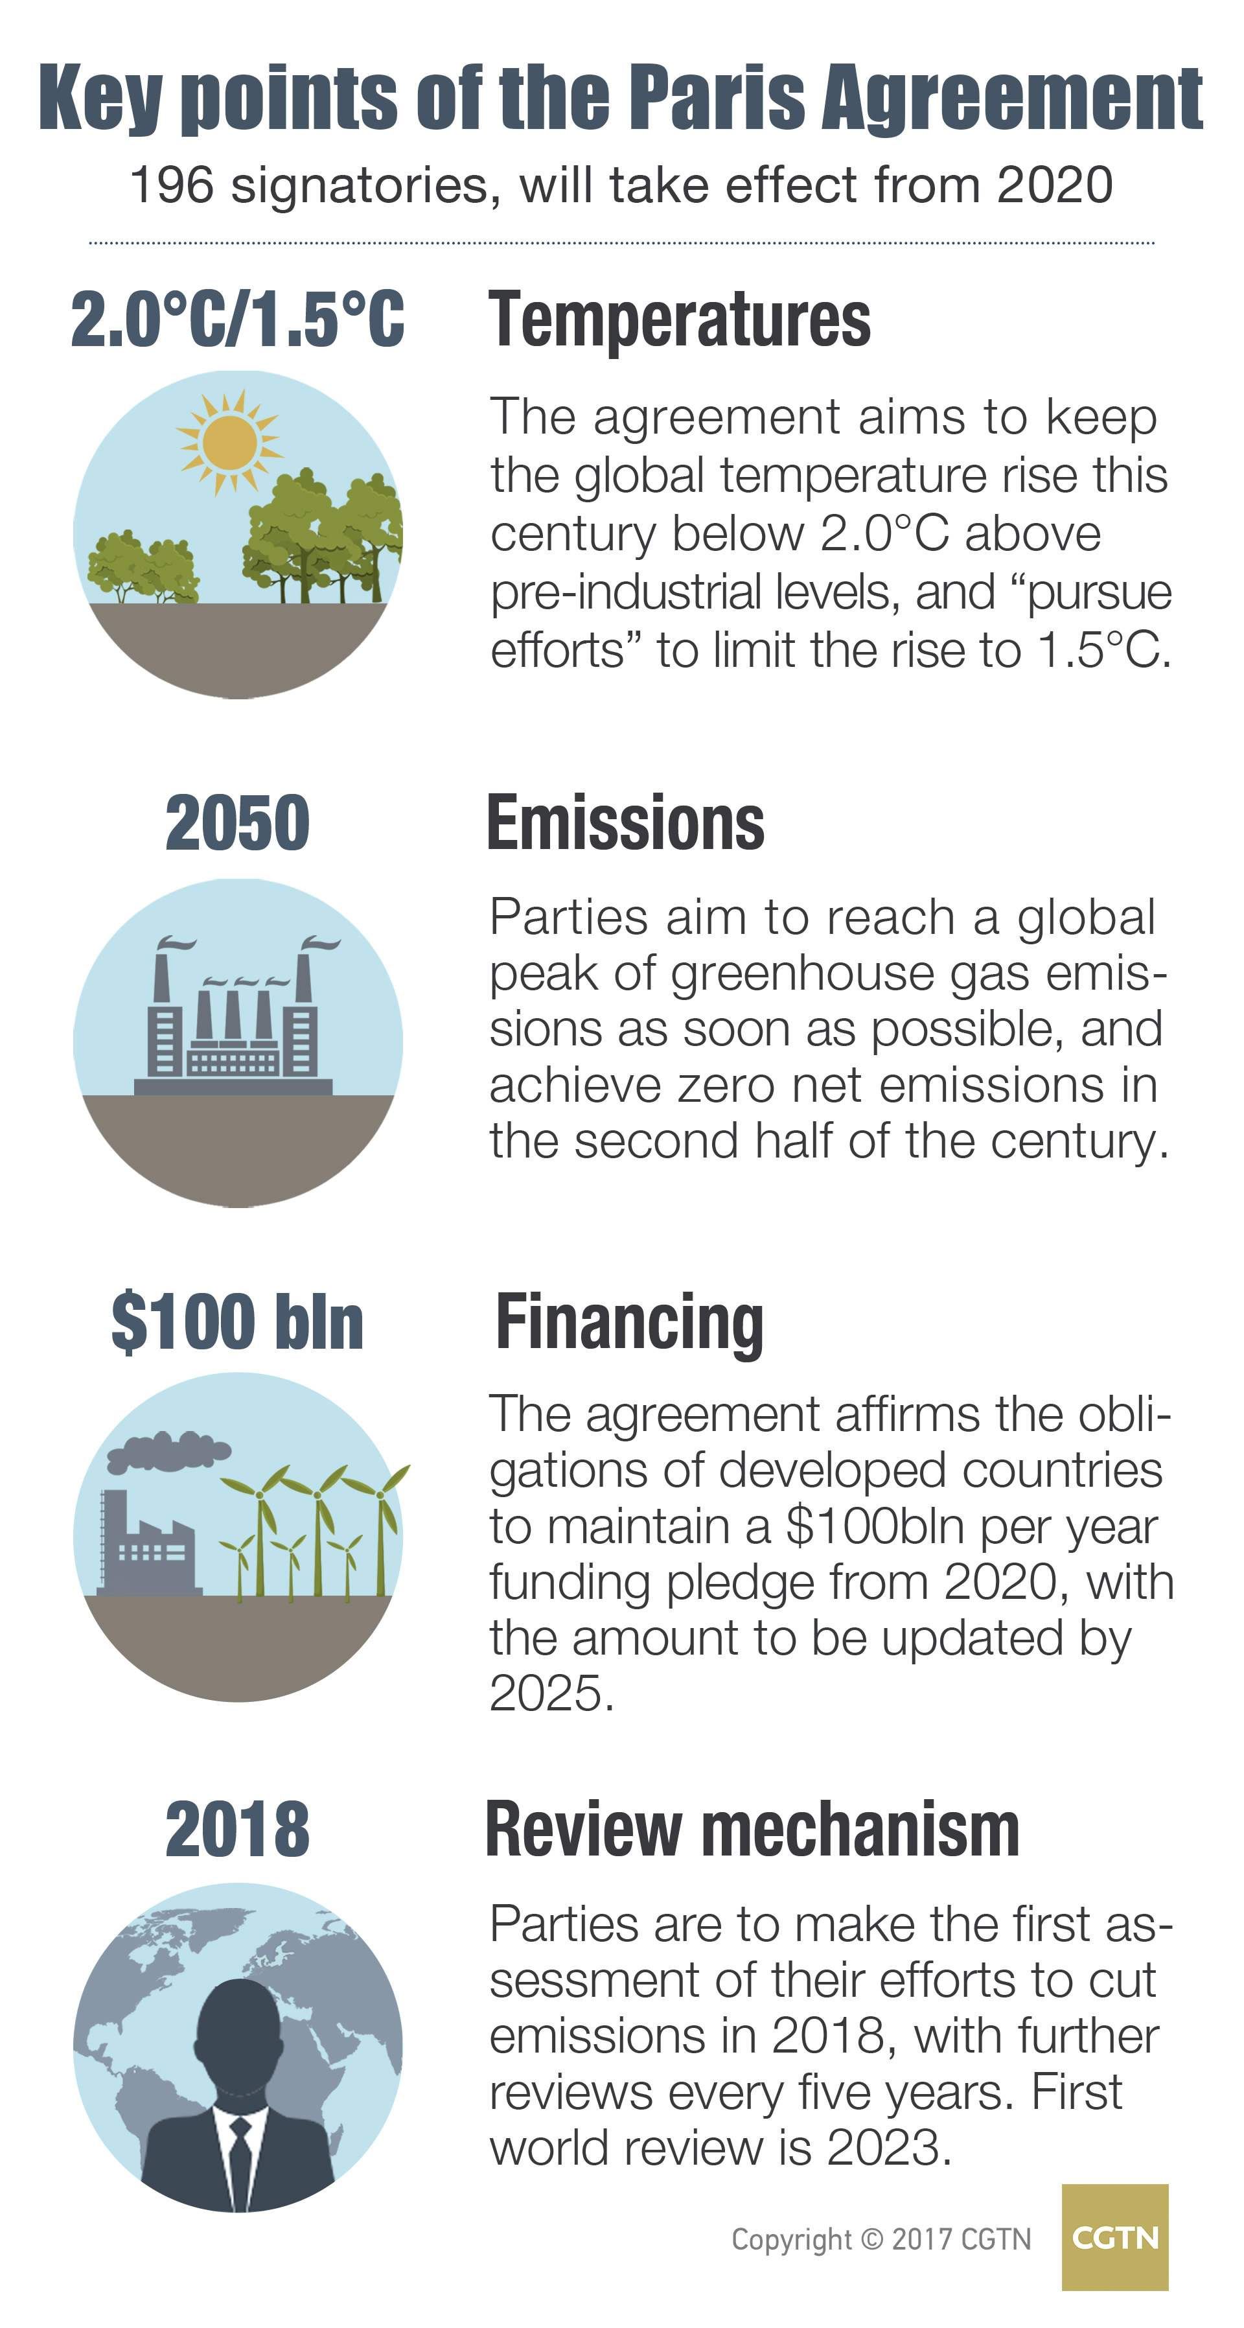
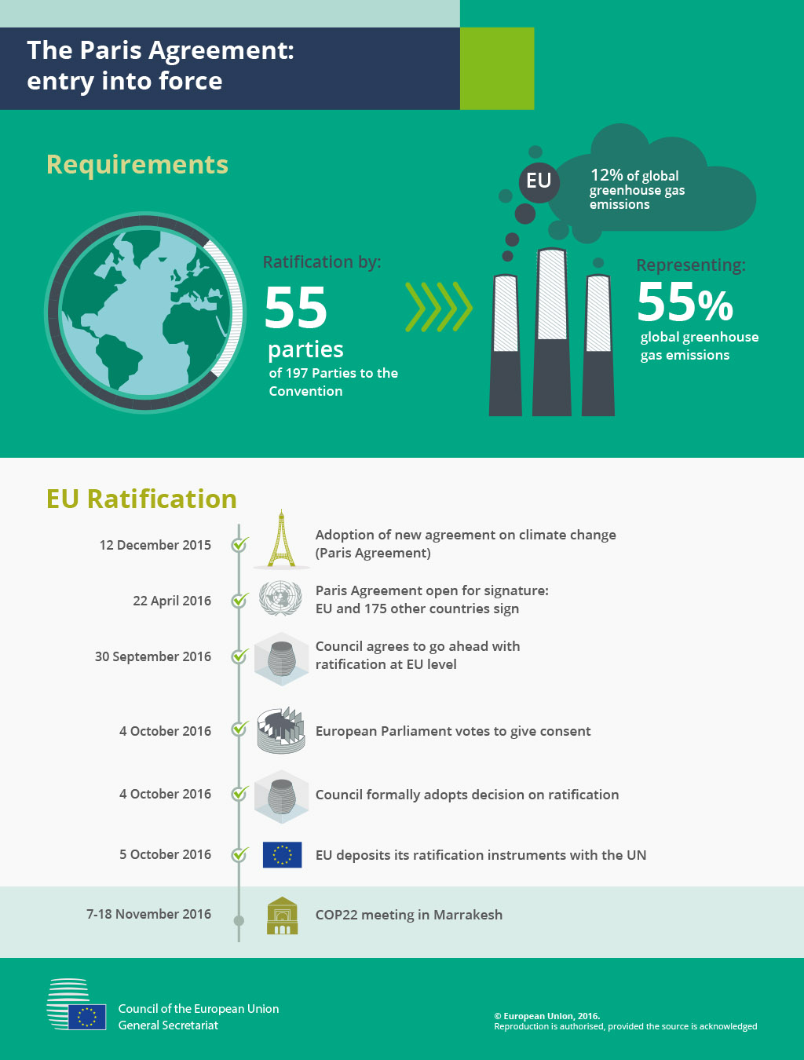
Paris Agreement
UNFCCC?
COP?
IPCC?

Slide 5
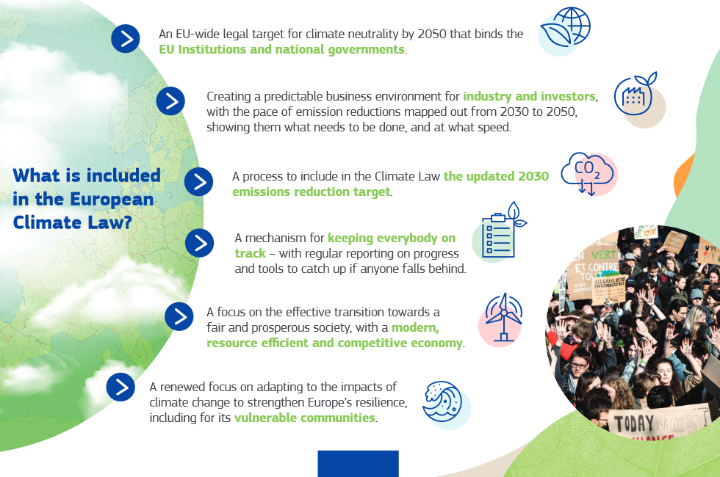
EU Climate Law
EU Emissions reduction targets:
-55% Emission reduction by 2030 compared to 1990 incl. LULUCF
Net zero by 2050
Proposal for 2040 Target in 2024
European Commission, Directorate-General for Communication, The European climate law, Publications Office, 2020, https://data.europa.eu/doi/10.2775/790913

Slide 6
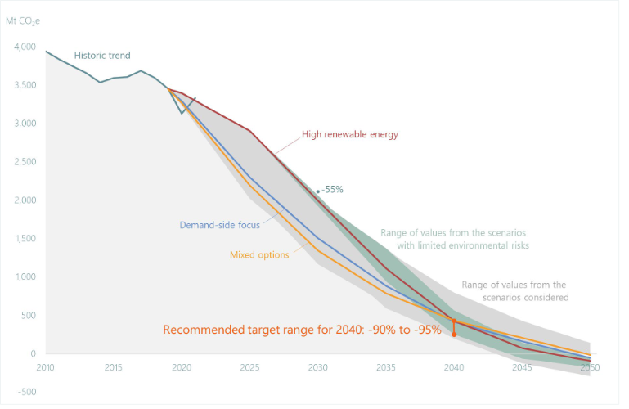
EU Emission profiles over time
EU Climate Advisory Board
https://climate-advisory-board.europa.eu/reports-and-publications/scientific-advice-for-the-determination-of-an-eu-wide-2040/esabcc_advice_eu_2040_target.pdf/@@display-file/file

Slide 7
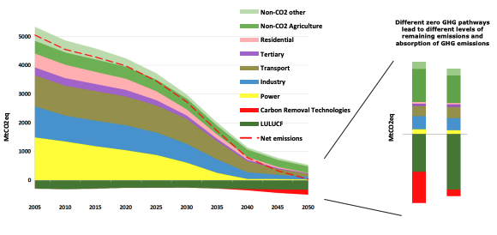
EU Emission profiles over time
A Clean Planet for all, COM(2018) 773 final
https://eur-lex.europa.eu/legal-content/EN/TXT/PDF/?uri=CELEX:52018DC0773

Slide 8
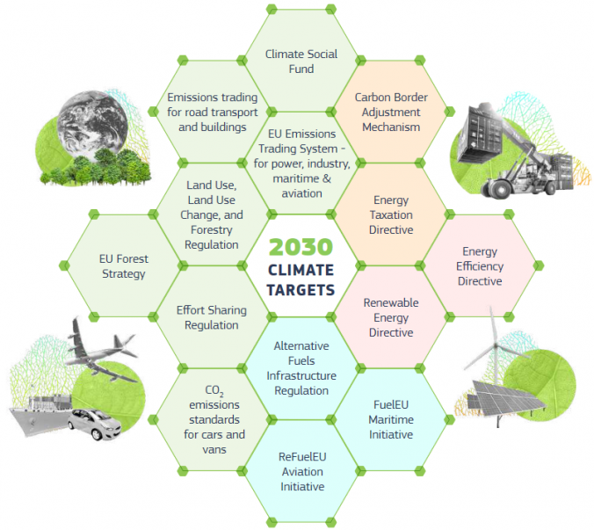
EU Green Deal
ETS II
CBAM
ETS I
Fit for 55 Climate and Energy package:
13 legislative proposals +
Establishing a Climate Social Fund
Additional initiatives: Farm to Fork, Nature Restoration Law
LULUCF
ETD
ESR
EED
AFIR
https://eur-lex.europa.eu/legal-content/EN/TXT/HTML/?uri=CELEX:52019DC0640&from=ET
https://www.citiesforum.org/news/green-deal-2/
RED
EPBD (GEG)
IED
…

Slide 9
What kind of elements does the EU Commission propose
Directive
Transposed into National Legislation
Within 2 years
Regulation
automatically valid in all EU MS
Financial
programmes
Recommendations for the negotiations of international agreements
Implementing and delegated acts
Communications
Legislative Acts
Non-Legislative Acts

Slide 10
Most democracies world-wide have a similar set-up!!

Slide 11
Where does the modelling come in?
Energy Trilemma
Modelling use
Simultaneous computation of indicators to understand the effect of a specific scenario on the energy trilemma components
Depending on the system configuration and policy priorities different elements gain importance
Syed Ahsan Ali Shah, Cheng Longsheng, Yasir Ahmed Solangi, Munir Ahmad, Sharafat Ali,
Energy trilemma based prioritization of waste-to-energy technologies: Implications for post-COVID-19 green economic recovery in Pakistan,
Journal of Cleaner Production, Volume 284, 2021, https://doi.org/10.1016/j.jclepro.2020.124729

Slide 12
Where does the modelling come in?
How will the energy system develop? And what do changes imply?
Initiatives require Impact assessments if initiatives are expected to have significant economic, social or environmental impacts.
“The impact assessment report must include a description of:
the environmental, social and economic impacts, including impacts on small and medium enterprises and competitiveness, and an explicit statement if any of these are not considered significant
who will be affected by the initiative and how
the consultation strategy and the results obtained from it
Impact assessment reports are published with the proposals or with acts adopted by the Commission. They are also sent to the EU lawmakers, the Parliament and Council, to consider as they decide on whether to adopt the proposed law.”*
The Regulatory Scrutiny Board (RSB) assesses the quality of the Impact Assessments
*Quoted from: https://commission.europa.eu/law/law-making-process/planning-and-proposing-law/impact-assessments_en

Slide 13
Why is modelling needed?
Guidelines for preparing Impact Assessments include:
Better regulation guidelines: https://commission.europa.eu/law/law-making-process/planning-and-proposing-law/better-regulation/better-regulation-guidelines-and-toolbox_en
Impact assessments need quantified assessment:
How much will it cost in monetary terms? And who will pay for what?
What investments are required?
Effect on SMEs?
Are there employment effects? Other social effects?
What are the relations to OTHER policy targets/initiatives/national legislation?

Slide 14
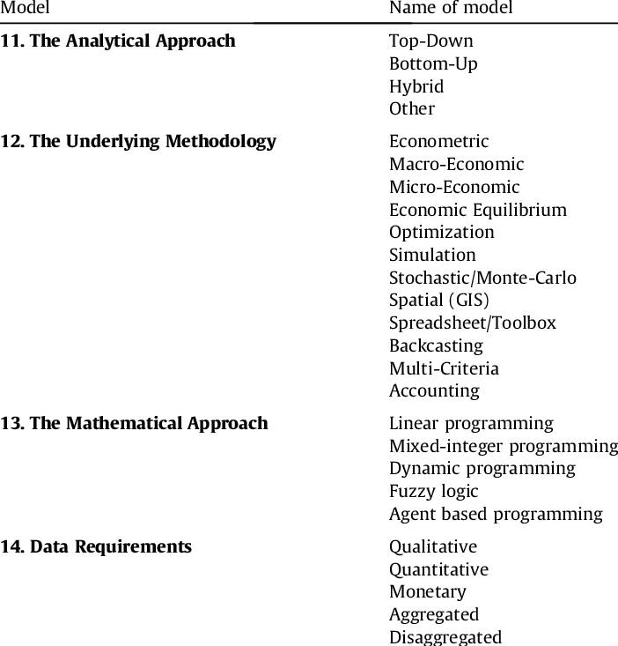
Hall, Lisa & Buckley, Alastair. (2016). A review of energy systems models in the UK: Prevalent usage and categorisation. Applied Energy. 169. 607-628. 10.1016/j.apenergy.2016.02.044.

Slide 15
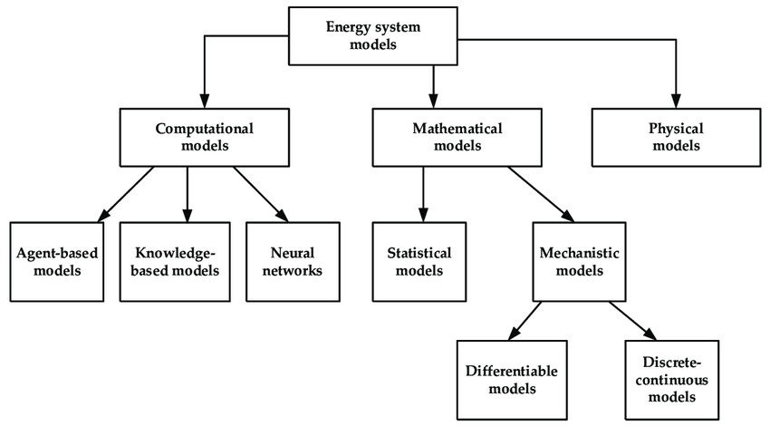
Subramanian, Avinash & Gundersen, Truls & Adams, Thomas. (2018). Modeling and Simulation of Energy Systems: A Review. Processes. 6. 238. 10.3390/pr6120238.

Slide 16
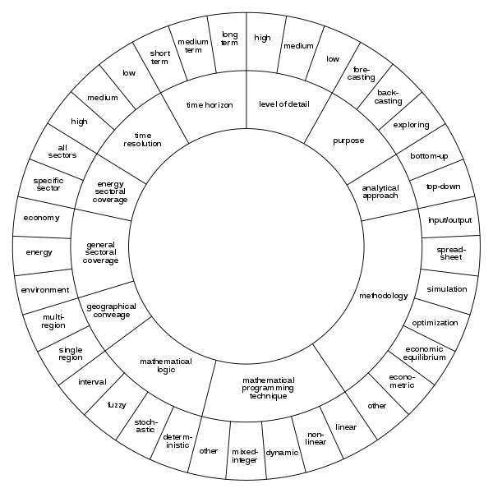
https://commons.wikimedia.org/wiki/File:Classification_of_energy_system_models.svg

Slide 17
Many kinds of energy system analysis…
Different types of models have different scopes and uses, each with its own merits
System simulation: Engineering issues
What-if questions, impact assessment: policy analysis, investment evaluation
Normative analysis, optimization: policy and investment recommendation
Forecasting-projections of demand prices, technology penetration, etc.
Scenario construction and comparison of scenarios: exploratory pathways of uncertain futures and policy analysis
However:
“... all models are approximations. Essentially, all models are wrong, but some are useful. However, the approximate nature of the model must always be borne in mind....”
Box, G. E. P.; Draper, N. R. (1987), Empirical Model-Building and Response Surfaces, John Wiley & Sons.

Slide 18
What kind of people work with modelling and policy making?
Model developers:
Who: (often) engineers, physicists, mathematicians, economists, …
What: create models for policy use
Analysts:
Who: (often) engineers, physicists, mathematicians, economists, …
What: Analyse data from statistics (ex-post) or model results (ex-ante)
Policy makers:
Who: Ministerial employees (economists, lawyers, political scientists,…)
What: prepare the legislative proposals
Politicians
What are the effects of policies?
Why are models needed?

Slide 19
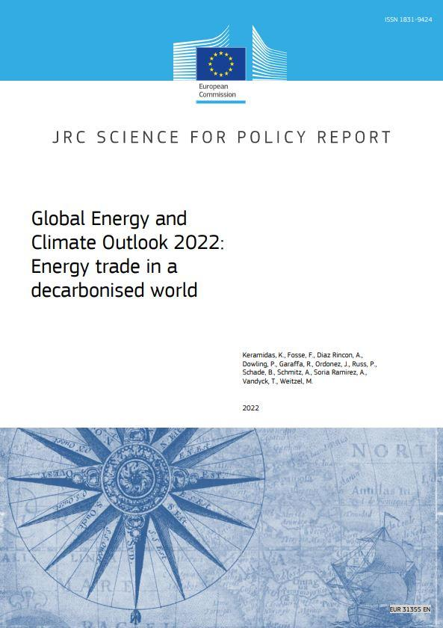
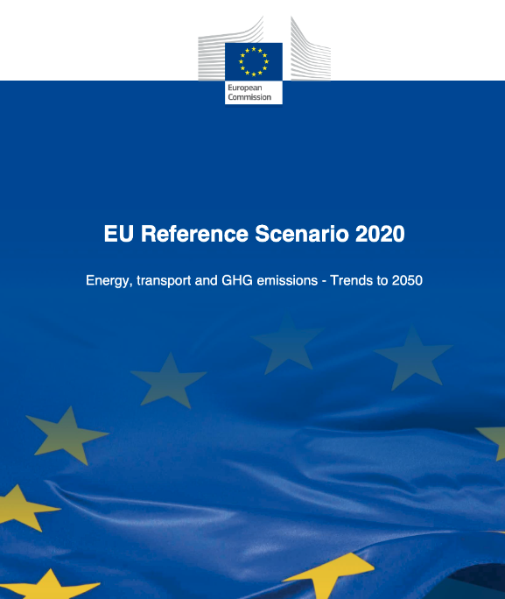
Where are energy system models used

Slide 20
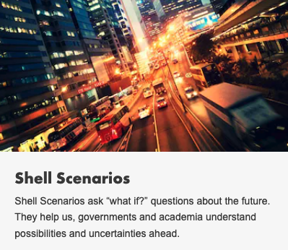
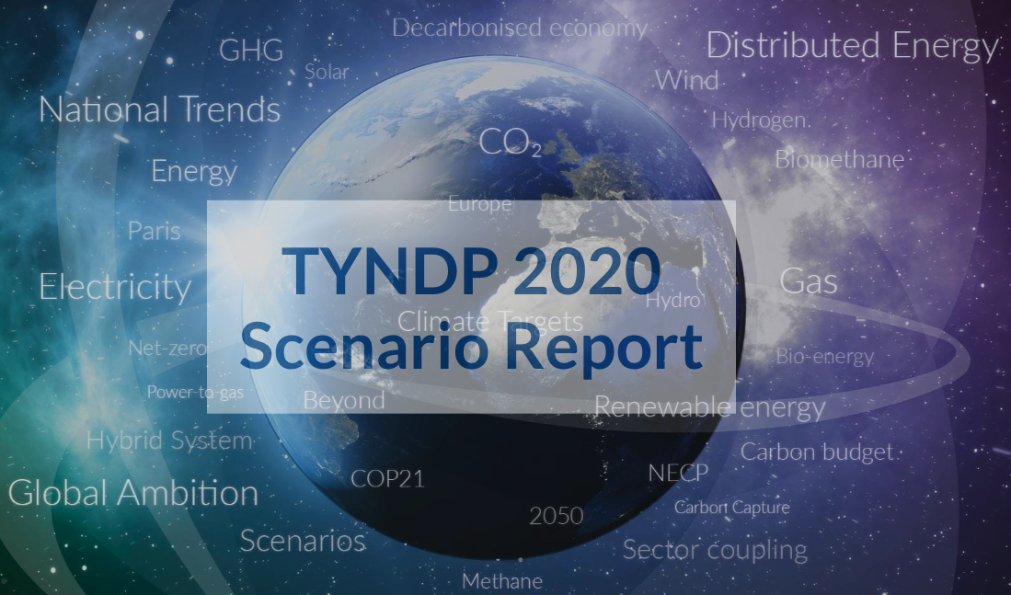
Where are energy system models used
UNFCCC: Nationally Determined Contributions (NDCs)
UNFCCC: Long-term Low Emissions and Development Strategies (LT-LEDS)
Just Energy Transition Partnerships (JETP)
EU: National Energy and Climate Plans (NECPs)

Slide 21
Are countries on track to achieve the 1.5C goal?
Still a lot to do!
https://climateactiontracker.org/

Slide 22
What is it like to work with energy modelling and policy-making?
Cons
Pros ( or why I do it anyway)
Impossible deadlines
Slow progress
Frustration
We need the energy transition to progress to avoid dangerous climate change
Improved understanding at all levels from CEOs and government heads to simple citizens
Allows decision making to progress

