Slide 1
Integrated course „Energy Economics“
- Financial management -
Chair of Energy Systems | Department of Energy Systems
Technische Universität Berlin

Slide 2
Outline
Fundamentals of finance
Time value of money
Capital structure and cost of capital
Capital budgeting: NPV method
NPV vs IRR
Levelised cost of electricity (LCOE)
Real options

Slide 3
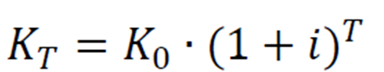
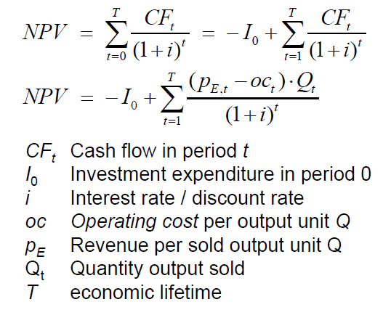
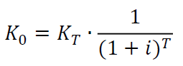
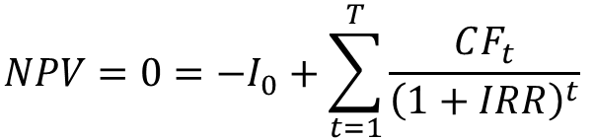
Recap: Time value of money, NPV and IRR
Compounding:
Net Present Value:
Discounting:
IRR:
$$NPV=0=−I_{0}+\sum_{t=1}^{T}{\frac{CF_{t}}{{\left(1+IRR\right)}^{t}}}$$
K = Capital
i = Interest rate / Discount rate
T = Time horizon / Economic lifetime
K₀ = Present value
K_{T} = Value at the Time horizon
CF_{t} = Cash Flow in period t
I₀ = Investment in period 0
i = Interest rate / Discount rate
T = Time horizon / Economic lifetime
t = Period

Slide 4
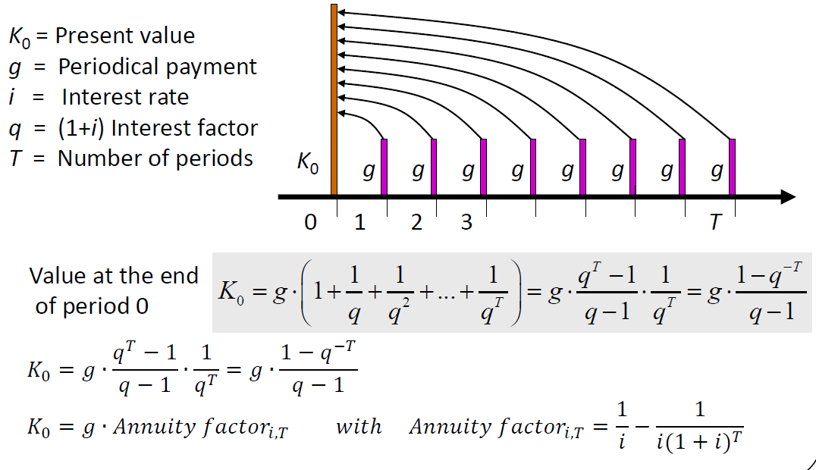
Recap: Annuity
Annuity is a level stream of regular payments during a fixed number of periods.

Slide 5
Annuity factor

Slide 6
Capital recovery factor

Slide 7
Levelised cost of electricity (LCOE)
lifetime costs divided by
lifetime electricity output
Lifetime costs: PV of total cost of building and operating
LCOE allows comparison of technologies regardless of lifetime, installed capacity, cost of capital, risk and return.
initial capital cost*
* specific investment costs: investment costs divided by capacity
annual operating expenses
capacity factor
discount rate
operational life

Slide 8
Levelised cost of electricity (LCOE)
Generic formula:
For electricity generation: CF are derived from operating cost and revenues from selling electricity
  oc operating cost per unit of energy Q
  p_{E} revenue per unit of energy Q
  Q total amount of electricity output over lifetime
Solving for p_{E} results in levelised cost of electricity (LCOE):
I₀
p_{E} = + oc
Q ∙ AF_{i,T}

Slide 9

Levelised cost of electricity (LCOE)
How to calculate the generation costs per unit of electricity?
I₀ ∙ CRF_{i, t}
LCOE = + oc
Q_{t}
Q_{t} = Cap * FLH
  Q_{t} annual electricity output
  Cap installed capacity (rated power)
  FLH full load hours: annual output divided by Cap
Q_{t} [kWh]
Capacity factor =
Cap [kW] * 8.760h

Slide 10
LCOE calculation
Source: Bradford, 2018

Slide 11
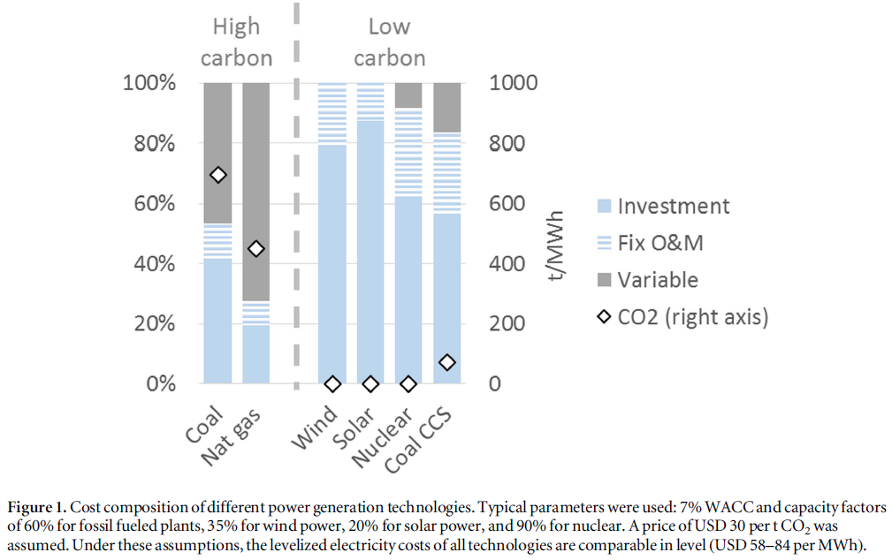
LCOE composition of generation technologies
Source: Hirth and Steckel, 2016

Slide 12
Task 3) NPV and Levelized Cost of Energy (LCOE)
The table below describes the investment conditions for a 5 kW_{peak} PV system in Germany and in Spain:
What is the Net Present Value (NPV) of the investment in Spain and in Germany, given a feed-in tariff (FIT) of 11.83 ct/kWh?
What are the levelised cost of electricity (LCOE) of the photovoltaic system in Germany and in Spain (LCOE = electricity generation costs in ct/kWh based on full costing)?
Assume that electricity retail prices in Spain and Germany are 29 ct/kWh. What does your result in b) imply for the self-consumption of the generated electricity?
Description | Germany | Spain | Unit
Specific investment costs | 1 500 | 1 500 | €/kW_{peak}
Operation and maintenance (O&M) costs | 9 | 9 | €/kW_{peak}/a
Full load hours | 900 | 1 500 | hours/a
Capacity | 5 | 5 | kW_{peak}
Lifetime | 20 | 20 | a
Interest rate | 3 | 3 | %

Slide 13
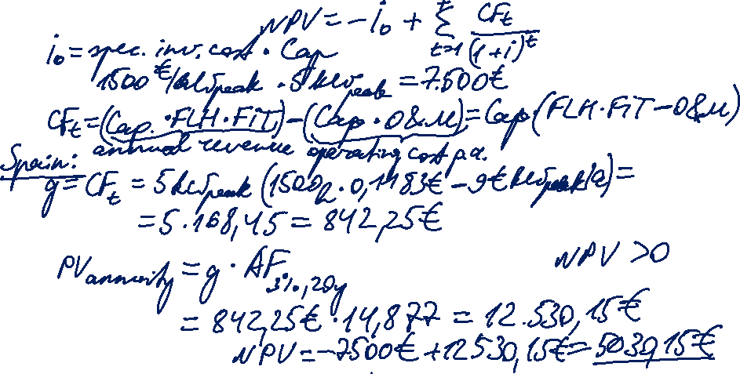
Task 3) NPV and Levelized
Cost of Energy (LCOE)
Description | Germany | Spain | Unit
Specific investment costs | 1 500 | 1 500 | €/kW_{peak}
Operation and maintenance (O&M) costs | 9 | 9 | €/kW_{peak}/a
Full load hours | 900 | 1 500 | hours/a
Capacity | 5 | 5 | kW_{peak}
Lifetime | 20 | 20 | a
Interest rate | 3 | 3 | %
The table describes the investment conditions for a 5 kW_{peak} PV system in Germany and in Spain:
What is the Net Present Value (NPV) of the investment in Spain and in Germany, given a feed-in tariff (FIT) of 11.83 ct/kWh?

Slide 14

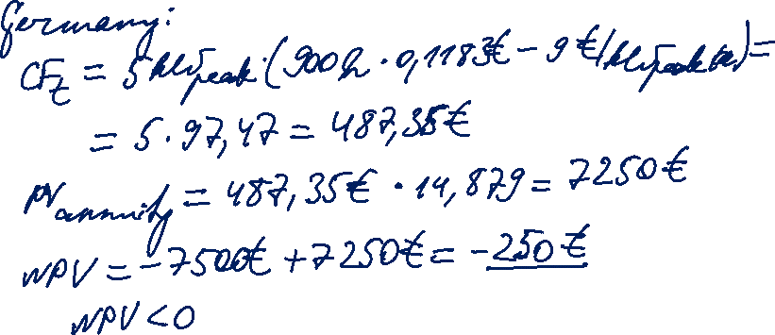
Task 3) NPV and Levelized
Cost of Energy (LCOE)
Description | Germany | Spain | Unit
Specific investment costs | 1 500 | 1 500 | €/kW_{peak}
Operation and maintenance (O&M) costs | 9 | 9 | €/kW_{peak}/a
Full load hours | 900 | 1 500 | hours/a
Capacity | 5 | 5 | kW_{peak}
Lifetime | 20 | 20 | a
Interest rate | 3 | 3 | %

Slide 15
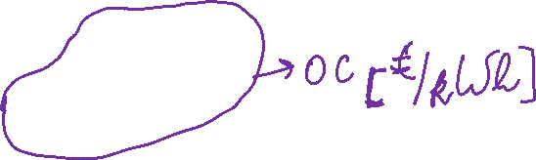
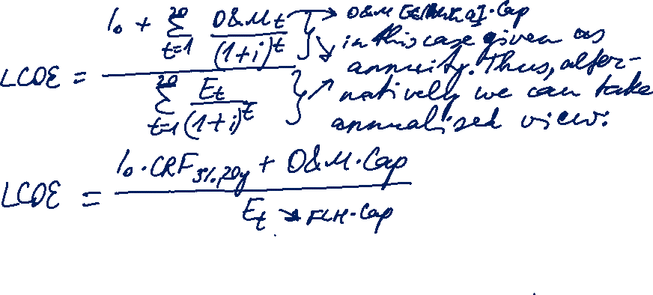
Task 3) NPV and Levelized
Cost of Energy (LCOE)
Description | Germany | Spain | Unit
Specific investment costs | 1 500 | 1 500 | €/kW_{peak}
Operation and maintenance (O&M) costs | 9 | 9 | €/kW_{peak}/a
Full load hours | 900 | 1 500 | hours/a
Capacity | 5 | 5 | kW_{peak}
Lifetime | 20 | 20 | a
Interest rate | 3 | 3 | %
The table describes the investment conditions for a 5 kW_{peak} PV system in Germany and in Spain:
What are the levelised cost of electricity (LCOE) of the photovoltaic system in Germany and in Spain (LCOE = electricity generation costs in ct/kWh based on full costing)?

Slide 16
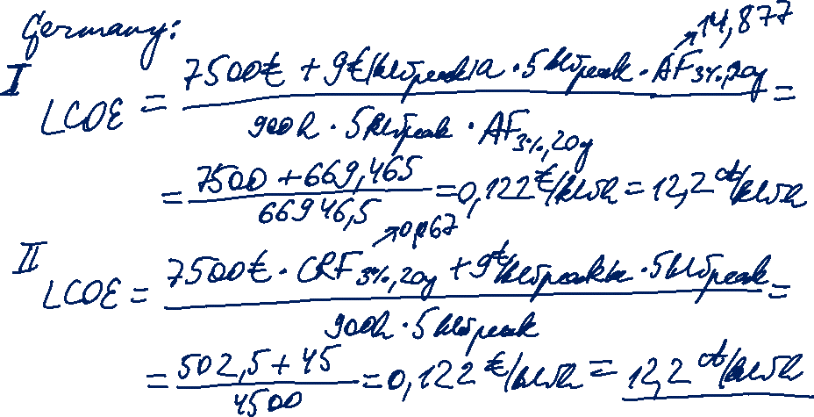
Task 3) NPV and Levelized
Cost of Energy (LCOE)
Description | Germany | Spain | Unit
Specific investment costs | 1 500 | 1 500 | €/kW_{peak}
Operation and maintenance (O&M) costs | 9 | 9 | €/kW_{peak}/a
Full load hours | 900 | 1 500 | hours/a
Capacity | 5 | 5 | kW_{peak}
Lifetime | 20 | 20 | a
Interest rate | 3 | 3 | %

Slide 17
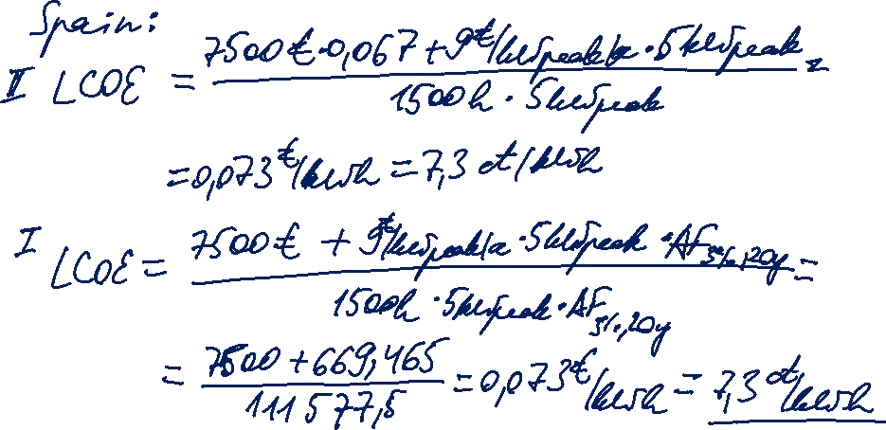
Task 3) NPV and Levelized
Cost of Energy (LCOE)
Description | Germany | Spain | Unit
Specific investment costs | 1 500 | 1 500 | €/kW_{peak}
Operation and maintenance (O&M) costs | 9 | 9 | €/kW_{peak}/a
Full load hours | 900 | 1 500 | hours/a
Capacity | 5 | 5 | kW_{peak}
Lifetime | 20 | 20 | a
Interest rate | 3 | 3 | %

Slide 18
Task 3) NPV and Levelized
Cost of Energy (LCOE)
Description | Germany | Spain | Unit
Specific investment costs | 1 500 | 1 500 | €/kW_{peak}
Operation and maintenance (O&M) costs | 9 | 9 | €/kW_{peak}/a
Full load hours | 900 | 1 500 | hours/a
Capacity | 5 | 5 | kW_{peak}
Lifetime | 20 | 20 | a
Interest rate | 3 | 3 | %
The table describes the investment conditions for a 5 kW_{peak} PV system in Germany and in Spain:
Assume that electricity retail prices in Spain and Germany are 29 ct/kWh. What does your result in b) imply for the self-consumption of the generated electricity?
LCOE < retail price (for both countries)
-> Self-consumption is preferred over buying electricity from the supplier (retail grid parity is reached).

Slide 19
Task 4) Investment appraisal
There are two power plants as investment options. The data is given below:
  What are the specific investment costs in €/kW of the two options?
  What are the (short-term) marginal generation costs?
  What are the annual capital costs?
  What are the total annual fixed costs per MW installed?
  What are the levelised cost of electricity (LCOE)?
  What must the full load hours of the natural gas power plant be so that the long-term marginal generation costs are equal for both technologies?
 | Natural gas power plant | Hard coal power plant | Units
Capacity | 900 | 900 | MW
Efficiency | 55 | 43 | %
Investment costs | 585 | 900 | Million €
Interest rate | 8 | 8 | %
Lifetime | 20 | 20 | a
Employees | 66 | 140 | Number
Labor costs | 60 000 | 60 000 | €/a/employee
O&M costs | 4 | 8 | Million €/a
Fuel price | 22 | 14 | €/MWh_{th}
Emission factor fuel | 56 | 92 | kg CO₂ / GJ_{th}
Full load hours | 4 000 | 5 500 | hours/a

Slide 20
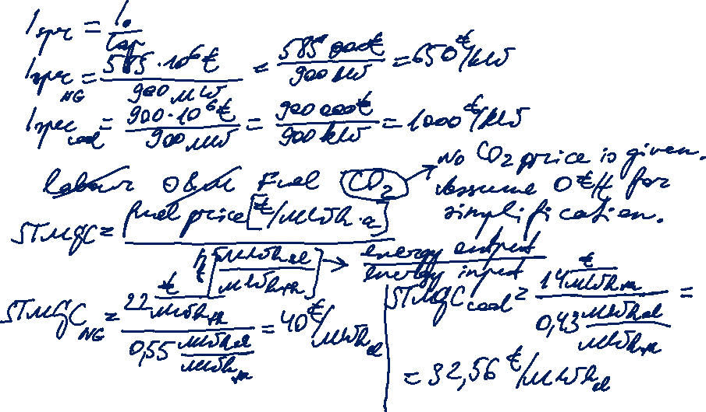
Task 4) Investment appraisal
There are two power plants as investment options.
  What are the specific investment costs in €/kW of the two options?
  What are the (short-term) marginal generation costs?

Slide 21
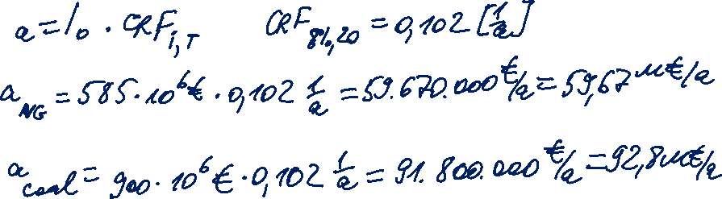
Task 4) Investment appraisal
There are two power plants as investment options.
  What are the annual capital costs?

Slide 22

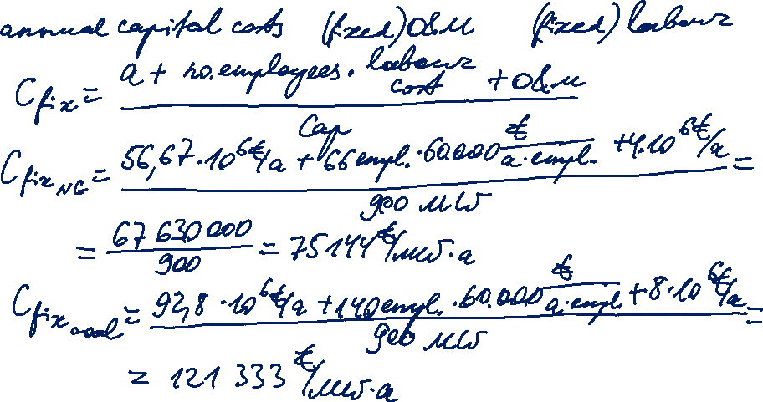
Task 4) Investment appraisal
There are two power plants as investment options.
  d) What are the total annual fixed costs per MW installed?

