Slide 1
Integrated course „Energy Economics“
- Microeconomics: basic concepts -
Chair of Energy Systems | Department of Energy Systems
Technische Universität Berlin

Slide 2
Outline
Economics and particularities of energy sector
Supply and demand
Welfare effect of markets
Tax effect – deadweight loss
Price elasticity
Costs terminology
Pricing in competitive markets
Pricing in monopoly
Cournot competition

Slide 3
Price elasticity
Elasticity is a measure of how much buyers and sellers respond to changes in market conditions (e.g. prices – price elasticity).
Price elasticity of demand is a measure of how much the quantity demanded of a good responds to a change in the price of that good.
% change in quantity demanded
Price elasticity of demand =
% change in price

Slide 4
Price elasticity (continued)
-1 < η_{p,Q} ≤ 0 inelastic demand
-∞ < η_{p,Q} ≤ -1 elastic demand
η_{p,Q} = -1 if price increases by 1%, demand
decreases by 1%
Convention to operate with absolute values │η_{p,Q} │:
η_{p,Q} > 1 elastic demand
0 ≤ η_{p,Q} ≤ 1 inelastic demand

Slide 5
Price elasticity of demand: Electricity
Demand for electricity is largely inelastic.
General reasons for inelastic demand (0 – 1):
Buyers do not perceive the price changes
Switching to alternative products (substitutes) is cumbersome
Lack of substitutes
Time:
Goods tend to have more elastic demand over longer time horizons

Slide 6

Task 2) Price elasticity
The price for electricity is 0.2 €/kWh. The demand function of a private household (per month) is given by:
Demand $q_{Di}\left(p\right)=625−625p$ q [kWh], p [€/kWh]
How much electricity does the single household consume per month? How much does it pay?

Slide 7

Task 2) Price elasticity
The price for electricity is 0.2 €/kWh. The demand function of a private household (per month) is given by:
Demand $q_{Di}\left(p\right)=625−625p$ q [kWh], p [€/kWh]
What is the price elasticity at this point? Is it elastic or inelastic?

Slide 8

Task 2) Price elasticity
The price for electricity is 0.2 €/kWh. The demand function of a private household (per month) is given by:
Demand $q_{Di}\left(p\right)=625−625p$ q [kWh], p [€/kWh]
How will the single household react if price doubles? How do demand, price and price elasticity change?

Slide 9
Supply side: Cost of production
The price at which a seller is willing to sell their goods is determined by their cost of production:
explicit cost: out-of-pocket expenses - money actually paid
opportunity cost: potential benefit or income that is foregone as a result of selecting one alternative over another

Slide 10
Terms and definitions of cost accounting
Fixed Costs are the share of the total costs that do not change with a variation of the produced quantity
Variable Costs are the share of the total costs that do change with a variation of the produced quantity
Total Costs are the sum of fixed and variable costs

Slide 11
Terms and definitions of cost accounting (continued)
Average costs are total cost per unit: TC divided by the produced quantity Q.
Marginal costs are costs incurred for producing one additional unit of production volume.
Contribution margin is selling price minus variable cost per unit.

Slide 12
Terms and definitions of cost accounting
Fixed Costs are the share of the total costs that do not change with a variation of the produced quantity
Variable Costs are the share of the total costs that do change with a variation of the produced quantity
Total Costs are the sum of fixed and variable costs
Average Costs are the total costs C divided by the produced quantity Q
Contribution margin is price minus variable costs
Marginal Costs are the costs that incur due to an increase of the produced quantity by one

Slide 13
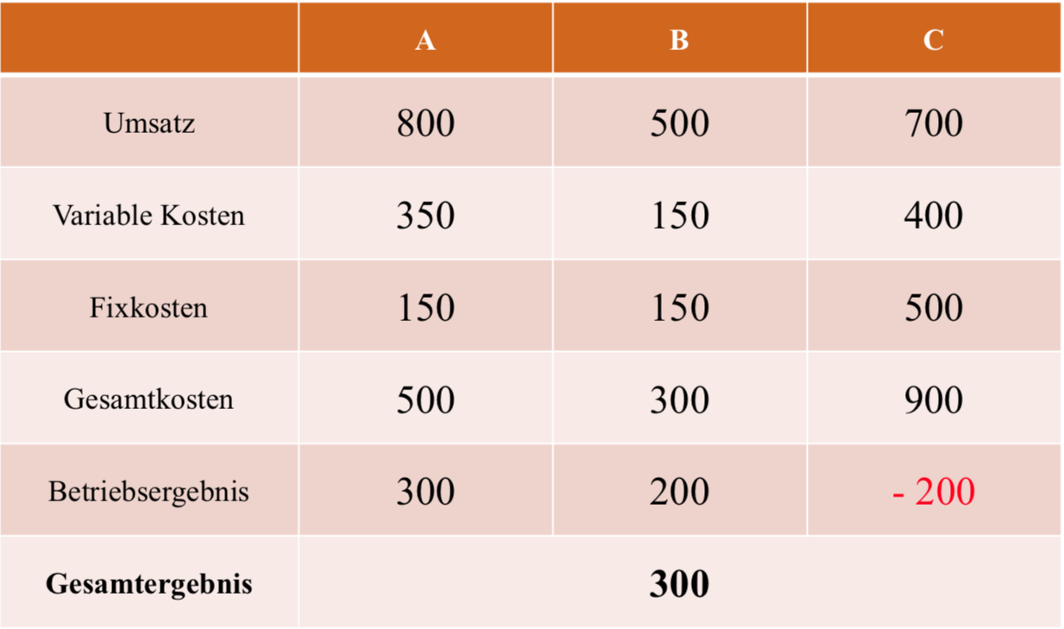
Total cost consideration
Turnover
Variable Cost
Fixed Cost
Total Cost
Operating income
Overall outcome

Slide 14
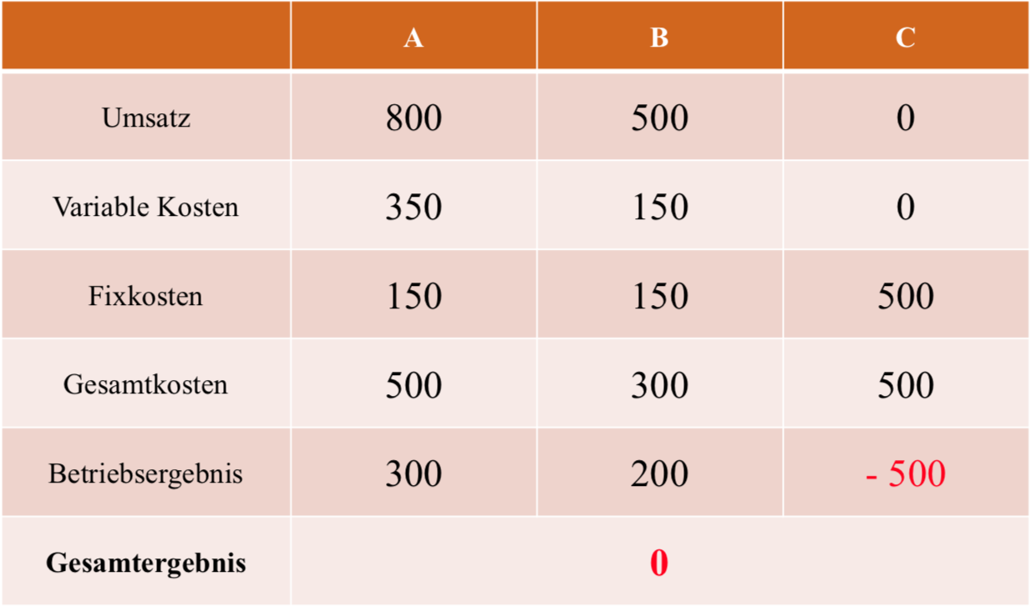
Total cost consideration without product C
Turnover
Variable Cost
Fixed Cost
Total Cost
Operating income
Overall outcome

Slide 15
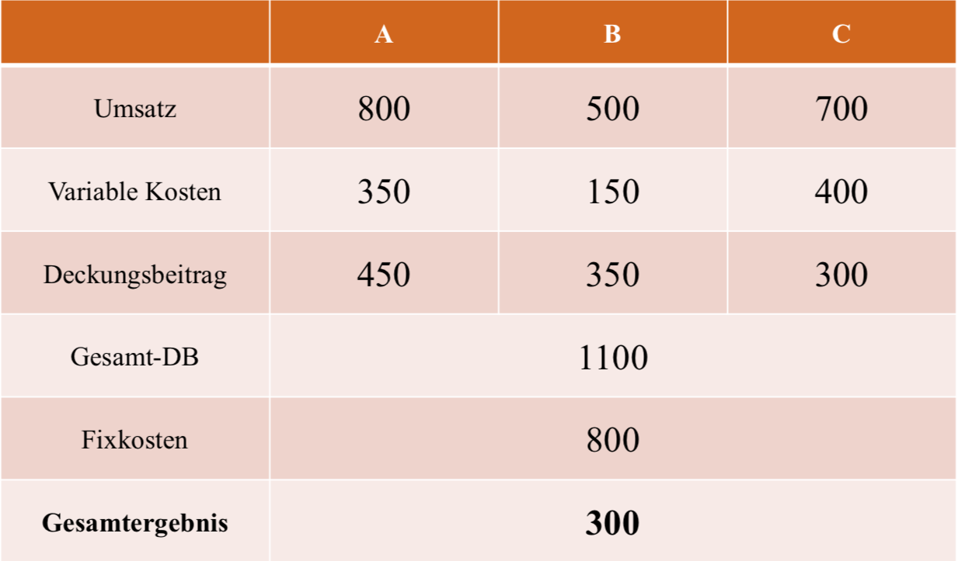
Variable cost
Turnover
Variable Cost
Contribution margin
Total contribution margin
Fixed cost
Overall outcome

Slide 16
Cost considerations

Slide 17
Cubic cost structure – cost structure
c
[EUR/unit]
dC/dQ
c (Q)
c_{var} (Q)
c_{fix}
Q
[unit]

Slide 18
Cubic cost structure – conclusions for a price taker
c
[EUR/unit]
dC/dQ
c (Q)
c_{var} (Q)
Market Price
[EUR/unit]
Profit
C_{fix}
C_{var}
c_{fix}
Q
[unit]

Slide 19
Market structures - 1
Market is a group of sellers and a group of buyers of a particular good or service.
Perfect competition:
many buyers and many sellers > cannot influence the price
goods at exactly the same (homogeneous)
consumers have perfect information
no entry or exit barriers
Monopoly:
seller is the sole producer and can influence the price of its output
Market power is the ability to maintain a price above the price under competition.

Slide 20
Market structures - 2
Cournot oligopoly:
More than one firm
All firms produce one homogeneous product (no product differentiation)
No cooperation among firms (no collusion)
Firms have market power - each firm's output decision affects the good's price
Fixed number of firms
Firms compete in quantities, and choose them simultaneously
Economically rational and strategically acting firms, seeking to maximize profit given their competitors' decisions

Slide 21
Supply and pricing – profit maximization of the firm
Π Profit (per period)
p Sales price
Q Output (Quantity)
C Production costs
Competitive markets
„Marginal cost = Price rule“
Monopoly markets
„Marginal costs = marginal revenue rule“

Slide 22
Perfect competition - pricing

