Slide 1
Integrated course „Energy Economics“
- Microeconomics: basic concepts -
Chair of Energy Systems | Department of Energy Systems
Technische Universität Berlin

Slide 2
Outline
Economics and particularities of energy sector
Supply and demand
Welfare effect of markets
Tax effect – deadweight loss
Price elasticity
Costs terminology
Pricing in competitive markets
Pricing in monopoly
Cournot competition

Slide 3
Economics and energy sector
General economic concepts hold as a basis.
In particular: analysis of monopolistic markets.
Energy markets are governed by rules that do not correspond to perfect markets.
They require a more complex analysis.

Slide 4
Particularities of energy markets
Energy is an essential factor of production.
Energy is necessary for satisfying basic human needs.
Long time horizons for infrastructure planning
Public sector stake
Energy sector causes the largest CO₂ emissions
Risk of large-scale accidents
Public interest in speeding up market entry of new technologies
Natural monopolies (or oligopolies) instead of perfect competition
Market failure: state of a market where resources are not allocated efficiently (e.g. externality, market power).

Slide 5
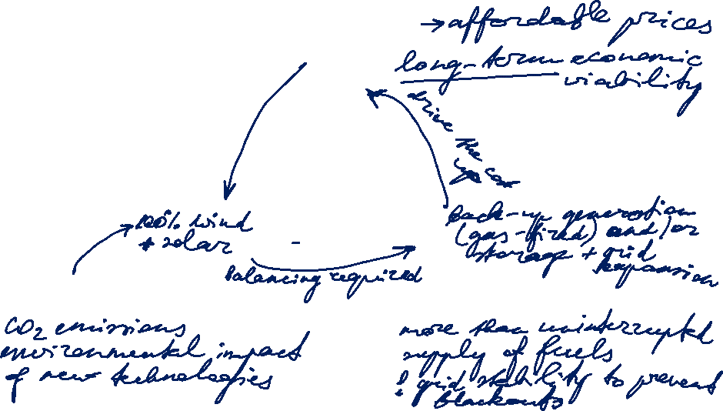
Energy Policy: Magical triangle of energy policy goals
Economic viability
Environment and climate
Security of supply

Slide 6
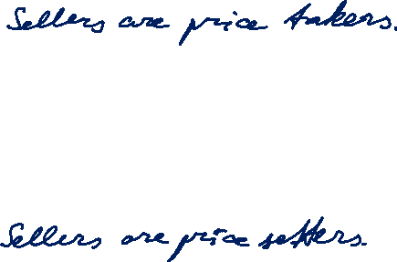
Market structures
Market is a group of sellers and a group of buyers of a particular good or service.
Perfect competition:
many buyers and many sellers > cannot influence the price
goods at exactly the same (homogeneous)
consumers have perfect information
no entry or exit barriers
Monopoly:
seller is the sole producer and can influence the price of its output
Market power is the ability to maintain a price above the price under competition.

Slide 7

Market structures

Slide 8
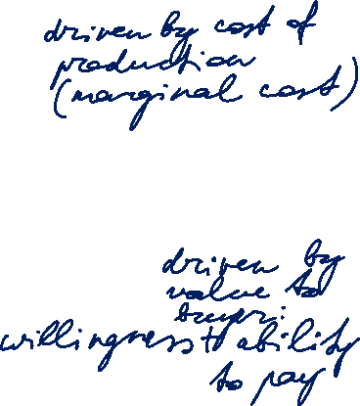
Demand and Supply
Price p
Supply function
p(QS)
Demand function
p(QD)
Q
Notes:
The demand curve reflects the value to the buyers.
The supply curve reflects the costs to the sellers.

Slide 9
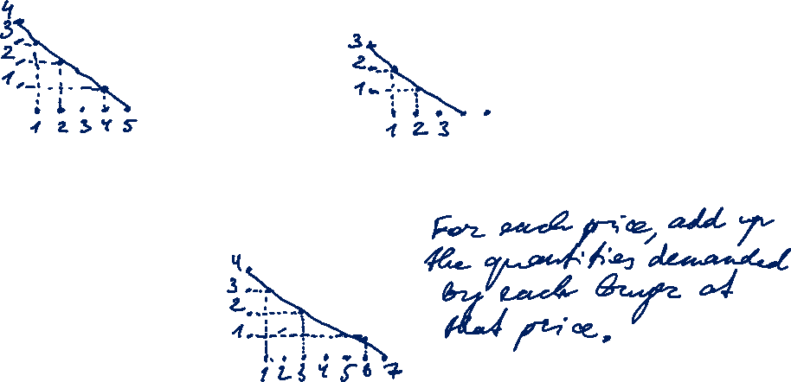
Demand and Supply
Buyer A
Buyer B
P
P
Q
Q
Market demand
(Buyer A + Buyer B)
P
Q
Notes:
The demand curve reflects the value to the buyers.
The supply curve reflects the costs to the sellers.

Slide 10
Demand and Supply
Price p
Supply function
p(QS)
MCP
At the equilibrium price, the quantity supplied equals the quantity demanded.
Market clearing price
Demand function
p(QD)
Market clearing volume
MCV
Q
Notes:
The demand curve reflects the value to the buyers.
The supply curve reflects the costs to the sellers.

Slide 11
Bidding curves at EEX
[delivery period Monday, 6.11.2006, 8-9 h]
[Euro/MWh]
Demand
Supply
150
100
50
0
0
5000
10000
15000
20000
25000
[MWh]

Slide 12
Price reaction to change in demand
p
Supply
Change factors:
Income
Prices of related goods (substitutes and complements)
Tastes
Expectations about the future
Number of buyers
p_{max}
p₁*
A₁
p₀*
A₀
Shift of demand curve
Q₀*
Q₁*
Q

Slide 13
Price reaction to change in supply
Shift of supply curve
p
Supply
p_{max}
Change factors:
Input prices
Technology reducing costs
Expectations about the future
Number of sellers
p₁*
A₁
p₀*
A₀
Demand
Q₁*
Q₀*
Q

Slide 14
State regulation: Minimum price (floor price)
P
Excess
Supply
p_{min}
p₀*
A₀
Examples:
EU agriculture politics:
milk overproduction discarded
Minimum wages
Demand
Q_{D}
Q_{S}
Quantity demanded
Q₀*
Quantity supplied
Q

Slide 15
State regulation: Maximum price (price cap)
P
Supply
p₀*
A₀
Examples:
apparment rent,
bread/staples,
energy products
Shortage
p_{max}
Demand
Q_{S}
Q_{D}
Q₀*
Q
Quantity supplied
Quantity demanded

Slide 16
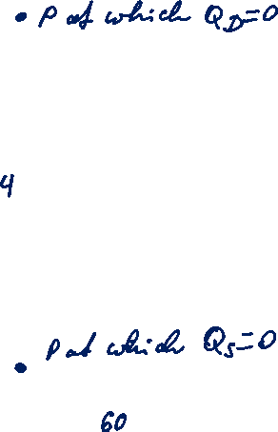
Demand and Supply: Welfare effect of markets
Price p
Some buyers are willing to pay a price larger than the market clearing price but pay MCP.
Supply function
p(QS)
MCP
Some sellers are able to produce at a marginal cost lower than the market clearing price but sell at MCP.
Demand function
p(QD)
MCV
Q
Notes:
The demand curve reflects the value to the buyers.
The supply curve reflects the costs to the sellers.

Slide 17
Demand and Supply: Welfare effect of markets
Price p
The amount the buyer is willing to pay for a good minus the amount the buyer actually pays for it.
Supply function
p(QS)
(CS)
Consumer Surplus
MCP
Producer Surplus
(PS)
The amount the seller is paid for a good minus the seller‘s cost of providing it.
Demand function
p(QD)
CS + PS = TS
Q
MCV
Total surplus indicates the degree of efficiency of resource allocation.
Notes:
Willingness to pay determines the value to buyers.
CS = value to buyers – amount paid by buyers
PS = amount received by sellers – cost of production
Free markets allocate goods to buyers who value them most highly and to sellers that produce at the least cost.

Slide 18

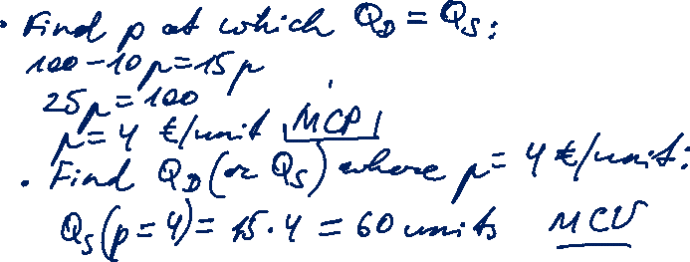
Task 1) Supply and demand
Given are the supply and demand functions for fuel depending on the price [€/unit] in a competitive market:
Demand $Q_{D}\left(p\right)=100−10p$
Supply $Q_{S}\left(p\right)=15p$
What is the market clearing price (MCP) and what are the quantities being traded (MCV)?

Slide 19

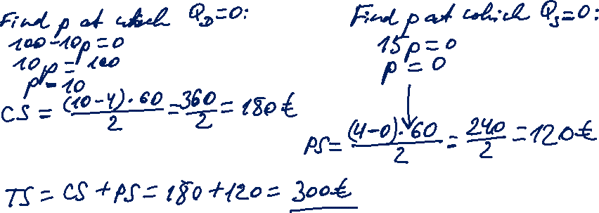
Task 1) Supply and demand
Given are the supply and demand functions for fuel depending on the price [€/unit] in a competitive market:
Demand $Q_{D}\left(p\right)=100−10p$
Supply $Q_{S}\left(p\right)=15p$
How much is the consumer surplus (CS) and how much is the producer surplus (PS)?

Slide 20

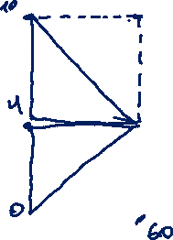
Task 1) Supply and demand
Given are the supply and demand functions for fuel depending on the price [€/unit] in a competitive market:
Demand $Q_{D}\left(p\right)=100−10p$
Supply $Q_{S}\left(p\right)=15p$
What will be the market clearing price and what will be the quantities being traded if the price increases by 2 because of a green tax?

Slide 21
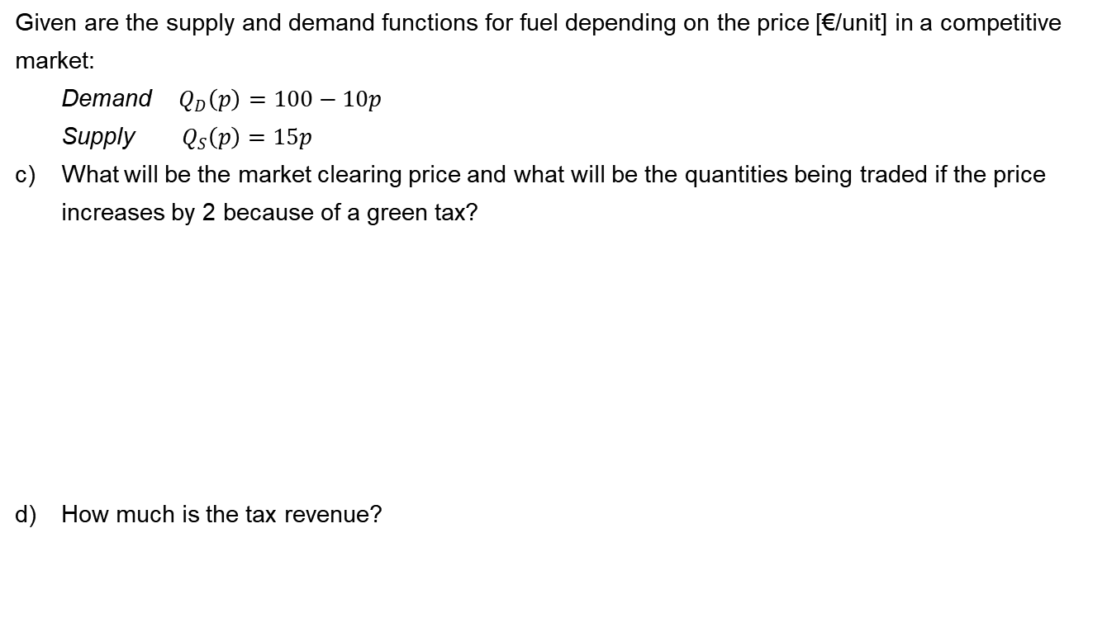
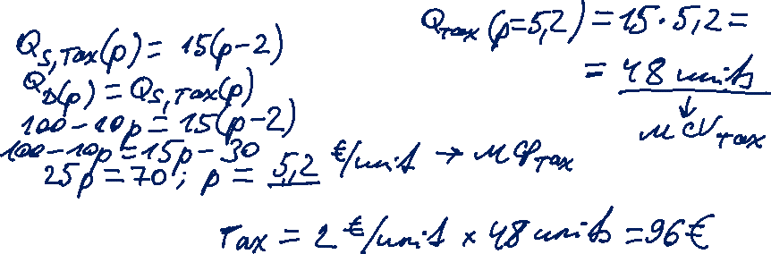
Task 1) Supply and demand
Given are the supply and demand functions for fuel depending on the price [€/unit] in a competitive market:
Demand $Q_{D}\left(p\right)=100−10p$
Supply $Q_{S}\left(p\right)=15p$
What will be the market clearing price and what will be the quantities being traded if the price increases by 2 because of a green tax?
How much is the tax revenue?

Slide 22

Task 1) Supply and demand with a tax
Supply function with tax
ptax(QS)
Price p
(CS)
Supply function
p(QS)
(PS)
MCPtax
MCP
Deadweight loss
Tax
Demand function
p(QD)
tax rate
MCVtax
MCV
Q

Slide 23

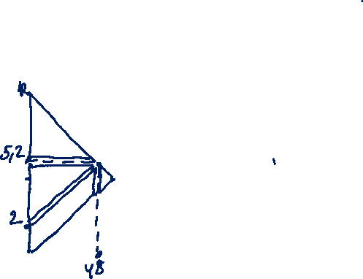
Task 1) Supply and demand
Given are the supply and demand functions for fuel depending on the price [€/unit] in a competitive market:
Demand $Q_{D}\left(p\right)=100−10p$
Supply $Q_{S}\left(p\right)=15p$
How much is the consumer and the producer surplus now? How much is the welfare now?

Slide 24

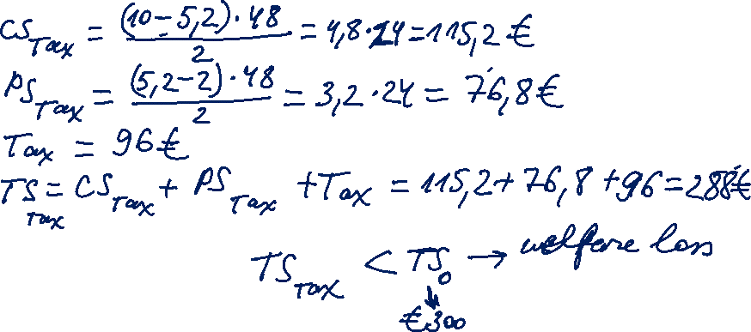
Task 1) Supply and demand
Given are the supply and demand functions for fuel depending on the price [€/unit] in a competitive market:
Demand $Q_{D}\left(p\right)=100−10p$
Supply $Q_{S}\left(p\right)=15p$
How much is the consumer and the producer surplus now? How much is the welfare now?

