Slide 1

Integrated course „Energy Economics“
- Exam Consultation
Chair of Energy Systems
Prof. Dr. Boris Heinz | Dr. Elena Timofeeva
elena.timofeeva@tu-berlin.de

Slide 2
Exam on Saturday, 06.03.2021 11:30 – 14:00 hrs online
Exam
  6 ECTS for a written exam of 90 minutes
  Subjects
    „Theoretical questions“ based on the lecture
    „Calculation based questions“ based on the tutorial
  Registration
    If possible, use QISPOS
    Free choice and supplementary modules: Examination office
    Erasmus: Mail with name, matriculation number to elena.timofeeva@tu-berlin.de
    Please do not register multiple ways
  Exam review
    In the beginning of the new semester SoSe 21; details to be announced
    Only for students who failed the exam or in other justified, exceptional cases

Slide 3
Exam Preparation
Consultation hour
  Tuesday, 02.03.2021 10:00 – 11:30 hrs via Zoom
  Please post your questions upfront in the ISIS forum

Slide 4
Final Exam: Energy Economics
Winter Term 2019/20 February 28, 2020
Task 1: 18 points
Task 2: 15 points
Task 3: 27 points
Task 4: 12 points
Task 5: 8 points
Task 6: 10 points
Task 7: 10 points
Total: 100 points

Slide 5
WS 12/13 Task 5 c 4)
  The electricity supply company A.Off wants to invest in own power utilities to provide electricity for their customers. Figure 3 shows the expected load duration curve based on the previous year load.
A.Off plans to build a flexible CCGT power plant for the peak load and a hard coal power plant to cover the base load. However they do not know the optimal capacity for the power plants.
Technical and economical data of the available technologies are given in table 3.

Slide 6
WS 12/13 Task 5 c 4)
4) How many full loud hours are possible for the CCGT? Solve this task both mathematically and graphically using diagram 1.

Slide 7
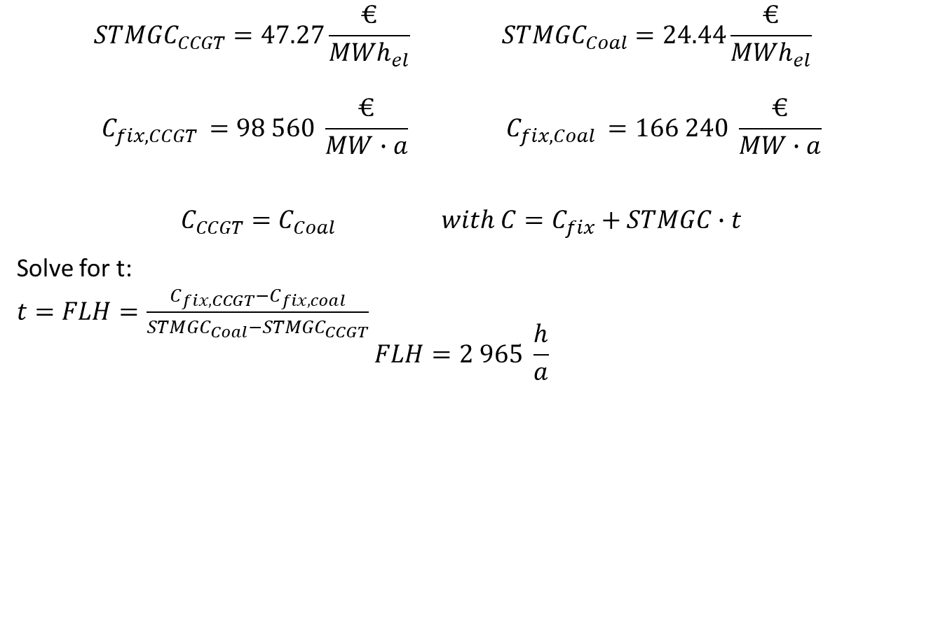
WS 12/13 Task 5 c 4)
$${STMGC}_{CCGT}=47.27\frac{€}{{MWh}_{el}} {STMGC}_{Coal}=24.44\frac{€}{{MWh}_{el}}$$
$$C_{fix, CCGT }=98 560 \frac{€}{MW∙a} C_{fix, Coal }=166 240 \frac{€}{MW∙a}$$
$$C_{CCGT}=C_{Coal} with C=C_{fix}+STMGC∙t$$
Solve for t:
$t=FLH=\frac{C_{fix, CCGT}−C_{fix, coal}}{{STMGC}_{Coal}−{STMGC}_{CCGT}}$
$$FLH=2 965 \frac{h}{a}$$

Slide 8







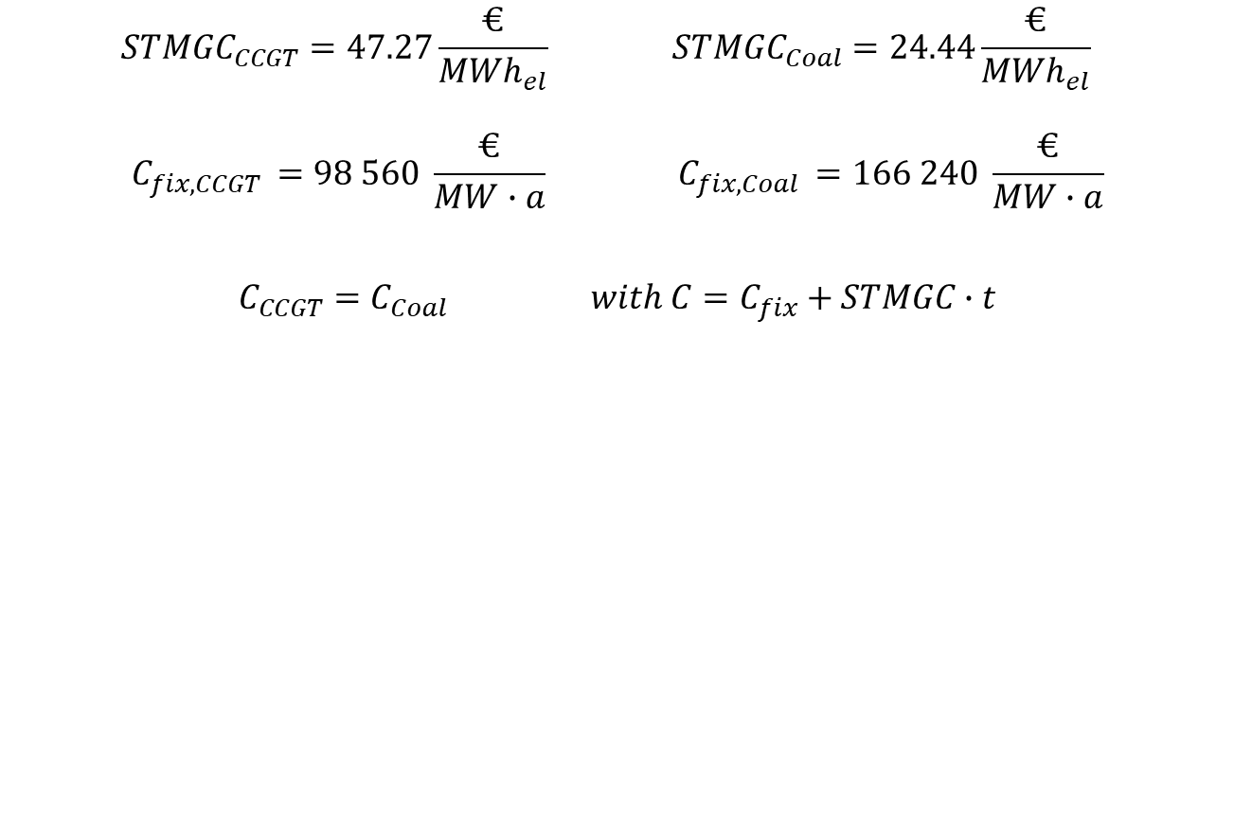










WS 12/13 Task 5 c 4)
$${STMGC}_{CCGT}=47.27\frac{€}{{MWh}_{el}} {STMGC}_{Coal}=24.44\frac{€}{{MWh}_{el}}$$
$$C_{fix, CCGT }=98 560 \frac{€}{MW∙a} C_{fix, Coal }=166 240 \frac{€}{MW∙a}$$
$$C_{CCGT}=C_{Coal} with C=C_{fix}+STMGC∙t$$

Slide 9
WS 12/13 Task 5 c 5)
  What are the optimal capacities of the two technologies? Use figure 3 to solve the task.

Slide 10
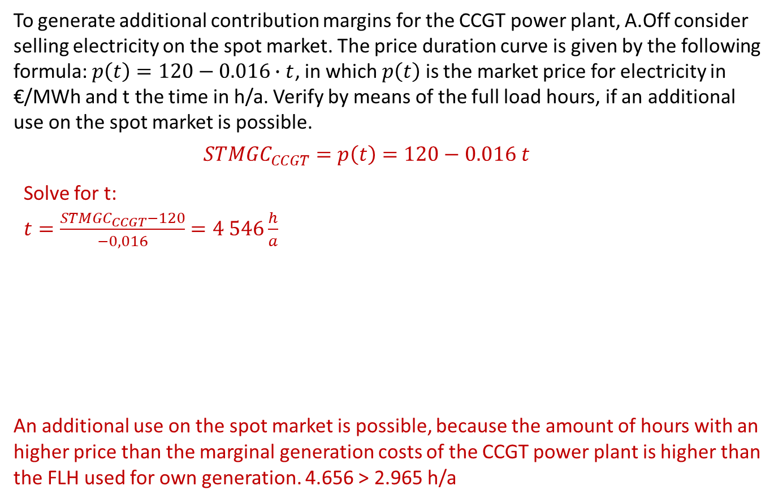
WS 12/13 Task 5 c 6)
  To generate additional contribution margins for the CCGT power plant, A.Off consider selling electricity on the spot market. The price duration curve is given by the following formula: $p\left(t\right)=120−0.016∙t$, in which $p\left(t\right)$ is the market price for electricity in €/MWh and t the time in h/a. Verify by means of the full load hours, if an additional use on the spot market is possible.
$${STMGC}_{CCGT}=p\left(t\right)=120−0.016 t$$
Solve for t:
$t=\frac{{STMGC}_{CCGT}−120}{−0,016}=4 546\frac{h}{a}$
An additional use on the spot market is possible, because the amount of hours with an higher price than the marginal generation costs of the CCGT power plant is higher than the FLH used for own generation. 4.656 > 2.965 h/a

Slide 11
Annual Price Duration Curve
Erdmann / Praktiknjo / Zweifel (2017)

Slide 12
Task 2) Merit Order and Dispatch Decisions
Which categories of costs in the power sector are relevant i) for operational decisions ii) for decommissioning decisions and iii) for investment decisions? Explain why.
i. Operational decisions should be made based on variable costs or, more specifically, marginal costs: fuel costs, CO₂ costs, variable O&M costs (costs denoted in €/MWh_{el}).
Fixed costs are irrelevant for the operational decision, as the decision to produce has no influence on them (from a short-term perspective). If the market price is just higher than our variable costs, we should produce. We generate revenues, which both cover the variable costs and contribute to recovering our fixed costs (contribution margin).
Notes:
a) See slide 5

Slide 13
Task 2) Merit Order and Dispatch Decisions
Which categories of costs in the power sector are relevant i) for operational decisions ii) for decommissioning decisions and iii) for investment decisions? Explain why.
(continued)
ii. Decisions with respect to decommissioning should not only consider variable costs, but also all fixed costs apart from the investment costs. As the investment costs cannot be influenced by the decommissioning decision, they are sunk costs and therefore irrelevant for the decision. On annual basis the contribution margin must recover the fixed costs (apart from the investment costs), otherwise we should consider decommissioning.
iii. Investment decisions should consider all costs: variable and fixed costs, including the investment costs. If we cannot recover all costs, the investment is not profitable.
Notes:
a) See slide 5

Slide 14
Task 2)
Dispatch Decisions
Assume the power plants given in table 2 have been constructed already. Sketch the merit order for these power plants. What is the electricity price at a load of 1.7 GW?

Slide 15
Task 2)
Dispatch Decisions
Assume the power plants given in table 2 have been constructed already. Sketch the merit order for these power plants. What is the electricity price at a load of 1.7 GW?

Slide 16
Task 2)
Dispatch Decisions
Now assume that there is a CO2 trading system. Calculate the emissions price (€/t CO2) at which the coal fired units show the same short-term marginal generation costs as the gas fired ones.

Slide 17
Task 1) Energy Balances
5. Find the average (electric) efficiency factor of CHP (combined heat and power) power plants. [2]
What are the average full load hours per year of CHP power plants? Assume that the total installed capacity of CHP power plants is 5.625 MW.
[3]

Slide 18
Task 1) Energy Balances
5. Find the average (electric) efficiency factor of CHP (combined heat and power) power plants. [2]
What are the average full load hours per year of CHP power plants? Assume that the total installed capacity of CHP power plants is 5.625 MW.
[3]

Slide 19
Task 2) Economics fundamentals in electricity markets
1. a) Sketch and label the merit order for available generation units with the following parameters: [2]
Power plant | Capacity [MW] | STMGC [€/MWh]
Hard coal | 1.500 | 42
Hydro | 1.500 | 15
Gas | 5.000 | 55
Nuclear | 6.000 | 30

Slide 20
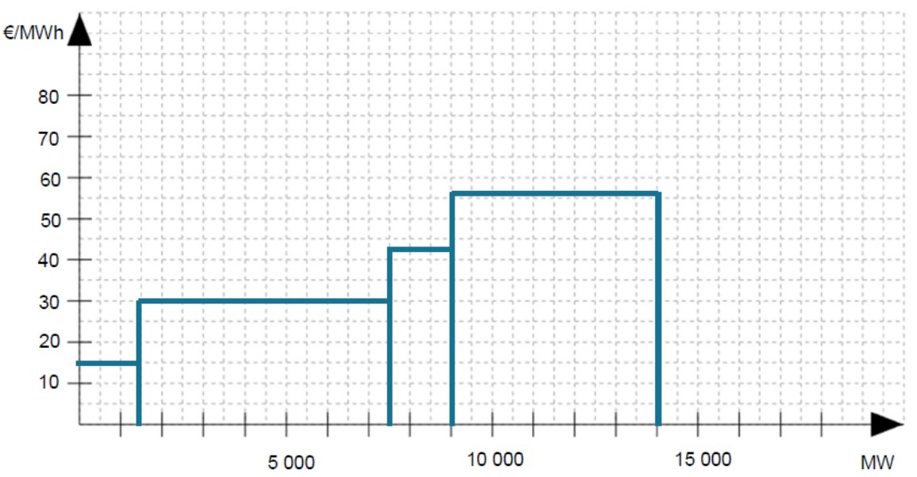
Task 2) Economics fundamentals in electricity markets
1. a) Sketch and label the merit order for available generation units with the following parameters: [2]
Power plant | Capacity [MW] | STMGC [€/MWh]
Hard coal | 1.500 | 42
Hydro | 1.500 | 15
Gas | 5.000 | 55
Nuclear | 6.000 | 30

Slide 21
Task 2) Economics fundamentals in electricity markets
b) Find graphically the market clearing price for a load of 8 GW and write down the value here. [2]
c) A nuclear power plant with an installed capacity of 1.500 MW shuts down for maintenance. What is the new market clearing price for the same given load of 8 GW? [3]

Slide 22
Task 2) Economics fundamentals in electricity markets
2. The total installed capacity of generation units in a power system is 14 GW.
The corresponding merit order can be approximated by the following supply function:
MC = -2 ∙ 10⁻⁷ ∙ Q_{S}² + 0,0054 Q_{S} + 13,106
where MC are the marginal generation costs in €/MWh, and Q_{S} the cumulated capacity in MW.
The demand for peak load power is given by the following function:
Q_{D} (p_{el}) = –14,3 ∙ p_{el} + 10.714
where Q_{D} (p_{el}) is the load demand in MW, and p_{el} is the electricity price in €/MWh.
a) What is the equilibrium price and load in the given example? [4]

Slide 23
Task 2) Economics fundamentals in electricity markets
2. The total installed capacity of generation units in a power system is 14 GW.
The corresponding merit order can be approximated by the following supply function:
MC = -2 ∙ 10⁻⁷ ∙ Q_{S}² + 0,0054 Q_{S} + 13,106
where MC are the marginal generation costs in €/MWh, and Q_{S} the cumulated capacity in MW.
The demand for peak load power is given by the following function:
Q_{D} (p_{el}) = –14,3 ∙ p_{el} + 10.714
where Q_{D} (p_{el}) is the load demand in MW, and p_{el} is the electricity price in €/MWh.
a) What is the equilibrium price and load in the given example?

Slide 24
Task 2) Economics fundamentals in electricity markets
2. The total installed capacity of generation units in a power system is 14 GW.
The corresponding merit order can be approximated by the following supply function:
MC = -2 ∙ 10⁻⁷ ∙ Q_{S}² + 0,0054 Q_{S} + 13,106
where MC are the marginal generation costs in €/MWh, and Q_{S} the cumulated capacity in MW.
The demand for peak load power is given by the following function:
Q_{D} (p_{el}) = –14,3 ∙ p_{el} + 10.714
where Q_{D} (p_{el}) is the load demand in MW, and p_{el} is the electricity price in €/MWh.
a) What is the equilibrium price and load in the given example?

Slide 25
Task 2) Economics fundamentals in electricity markets
2. The total installed capacity of generation units in a power system is 14 GW.
The corresponding merit order can be approximated by the following supply function:
MC = -2 ∙ 10⁻⁷ ∙ Q_{S}² + 0,0054 Q_{S} + 13,106
where MC are the marginal generation costs in €/MWh, and Q_{S} the cumulated capacity in MW.
The demand for peak load power is given by the following function:
Q_{D} (p_{el}) = –14,3 ∙ p_{el} + 10.714
where Q_{D} (p_{el}) is the load demand in MW, and p_{el} is the electricity price in €/MWh.
b) What is the price elasticity of demand in the market equilibrium? Is it elastic or inelastic? [4]

Slide 26
Task 3) Case study: Tropical island
5. You are valuing a project for construction of a PV power plant using the NPV method.
a) The project should be financed 20% with equity and 80% with debt capital. The return on equity is 10%, and the interest rate of debt is 5,5%.
Find the applicable discount rate for the NPV calculation. [2]
b) Find the applicable capital recovery factor. Assume that the power plant has a lifetime of 25 years. Assume a discount rate of 8%. [2]

Slide 27
Annuity factor
Notes:
Used to calculate PV of annuity

Slide 28
Capital recovery factor
Notes:
Constant annual amount needed to repay a loan amount.
Annual capital user cost.

Slide 29
Task 3) Case study: Tropical island
Answer below questions using the following techno-economic data of a diesel power plant:
5. Calculate the annualised investment cost of the power plant. [3]

Slide 30
Task 3) Case study: Tropical island
6. Calculate the production threshold price (shutdown price) of the diesel power plant. [3]

Slide 31
Task 3) Case study: Tropical island
7. Calculate the levelized cost of electricity of the power plant. Assume that annual electricity output of the power plant is 100.000 MWh [3]

Slide 32

Task 4) Hotelling’s rule
You are a resource mine owner of an exhaustible resource and you know your marginal extraction cost c are 2 $/unit. The demand function for your resource is given by: $Q_{t}(p_{t})=8−{0.5∗p}_{t}$,
where $Q_{t}$ is the demand (in tons) and $p_{t}$ is the price for the resource in period t. The general interest rate in the market is 5 %.
1. What is the backstop price in this example? Explain what the backstop price means. [4]

Slide 33

Task 4) Hotelling’s rule
You are a resource mine owner of an exhaustible resource and you know your marginal extraction cost c are 2 $/unit. The demand function for your resource is given by: $Q_{t}(p_{t})=8−{0.5∗p}_{t}$,
where $Q_{t}$ is the demand (in tons) and $p_{t}$ is the price for the resource in period t. The general interest rate in the market is 5 %.
2. At the time that the backstop price is reached, what will the scarcity rent be? [2]

Slide 34

Task 4) Hotelling’s rule
You are a resource mine owner of an exhaustible resource and you know your marginal extraction cost c are 2 $/unit. The demand function for your resource is given by: $Q_{t}(p_{t})=8−{0.5∗p}_{t}$,
where $Q_{t}$ is the demand (in tons) and $p_{t}$ is the price for the resource in period t. The general interest rate in the market is 5 %.
3. You have figured out that the time to depletion is T = 25 years. What would be the price of the resource in t = 0? How much higher is the price of the resource in t = 7 (give a percentage increase of the price)? [3]

Slide 35

Task 4) Hotelling’s rule
You are a resource mine owner of an exhaustible resource and you know your marginal extraction cost c are 2 $/unit. The demand function for your resource is given by: $Q_{t}(p_{t})=8−{0.5∗p}_{t}$,
where $Q_{t}$ is the demand (in tons) and $p_{t}$ is the price for the resource in period t. The general interest rate in the market is 5 %.
3. You have figured out that the time to depletion is T = 25 years. What would be the price of the resource in t = 0? How much higher is the price of the resource in t = 7 (give a percentage increase of the price)? [3]

Slide 36

Task 4) Hotelling’s rule
You are a resource mine owner of an exhaustible resource and you know your marginal extraction cost c are 2 $/unit. The demand function for your resource is given by: $Q_{t}(p_{t})=8−{0.5∗p}_{t}$,
where $Q_{t}$ is the demand (in tons) and $p_{t}$ is the price for the resource in period t. The general interest rate in the market is 5 %.
4. Assume the scarcity rent in t = 0 is given by 6.5 $/unit. How long does it take until depletion of the resource? [3]

Slide 37
Task 4) Hotelling’s rule
You are a resource mine owner of an exhaustible resource and you know your marginal extraction cost c are 2 $/unit. The demand function for your resource is given by: $Q_{t}(p_{t})=8−{0.5∗p}_{t}$,
where $Q_{t}$ is the demand (in tons) and $p_{t}$ is the price for the resource in period t. The general interest rate in the market is 5 %.
4. Assume the scarcity rent in t = 0 is given by 6.5 $/unit. How long does it take until depletion of the resource? [3]

Slide 38
Task 4) Hotelling‘s Rule

Slide 39
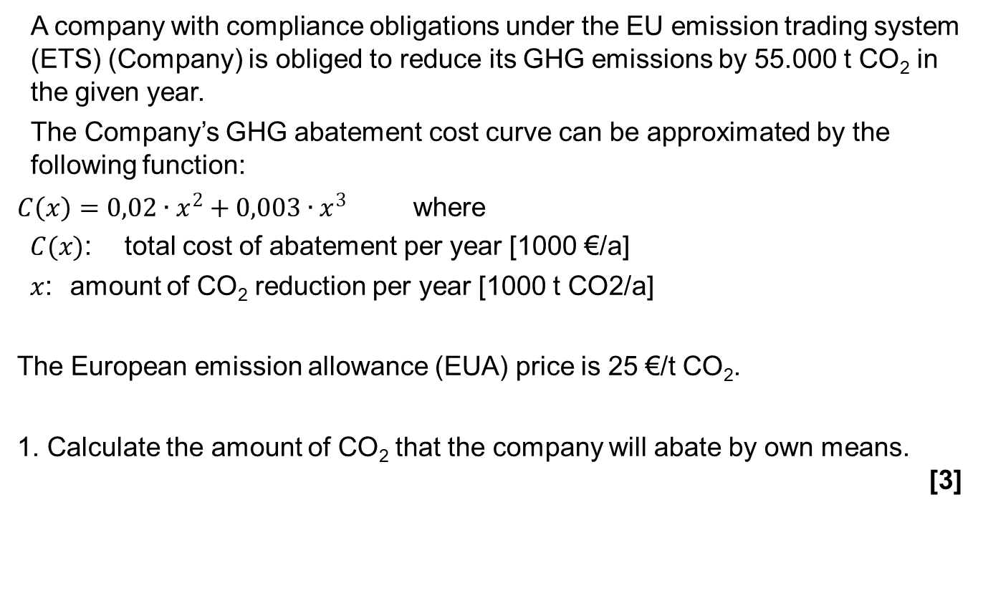
Task 5) Emissions
A company with compliance obligations under the EU emission trading system (ETS) (Company) is obliged to reduce its GHG emissions by 55.000 t CO₂ in the given year.
The Company’s GHG abatement cost curve can be approximated by the following function:
$C\left(x\right)=0,02∙x^{2}+0,003∙x^{3}$where
$C(x)$: total cost of abatement per year [1000 €/a]
$x$: amount of CO₂ reduction per year [1000 t CO2/a]
The European emission allowance (EUA) price is 25 €/t CO₂.
1. Calculate the amount of CO₂ that the company will abate by own means. [3]

Slide 40

Task 5) Emissions
A company with compliance obligations under the EU emission trading system (ETS) (Company) is obliged to reduce its GHG emissions by 55.000 t CO₂ in the given year.
The Company’s GHG abatement cost curve can be approximated by the following function:
$C\left(x\right)=0,02∙x^{2}+0,003∙x^{3}$where
$C(x)$: total cost of abatement per year [1000 €/a]
$x$: amount of CO₂ reduction per year [1000 t CO2/a]
The European emission allowance (EUA) price is 25 €/t CO₂.
1. Calculate the amount of CO₂ that the company will abate by own means.

Slide 41

Task 5) Emissions
A company with compliance obligations under the EU emission trading system (ETS) (Company) is obliged to reduce its GHG emissions by 55.000 t CO₂ in the given year.
The Company’s GHG abatement cost curve can be approximated by the following function:
$C\left(x\right)=0,02∙x^{2}+0,003∙x^{3}$where
$C(x)$: total cost of abatement per year [1000 €/a]
$x$: amount of CO₂ reduction per year [1000 t CO2/a]
The European emission allowance (EUA) price is 25 €/t CO₂.
2. Calculate the company’s total annual cost of compliance with the GHG reduction obligation. [3]

Slide 42
Trade of Emission Allowances
Abatement cost of company 1 (marginal cost)
Abatement cost of company 2 (marginal cost)
ARBITRAGE
Allocated rights
Emission trade

