Slide 1
Integrated course „Energy Economics“
- Energy Balances -
Chair of Energy Systems | Department of Energy Systems
Technische Universität Berlin

Slide 2
Outline
Energy sources
Energy flow chart
Energy balances
Tutorial on energy balances
Data sources
Explore energy statistics in groups

Slide 3
Introduction: Energy economics
Economics is a social science studying production, distribution and consumption of goods and services.
Economics deals with allocation of scarce resources.
Energy is abundant in the nature but mostly not immediately applicable for doing useful work.
Engineering know-how + Economic viability
Notes:
Water wheel converts kinetic energy of water is converted into mechanical movement.

Slide 4
Primary and secondary energy sources
Primary energy sources are in the form as found in nature and have not undergone any transformation.
  oil, coal, natural gas, nuclear, wind, solar, biomass, geothermal, hydropower
Secondary energy sources are forms of energy after conversion, either chemical or physical.
  electricity, refined fuels (e.g. gasoline), synthetic fuels (e.g. hydrogen)
  easily usable form
Notes:
Synthetic fuels are produced through chemical conversion.

Slide 5
Classification of Energy Sources
Source: OECD/IEA Energy Statistics Manual, 2005

Slide 6
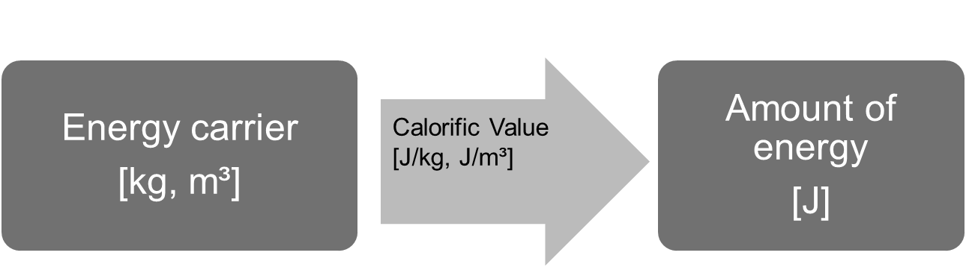
Measuring primary energy
Primary energy sources are originally measured in units corresponding to their natural form: volume, mass etc.
Original units can be converted into energy units.
Calorific value is used for energy sources that can be converted into heat through combustion: coal, gas, oil, biomass.
@ Ensys
Notes:
calorific / heating / energy value
Calorific value: amount of heat released by complete combustion of a unit quantity of fuel under specified conditions.
Energy stored in a unit of volume -> energy density
Energy stored in a uni mass -> specific energy

Slide 7
Upper and lower calorific/heating values
Lower Heating Value H_{i} (Heating Value): maximum amount of usable heat from combustion (without counting the conensation enthalpy of water vapor contained in the exhaust gas).
Upper Heating Value H_{s} (Gross Calorific Value): condensation enthalpy of water vapor (2.44 MJ/kg at 25°C) is included.
For methane H_{s} is 111% of H_{i}.
Notes:
calorific / heating / energy value
Calorific value: amount of heat released by complete combustion of a unit quantity of fuel under specified conditions.
Energy stored in a unit of volume -> energy density
Energy stored in a uni mass -> specific energy

Slide 8
Lower calorific value of energy fuels
© Prof. Dr. Georg Erdmann
Notes:
calorific / heating / energy value
Heat energy can be converted into electrical energy.

Slide 9

Energy units
Source: Zweifel / Praktiknjo / Erdmann, 2017
Notes:
Basic: calorie, Joule, kWh, Btu
Source-based: t.c.e., t.o.e.

Slide 10
Example: Energy units conversion
Unit | Density | Energy [10⁹ J] | Remarks
1 t of crude oil | 0,86 g/cm³ | 39-43 | mean: 41,9 ∙ 10⁹ J
1 barrel (bbl) of crude oil |  | 5,7 | = 159 l (rule of thumb: 50/365 t.o.e.)
1000 m³ of natural gas (H gas) | 0,79 kg/m³ | 36,6
1 t of hard coal |  | 29-35 | mean: 29,3 ∙ 10⁹ J
1 t.o.e. (tonne of oil equivalent) is equivalent to the energy content of:
1 t of crude oil, or
41,9 GJ / 5,7 GJ = 7,35 barrel or crude oil, or
41,9 GJ / 36,6 GJ = 1,1448 ∙ 10³ m³ = 1144,8 m³ of natural gas, or
41,9 GJ / 29,3 GJ = 1,43 t of hard coal

Slide 11
Unit Prefixes
Unit prefixes
10³ | k | Kilo
10⁶ | M | Mega
10⁹ | G | Giga
10¹² | T | Tera
10¹⁵ | P | Peta
10¹⁸ | E | Exa

Slide 12
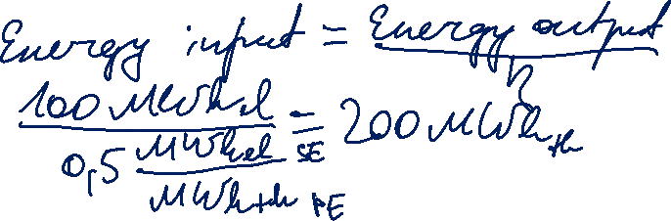
Energy conversion efficiency
Efficiency of an energy conversion device:
Example: How much natural gas is required for generating 100 MWh of electricity in a gas power plant with an efficiency of 50%?
Useful energy output
η =
Energy input

Slide 13
Energy flow chart
Source: Zweifel / Praktiknjo / Erdmann, 2017
Notes:
Energy flow chart helps understand and analyse interrelations in the energy industry.
Energy flow chart / energy balances refer to a territory (country or region) and to aggregate amounts of energy over a period of time (year).
Final energy includes energy sold to end users for energetic use and treatment for non-energetic use.
Energy services

Slide 14
Terms and definitions
Gross energy / Primary energy: Aggregate energy supply from domestic sources and imports minus energy exports
Final energy supply (intermediate good): Energy sold by energy companies to end users for energetic use
Treatment of non-energy use (raw material in chemistry)
Useful energy: Energy that is supplied from heaters, radiators, coolers, motors, light bulps etc. to end users
Energy Services: Not the energy from radiators matters but the well being of people in a well tempered room …
© Prof. Dr. Georg Erdmann

Slide 15
Energy Balances: Energy flow chart for Germany in 2018
Source: AGEB, 2019
Petajoule (PJ)
Notes:
TPES = Imports + Extraction – Exports – Int. Marine & Aviation Bunkers +/- Stock changes

Slide 16
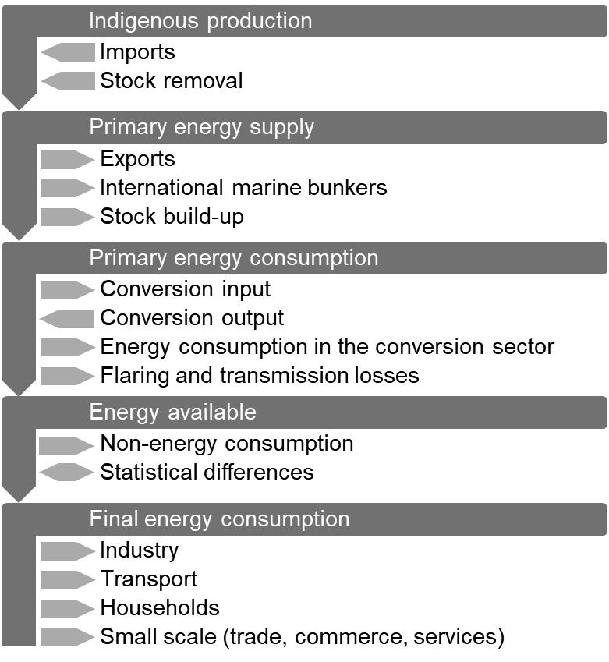
Energy balance structure (AGEB)

Slide 17
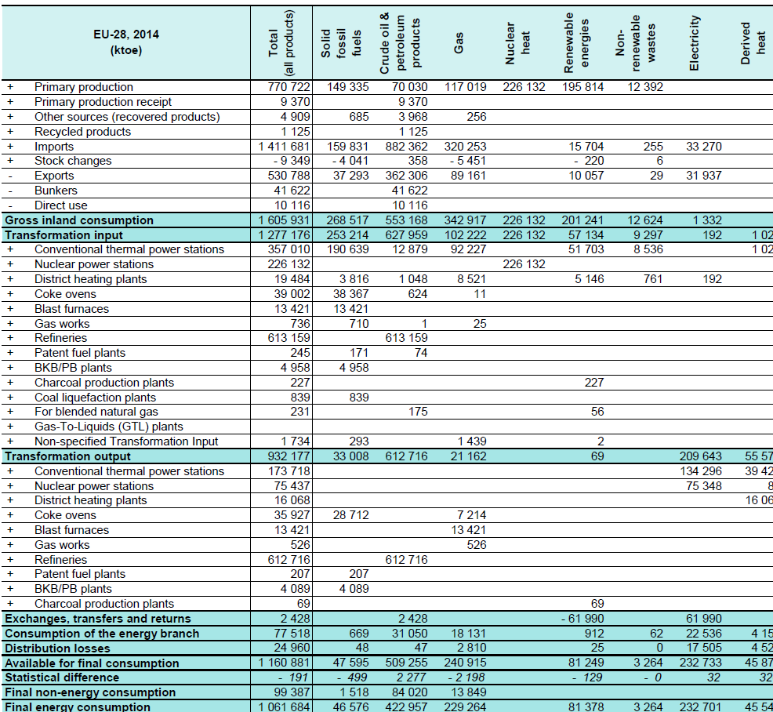
EU Energy Balance: Simplified structure
Source: Eurostat
+ Industry
+ Transport
+ Other sectors
Notes:
Matrix: fuels – flows
Production – transformation – consumption
Accounting framework for compilation of data on all energy products entering, exiting and used within the territory of a country during a reference period.
Contribution of different fuels to the economy

Slide 18
Accounting for RES
How to value energy carriers which do not have a calorific value, e.g. wind, PV, nuclear energy, electricity imports, water, geothermal heat?
Substitution Principle: amount of fuel that would be necessary to produce that amount of electricity in a thermal powerplant (35-40%)
Efficiency Principle: actual efficiency of respective technology (hydro 80-90%, wind 30-55%, solar 10-25%)
Fictive Efficiency Principle (IEA): 100% for wind, solar, hydro
(underestimated RES share); 33% for nuclear
Source: IEA

Slide 19
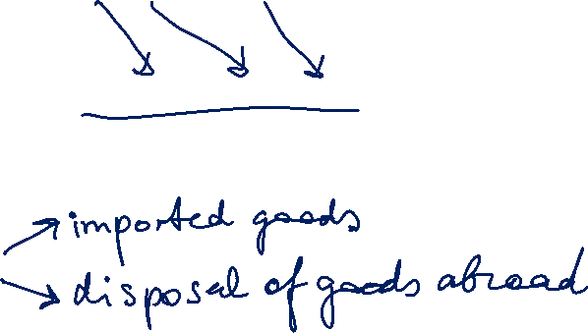
Energy Balance: Cumulated energy requirement
Cumulated energy requirement is total primary energy amount required for production, use and disposal of a product over its lifetime.
CER = CER_{P} + CER_{U} + CER_{D}
CER is used in life-cycle assessment to account for all environmental impacts of an industrial process.
'Grey energy‘
Energy required for production/recycling is not reflected in the national energy balances in this case.

Slide 20
Task 1) Basics
Explain the difference between primary and secondary energy sources.
Primary energy sources occur naturally.
Secondary energy sources have undergone at least one conversion process.
Why does the primary energy consumption comprise secondary energy sources?
Accounting for imports of secondary energy sources for completeness (e.g. electricity, motor gasoline etc.)
All power plants and all industrial plants require energy for their construction. Where do those energy flows appear in the energy balance?
Final consumption (manufacture of machinery etc.)

Slide 21
Task 1) Basics
What are the consequences of this fact for the real share of useful energy on the amount of primary energy?
The real share of useful energy is lower than expected, as part of final energy consumption is used for conversion purposes.
There is another important category of energy imports that does not appear in the energy balance. What could this be?
Imported goods (“grey energy”)
“Gasoline tourism” (cars fuelled in a neighbouring country)

Slide 22
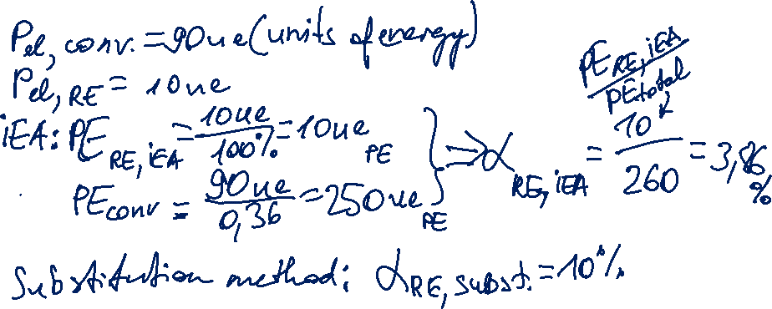
Task 1) Basics
The average efficiency of all fossil power plants in an exemplary country is 36 %. The share of renewables of electricity production is 10 %. What is the share of renewables of total primary energy consumption if you use the substitution method and what, if you use the IEA-method?

Slide 23
Task 2) German Energy Balance of 2015
Please have a look at the German energy balance of 2015 and answer the following questions:
How much electricity was generated overall in 2015 (in GWh) and how high was the share of renewables (in percent)?
What is the average efficiency (in percent) of a German public thermal power station?
What is the assumed efficiency (in percent) of nuclear power plants and how is it calculated?
Please calculate the internal electricity consumption at electricity production and the conduction losses at the transport from power plant to end user (absolute and percentage values with respect to the total conversion output).
The calculation of renewable primary energy consumption is based on the ________-method. Give reasons for your answer.
If the substitution-method is used, what is the primary energy consumption in PJ (PJ = 1000 TJ) of Hydro-, Wind- and Photovoltaic Power Plants?
What does the negative primary energy consumption of motor gasoline imply and how much of motor gasoline was consumed in 2015?

Slide 24
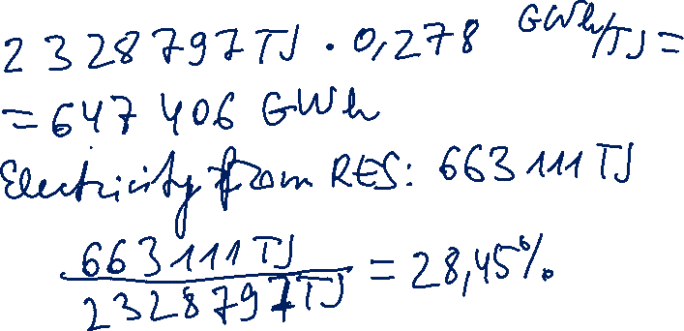
Task 2) German Energy Balance of 2015
Please have a look at the German energy balance of 2015 and answer the following questions:
How much electricity was generated overall in 2015 (in GWh) and how high was the share of renewables (in percent)?

Slide 25
Energy units
Energy unit conversion
 | MJ | kcal | kWh | t.o.e. | Barrel | t.c.e.
1 MJ | 1 | 238,8 | 0,2778 | 23,88 E⁻⁶ | 175 E⁻⁶ | 34,14 E⁻⁶
1 kcal | 0,0042 | 1 | 0,00116 | 0,1 E⁻⁶ | 0,73 E⁻⁶ | 0,143 E⁻⁶
1 kWh | 3,6 | 860 | 1 | 86 E⁻⁶ | 630 E⁻⁶ | 123 E⁻⁶
1 t.o.e. | 41.880 | 10 E⁺⁶ | 11.630 | 1 | 7,33 | 1,430
1 Barrel | 5.713 | 1,36 E⁺⁶ | 1.587 | 0,1364 | 1 | 0,195
1 t.c.e. | 29.290 | 6,995 E⁺⁶ | 8.136 | 0,6995 | 5,127 | 1
Notes:
Sorry for the horrid quality

Slide 26
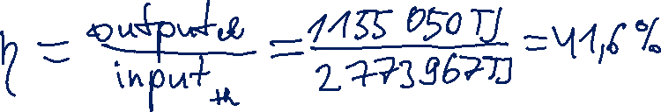
Task 2) German Energy Balance of 2015
What is the average efficiency (in percent) of a German public thermal power station?

Slide 27

Task 2) German Energy Balance of 2015
What is the assumed efficiency (in percent) of nuclear power plants and how is it calculated?
See pdf document under „Energy Balances“
for solutions to Task 2) d)-g) and Task 3)

