Slide 1

Integrated course „Energy Economics“
- Natural Gas Markets
Prof. Dr. Boris Heinz | Dr. Elena Timofeeva
Department for Energy Systems

Slide 2
Outline
Natural gas reserves and production
Long distance gas pipelines
Gas storage
LNG markets
Wholesale markets for natural gas
Retail gas markets

Slide 3
Gaseous Fuels
Natural gas – mainly methane
  H gas – high-calorific natural gas (higher CH₄ content → heat value)
  L gas – low-calorific natural gas (produced in GE &NL)
Liquefied petroleum gas (LPG) – mainly propane and butane, byproduct of oil refinery process
Town gas (cooking gas) – byproduct of coke plants

Slide 4


Properties of Gaseous Fuels
© Prof. Dr. Georg Erdmann
Notes:
Latent heat of vaporisation of water vapour. Same types of fuel are compared by HHV, different types of fuel – by LHV (due to different hydrogen content).

Slide 5
Natural gas
Conventional natural gas
Extracted from gas deposits by conventional means
Associated gas – released during oil extraction (often flared but can be utilised)
Unconventional natural gas
Shale gas (>1000 m deep) – extracted by fracking
Coal bed methane – found in coal formations (300-1000 m deep)
Methane hydrates – found on ocean seabed

Slide 6
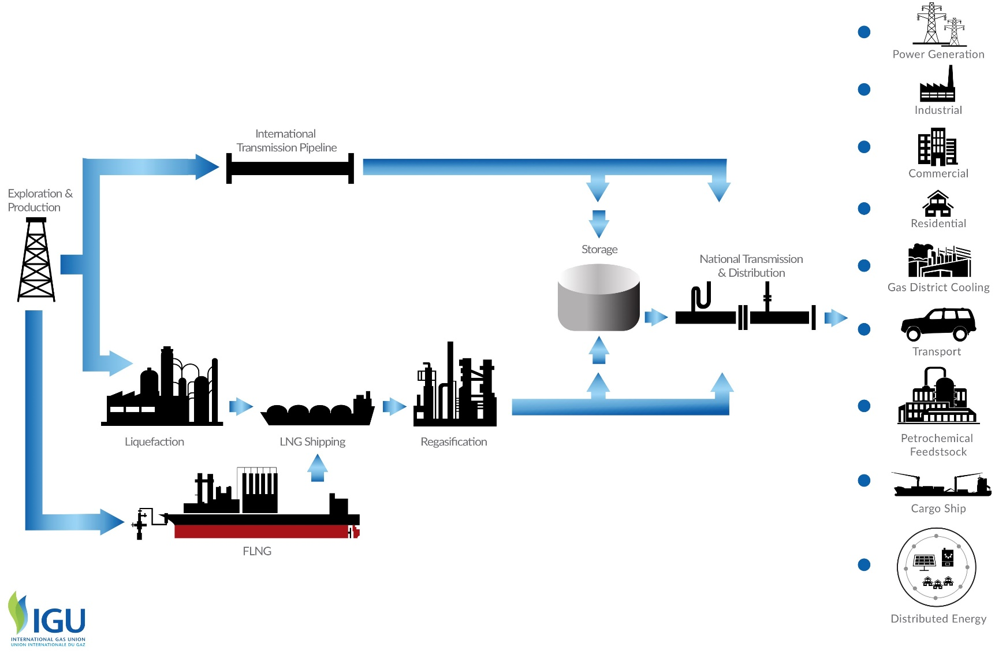
Natural gas value chain

Slide 7

Global Gas Resources
Source: BGR, 2013
Resources are all useful raw materials available in nature.
Reserves are resources existing with high probability and economically feasible for extraction.

Slide 8

Reserves and extraction of natural gas
*
The Persian Gulf and the Caspian Sea areas
  (Bahrain, Iran, Iraq, Kuwait, Oman, Qatar, Saudi Arabia, Syria, UAE, Yemen, other Middle East;
  Azerbaijan, Kazakhstan, Russia, Turkmenistan, Uzbekistan, other Europe & Eurasia)
Source: Zweifel / Praktiknjo / Erdmann (2017) after BP (2014)

Slide 9
Natural Gas in the EU
© Prof. Dr. Georg Erdmann

Slide 10
German Gas Imports
Source: BAFA, 2015
[TJ]
© Prof. Dr. Georg Erdmann

Slide 11
Economics of Gas Pipelines
Throughput is the volume of gas passing through a pipeline in a period of time.
[m³/h]
Pipeline capacity is the maximum throughput.
© Prof. Dr. Georg Erdmann

Slide 12
Game Theory: Double Marginalisation
Gas producer is able to infer on the import price resulting from gas importer’s optimisation based on the domestic demand curve. It then optimises its profit at the given import price.
© Prof. Dr. Georg Erdmann

Slide 13
Retail Gas Price set by the Monopolistic Gas Importer
Willingness to pay for the first unit = max. retail price
Linear demand function
Importer’s marginal cost = import price
(neglecting other cost elements)
© Prof. Dr. Georg Erdmann

Slide 14

Game Theoretical View of the Gas Importer
© Prof. Dr. Georg Erdmann

Slide 15
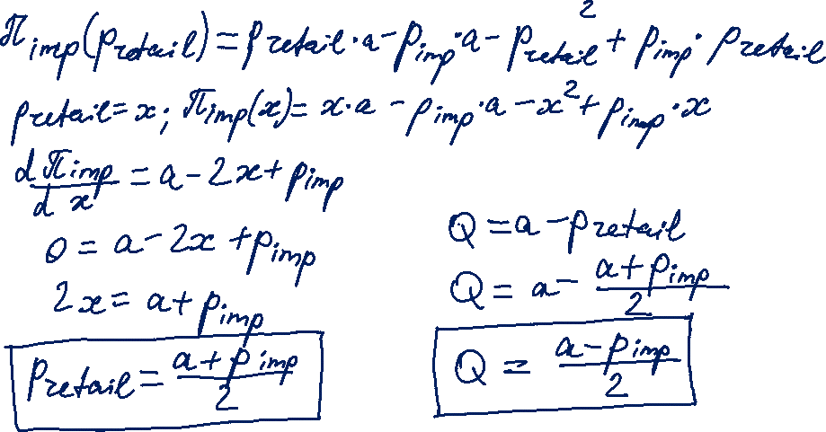
Game Theoretical View of the Gas Importer

Slide 16

Game Theoretical View of the Pipeline Operator
© Prof. Dr. Georg Erdmann

Slide 17
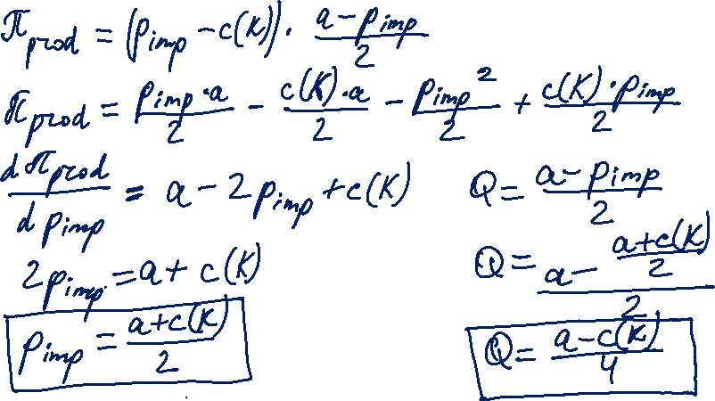
Game Theoretical View of the Pipeline Operator
Correction: differentiation with respect to the import price to be agreed with the gas importer.

Slide 18

Solution under “Cooperation”
© Prof. Dr. Georg Erdmann

Slide 19
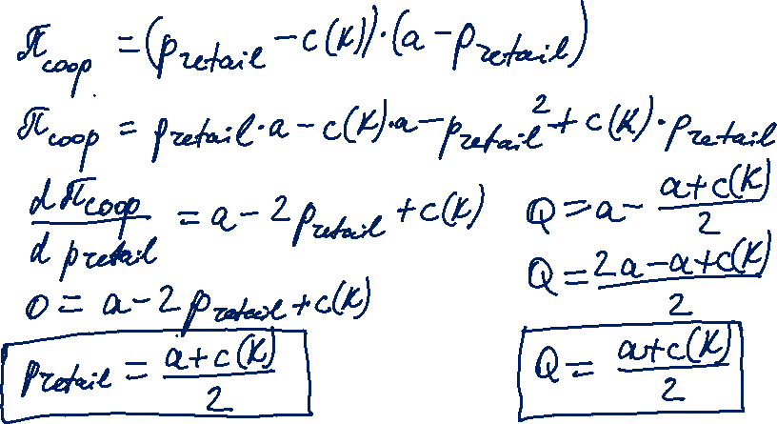
Solution under “Cooperation”

Slide 20
Decision of the Pipeline Investor
© Prof. Dr. Georg Erdmann

Slide 21
Transportation Cost of Hydrocarbons
Source: Zweifel / Praktiknjo / Erdmann, 2017

Slide 22
LNG Process Chain
Boiling point of methane −162 °C (−259.6 °F)
Approx. 600 times volume reduction
Source: Osaka Gas
Source: BV 2009 / GIIGNL

Slide 23
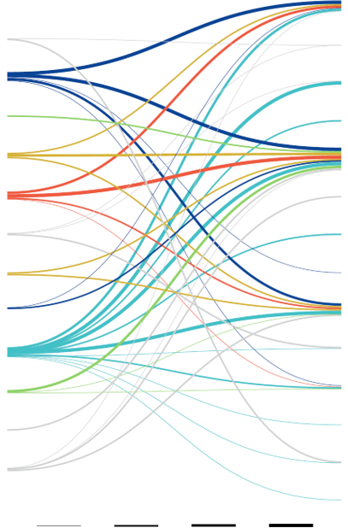

Major LNG Trading Flows in 2018
EXPORT
IMPORT
China
Algeria
France
Australia
India
Brunei
Italy
Indonesia
Japan
Malaysia
Mexico
Nigeria
Pakistan
Oman
Singapore
Papua New Guinea
South Korea
Quatar
Spain
Russia
Taiwan
UAE
Thailand
USA
Turkey
2 - 3 MT
3 - 5 MT
5 - 10 MT
>10 MT
United Kingdom
Source: GIIGNL, 2019

Slide 24
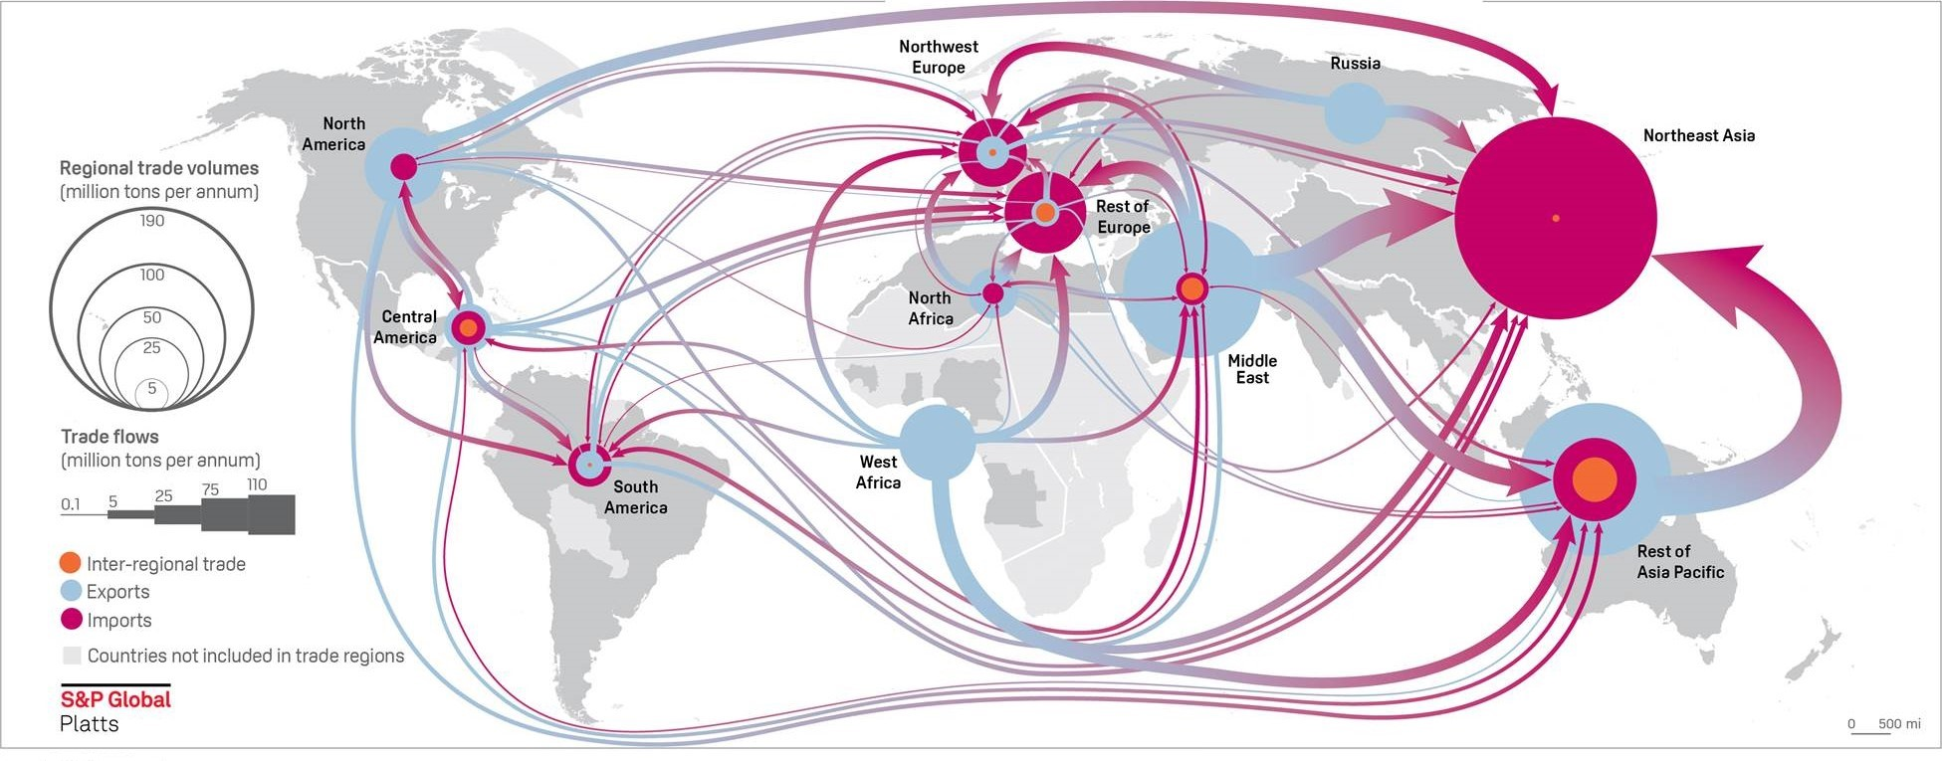

LNG Flows in 2018

Slide 25
Cost Structure of LNG Process Chain
Liquefaction plant:
Investment outlay | 900M €
Operating expenses | 0,04 €/m³
LNG tanker fleet | e.g. 2 vessels á 135T t each
Investment outlay | 360M €
Operating expenses | 0,014 €/m³
Regasification plant w. storage | e.g. 80T m³ (Cartagena)
Investment outlay | 320M €
Operating expenses | 0,015 €/m³
Own gas requirement | 1/3 of transported gas
Source: Zweifel / Praktiknjo / Erdmann (2017), after Cayrade (2014)

Slide 26
Cost Comparison of LNG Projects
Source: Songhurst, OIES, 2018

Slide 27
LNG Impact on Global Gas Markets
LNG trade leads to integration of regional gas markets
LNG supply chain is more flexible
LNG helps to develop more remote gas fields
Diversification helps mitigate the holdup problem
Source: Zweifel / Praktiknjo / Erdmann, 2017

Slide 28
Vertical Integration or Long-Term Contracts
© Prof. Dr. Georg Erdmann
Notes:
Long-term contracts are imperfect substitute for vertical integration.

Slide 29
Take-or-Pay Clause in Long Term Contracts
© Prof. Dr. Georg Erdmann

Slide 30
Volume Flexibility Under Long Term Contracts (2007)
Souce: European Commission, Energy sector inquiry 2005-2006

Slide 31
Gas storage technologies
Station
Station
Observation well
Aquifer/
Production field
Source: E.ON Ruhrgas
Porous rock storage
Cavern storage

Slide 32
Gas storage facilities: Underground
Porous rock storage
  uses existing geological underground formations (e.g. depleted oil and gas fields)
  relatively inexpensive
  large storage volume
  more cushion gas required
  low injection and withdrawal rate
Cavern storage
  artificial hollows carved out in underground rock or salt formations
  higher investment
  less cushion gas required
  higher withdrawal rate
  fast switching between injection and withdrawal mode
  provide short-term flexibility

Slide 33
Gas storage facilities: Above ground
LNG storage
Insulated tanks at LNG terminals
No cushion gas needed
High injection/withdrawal rates
Gas tanks
Law or high pressure
Not economical for high volumes
Local storage
Line pack
Gas stored inside pipeline through increased pressure
Used to balance daily demand fluctuations

Slide 34
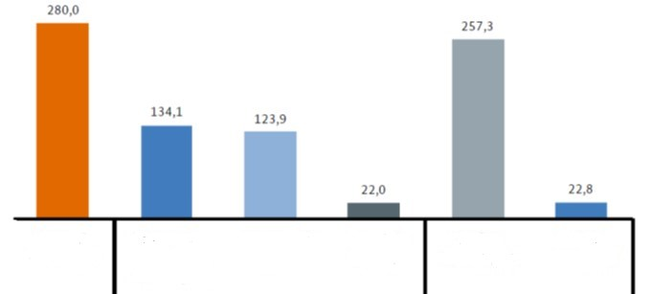
Gas storage facilities in Germany
Max. usable working gas volume as of 31.12.2018, in TWh
Total
33 storage facilities
Cavern storage
17 facilities
Porous rock storage
15 facilities
Other
1 facility
H-Gas
29 facilities
L-Gas
4 facilities
BNetzA, 2019

Slide 35
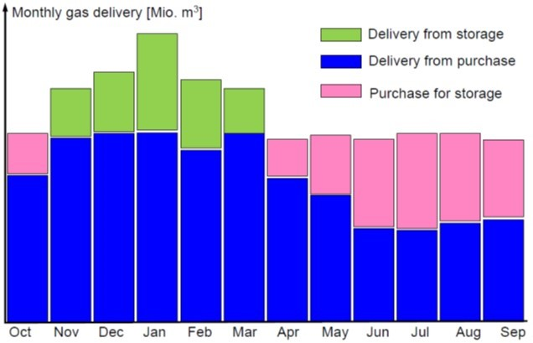
Merchant Use of a Gas Storage
© Prof. Dr. Georg Erdmann

Slide 36
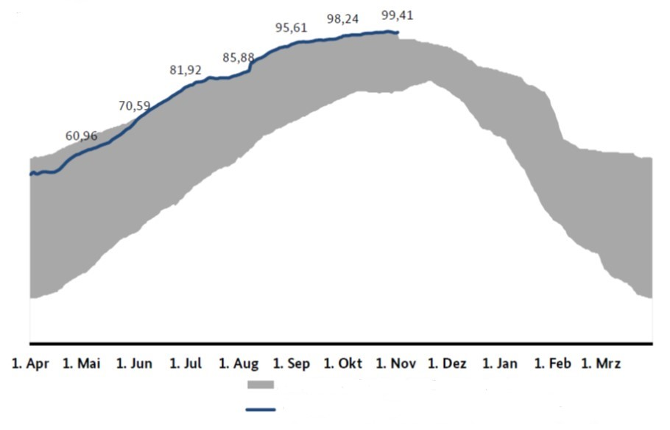
German gas storage: Filling level development
Storage year 2018/19 – compared to previous years
[%]
Range of storage filling level since 04/2011
Filling level for current storage year – as of 1 Nov 2019
Source: BNetzA, 2019

Slide 37
Value of gas storage
Storage buffers supply and (daily & seasonally fluctuating) demand
Value of storage is determined by the cost of alternative sources of flexibility (transportation and capacity charges):
production swing, take-or-pay, interruptible contracts, spot market
Intrinsic value
  ability to inject a certain amount of gas in summer and withdraw it in winter
  price during withdrawal minus price during injection, i.e. seasonal spread
Extrinsic value
  ability to utilise the storage volume more than once (inject and withdraw gas) during the season to profit from short-term price volatility

Slide 38
Gas and Heating Oil Prices
© Prof. Dr. Georg Erdmann

Slide 39
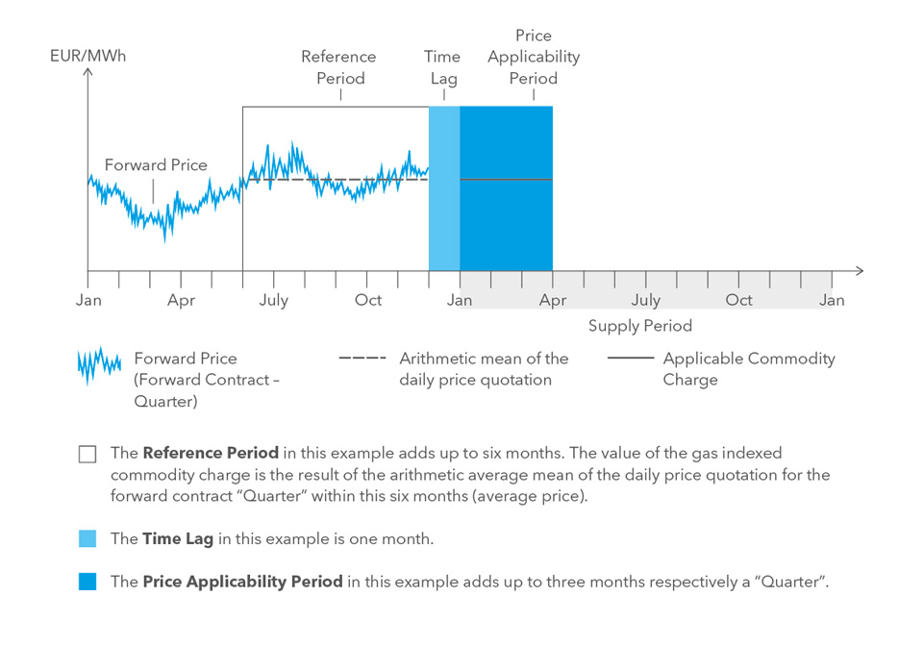
Index-based Gas Price
In this example: 6/1/3 rule
Typical indexation in long-term gas supply contracts: 6/3/3 rule
(6 months reference period; 3 months time lag; 3 months price applicability period)
Time period in or for which (depending on the specific index type) the index is published
Time lag between the reference period and price applicability period
Part of the delivery period to the calculated price applies.
Souce: WINGAS

Slide 40
Price Indexation Under Long Term Contracts (2007)
Souce: European Commission, Energy sector inquiry 2005-2006

Slide 41
Price Indexation by Production Region (2007)
Souce: European Commission, Energy sector inquiry 2005-2006

Slide 42
Oil-product linked gas prices
Initial rationale for oil-based indexation is that users can choose between burning gas and oil products.
Early liberalised gas markets of the US and the UK with a liquid wholesale trading in natural gas resulted into gas-to-gas competition.
Long-term supply contracts for Continental Europe were initially linked to oil prices.
Since late 2000s European gas markets have shifted significantly from oil indexation towards hub-linked prices.
Renegotiation of price formulas in long-term supply contracts followed.

Slide 43
Downside of Long-Term Contracts
Lacking transparency
Reduced liquidity on wholesale markets
Barrier for entry for new competitors

Slide 44
LTC Renegotiation
Driving factors for transition to hub-linked gas prices:
US shale gas production
Qatari LNG available in Europe
Reduction in gas demand
Gas importers stayed bound by LTC at oil-linked prices incurring losses.
Renegotiation of LTC followed to introduce hub indexation.
Trends in newly signed contracts:
→ shorter duration period (10-15 years)
→ full hub indexation
→ new buyer/seller balance

Slide 45
Evolution of TTF and German Import Contract Prices
TTF (Title Transfer Facility) – Dutch gas hub
BAFA – average German import contract
Source: Franza, CIEP (2014), with reference to DEPA

Slide 46
Third-Party Access to Gas Infrastructure
Non-discriminatory (effective and transparent) access to gas transportation systems is a crucial prerequisite for a liquid market for natural gas.
Unbundling for gas TSOs (see EU Gas Directive 2009/73/EC):
Transmission and distribution activities are separated from the rest of the value chain
Ownership unbundling
Independent system operator (ISO)
Independent transmission operator (ITO)
Certification to ensure compliance with unbundling requirements for transmission system owner or TSO controlled by person(s) from third country(ies)
„Gazprom clause“
See lecture 11
on unbundling: equivalent rationale and requirements apply for the gas sector.

Slide 47
Gas Network Access Models
Point-to-point system
gas traders book specific transportation route from an entry to an exit point
distance-based capacity pricing
Entry-exit system
entry and exit capacities are booked separately
entry fee and exit fee – capacity pricing independent of distance
traders with entry capacities can sell gas to traders with exit capacities
each exit point can be supplied from any entry point
Entry-exit system enables wholegas gas trading on virtual trading point (virtual hub) / market area level: gas is traded independently of its location in a market area.

Slide 48
Key Elements of Network Access Model
Overall
objective
Non-discriminatory network access to facilitate competition
Areas of
network
access
General network access model
Capacity and congestion management
Balancing
Options/
major
determinants
Entry-exit
Point-to-point
Postage stamp
Allocation principles
Capacity products
Further rules/incentives
Balancing period
Imbalance pricing
Flexibility market
Source: Hewicker & Kesting, in: Handbook Utility Management, 2009
Notes:
In point-to-point model imbalance under each contract is priced.
In entry-exit model net imbalance is considered.

Slide 49
Point-to-point Model
Entry
Contract Path
Network
Shippers specify entry and exit points and the transportation path.
Actual physical flow may differ from the contracted path.
Entry and exit capacities cannot be separated from each other and from the gas (commodity) transaction.
Exit
Source: Hewicker & Kesting, 2009

Slide 50

Entry-exit Model
Entry
Entry
7
5
Exit
4
Exit
Exit
10
Exit
12
Entry
10
5
Shippers book entry and exit capacity independently from each other.
No need to specify transportation path or distance.
Contracts for entry and exit capacities are independent from each other and from commodity transactions.
Entry and exit tariffs are set independently for each entry/exit point
Different tariffs for each point
All network operators in a network zone cooperate and set tariffs on a cost-reflective basis.
Source: Hewicker & Kesting, 2009
Notes:
Point-specific tariffs should, ideally, reflect the cost of capacity extension required to eliminate congestion.

Slide 51
European gas regions, markets and hubs
Source: OIES (2017) with reference to www.worldatlasbook.com and P. Heather

Slide 52
Gas Hubs
Physical gas hub, e.g.
Henry Hub (USA) – connecting point of 14 pipelines
Zeebrugge (Belgium)
Baumgarten (CEGH, Austria)
Virtual gas hub, e.g.
NBP, National Balancing Point (UK)
TTF, Title Transfer Facility (Netherlands)

Slide 53
Physical gas hubs: Baumgarten
Major physical pipeline interconnection point in the near Slovakian border
13 physical locations (flanges)
Wheeling services provided by CEGH
1/3 of gas imports from Russia to Western Europe
Source: Heather, OIES (2012) with reference to CEGH Exchange

Slide 54
Virtual Gas Hubs: Austrian Virtual Trading Point (VTP)
Source: Heather, OIES (2012) with reference to E-Control

Slide 55
Forms of Gas Trading
Motivations to trade:
Balancing physical portfolio (asset-backed)
Financial hedge
Speculation (merchant/proprietary)

Slide 56
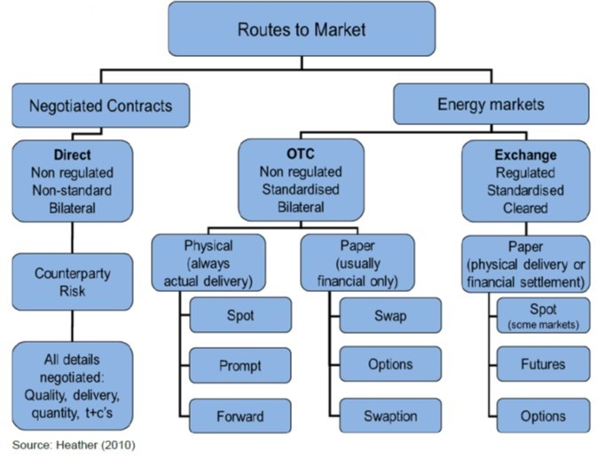
Forms of Gas Trading

Slide 57
Comparison Electricity – Gas
Electricity Market
Transmission system operator (TSO)
Balance group coordinator
Distribution system operator (DSO)
Control area
BG per control area
Balance Responsible Party (BRP)
SLP and RLM customers
Symmetrical imbalance price
Gas Market
Transmission system operator (TSO)
Market area coordinator (NCG, Gaspool)
Regional and local system operators (DSO)
Market area / Virtual trading point
BG per market area
Balance Responsible Party (BRP)
SLP and RLM customers
Positive and negative imbalance price

Slide 58
Structure of the Value Chain
© Prof. Dr. Georg Erdmann

Slide 59
Companies Along the Value Chain
© Prof. Dr. Georg Erdmann

Slide 60
Incumbent’s standard gas offers for households in EU capitals – Nov/December 2018 [%]
Source: ACER/CEER, 2018

Slide 61
Pass-through in gas retail market at EU level
Responsiveness of the energy component of the retail prices to changes in wholesale prices and evaluation of mark-ups in the household segments from 2012 to 2018
Source: ACER, 2018

