Slide 1

Integrated course „Energy Economics“
- Oil Markets
Prof. Dr. Boris Heinz | Dr. Elena Timofeeva
Department for Energy Systems

Slide 2
Outline
Introduction: Role of oil
History and market structure
Oil wholesale markets

Slide 3
Introduction
Crude oil has been the world‘s most important energy source.
Two concerns:
Exhaustible reserves
Carbon emissions

Slide 4
Oil in World’s Total Primary Energy Supply
Source: BP (2019)
Notes:
Crude oil has been the world’s most important energy souce. Global demand for it has been rising steadily.

Slide 5
IEA Scenarios: Global End-User Energy Spending by Fuel
Source: IEA World Energy Outlook 2018

Slide 6
Global Oil Demand and Prices Projections
Source: IEA World Energy Outlook 2018

Slide 7
Need for New Investments
Source: IEA World Energy Outlook 2018
Notes:
As new investments are required, we will look at what is driving the oil industry. Also, we will look at interplays with other commodities to understand how oil markets influence future development of the energy sector.

Slide 8
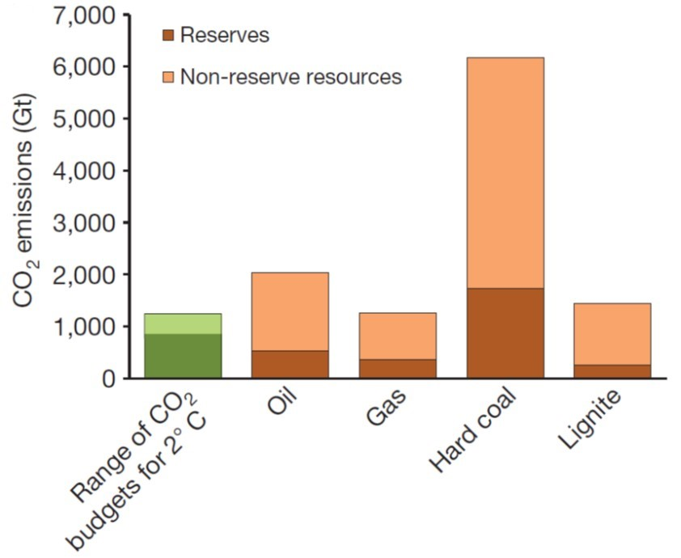

CO₂ Emissions from Oil Combustion
McGlade and Ekins (2015):
Globally,
1/3 of oil reserves,
1/2 of gas reserves, and
80% of coal reserves
should remain in the ground
to meet the 2° target.
1.294 bln barrels
192 trillion m³
728 Gt
276 Gt
870-1240 Gt
Source: McGlade and Ekins (2015)
Notes:
As new investments are required, we will look at what is driving the oil industry. Also, we will look at interplays with other commodities to understand how oil markets influence future development of the energy sector.

Slide 9
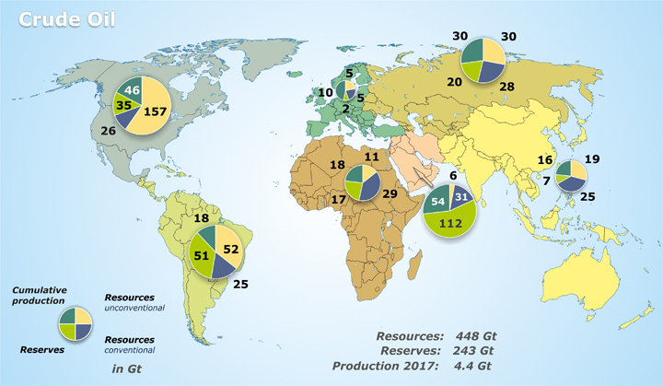

Total Crude Oil Potential 2017
Source: BGR

Slide 10
Distribution of Oil Reserves in 1998, 2008 and 2018
Source: BP Statistical Review of World Energy 2019

Slide 11
Oil Production and Consumption by Region
Source: BP (2019)

Slide 12
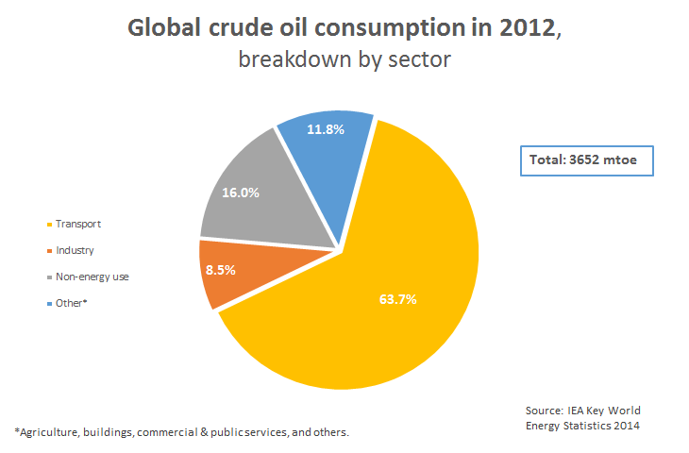
Oil Consumption by Sector

Slide 13

Global Oil Demand by Sector
New Policies Scenario
Source: IEA World Energy Outlook 2018

Slide 14
Transformations of the Oil Industry
© Prof. Dr. Georg Erdmann

Slide 15
Mergers in the Oil Industry 1998-2002
© Prof. Dr. Georg Erdmann

Slide 16
Transformations of the Oil Industry
© Prof. Dr. Georg Erdmann

Slide 17
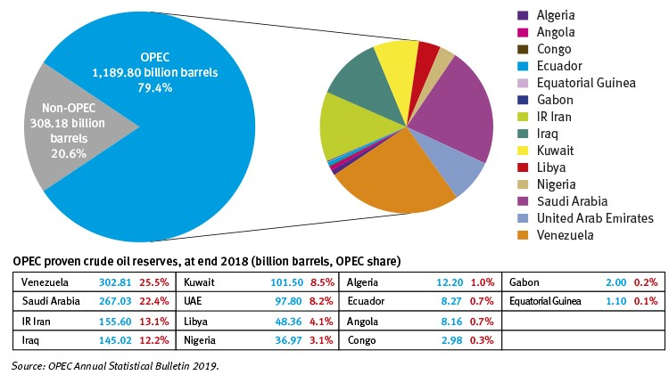
OPEC Share of World Crude Oil Reserves, 2018

Slide 18
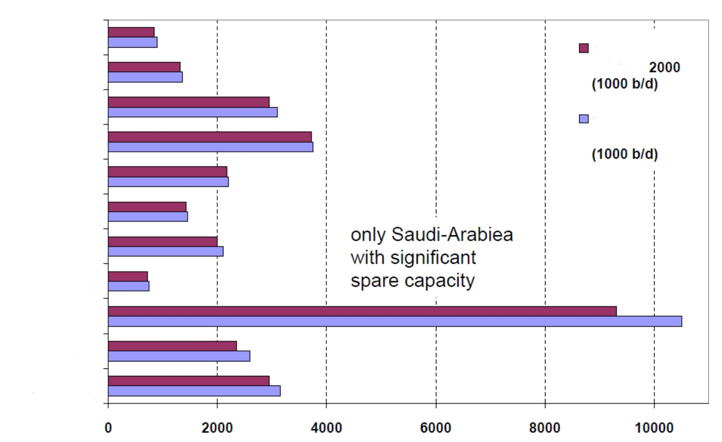
Organisation of Petrol Exporting Countries OPEC
[Source: CGES June 2006]
Algeria
Production
Q4
Indonesia
Iraq
Production capacity
Iran
Kuwait
Libya
Nigeria
Qatar
Saudi Arabia
UAR
Venezuela
© Prof. Dr. Georg Erdmann

Slide 19
Oil Export Revenues of OPEC Countries
[Source: from DOE]
© Prof. Dr. Georg Erdmann

Slide 20
Crude oil price and OPEC market share
Zweifel/Praktiknjo/Erdmann (2017) with reference to BP

Slide 21
Cartels
© Prof. Dr. Georg Erdmann

Slide 22
Oil Price Development
Brent Dated 1970-2010 and main historical events
Source: Carollo (2012)
Notes:
Extraction of unconventional oil is more costly and may gain importance in the future.

Slide 23
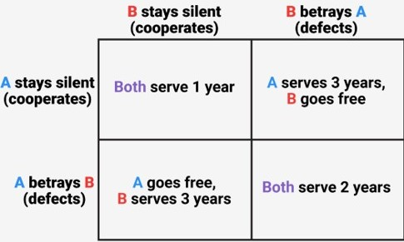
The Prisoner‘s Dilemma

Slide 24

Stability of Cartels and the Prisoner‘s Dilemma
Saudi Arabia and the rest of OPEC each extract 10 mio bbl/day.
Price under cooperation: 60 USD/bbl
Price without cooperation: 40 USD/bbl
At 50 USD/bbl, each party can take over 50% of the other party’s share.
Strategy of Saudi-Arabia | Strategy of other OPEC countries
 | Cooperative |  | Non cooperative
 | Saudi-Arabia [USD/day] | Other OPEC [USD/day] | Saudi-Arabia [USD/day] | Other OPEC [USD/day]
Cooperative | 600 mio | 600 mio | 300 mio | 750 mio
Non cooperative | 750 mio | 300 mio | 400 mio | 400 mio
Source: Zweifel / Praktiknjo / Erdmann (2017)
Notes:
1200 vs 800

Slide 25
Introduction into Game Theory
Two companies have the choice to sell their product for a price of either p=1, 2 or 3 EURO. The company that offers their product for a lower price will have a higher sales quantity compared to its competitor.
Profit Matrix Company I ; Company II
 | p_{II}=1 | p_{II}=2 | p_{II}=3
p_{I}=1 | 0; 0 | 50; -10 | 40; -20
p_{I}=2 | -10; 50 | 20; 20 | 90; 10
p_{I}=3 | -20; 40 | 10; 90 | 50; 50
The sum of the profits vary and can be either
100, 40, 20 or 0 in total.
© Prof. Dr. Georg Erdmann

Slide 26
Game Theoretical Terms
The Maximising Strategy (maximize the minimal profit):
In the previous example for p=1.
Should a player choose the strategy with the highest profit and this strategy remains the same under all circumstances, this strategy will be called dominant strategy. If there is a dominant strategy for every player, there is a dominant strategy equilibrium: If company II choses a price p_{II}=3, the other company should choose a price of p=2, in all other cases p=1. There is therefore no dominant strategy equilibrium in this example.
Nash equilibrium: Situation where no player can improve his position through a change in strategies if the other player stays with his strategy. p_{I} = 3 is not a Nash equilibrium. Both could profit by choosing a lower price if the other player stays with his choice. Only p_{I}=1; p_{II}=1 is a Nash equilibrium.
© Prof. Dr. Georg Erdmann

Slide 27
Transformations in the Oil Industry (III)
Vertical monopoly
Vertical oligopoly of the „7 sisters“
OPEC cartel
Oligopoly of national oil companies
  Azerbaijan (1924), Mexico (1938), Rumania (1948), Iran (1951-1953), Indonesia (1960), Algeria (1970), Libya (1971), Iraq (1972), Iran (1973), Venezuela (1975-1990), Kuwait (1975), Saudi-Arabia (1980), Venezuela (2004), Russia (2004), Bolivia (2006)
pro | con
Bargaining Power Souvereignity Justice („resource rent should be owned by the people“) | Lack of economic efficiency Taxes and tariffs instead of NOC returns Counteractions of import countries

Slide 28
Oil Sources
Conventional oil
Unconventional oil
Heavy crude oil
Oil sands
Bitumen
Tar sands
Shale oil (tight oil)
Notes:
Extraction of unconventional oil is more costly and may gain importance in the future. E.g. oil sands have to be heated and refined to crude oil (before further processing) – while already their extraction costs are significantly higher than those of conventional oil.

Slide 29
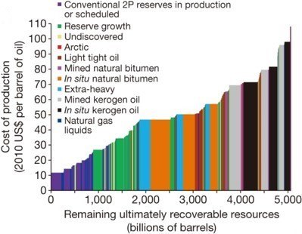
Cost of Production by Oil Source
Source: McGlade and Ekins (2015)
Notes:
Supply cost curve – cost of production depends on the deposit’s nature.
2P = proved plus probable

Slide 30
Cost of Production by Country
Source: Zweifel / Praktiknjo / Erdmann (2017) with reference to Oil Industry Trends
Notes:
Extraction of unconventional oil is more costly and may gain importance in the future. E.g. oil sands have to be heated and refined to crude oil (before further processing) – while already their extraction costs are significantly higher than those of conventional oil.

Slide 31
Crude Oil Specifications
Crude oil is a heterogeneous commodity.
density / viscosity:
light oil has low density
heavy oil has high density (large portion of low-value products to be removed through processing)
sulfur content:
sweet oil has low sulfur content
sour oil has high sulfur content (>0,5%)
  (Price spread on different markets depend on local environmental regulations.
  IMO limits sulfur content in marine fuels to max. 0,5% since 2020.)
Notes:
Sulfur causes adverse health effects and corrosion.

Slide 32

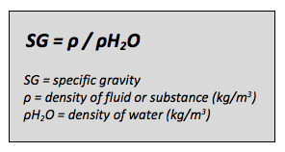
Properties of Crude Oil Varieties
Source: American Petroleum Institute API
Notes:
t/m3 is the measure of density
Viscosity is affected by oil composition, temperature, pressure and dissolved gas.

Slide 33
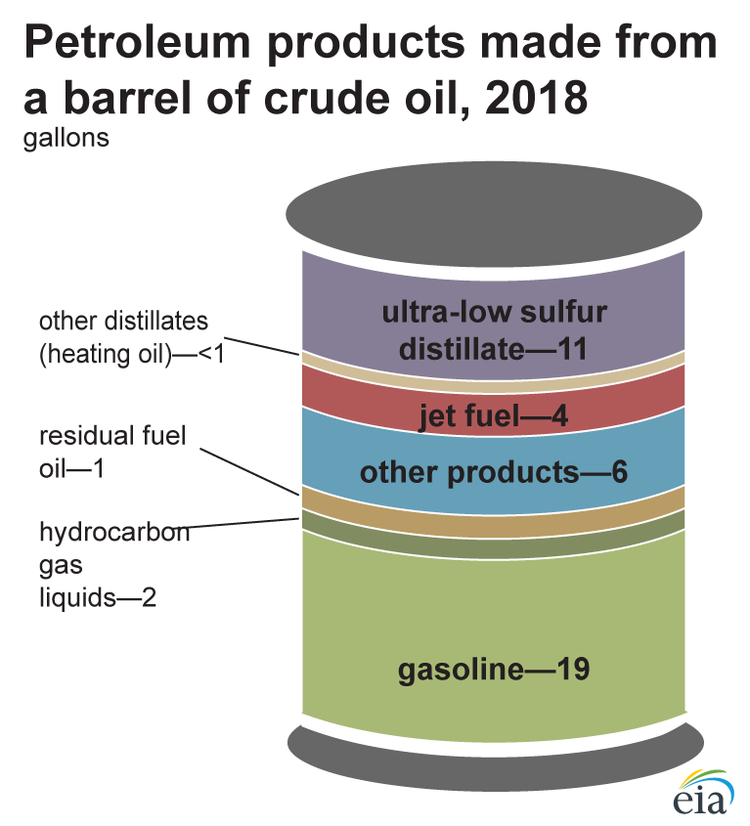
Petroleum Products
Refining: crude oil is separated into oil products through distillation.
Note: A 42-gallon (U.S.) barrel crude oil yields about 45 gallons of petroleum products because of refinery precessing gain. The sum of the product amounts in the image may not equal 45 because of independent rounding.
Source: U.S. Energy Information Administration, Petroleum Supply Monthly, April 2019, preliminary data
Notes:
Extraction of unconventional oil is more costly and may gain importance in the future.

Slide 34
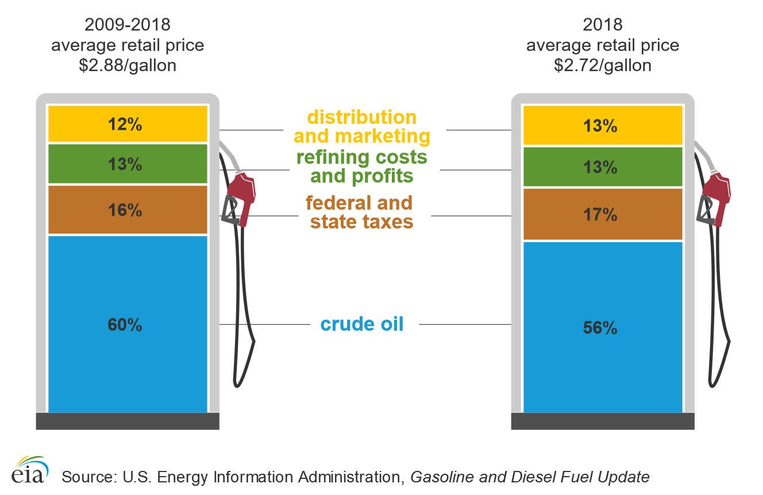
Gasoline Price Structure
Notes:
Crude oil is the major component (also most subject to fluctuation).

Slide 35
Crude Oil Product Types
Light distillates: liquefied petroleum gases (LPG), naphtha, gasoline
Middle distillates: kerosine, gaspol or heating oil, diesel
Fuel oil
Others: e.g. lubricating oils, paraffin wax, petroleum coke, bitumen
Notes:
Sulfur causes adverse health effects and corrosion.

Slide 36


Oil Market
Market participants:
Producers
Refiners
Marketers
Retailer*
Consumers
Gasoline
Diesel
Jet fuel
Fuel oil
Chemical feedstock
Lubricants
Source: Carollo (2012)
* oil products

Slide 37
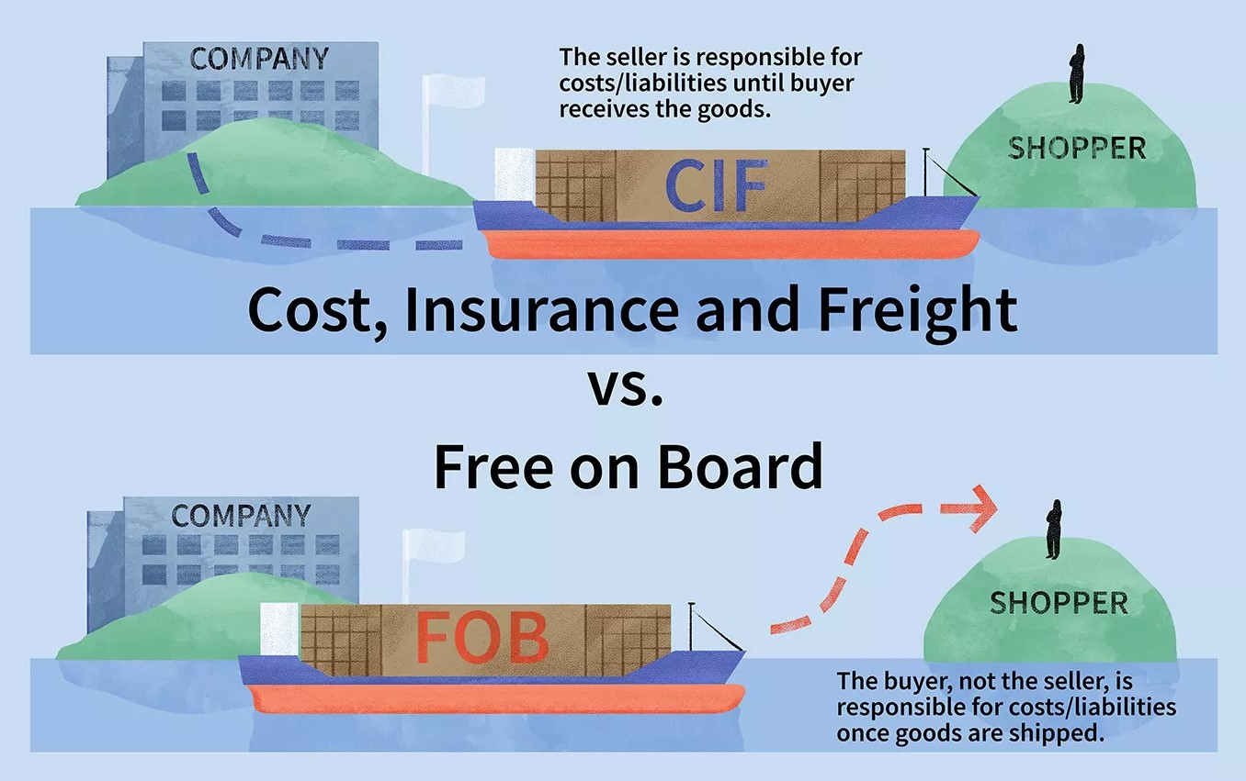
Incoterms: FOB vs CIS
The geographical location of oil influences its value.
© Melissa Ling, Investopedia
Notes:
Tasks, costs and risks associated with international delivery of goods.

Slide 38
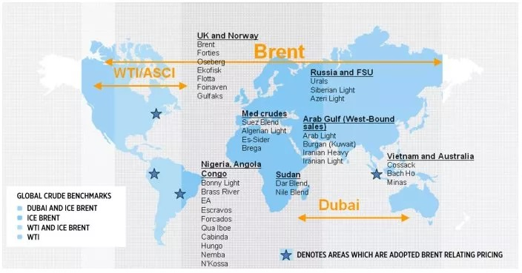


Crude Oil Benchmarks
Source: IntercontinentalExchange (ICE)

Slide 39
Crude Oil Benchmarks
West Texas Intermediate
- light (39,6° API)
- sweet (0,24%)
* WTI Cushing: delivered in Cushing, Oklahoma
(inland pipeline &
refining hub)
* Permian WTI: delivered at Magellan East Houston terminal (incl. for export)
North Sea: BFOE
- light (38° API)
- sweet (0,37%)
- Platts: FOB Sullom Voe terminal or CIF Rotterdam
Persian Gulf
- medium heavy (31° API); sour (2%)
- Platts: FOB Fateh terminal (Dubai, UAE)
Source: IntercontinentalExchange (ICE)

Slide 40
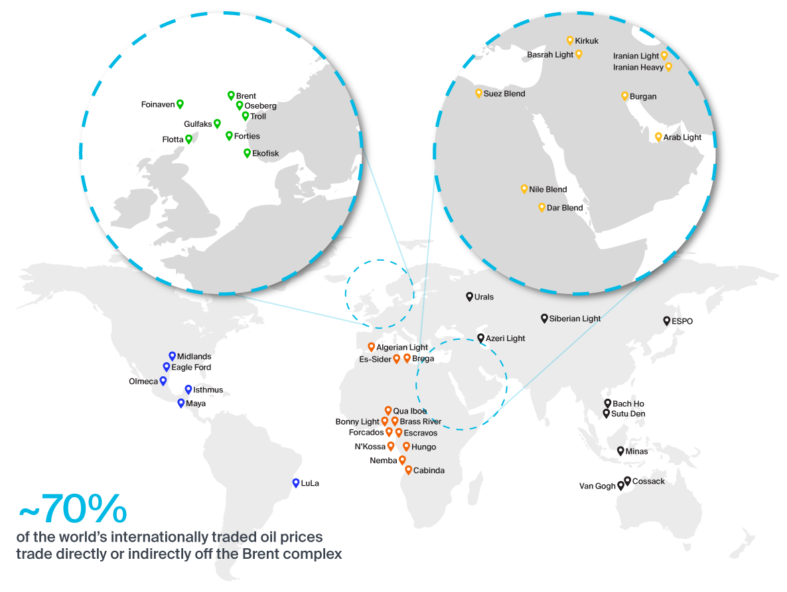
Brent-related Crudes
Source: IntercontinentalExchange (ICE)

Slide 41
Oil Futures and Physical Prices
Source: Trafigura

Slide 42
Oil Industry 2003 [Source: www.energyintel.com]
© Prof. Dr. Georg Erdmann

