Slide 1
Integrated course „Energy Economics“
- Electricity Grid -
Chair of Energy Systems | Department of Energy Systems
Technische Universität Berlin

Slide 2
Outline
Electricity grid (continued)
  Congestion management
  Grid access
  Grid tariff regulation
  Security of supply
Retail markets

Slide 3
Congestion management
Congestion management relieves expected grid bottlenecks due to limited transmission capacity by correcting (cost-based) power plant dispatch decisions.
Countertrading
TSO counter-trades against the flow of congestion between bidding zones.
Redispatch
ramping up certain power plants while ramping down certain other power plants
Feed-in management (Einsman)
ramping down renewable power plants
Grid reserve
power plants kept available for service but not operational
against remuneration

Slide 4
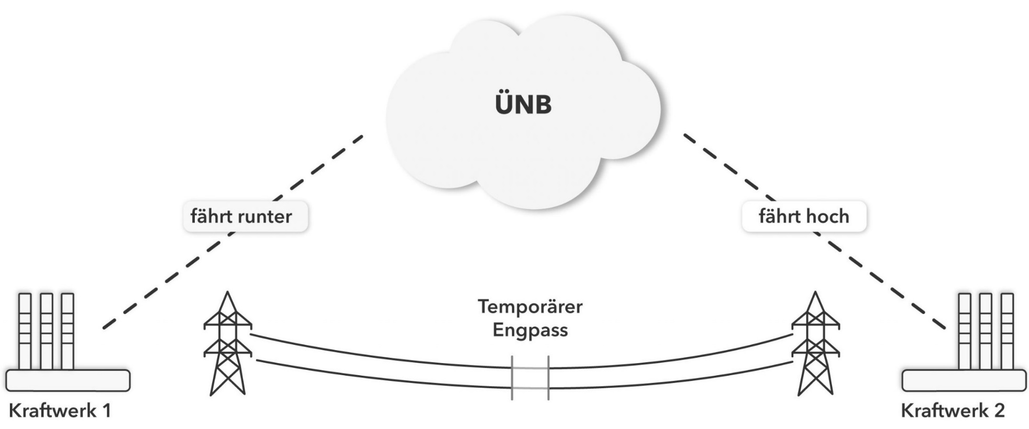
Redispatch: example
TSO
ramps up
ramps down
Temporary
grid bottleneck
Power plant 1
Power plant 2
Source: Next Kraftwerke

Slide 5
Rising redispatch cost 2010-2018
© NODES, E-Bridge and Pöyry
Source: BNetzA

Slide 6
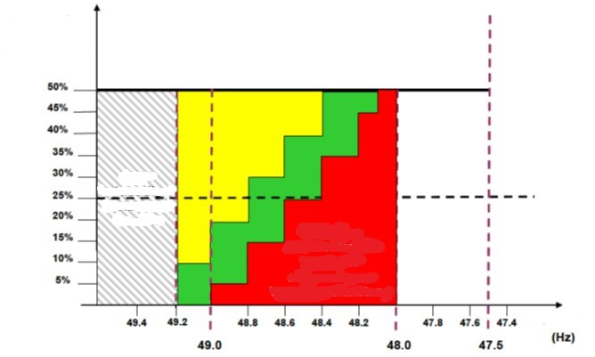
Automatic frequency control
Automatic low frequency demand disconnection scheme
Load to be diconnected
Disconnecting load is not required at this level.
Minimum required % of load to be disconnected
Frequency
Source: VNN VDE

Slide 7
Grid restoration
Grid operator coordinates grid restoration after a black-out by step-by-step activation of generation units and matching (appropriate) loads.
Blackstart capability: while most power plants require electricity to get running after a black-out, certain generation units are able to start operation when disconnected from the grid.
Associated costs for blackstart capability provider:
Maintenance
Regular tests
Personnel and training
Documentation

Slide 8
Access to electrical grids
Grid operation is a natural monopoly, as network infrastructure is prohibitively costly to replicate.
As any monopoly, it is prone to eliminating newcomers (potential competition for affiliated generation/retail unit) by overcharging or denying technical feasibility.
Non-discrimination
Transparency
Cost recovery
Cost reflectiveness
Grid is an essential facility.
→ non-discriminatory third-party access
Source: Lévêque, 2010
Notes:
Economies of scale: single firm can transport any amount of electricity at least cost.

Slide 9
Electrical grid as a natural monopoly
Source: Zweifel / Erdmann / Praktiknjo, 2017
Notes:
Average cost declines with rising quantity.
Downward sloping demand function (vs. price-taker under perfect competition)
Average revenue = price
Marginal revenue is always less than the price.
Increased amount tends to increase total revenue; the lower price tends to decrease total revenue.
Marginal revenue curve lies below demand curve.
Profit maximisation: Quantity at which marginal revenue equals marginal cost. Price corresponding to that quantity on the demand curve.

Slide 10
Grid tariff regulation: Regulation approaches
Regulation approach
Cost-based
Incentive-based
Cost-plus:
a pre-defined profit margin is added to the costs
Rate-of-return:
a pre-defined rate of return on the regulatory asset base is guaranteed.
RAB is determined by amount of invested capital and cost of capital.
Price cap:
max. prices (per unit) are determined for the regulatory period
Revenue cap:
if higher profit realised within allowed revenues, the regulated entity keeps it.
Quality regulation: indicators for service quality and reliability
Notes:
Water wheel converts kinetic energy of water is converted into mechanical movement.

Slide 11
Averch-Johnson effect (1)
© Prof. Dr. Georg Erdmann
Notes:
Principle-agent problem

Slide 12
Averch-Johnson effect (2)
© Prof. Dr. Georg Erdmann

Slide 13
Incentive regulation in Germany
5-year regulatory period (current period 2019-2024)
Revenue that TSO/DSO is allowed to earn is fixed for the regulatory period at a level.
Revenue cap: total cost + depreciation + return on equity
Investment costs into grid extension are allowed above cap.
Costs:
permanently non-controllable
temporarily non-controllable
controllable
volatile
Efficiency benchmarking – based on cost examination and structural data validation of individual TSO/DSO
The most efficient entity serves as benchmark.

Slide 14
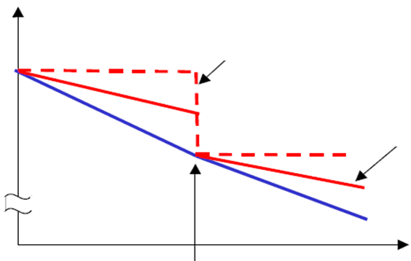
Incentive Regulation
Revenue
costs
Revenue without anticipated cost reductions
Revenue with anticipated cost reductions
Tariff
regulation
Time
© Prof. Dr. Georg Erdmann

Slide 15
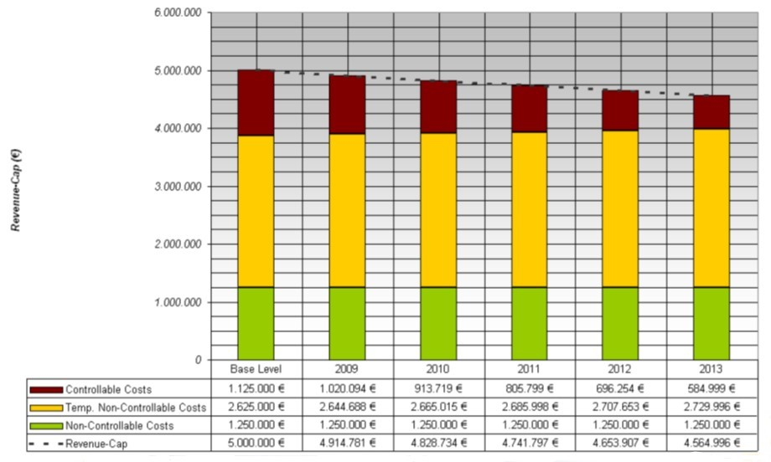
Incentive Regulation in Germany (cont.)
Source: CEER/BNetzA (2014)

Slide 16
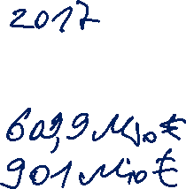
Composition of grid tariffs
O&M
Grid extension
Control power (capacity component)
Feed-in management (Einsman)
Redispatch
Grid reserve
Capacity reserve
Security reserve (coal/climate reserve)
Reactive power
Grid losses
Other

Slide 17
Cost allocation of control power
© Prof. Dr. Georg Erdmann

Slide 18
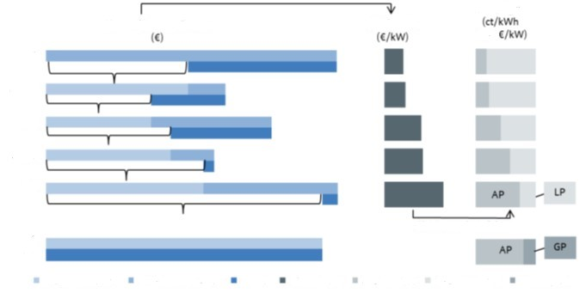
Grid tariffs structure
Starting point
divided by annual Pmax (kW)
Grid tariffs
Cost/revenues of grid level
Total annual cost
HV
HV/MV
MV
MV/LV
LV
LV without power measuring
simultaneity factor
transferred cost
own cost of
Grid level
total annual cost (€/kW)
energy
price (AP)
power
price (LP)
basis
price (BP) (household consumers)
revenues
Starting from the highest voltage level, part of the grid costs (based on that level’s aggregated annual consumption peak – Pmax) are paid by grid users connected to that grid level. The residue is transferred to the next voltage level and distributed after the same logic – etc.
Source: BNetzA, 2015
Notes:
Grid tariffs are determined top-down for each grid level.

Slide 19
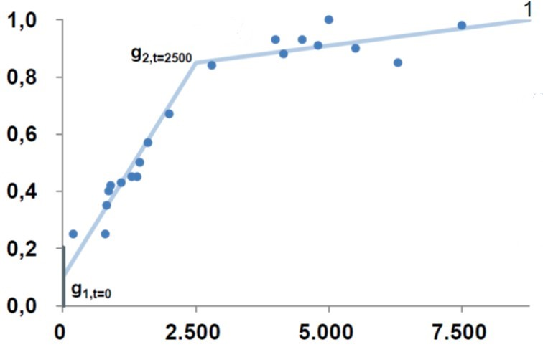
Simultaneity (diversity) function
Grid users with low FLH pay lower power price (PP) and higher energy price (EP)
Grid users with high FLH pay higher PP and lower EP
FLH | PP [€/kW*a] | EP [ct/kWh]
< 2.500 | a | x
> 2.500 | b | y
Annual grid fee:
EP * annual consumption + PP * Pmax
Pmax: annual peak load
Source: BNetzA, 2015

Slide 20
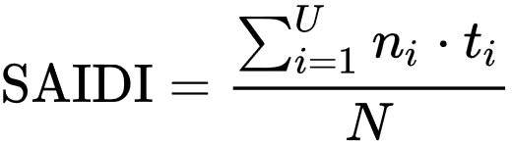
Security of supply indicators
ENS – Energy Not Served – amount of demand not served
LLD – Loss of Load Duration – number of hours of ENS
LOLE – Loss of Load Expectation
SAIDI – System Average Interruption Duration Index
SAIFI – System Average Interruption Frequency Index
MAIFI – Momentary Average Interruption Frequency Index
ENTSO-E Mid-term adequacy forecast
n_{i} : no. of customers affected by interruption i
t_{i} : duration of interruption i [min]
N : no. of customers
U : no. of interruptions
Notes:
Unplanned interruptions

Slide 21
SAIDI – System Average Interruption Index
Unplanned SAIDI, including exceptional events (minutes per customer)
(2002 or later – 2016)
Source: CEER, 2018

Slide 22
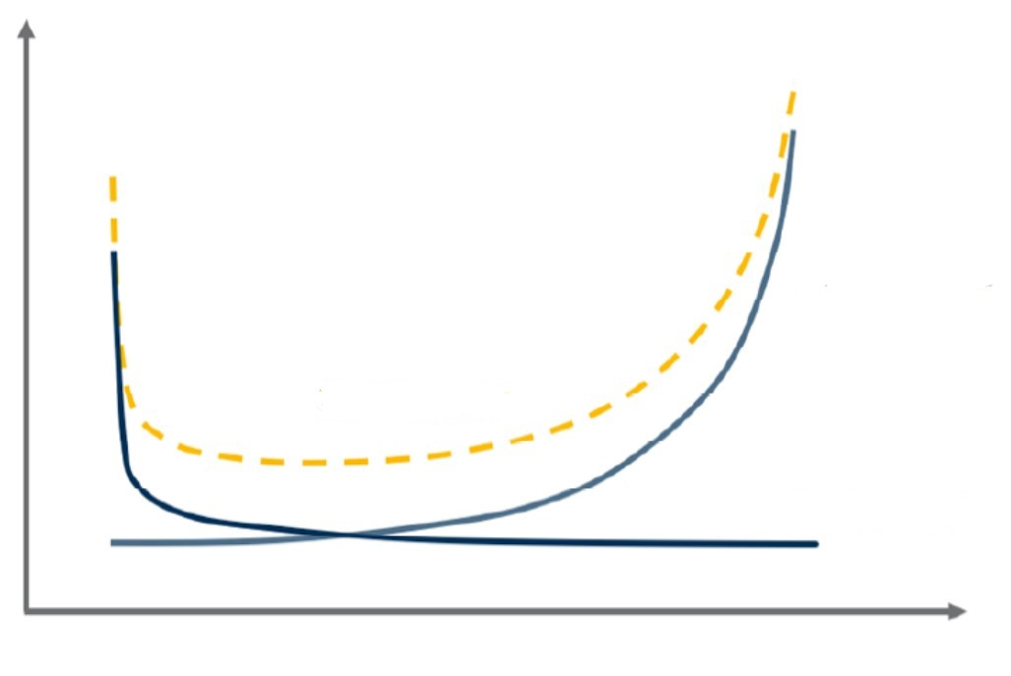
Security of supply indicators
Cost
Grid cost
Total cost
Value of lost load (VoLL)
Quality
Source: E-Bridge, ZEW & FGH (2020)
Notes:
Unplanned interruptions

Slide 23
Recap: Electricity market structure types
Single buyer
Power pool
Free wholesale competition
Fully liberalised market with retail competition

Slide 24
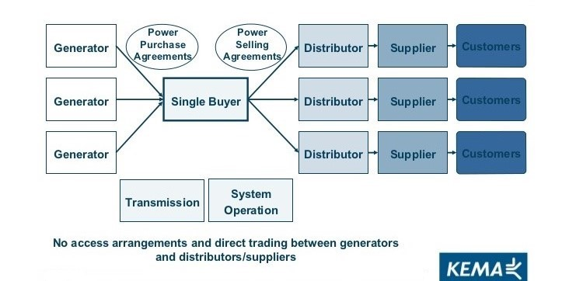
Electricity market structures: Single buyer

Slide 25
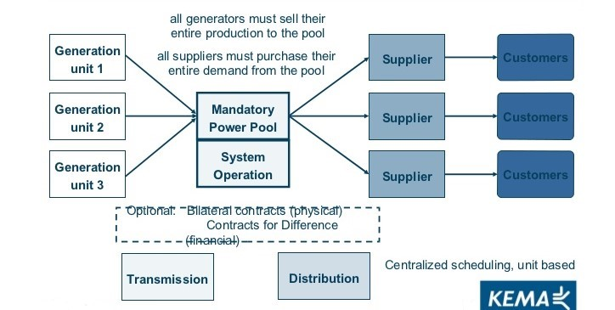
Electricity market structures: Power pool

Slide 26
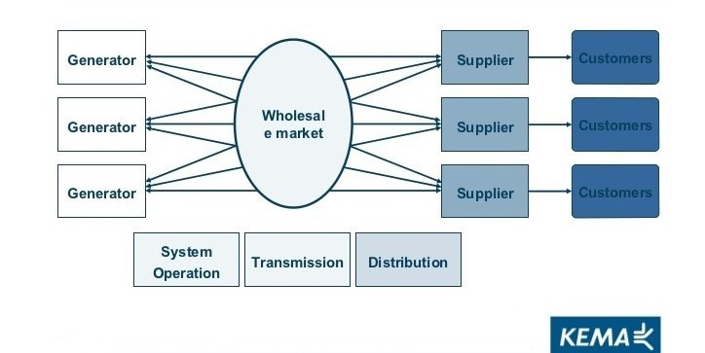
Electricity market structures: Wholesale competition

Slide 27
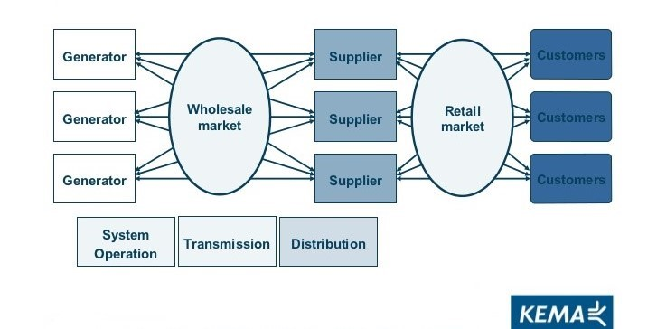
Electricity market structures: Retail competition

Slide 28
Electricity retail under different market structures
Single buyer → regulated retail prices
Power pool → regulated retail prices;
Free wholesale competition
Fully liberalised market → retail competition
                unregulated retail prices
large consumers may be eligible to participate in the wholesale market

Slide 29
Retail competition
The ultimate rationale of liberalisation/restructuring of the electricity sector is the prospect of lower prices for electricity consumers achievable through competition.
The option for final customer to switch supplier creates a competitive pressure for market players along the electricity supply chain.

Slide 30
Categories of suppliers in the German market
Large vertically integrated utilities: E.ON, RWE, Vattenfall, EnBW
Municipal utilities
Retailers with mixed ownership structure
Small independent retailers
Electricity retail markets are regional: distribution network level.
Default supplier is the designated supplier obliged to supply any customer in their supply area (in Germany: the entity supplying the largest number of grid connection points).
Apart from the baseline contract, the default supplier can offer alternative tariffs.

Slide 31
Categories of final customers
Industrial
Commercial
Residential
Household customers: up to 10.000 kWh yearly consumption
  residential & small commercial
  standard load profile (SLP) - approximation
Non-household customers: all other
  commercial (> 10.000 kWh yearly consumption) & industrial
  registered load profile measurement (RLM): >100 GWh p.a.

Slide 32
Contractual set-up for electricity consumer
Contract with supplier
  Types:
    default supply
    alternative tariff with default supplier
    alternative supplier
  Typically, supplier has BRP role.
Contract with the grid operator (Network contract)
  Grid tariffs
  Metering and metering charges
Network connection contract – technical connection to the grid.
Metering responsibility:
by default – grid operator
by opt-in – independent metering company

Slide 33

Supplier structure: Industrial and household customers
Household customers
RLM customers
Contract with alternative supplier
37,10 TWh
31,0%
Baseline
contract with default supplier
33,20 TWh
27,8%
Contract with alternative supplier
189 TWh
72%
Baseline
contract with default supplier
0,7 TWh
< 1%
Alternative tariff with default supplier
72 TWh
27%
Alternative tariff with default supplier
49,30 TWh
41,2%
Source: BNetzA, 2018

Slide 34
Retail price composition: Household customers
Average composition of electricity price for a German household with an annual consumption of 3.500 kWh (2019)
Average price:
30,43 ct/kWh
Taxes and levies
State-induced
Grid tariffs
(incl. metering)
Regulated
Electricity
procurement,
retail
Market-based
Source: BDEW, 2019

Slide 35
Retail price composition: Household customers
Average composition of electricity price for a German household with an annual consumption of 3.500 kWh (2019)
Interruptible load levy (AbLaV)
Offshore levy
Levy to compensate reduced grid tariffs for certain grid users (§19 StromNEV)
CHP levy (KWK)
Green levy (EEG)
Electricity tax
Concession levy
VAT 19%
Taxes and levies
15,98 ct/kWh
Grid tariffs
(incl. metering)
7,39 ct/kWh
Electricity
procurement,
retail
7,06 ct/kWh
Source: BDEW, 2019

Slide 36
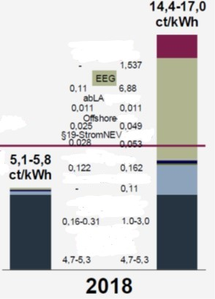
Retail price composition: Industrial consumers
Range of electricity prices for large industrial consumers with an annual consumption of 100 GWh/a:
Max. available cost relief vs. No cost relief
El. tax
Average price 2018:
8,96 ct/kWh
Source: Eurostat
KWK
Concession levy
Grid tariff
Procureme
nt, retail
Source: BDEW, 2019
(with reference to Eurostat)

Slide 37
Retail competition
% of grid areas with given number of suppliers:
In almost all grid areas the number of operating suppliers is more than 20.
In approx. 90% of grid areas more than 50 suppliers are operating.
1 – 20 suppliers
21 – 50 suppliers
51 – 100 suppliers
> 100 suppliers
Source: BDEW, 2019 (after BNetzA, 2018)

Slide 38
Supplier switching among household customers
%
household customers
Cumulated switching rate since liberalisation
Mio households
Souce: BDEW, 2019

Slide 39
Retail competition: Pass-through rate
Pass-through rate is the percentage to which an electricity retailer passes on a change in their cost to their customers/ electricity consumers.

Slide 40
Retail market: Pass-through rate
Incumbents in regional retail markets in Germany in 2010
Source: Duso / Szücs, 2017

Slide 41
Retail market: Heterogeneity in baseline tariffs
Baseline tariff in € per MWh at 2800 kWh yearly consumption
Source: Duso / Szücs, 2017

Slide 42
Retail market: Within-network price dispersion (2010)
Difference between baseline and best-available tariff in € per MWh at 2800 kWh yearly consumption
Source: Duso / Szücs, 2017

Slide 43
Pass-through rate in the German retail market
Duso and Szücs / European Economic Review 98 (2017) 354-372
Summarised findings:
Supplier and customer types
Pass-through rate to baseline tariffs is quite similar across firms.
Pass-through rate to competitive tariffs is 12-23% higher for independent suppliers.
Thus, the pass-through rate depends on the customer segment, rather than supplier segment.
Time differentiation
Pass-through rates to baseline tariffs remain stable over time.
Pass-through rate to the best available tariff increases to almost unity.
Ability to switch supplier is the main driving factor for pass-through.

