Slide 1
Integrated course „Energy Economics“
- Electricity Grid -
Chair of Energy Systems | Department of Energy Systems
Technische Universität Berlin

Slide 2
Continued: Investment into generation capacities

Slide 3
Annual Price Duration Curve
Erdmann / Praktiknjo / Zweifel (2017)

Slide 4
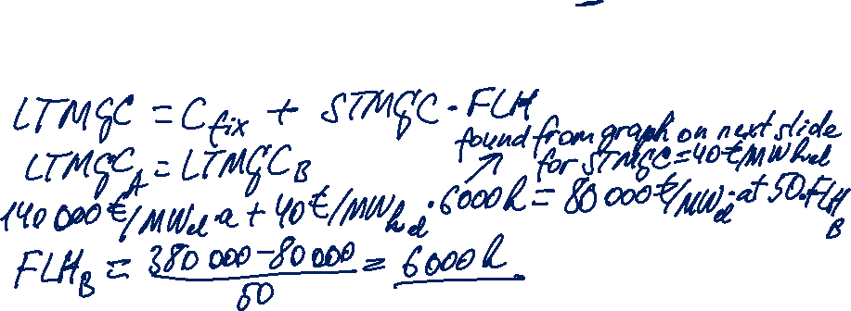
Task 1
Anwer the questions regarding the economics of technologies A and B based on the following techno-economic power plant data:
a) Up to which number of full load hours is technology B cheaper than technology A?

Slide 5

Task 1

Slide 6
Task 1
b) You sell electricity from power plant A on spot market which is characterised by a given price duration curve. Your generation unit has a rated capacity of 600 MW.
Calculate the power plant’s:
annual fixed costs in Euro
annual variable costs in Euro
annual contribution margin in Euro
annual profit in Euro

Slide 7

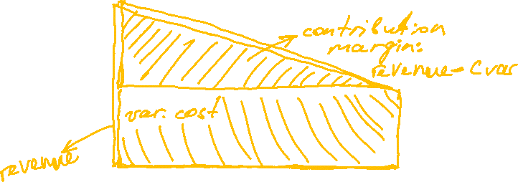

Task 1

Slide 8
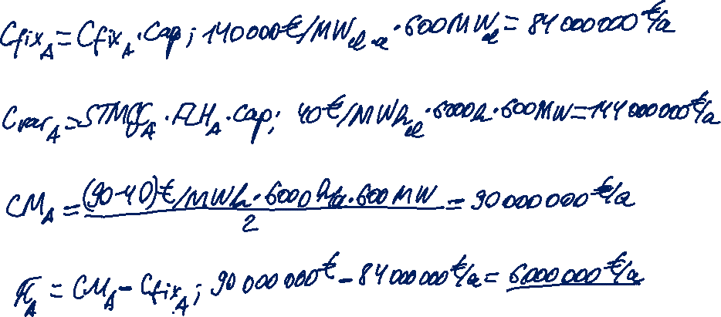
Task 1
annual fixed costs in Euro
annual variable costs in Euro
annual contribution margin in Euro
annual profit in Euro

Slide 9
Spark spread
Spark spread is the gross margin of a gas-fired power plant from selling a unit of electricity, having bought the fuel required to produce this unit of electricity. (peak load electricity future – gas future, corrected by power plant efficiency)
Clean spark spread is the gross margin after substracting the cost of CO₂ emissions.
Hedging: Buying gas and emission allowances on forward markets

Slide 10
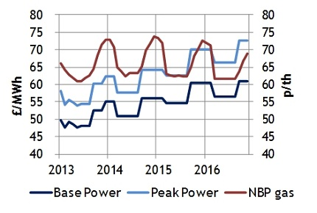
UK Base and Peak power and NBP gas curves
Source: ICE monthly futures

Slide 11
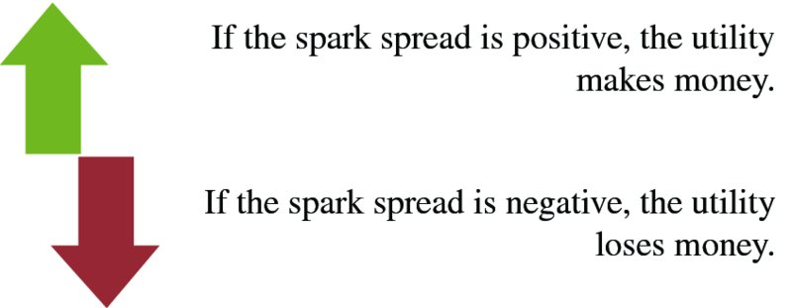
Spark spread (continued)
Source: Mack, Energy trading and risk management, 2014

Slide 12
Spark spread (continued)
Price of gas
Spark spread = Price of electricity –
Efficiency factor
Spark spread > 0: It is more economical to buy gas
Spark spread < 0: It is more economical to buy power from the grid
  Underlying assumptions:
  no transaction costs
  no electricity transmission costs (where relevant)
  no gas transportation costs
  no start costs (cost of starting the power plant)
Source: Mack, Energy trading and risk management, 2014

Slide 13
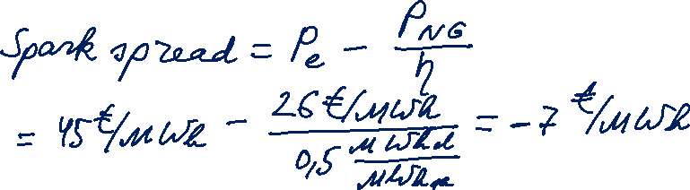
Task 2
Calculate the spark spread, given that:
  Price of natural gas = 26 €/MWh
  Price of electricity = 45 €/MWh
  Natural gas-fired power plant with
  Efficiency factor = 50%

Slide 14
Spark spread
Dark spread is the gross margin of a coal-fired power plant from selling a unit of electricity, having bought the fuel required to produce this unit of electricity.
Base load electricity future – coal future, corrected by the power plant efficiency factor
Clean dark spread is the gross margin after substracting cost of CO₂ emissions.
Hedging: Buying coal and emission allowances on forward markets

Slide 15
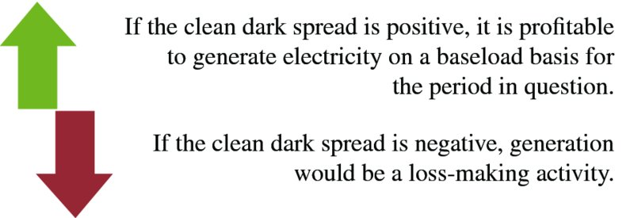
Spark spread (continued)
Source: Mack, Energy trading and risk management, 2014

Slide 16
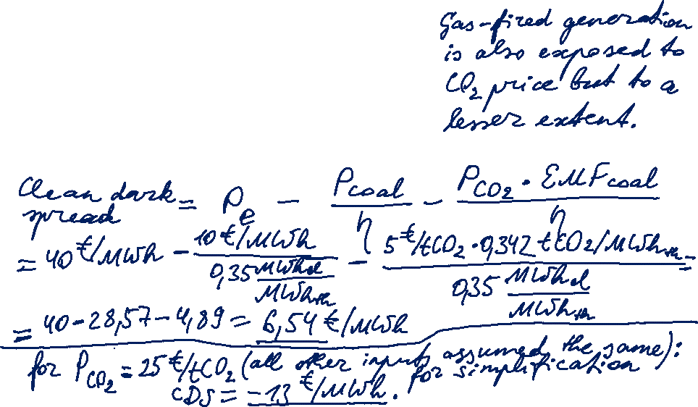
Task 3
Calculate the clean dark spread, given that:
  Price of coal = 10 €/MWh
  Price of electricity = 40 €/MWh
  Natural gas-fired power plant with
  Efficiency factor = 35%
  CO₂ emission factor = 0,342 tCO₂/MWh_{th}
  CO₂ price = 5 €/tCO₂

Slide 17
Load Curve and Load Duration Curve
P[MW]
P[MW]
Load Curve
Load Duration Curve
1
1
P_{max}
2
2+3
3
4
4
P_{min}
Time of day
Cumulative hours

Slide 18
Levelised cost of electricity (LCOE)
lifetime costs divided by
lifetime electricity output
Lifetime costs: PV of total cost of building and operating
LCOE allows comparison of technologies regardless of lifetime, installed capacity, cost of capital, risk and return.
initial capital cost*
* specific investment costs: investment costs divided by capacity
annual operating expenses
capacity factor
discount rate
operational life
Notes:
LCOE is the present value of the revenue from produced electricity over the economic life of the plant and the costs incurred in the construction, operation and maintenance, and the fuel costs.

Slide 19

Levelised cost of electricity (LCOE)
How to calculate the generation costs per unit of electricity?
I₀ ∙ CRF_{i, t}
LCOE = + oc
Q
E_{t} = Cap * FLH
  E_{t} annual electricity output
  Cap installed capacity (rated power)
  FLH full load hours: annual output divided by Cap
E_{t} [kWh]
Capacity factor =
Cap [kW] * 8.760h
Notes:
Generation costs of wind depend on lifetime, interest rate, investment and operation costs and full load hours.

Slide 20
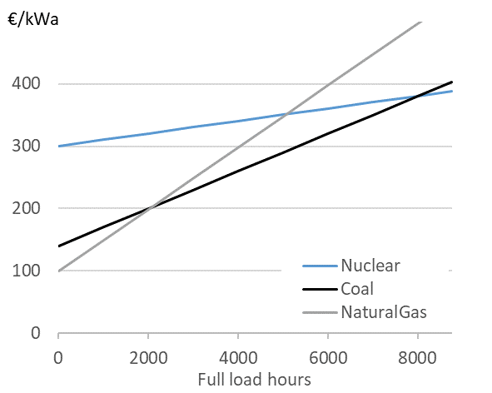
Screening Curves
Total cost p. a.
per unit of capacity
Hirth & Steckel (2016)

Slide 21
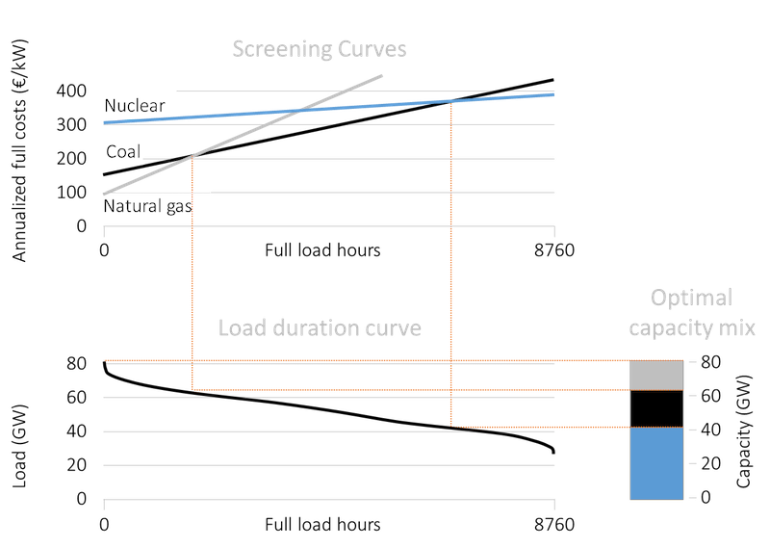
Cost-optimal mix of thermal technologies
Source: OEE

Slide 22
Power plants in the merit order
Power plant types based on their place in merit order:
Power plant type | FLH [h/a] | Operation features | Technologies
Baseload | > 7.000 | continuous | lignite
Intermedium load | 4.500 – 5.500 | during peak hours (wd 8-8) | hard coal
Peak load | < 1.250 | at times of peak demand | pumped-storage hydro, gas
Reserve |  | during power plant shut-downs | old power plants
Source: Konstantin, 2017

Slide 23
Merit Order: Future trends
FLH of conventional power plants will decline with increasing RES share.
This – along with higher prices of fuel and CO₂ certificates – will lead to higher LCOE.
Conventional powerplants with the highest flexibility for ramping up/ramping down have the best chances to stay in the market – not necessarily the least expensive ones → gas power plants.
Source: Fraunhofer ISE, 2018

Slide 24
Electricity Grid: Outline
Grid structure and system operator tasks
Markets for control power
Congestion management
Grid access
Grid tariff regulation
Security of supply

Slide 25
Categories of power grids
© Prof. Dr. Georg Erdmann

Slide 26
Tasks of system operator
Grid operation
system security
reliability
cost-efficiency
Grid extension
Various organisational set-ups in different countries
Unbundling

Slide 27
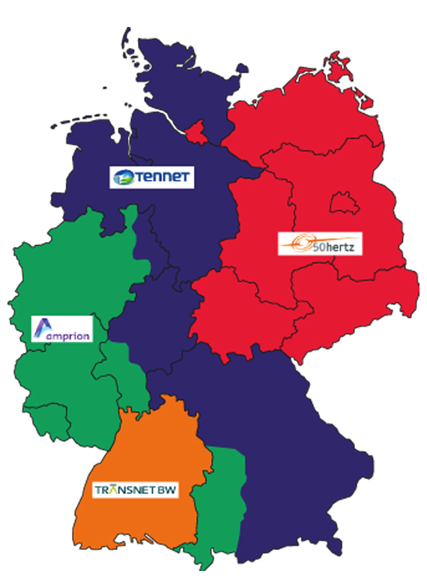
Germany’s electrical grid
4 TSOs
approx. 900 DSOs

Slide 28
Regionalisation of generation and load
© Prof. Dr. Georg Erdmann

Slide 29
Grid extension Germany
Source: BNetzA, 2019

Slide 30
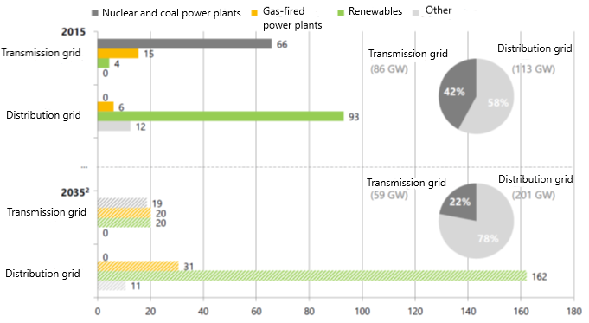
Energy transition in distribution grids
² 50Hertz, Energiewende Outlook 2035, 2016 Source: E-Bridge, MITNETZ Strom, 2016
Notes:
Installed generation capacities connected to distribution grid prevailed over transmission grid already in 2015. This trend will continue with the growing RES share.

Slide 31
Energy transition in distribution grids
More complexity for the DSO tasks:
Congestion management
Voltage control
Grid restauration after blackout
(Frequency control – only in isolated systems)

Slide 32
Nuclear phase-out in Germany
Power plant | Operating until | Installed capacity (MW)
Philippsburg 2 | 2019 | 1.402
Grohnde Gundremmingen C Brokdorf | 2021 | 1.360 1.288 1.410
Isar 2 Emsland Neckarswestheim 2 | 2022
Source: BNetzA, Monitoringbericht 2018

Slide 33
Fossil generation
Coal phase-out by 2038
Power plant | Operating until | Installed capacity (MW)
Jänschwalde E Neurath C | 2019 | 757 (in total)
Hard coal power plants Gas-fired power plant Lignite p/plant block Other technologies | 2021 | 852 MW in total 760 11 14 67
Source: BNetzA, Monitoringbericht 2018
Notes:
Coal phase-out until 2038

Slide 34
European single market for electricity
Goal: Creation of a Single market for electricity in Europe
Technical constraints lead to congestion.
Adequate allocation of this scarce resouce:
Congestion management
Curative measure:
  Redispatch
Pre-emptive measure:
  Explicit auctions
  Implicit auctions
© Prof. Dr. Georg Erdmann
Notes:
Imbalance vs control power

Slide 35
Benefits of market integration
Level out price differences between bidding zones
Strengthen competition between suppliers
Improve system integration of volatile RES
Improve network security
Notes:
Imbalance vs control power

Slide 36
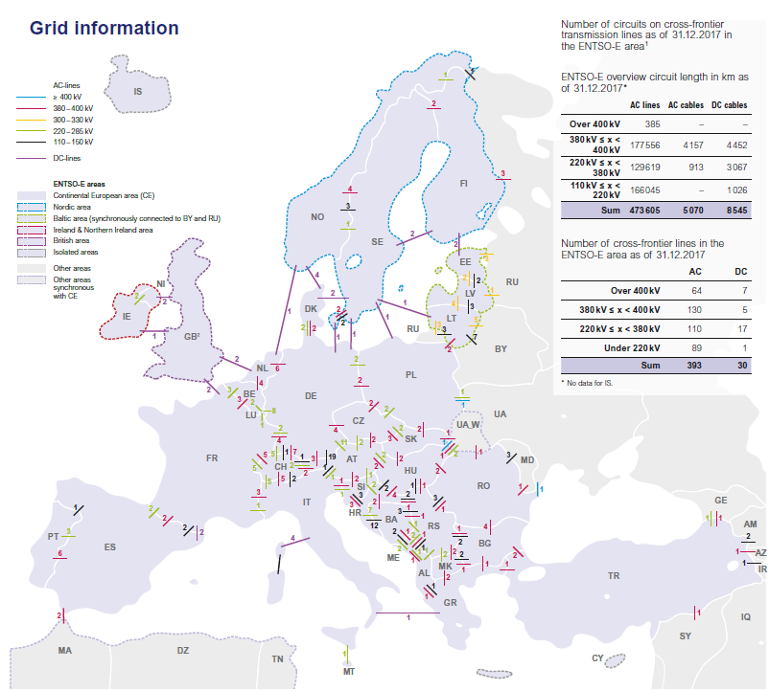
Interconnection lines Europe
≈
Source: ENTSO-E, 2017
Notes:
Imbalance vs control power

Slide 37
Trade among different bidding zones (1)
≈
© Prof. Dr. Georg Erdmann
Notes:
Imbalance vs control power

Slide 38
Trade among different bidding zones (2)
≈
Notes:
Imbalance vs control power

Slide 39
Trade among different bidding zones (3)
≈
Notes:
Imbalance vs control power

Slide 40
Crossborder transmission capacity trading
Goal: efficient allocation of cross-border transmission capacities in order to optimise social welfare.
Explicit auction: transmission rights are auctioned separately and independently from the electricity market.
annual, monthly and daily auctions
bilaterally or via exchange
Implicit auction: transmission rights and energy are coupled and traded simultaneously (i.e. buyers bid for electricity supplied by generators from the neighbouring market area). The price per area reflects both the cost of energy and congestion.
via exchange
≈
Notes:
Imbalance vs control power

Slide 41
Explicit auction
≈
© Prof. Dr. Georg Erdmann
Notes:
Imbalance vs control power

Slide 42
Implicit auction
≈
© Prof. Dr. Georg Erdmann
Notes:
Imbalance vs control power

Slide 43
Market Coupling
≈
Source: TenneT (2010)
Notes:
Imbalance vs control power

Slide 44
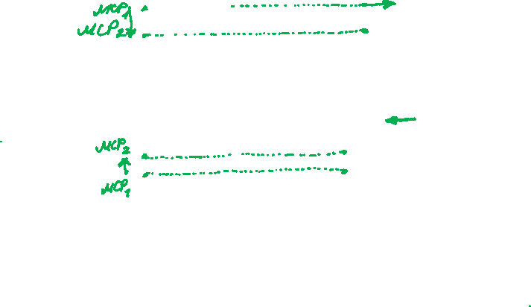
Example of trading between two markets
≈
© Prof. Dr. Georg Erdmann
Notes:
Imbalance vs control power

Slide 45
Example of trading between two markets (continued)
≈
© Prof. Dr. Georg Erdmann
Notes:
Imbalance vs control power

Slide 46
System services
Frequency control
Voltage control
Black-start capacities for grid restauration after black-outs
Compensation for transmission losses
Cross-border interconnection management
General modes of provision:
Compulsory
Bilateral
Tendering
Wholesale market

Slide 47
Markets for control power
Control power markets serve for frequency control.
Frequency is determined by balance of supply and demand.
Target frequency in Europe: 50 Hz
Excessive demand → frequency drops → positive balancing energy is procured by TSO
Excessive generation → frequency rises → negative balancing energy is procured by TSO
Source: Zweifel / Praktiknjo / Erdmann, 2017

Slide 48
Netting of balancing power
© Prof. Dr. Georg Erdmann

Slide 49
European balancing markets
European balancing target model has following goals:
Effective competition
Non-discrimination
Transparency
Integration
European platforms and projects under development:
IGCC, International Grid Control Cooperation – imbalance netting
PICASSO, Platform for the International Coordination of Automated Frequency Restoration and Stable System Operation – aFRR
MARI, Manually Activated Reserves Initiative – mFRR
TERRE, Trans-European Restoration Reserves Exchange – RR

Slide 50
Markets for control power
Balancing service providers:
generators
demand response providers
storage facilities operators
System imbalance vs BG imbalance
Source: ENTSO-E, 2018
Notes:
Each BRP is responsible for their individual position.

Slide 51
Balancing market processes
+ Imbalance netting (IN): exchange of imbalances between TSOs
Source: ENTSO-E, 2018
Notes:
Each BRP is responsible for their individual position.

Slide 52
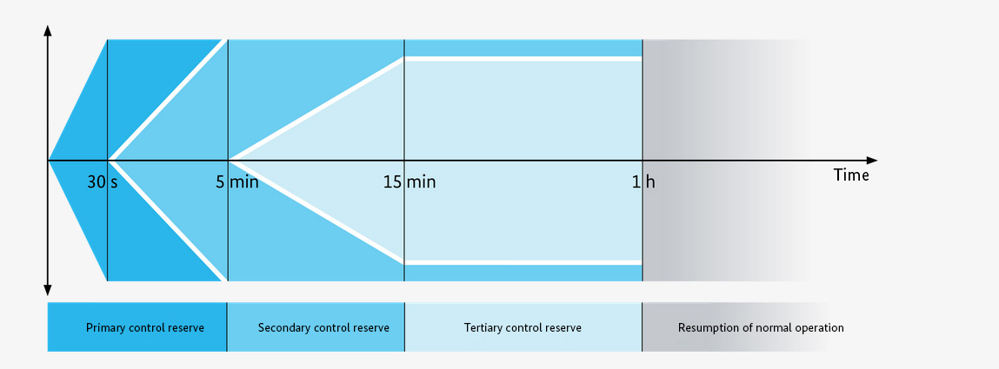
Markets for control power
Source: Bundesnetzagentur
Notes:
Positive balancing energy – additional generation or less consumption.
Negative balancing energy – less generation or additional consumption.

Slide 53
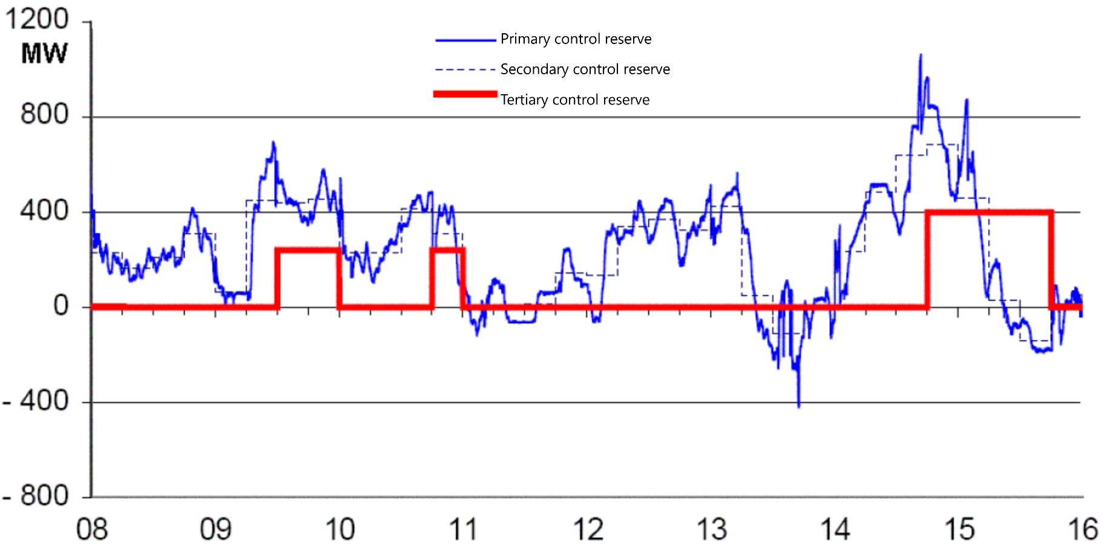
Utilisation of control power
© Prof. Dr. Georg Erdmann
Notes:
Positive balancing energy – additional generation or less consumption.
Negative balancing energy – less generation or additional consumption.

Slide 54
Control power markets
Primary reserve – procured in weekly auction (Tue)
Secondary and tertiary reserves are procured in pay-as-bid auctions.
Prequalification required for participating in the control power markets.
Primary reserve
until Tue 15:00 for Mo from 00:00
Time blocks: one week
Secondary reserve
daily until 8:00 for following day from 00:00
Time blocks: six 4-hour blocks
Minute reserve
daily until 8:00 for following day from 00:00
Time blocks: six 4-hour blocks

Slide 55
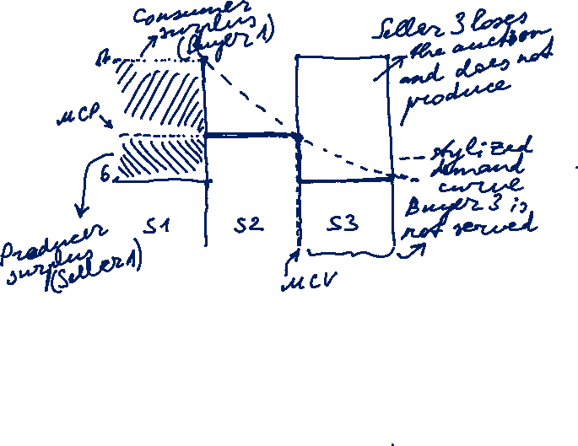
Pay-as-bid auction: Stylised example
$
Pay-as-bid: units are sold at different prices (e.g. control power)
(vs. Uniform price: market clearing price)
 | No. of units | Price [$/unit]
Buyer 1 | 5 | 17
Buyer 2 | 5 | 10
Buyer 3 | 5 | 6
Seller 1 | 5 | 6
Seller 2 | 5 | 10
Seller 3 | 5 | 17
15
10
5
5
10
15
Volume [units]
Source: Morey, EEI, 2001, p. 21-22.
Notes:
Supply offer reflects the seller’s individual supply schedule.
Demand bid reflects the buyer’s individual demand schedule.
At the market equilibrium point, the value of the last unit purchased equals the cost of the last unit supplied.

Slide 56
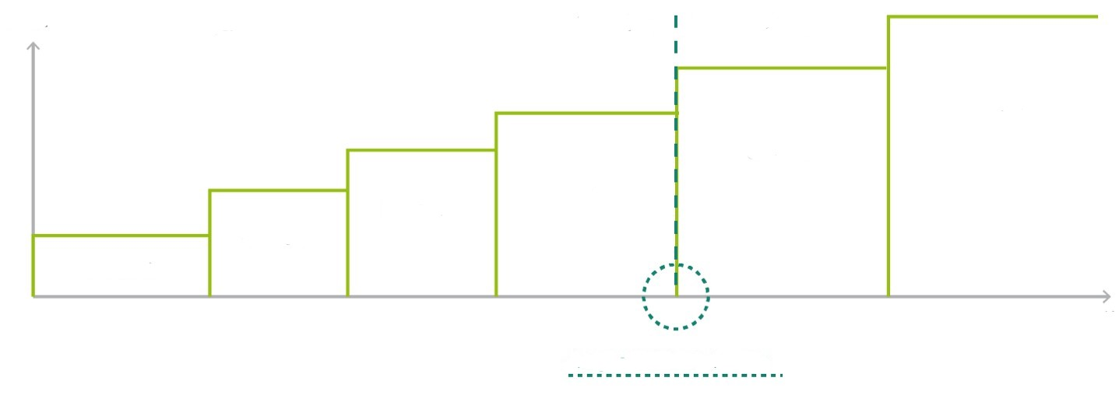
Control power auction
Price
Capacity auctioned by TSO
Awarded
Not awarded
Bid 1
Bid 2
Bid 3
Bid 4
Bid 5
Bid 6
MW
Auctioned capacity
Source: Next Kraftwerke

Slide 57
Control power markets
Source: Zweifel / Praktiknjo / Erdmann, 2017
Entry barriers are in focus of market design.

Slide 58
Cost allocation of control power
© Prof. Dr. Georg Erdmann
Notes:
Socialisation of balancing power capacity costs

Slide 59
Control power markets
Link between energy and anciliary services:
A supplier can choose to either use a certain generation unit for supplying electricity on the wholesale market or offer its generation capacity on the control power market – not both simultaneously.
Generator’s costs:
higher fuel consumption
higher wear and tear
etc.

Slide 60
Opportunity costs: Energy vs. Ancillary Services
Source: Morey, EEI, 2001, p. 52.

Slide 61
Control power markets
Source: Hirth, Ziegenhagen / Renewable and Sustainable Energy Reviews 50 (2015), p.1039

