Slide 1
Integrated course „Energy Economics“
- Renewable Energy Support Schemes -
- Generation Capacities -
Chair of Energy Systems | Department of Energy Systems
Technische Universität Berlin

Slide 2
Outline
Renewables support schemes
Generation capacities

Slide 3
Motives for renewables support
reducing carbon emissions
reducing cost through knowledge spillovers
developing an export industry by early specialisation
energy security: limiting dependence on fossile fuels imports
ancilliary benefit: generating employment
Three groups of support schemes:
Public financing – public investments, loans, grants
Fiscal incentives – subsidies and tax reductions
Requirements for electricity consumers to pay for RES:
  fixing price
  fixing amount
Source: Green and Yatchew (2012)

Slide 4
Global weighted average of total installed cost and LCOE for solar PV 2010-2019
Source: IRENA (2019)

Slide 5
Global weighted average of total installed cost and LCOE for onshore wind 2010-2019
Source: IRENA (2019)

Slide 6
Global weighted average of total installed cost and LCOE for offshore wind 2010-2019
Source: IRENA (2019)

Slide 7
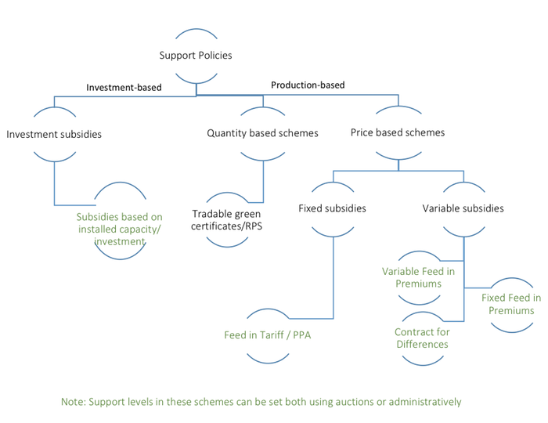
Renewable Electricity Support Schemes in Europe
Source: OEE

Slide 8
European Union’s RES policies
2030 energy and climate framework
Key targets for 2030:
At least 40% cuts in greenhouse gas emissions (from 1990 levels)
At least 32% share for renewable energy
At least 32.5% improvement in energy efficiency
European Green Deal
towards carbon-neutral economy by 2050

Slide 9
Renewable Electricity Support Schemes in Europe
EU Clean Energy Package (2018): binding target of 32% for renewable energy sources in EU’s energy mix by 2030

Slide 10
RES support mechanisms: Green Certificates (GC)
Fossile fuel-fired generators are required to replace every year a certain percentage of their energy production with RES.
The balance between demand (from generators and importers under the GC obligation) and supply (RES generators) determines the GC price.
The charges linked to the GC are translated to the final customers through the electricity price (on wholesale or retail market).

Slide 11
Green Certificates Mechanism
© Prof. Carlo Andrea Bollino

Slide 12
RES support mechanisms: Administered fees (all-inclusive or premium)
The government fixes the price for each MWh produced or injected into the grid from RES.
Normally, the fee depends on renewable source and size of power plant.
Feed-in tarif (FIT)
Premium ensures that at least FIT is covered and gives incentives for selling RES output directly on the wholesale market
If the fee is coherent with the production cost, the government’s RES output target can be met; otherwise it would be not reached or exceeded.
The charges linked to the support system are paid by final customers.

Slide 13
Feed-in-tariff and Market Premium Mechanism
© Prof. Carlo Andrea Bollino

Slide 14

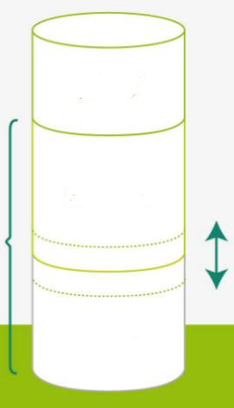
Feed-in-tariff and Market Premium Mechanisms
revenues from
flexibility
guaranteed revenue
incl. management premium
fixed
feed-in tariff
market premium
variable
revenues from
wholesale market
fixed
(asset-specific)
Source: Next Kraftwerke

Slide 15
RES auctions under market premium scheme
EEG 2017:
Predetermined auctioned capacity for RES new build
Prequalified projects bidding their reference value (guaranteed revenue)
Installation-specific reference value
Auction requirement for
Offshore wind
Onshore wind and solar PV from 750 kW
Biomass from 150 kW
revenues from
flexibility
guaranteed revenue
incl. management premium
market premium
variable
revenues from
wholesale market
fixed
(asset-specific)
Source: Next Kraftwerke

Slide 16
Market integration objectives of RES
Source: Purkus et al. Energy, Sustainability and Society (2015) 5:12

Slide 17
Renewables support levy (green fee)
RES support payments – RES marketing revenue
RES levy =
Adjusted non-preferred final electricity consumption
Adjusted final electricity consumption is equal to total final electricity consumption minus:
Share of electricity consumption of energy intensive industries, which are exempted from the levy
Own generation (self-consumption), which is partly exempted from the levy

Slide 18
Direct and Indirect Costs of Renewables
Cost of new RES capacity invested in Germany in January 2012
© Prof. Carlo Andrea Bollino

Slide 19
Expenditures for Electricity
© Prof. Carlo Andrea Bollino

Slide 20
German Renewables Act (2021)
At least 65% share of renewable energy in gross electricity demand in 2030
100% CO₂-neutral electricity generation and consumption by 2050
Continuous, cost-efficient and grid-adjusted RES expansion.

Slide 21
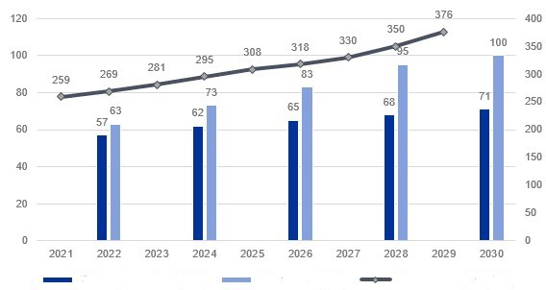
German Renewables Act (2021): RES expansion pathway
Onshore wind (GW)
PV (GW)
Electricity volume path (GWh)
Source: IKB Deutsche Industriebank
For offshore wind, yearly auction volumes are determined by BNetzA to ensure synchronisation with required grid expansion and reach 20 GW by 2030 and 40 GW by 2040.

Slide 22
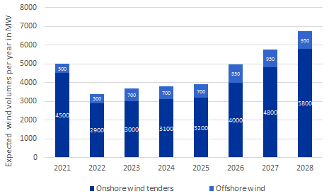
Additional capacities of onshore and offshore wind
Source: Energy Brainpool

Slide 23
2. Investment into generation capacities
Erdmann / Praktiknjo / Zweifel (2017)

Slide 24
Annual Price Duration Curve
Erdmann / Praktiknjo / Zweifel (2017)

Slide 25
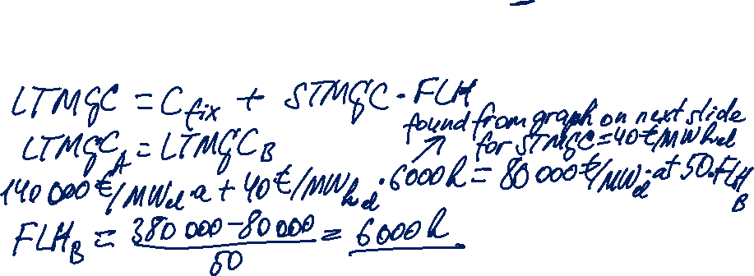
Task 1
Anwer the questions regarding the economics of technologies A and B based on the following techno-economic power plant data:
a) Up to which number of full load hours is technology B cheaper than technology A?

Slide 26

Task 1

Slide 27
Task 1
b) You sell electricity from power plant A on spot market which is characterised by a given price duration curve. Your generation unit has a rated capacity of 600 MW.
Calculate the power plant’s:
annual fixed costs in Euro
annual variable costs in Euro
annual contribution margin in Euro
annual profit in Euro

Slide 28

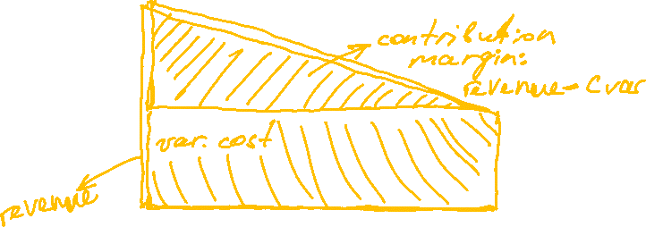

Task 1

Slide 29
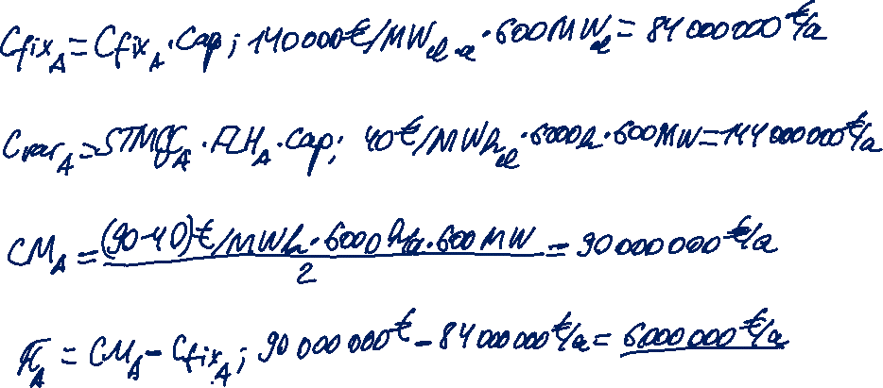
Task 1
annual fixed costs in Euro
annual variable costs in Euro
annual contribution margin in Euro
annual profit in Euro

