Slide 1
Integrated course „Energy Economics“
- Paper reading and discussion:
Balancing power and variable renewables -
Chair of Energy Systems | Department of Energy Systems
Technische Universität Berlin

Slide 2
Read and discuss in class:
Hirth, L. and Ziegenhagen, I., Balancing power and variable renewables: Three links, Renewable and Sustainable Energy Reviews 50 (2015) 1035-1051
What are the three roles of VRE in the balancing system?
Who are the main actors in the balancing system?
What are the types of balancing power?
What are the sources of imbalances?
What is the German balancing paradoxon?
How is the imbalance price calculated?

Slide 3
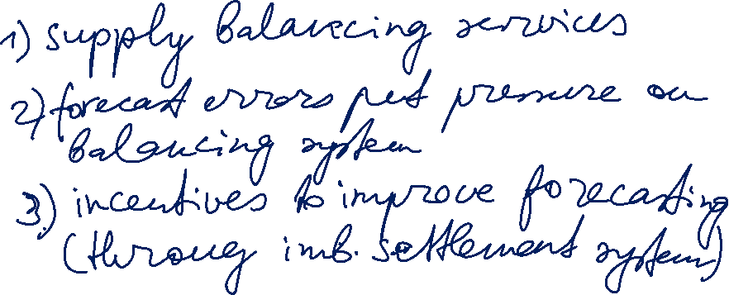
Read and discuss in class:
What are the three roles of VRE in the balancing system?

Slide 4
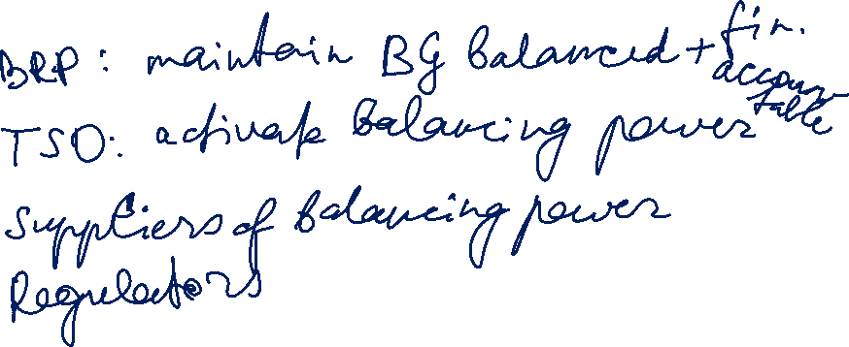
Read and discuss in class:
Who are the main actors in the balancing system?

Slide 5
Markets for control power
Control power markets serve for frequency control.
Frequency is determined by balance of supply and demand.
Target frequency in Europe: 50 Hz
Excessive demand → frequency drops → positive balancing energy is procured by TSO
Excessive generation → frequency rises → negative balancing energy is procured by TSO
Source: Zweifel / Praktiknjo / Erdmann, 2017

Slide 6
Energy Trading: Submarkets
Time
Delivery time (t0)
EEX Futures
until 24:00 on the last day of M-2
Mo-Fr (no trading on weekend and public holidays)
Day-Ahead Auction EXAA
until 10:12 on D-1
hours and 15 min
Mo-Fr (no trading on weekend and public holidays)
Day-Ahead Auction EPEX Spot
until 12:00 on D-1
hours and blocks
Intraday Auction EPEX Spot
until 15:00 on D-1
15 min
Intraday continuous EPEX Spot
from 15:00 on D-1 until 5 min before t0
15 min [16:00 D-1 until 5 min before t0)
Exchange
Bilateral
Forward / Term
Spot / Short-term
until 15 min before t0 across control areas; immediately before t0 for trades within the same
control area. Forward and spot All products are negotiated bilaterally.
Control power
Primary reserve
until Tue 15:00 for Mo from 00:00
Time blocks: one week
Secondary reserve
daily until 8:00 for following day from 00:00
Time blocks: six 4-hour blocks
Minute reserve
daily until 8:00 for following day from 00:00
Time blocks: six 4-hour blocks
Source: Adapted from Next Kraftwerke
Notes:
Submarkets with different lead times between trade conclusion and actual delivery.
Forward/futures: hedging
Spot: day-ahead market, 15-min intraday auction, continuous intraday market

Slide 7
Netting of balancing power
© Prof. Dr. Georg Erdmann

Slide 8

Markets for control power
Balancing service providers:
generators
demand response providers
storage facilities operators
System imbalance vs BG imbalance
Source: ENTSO-E, 2018
Notes:
Each BRP is responsible for their individual position.

Slide 9
Read and discuss in class:
What are the types of balancing power?

Slide 10
Ramp rates and start-up times of termal power plants
Source: Agora Energiewende, 2017, with ref. to: Fichtner (2017), VDE (2012), Steck & Mauch (2008), Balling (2010)
Notes:
Flexible: fast ramp-up / ramp-down

Slide 11
Balancing market processes
+ Imbalance netting (IN): exchange of imbalances between TSOs
Source: ENTSO-E, 2018
Notes:
Each BRP is responsible for their individual position.

Slide 12
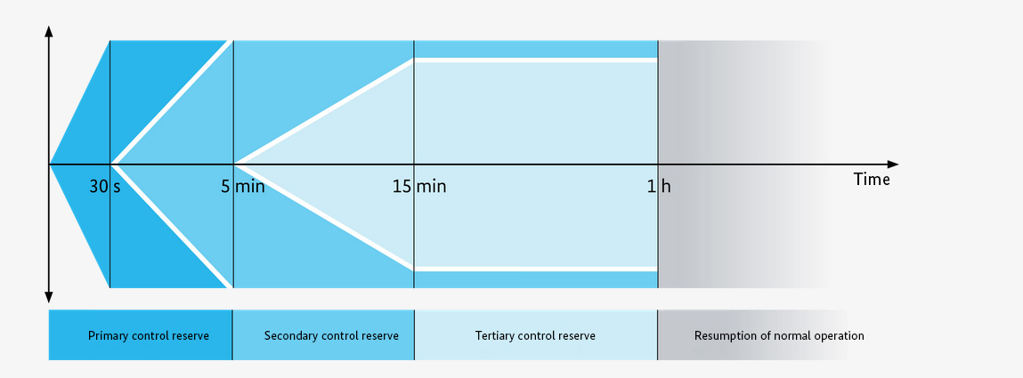
Markets for control power
Source: Bundesnetzagentur
Notes:
Positive balancing energy – additional generation or less consumption.
Negative balancing energy – less generation or additional consumption.

Slide 13
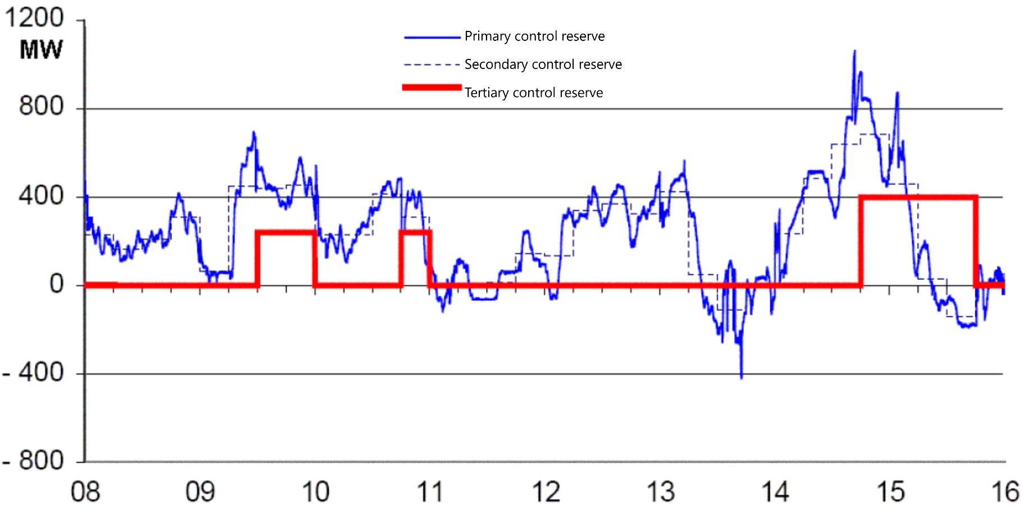
Utilisation of control power
© Prof. Dr. Georg Erdmann
Notes:
Positive balancing energy – additional generation or less consumption.
Negative balancing energy – less generation or additional consumption.

Slide 14
Control power markets
Primary reserve – procured in weekly auction (Tue)
Secondary and tertiary reserves are procured in pay-as-bid auctions.
Prequalification required for participating in the control power markets.
Primary reserve
until Tue 15:00 for Mo from 00:00
Time blocks: one week
Secondary reserve
daily until 8:00 for following day from 00:00
Time blocks: six 4-hour blocks
Minute reserve
daily until 8:00 for following day from 00:00
Time blocks: six 4-hour blocks

Slide 15
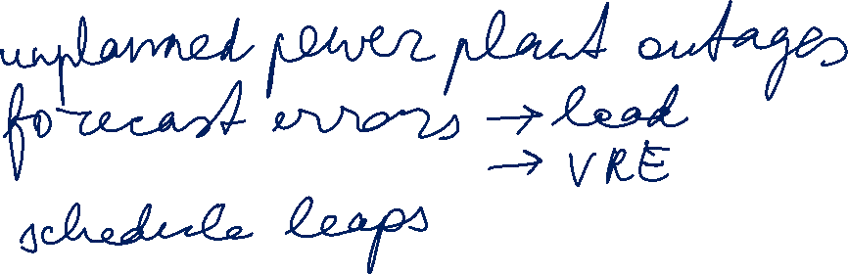
Read and discuss in class:
What are the sources of imbalances?

Slide 16

Read and discuss in class:
What is the German balancing paradoxon?

Slide 17
Read and discuss in class:
What is the German balancing paradoxon?
Newer data:
https://www.regelleistung-online.de/rueckgang-der-srl-abrufmengen/

Slide 18
Read and discuss in class:
How is the imbalance price calculated?

Slide 19

Control power markets
Source: Zweifel / Praktiknjo / Erdmann, 2017
Entry barriers are in focus of market design.

Slide 20
Cost allocation of control power
© Prof. Dr. Georg Erdmann
Notes:
Socialisation of balancing power capacity costs

Slide 21
Control power markets
Link between energy and anciliary services:
A supplier can choose to either use a certain generation unit for supplying electricity on the wholesale market or offer its generation capacity on the control power market – not both simultaneously.
Generator’s costs:
higher fuel consumption
higher wear and tear
etc.

Slide 22
Opportunity costs: Energy vs. Ancillary Services
Source: Morey, EEI, 2001, p. 52.

Slide 23
Control power markets
Source: Hirth, Ziegenhagen / Renewable and Sustainable Energy Reviews 50 (2015), p.1039

Slide 24
European balancing markets
European balancing target model has following goals:
Effective competition
Non-discrimination
Transparency
Integration
European platforms and projects under development:
IGCC, International Grid Control Cooperation – imbalance netting
PICASSO, Platform for the International Coordination of Automated Frequency Restoration and Stable System Operation – aFRR
MARI, Manually Activated Reserves Initiative – mFRR
TERRE, Trans-European Restoration Reserves Exchange – RR

