Slide 1
Integrated course „Energy Economics“
- Electricity markets fundamentals - (continued)
Chair of Energy Systems | Department of Energy Systems
Technische Universität Berlin

Slide 2
Task 2) Merit Order and Dispatch Decisions
Which categories of costs in the power sector are relevant i) for operational decisions ii) for decommissioning decisions and iii) for investment decisions? Explain why.
i. Operational decisions should be made based on variable costs or, more specifically, marginal costs: fuel costs, CO₂ costs, variable O&M costs (costs denoted in €/MWh_{el}).
Fixed costs are irrelevant for the operational decision, as the decision to produce has no influence on them (from a short-term perspective). If the market price is just higher than our variable costs, we should produce. We generate revenues, which both cover the variable costs and contribute to recovering our fixed costs (contribution margin).
Notes:
a) See slide 5

Slide 3
Task 2) Merit Order and Dispatch Decisions
Which categories of costs in the power sector are relevant i) for operational decisions ii) for decommissioning decisions and iii) for investment decisions? Explain why.
(continued)
ii. Decisions with respect to decommissioning should not only consider variable costs, but also all fixed costs apart from the investment costs. As the investment costs cannot be influenced by the decommissioning decision, they are sunk costs and therefore irrelevant for the decision. On annual basis the contribution margin must recover the fixed costs (apart from the investment costs), otherwise we should consider decommissioning.
iii. Investment decisions should consider all costs: variable and fixed costs, including the investment costs. If we cannot recover all costs, the investment is not profitable.
Notes:
a) See slide 5

Slide 4
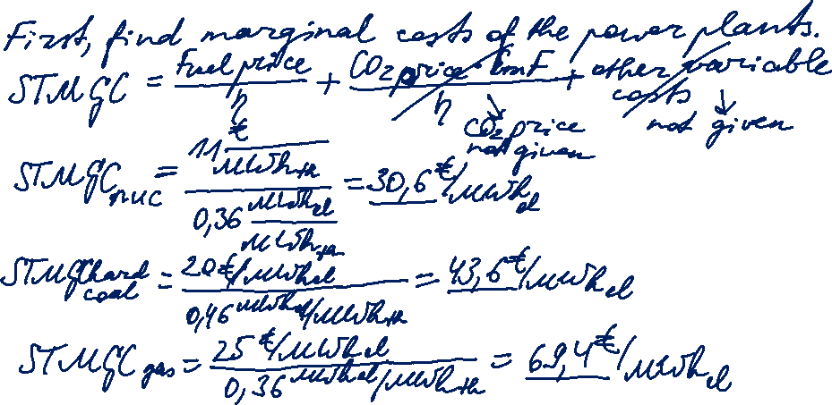

Task 2)
Dispatch Decisions
Assume the power plants given in table 2 have been constructed already. Sketch the merit order for these power plants. What is the electricity price at a load of 1.7 GW?

Slide 5
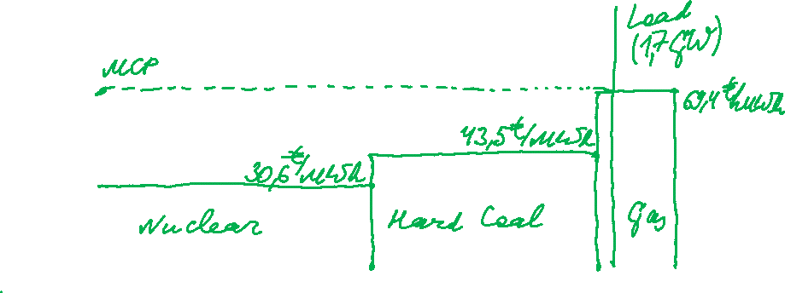
Task 2)
Dispatch Decisions
Assume the power plants given in table 2 have been constructed already. Sketch the merit order for these power plants. What is the electricity price at a load of 1.7 GW?

Slide 6
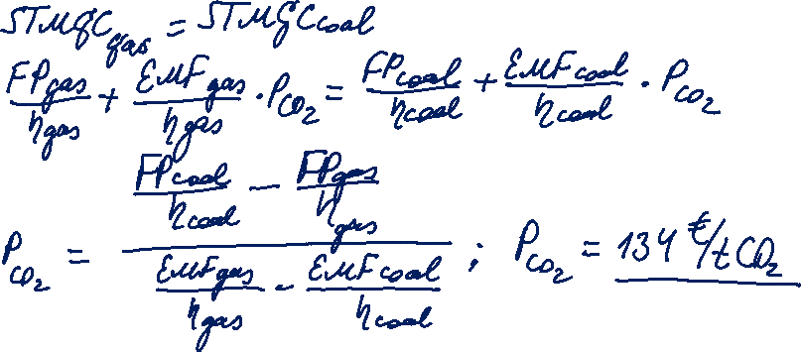
Task 2)
Dispatch Decisions
Now assume that there is a CO2 trading system. Calculate the emissions price (€/t CO2) at which the coal fired units show the same short-term marginal generation costs as the gas fired ones.

