Slide 1
Integrated course „Energy Economics“
- Energy Trading – Wholesale markets for electricity
Chair of Energy Systems | Department of Energy Systems
Technische Universität Berlin

Slide 2
Outline – Electricity Trading
Role of energy trading
Submarkets and trading forms
Trading products
Balance group concept
Credit risk management

Slide 3
What is energy trading
Trading is buying and selling, i.e. exchanging commodities.
Electricity is a homogeneous product – uniform and standardised: a commodity.
Other commodities: agricultural (wheat, coffee), metals (gold, steel) etc.
Other energy commodities: natural gas, crude oil, LNG, coal Related markets: freight, CO₂ emission allowances
Energy trading has parallels to financial markets (shares, bonds and other financial instruments) – even with its particularities due to the physical nature of electricity (gas/oil/coal etc.) as underlying.
Notes:
Market participants are buying and selling at the same time – in contrast to supplier – final consumer relationship. Purchased commodity can be resold.

Slide 4
Energy trading and Financial markets
Future prices cannot be predicted based on historical prices.
The best prediction of tomorrow’s price P_{t+1} is today’s price P_{t}.
The unique reason for a change in price is arrival of “news” not correlated with information available at time t.
Transparency (availability of information to all market participants) is a crucial prerequisite for efficient market functioning.

Slide 5
Trading forms: Exchange vs. OTC
Mediated trading: power pool or power exchange
organised auction resulting in a uniform price
highly standardised products; no room for negotiation
transparency
regulated
clearing and colateral costs
Bilateral trading: over-the-counter (OTC)
intermediation cost (opportunity cost or broker fee)
individual prices agreed between pairs of buyers and sellers
(≈pay-as-bid principle)
standard framework agreements: EFET/GTMA; ISDA; DRV etc.
unregulated
Typically: Combination of exchange and OTC trading.
Notes:
Transparency: exchange publishes traded volumes and prices.

Slide 6
Energy trading: Submarkets
Time
Delivery time (t0)
Forward /
Futures /
Term
Spot /
Short-term /
Cash
Day-ahead
Intraday
years, quarters, months ahead of delivery
day ahead delivery
up to 5 min ahead of delivery
Notes:
Transparency: exchange publishes traded volumes and prices.

Slide 7
Energy Trading: Submarkets
Time
Delivery time (t0)
EEX Futures
until 24:00 on the last day of M-2
Mo-Fr (no trading on weekend and public holidays)
Day-Ahead Auction EXAA
until 10:12 on D-1
hours and 15 min
Mo-Fr (no trading on weekend and public holidays)
Day-Ahead Auction EPEX Spot
until 12:00 on D-1
hours and blocks
Intraday Auction EPEX Spot
until 15:00 on D-1
15 min
Intraday continuous EPEX Spot
from 15:00 on D-1 until 5 min before t0
15 min [16:00 D-1 until 5 min before t0)
Exchange
Bilateral
Forward / Term
Spot / Short-term
until 15 min before t0 across control areas; immediately before t0 for trades within the same
control area. Forward and spot All products are negotiated bilaterally.
Control power
Primary reserve
until Tue 15:00 for Mo from 00:00
Time blocks: one week
Secondary reserve
daily until 8:00 for following day from 00:00
Time blocks: six 4-hour blocks
Minute reserve
daily until 8:00 for following day from 00:00
Time blocks: six 4-hour blocks
Source: Adapted from Next Kraftwerke
Notes:
Submarkets with different lead times between trade conclusion and actual delivery.
Forward/futures: hedging
Spot: day-ahead market, 15-min intraday auction, continuous intraday market

Slide 8
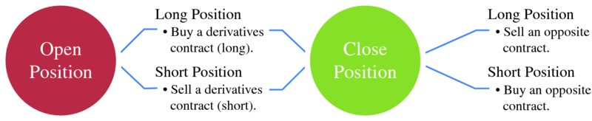
Forward markets: Continuous trading
Traders take up forward positions based on market expectations but can reverse them later up until delivery by offsetting (back-to-back) purchases or sales.
Buy a contract to cancel out an earlier sale (cover a short).
Sell a contract to close an earlier purchase (cover a long).
Source: Mack, Energy trading and risk management, 2014
Notes:
Buying a commodity at a price a year from now is a short position.
Purchasing a commodity at a market price and selling it at a fixed price: two

Slide 9
Forward markets: Long and short positions
Long position: trader benefits from a price increase.
E.g. trader buys electricity forward at today’s market price. If the market price rises, the trader will be able to sell the contract later at a higher price and realise a profit.
Short position: trader benefits from a price decrease.
E.g. trader sells electricity forward at today‘s market price. If the market price goes down, the trader will be able to buy the same product later at a lower price and realise a profit.
But: Long ≠ Buy, and Short ≠ Sell For example:
1. Buying a commodity at a price a year from now is a short position. The position benefits the trader only if the current market higher than the market price in one year (i.e. in falling price case)
2. Purchasing a commodity at the market price and selling it at a fixed price (both short) is an open position, rather than a closed one. Trader benefits from selling at a fixed price (other than the current market price) if the price falls.
See: Edwards, Energy trading & investing, 2010, p. 5

Slide 10
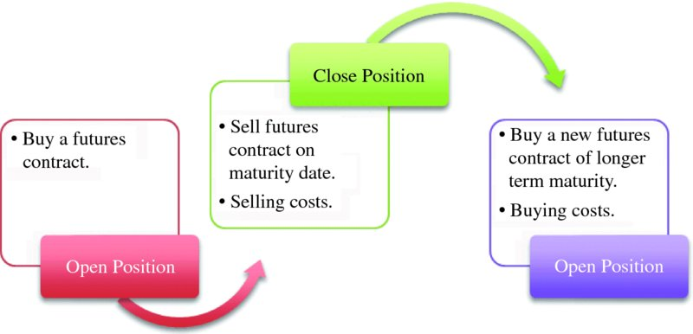
Rolling of futures
A futures trader has two options:
closing the contract on or before the maturity date (delivery period) by selling or
rolling over the contract
Source: Mack, Energy trading and risk management, 2014

Slide 11
Rolling of futures (continued)
At the beginning of the delivery period, the initial product splits into a set of equivalent shorter-term products.
Longer maturities cascade into corresponding shorter marturities.
„
„
Source: EEX Contract Specifications
Notes:
Forward=Term trading

Slide 12
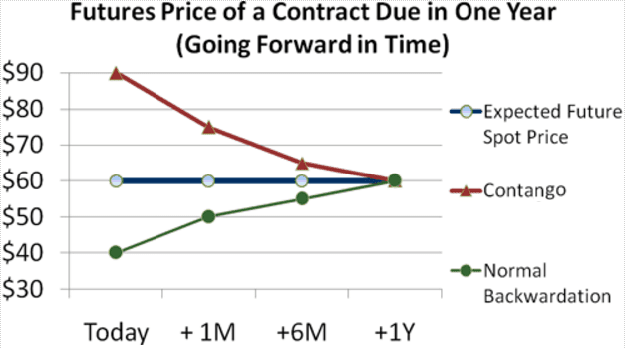
Forward market: Price development patterns
Contango: forward price exceeds the spot price.
Backwardation: spot price exceeds the forward price.
Market participants are driving the forward price up/down in line with their expectations.
Source: Mack, Energy trading and risk management, 2014
Notes:
Contango: Traders anticipate decrease in supply or increase in demand. Trading activities to hedge against the potential price increase drives the forward price up.
Backwardation: traders anticipate price decline and drive the forward price down.

Slide 13
Sample power purchase portfolio
Standardised futures do not match with typical load schedules.
© Prof. Dr. Georg Erdmann
Notes:
Flat deliveries (blocks) under forward/futures contracts are matched with actual load profile by trading in the day-ahead and intraday market (or by balancing power).

Slide 14


Portfolio management of a power retailer
© Prof. Dr. Georg Erdmann
Notes:
Flat deliveries (blocks) under forward/futures contracts are matched with actual load profile by trading in the day-ahead and intraday market (or by balancing power).

Slide 15
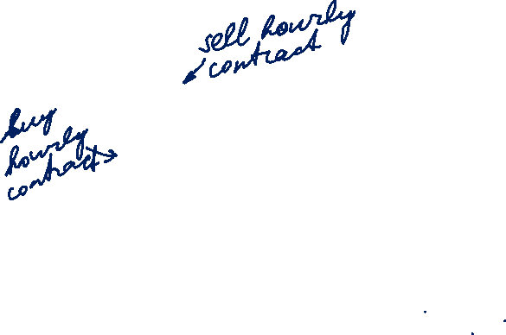
Day-ahead contracts for singular hours
© Prof. Dr. Georg Erdmann
Notes:
Flat deliveries (blocks) under forward/futures contracts are matched with actual load profile by trading in the day-ahead and intraday market (or by balancing power).

Slide 16
Market liquidity
Churn rate is the ratio of traded volume to physically delivered volume.
i.e. how many times the electricity generated/consumed has been traded before delivery
Bid-ask spread is the difference between the ask price (sell side) and the bid price (buy side).
Market depth is the volume of buy and sell orders.
Liquidity impacts:
the intermediation costs and the bid/ask spread
the time horizon and costs for closing a position
Notes:
Liquidity is an indicator of the market quality.
A liquid market is where you can buy or sell quickly.
Mor illiquid/thinner markets are more volatile.
The more liquid a market it, the more reliable the technical patterns.

Slide 17
EPEX Spot Day-ahead auction
Double-sided auction: bid and ask order book (order book trading)
Uniform price auction: market clearing price for each product (hour or block)
Hourly contracts and blocks (base, peak etc.)
Occurs daily at 12h for delivery on the following day (0-24h)
Price publication time: asap from 12:42h
Volume tick (min order amount/amount increment): 0,1 MWh
Min price: -500 €/MWh; Max price: 3.000 €/MWh
Notes:
Auction market is a centrally managed market (central clearing house) under uniform rules.

Slide 18
Bidding curves at EEX
[delivery period Monday, 6.11.2006, 8-9 h]
[Euro/MWh]
Demand
Supply
150
100
50
0
0
5000
10000
15000
20000
25000
[MWh]

Slide 19
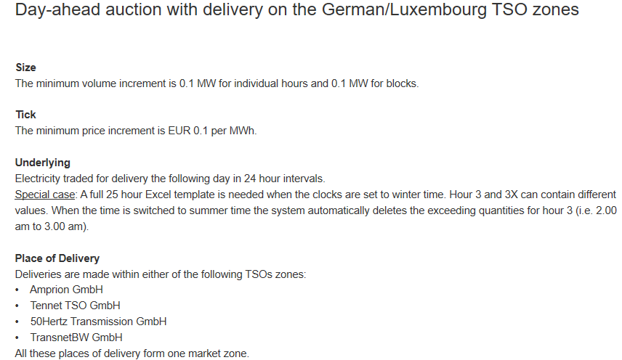
EPEX Spot Day-ahead auction: Product description
https://www.epexspot.com/en/product-info/auction/germany-luxembourg

Slide 20
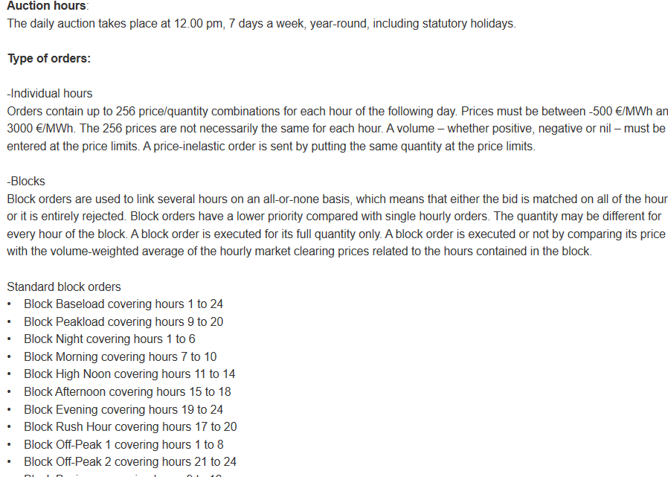
Product description (continued)

Slide 21
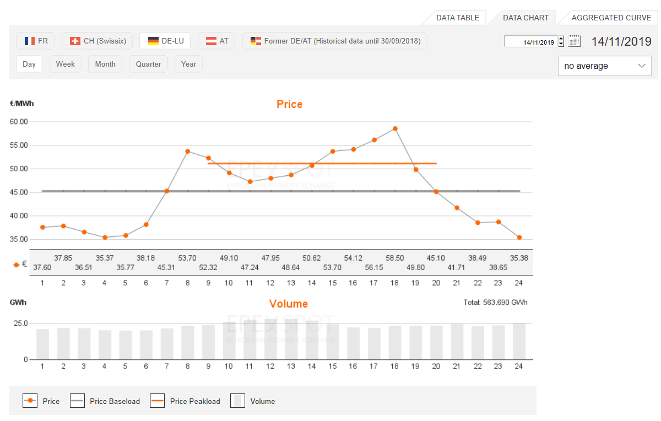
EPEX Spot Day-ahead auction

Slide 22
Intraday market
Intraday market reflects a growing need for flexibility close to delivery due to a growing share of volatile renewables.
Intraday market serves for adjusting trading positions based on corrected forecasts closer to real-time.
uniform price auction for hourly products; daily at 3 pm (d-1)
uniform price auction for 15-min products; daily at 4 pm (d-1)
continuous intraday market for hourly products
The German spot power market for hourly contracts
Source: Balardy, 2018
Notes:
Less liquid than day-ahead markets
Price range: -9.999€ to 9.999€
Intraday market reduces imbalance costs, helps to optimise production and consumption and promotes flexibility.

Slide 23
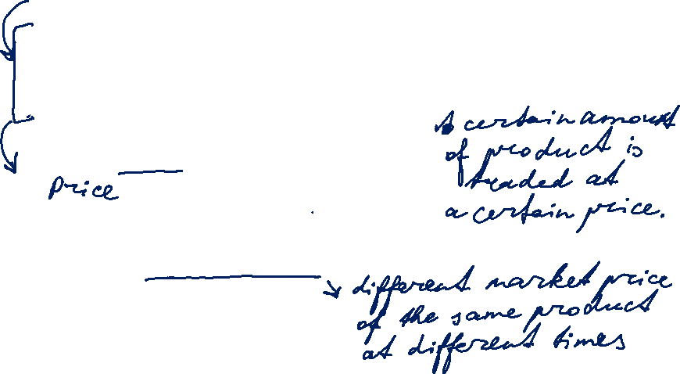

What is a trading product
Trading product is combination of transaction features:
Underlying asset electricity
Delivery point TSO control area
Delivery period start date / end date
Delivery amount contract capacity [MW]
  contract quantity [MWh]
A bid (offer to buy) or ask (offer to sell) is characterised by: product, price, trading day and time.

Slide 24
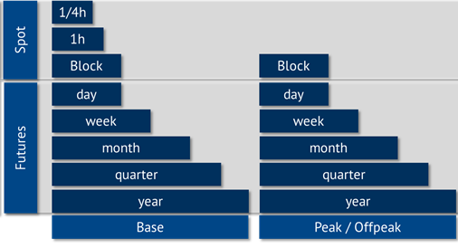
Electricity product types based on delivery period
Source: Energy Brainpool

Slide 25
Product types
Physical vs. Financial
Physical product implies physical delivery of the underlying (i.e. electricity).
Financial product implies exchange of cash without physical delivery (no set-up with TSO required) → Swap
Fixed-price vs. floating price (index-based)
Fixed price is stated as an amount of money per unit of underlying
Floating price is determined by reference to a price index publication at a time point after deal conclusion.
Fixed-amount vs. options

Slide 26
Product types: Swaps
Swaps is a general category of financial products
fixed-for-floating swap: Party A is fixed price payer; Party B is floating price payer (=reference price based on a price index published in the future → market price); only the difference is exchanged each month
e.g. large consumer (as Party A – fixed price payer) hedging price risk from their long-term supply contract with an index-based price
floating-for-floating swap: both Party A and Party B pay their respective floating price
swaption: option to enter into a swap
floor, cap, collar etc.

Slide 27
Trade life cycle - OTC
Deal conclusion → (Confirmation) → Nomination → Settlement
Possible by any means of communication:
written contract
via phone (on recorded line) – with or without broker
via email
via electronic broker platform (screen)
Deal capture in the company’s trading system
In case of non-written deal conclusion for forward transactions
Objective: align the parties’ understanding of the terms of the transaction > identify and resolve any discrepancy before delivery
Delivery obligations are performed by nominating to TSO:
Trader (balance responsible party) submits (net) delivery amount with each counterparty for each day before 14:30h on D-1
Invoice and payment for each delivery month in the following month
Standardised payment terms:
Invoice in the beginning of the following month; payment date on the 20th (5th working day for financial contracts)

Slide 28
Trade life cycle - EEX
EPEX SPOT transmits trade information to the central counterparty European Commodity Clearing (ECC) for settlement and delivery.
ECC nominates deliveries to the relevant TSO on behalf of the exchange member until applicable nomination deadline (14:30 pm).
Souce: EPEX SPOT

Slide 29
Balancing group: Linking the virtual and physical worlds
Balancing group (BG) is a virtual energy volume account associated with one or more grid users within a control area.
each grid connection point is allocated to one balancing group
balance responsible party (BRP) is responsible for balancing its BG’s saldo (feed-in and consumption) for each 15 min – incl. through trading on spot markets
deviations are penalised by imbalance fees
Analogy to a bank account:
TSO | ≈Bank
Balance responsible party | ≈Account holder
EIC | ≈Account number
Balancing circle | ≈Bank account
Energy deliveries | ≈Payments
Notes:
Control area is a power system or part thereof within a certain geographical area that is operated by one TSO.
BG focuses on electricity amounts only – not the prices.
Any imbalance that BRP is not able to mitigate through trading, is tackled by TSO via ancilliary services.

Slide 30
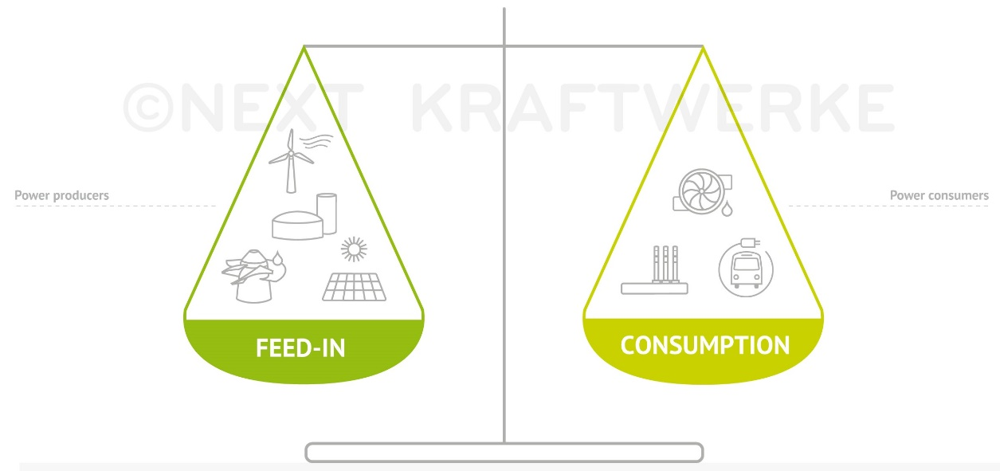
Balancing group (continued)
Trading on transmission grid level, i.e. performing delivery by scheduling to TSO, assumes no physical restrictions within a market area.
Depending on the nature and composition of a balancing group, the BGR transmits to the TSO forecasted load or generation and/or buy and sell amounts.
Imbalance fee is uniform for the control area (in Germany: for all four control areas), symmetric and based on actual activation of control power.
Schedule is power per time
unit exchanged between
BCs, fed into or consumed
from the grid.
Notes:
Imbalance vs control power

Slide 31
Market roles and processes at TSO level
© Prof. Dr. Georg Erdmann
Notes:
Imbalance vs control power

Slide 32
Market roles and processes at DSO level
Default/
© Prof. Dr. Georg Erdmann
Notes:
Imbalance vs control power

Slide 33
Tasks of the Balancing group management
© Prof. Dr. Georg Erdmann
Notes:
Imbalance vs control power

Slide 34
Reasons for imbalances
Unplanned outage of generation units
Unplanned outage or activation of large loads
Forecast gap in volatile RES generation
Inaccurate forecast of demand
≈
Notes:
Imbalance vs control power

Slide 35
Credit risk management: Terminology
„Exposure is a measure of loss if an adverse materialisation of uncertainties occurs for a particular decision.“ *
Mark-to-market accounting is regular (daily) valuation of all open trading positions based on the current market price of the product.
* Perreira et al, IEEE Computer Applications in Power, vol. 13, 2000, p. 22

Slide 36
Credit risk management: Credit risk exposure – OTC
transaction date
delivery period
counterparty default
payment date for M1
Product: Q4 2019
Settlement exposure: delivered but unpaid amount * contract price (≈50 days; credit exposure updated after payment)
Mark-to-market exposure: contract amount from default date until end of delivery period * mark-to-market
Credit exposure for a portfolio depends on the netting rules:
Does the jurisdiction of the counterparty allow cherry-picking, i.e. performing under in-the-money transactions and dropping the ones that are out-of-the-money?
20th
M-1
M1
M2
M3
t
Notes:
MtM risk may aggravate or reduce credit risk exposure.
Settlement exposure is much lower for financial products compared to physical ones.

Slide 37
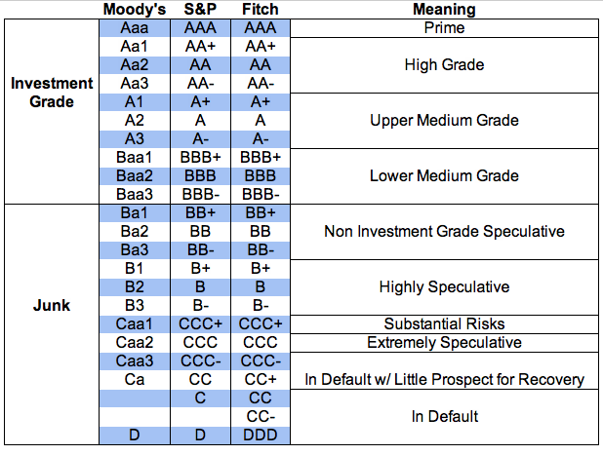
Creditworthiness: Long-term corporate credit ratings

Slide 38
Creditworthiness: Financial ratios
EBIT to Interest – interest coverage ratio
Funds from operations to Total debt
Total debt to Total capitalisation – leverage ratio
Credit risk management involves continuous monitoring of each counterparty‘s creditworthiness and utilisation of the credit line by outstanding (live) trading transactions.
Breach of pre-agreed threshold indicators for creditworthiness triggers a credit call – request to provide additional colateral.

Slide 39
Colateral types
Stand-alone credit line – no initial colateral
Parent company guarantee
Stand-by letter of credit
Bank guarantee
Cash collateral
Colateral amount:
Expected loss given default = Expected value of collateral
Creditworthiness impacts transaction costs.

Slide 40
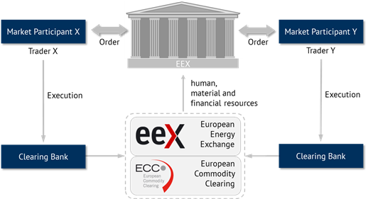
Clearing
Source: Energy Brainpool
Notes:
EEX, as Central Counterparty, covers counterparty risk of their customers

Slide 41
Clearing (continued)
Clearing is performed by European Clearing Counterparty (ECC).
Credit risk exposure is determined similarly to OTC trading.
Margining is the process of continuously recalculating the credit exposure under open positions based on the current market price and adjusting the amount of collateral required to cover it.
Initial margin: cash collateral or other first-class guarantee to ensure that the exchange member fulfills their obligations under open transactions.
Variation margin: daily margining based on mark-to-market calculation – resulting into a margin call as necessary.
Risk of clearing banks is limited to overnight risk.

Slide 42

Clearing at EEX (via ECC)
Source: ECC

Slide 43
Margining process
To cover the counterparty risk, each trader is obliged to sustain a margin account at the energy exchange (or the clearing house). In addition, the trader has to open a maintenance account and to transfer an initial margin that depends, among others, on the expected volume of his open positions
If a trader holds an open position and the futures price exceeds the contracted price, the clearing house transfers the price difference times contract size from the maintenance account to the margin account of the seller and from the margin account to the maintenance account of the buyer.
© Prof. Dr. Georg Erdmann

Slide 44
Margining process (continued)
Debits and credits are adjusted at the end of each trading day according to the market price at closure.
If the maintenance account drops below a maintenance margin, the trader has to remargin the maintenance accounts within short time. Otherwise all open positions of the trader are closed by the clearing house at market conditions.
© Prof. Dr. Georg Erdmann

Slide 45
Calculation of Spot Margin
Spot Initial Margin (IMSM) is called for expected transactions.
The daily exposure at day t comprises all spot transactions that have been concluded between the accounting cut-off of the previous ECC business day and the latest point in time where a trading participant in default would be suspended from trading.
Source: ECC
Notes:
IMSM is based on statistical daily exposures.

Slide 46
Market transparency: REMIT
EU Regulation No 1227/2011 on wholesale energy market integrity and transparency (REMIT) Art. 4:
Market participants are obliged to publicly disclore in an effective and timely manner inside information regarding business or facilities that they control or operate for production, storage, consumption or transmission (of electricity and gas). Information relevant to the capacity and use of facilities, incl. planned or unplanned availability.
Prohibited activities:
Insider trading → non-discriminatory disclosure of inside information (see above); prohibition to trade or recommend trading on its basis unless published
Market manipulation: giving misleading signals as to supply, demand or price; actions to secure an artificial price level (incl. in collusion with other market participants/persons)
Notes:
Goal is to ensure that wholesale prices reflect a fair and competitive interplay between supply and demand, and no profits can be drawn from market abuse (REMIT rec. (1)).

Slide 47
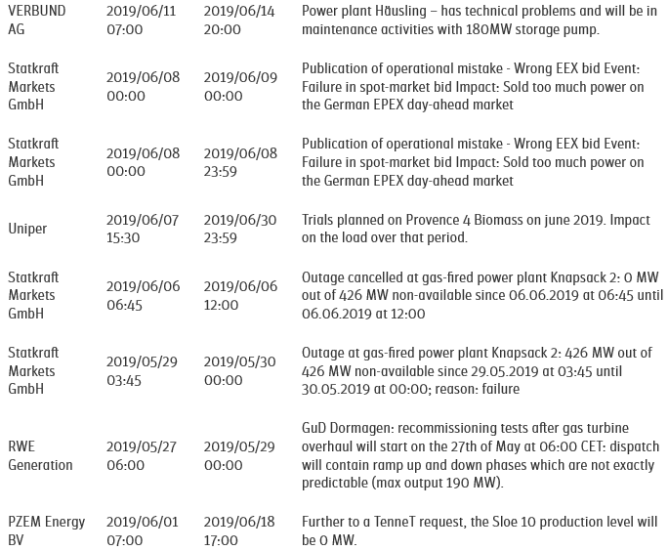
EEX Market transparency platform
← unplanned maintenance of an Austrian storage pump power plant
← to avoid accusation of attempted market manipulation
← short outage of a gas power plant
← redispatch for a Dutch CCGT
Source: www.eex-transparency.com

Slide 48
Trading motives and trader types
Trader categories:
asset-backed – trade to optimise assets / hedge price risk
merchant / proprietary – speculate / gamble
Generators have a natural net long position: their value increases with rising prices.
Final consumers have a natural net short position: they benefit from falling prices.
Marketers who buy and resell power can be long or short.
Generators are exposed to volatile fuel prices / fixed selling prices.
Retailers are exposed to volatile purchase prices / fixed selling prices.

Slide 49
Trading strategies: Managing price risk
Risk is a source of uncertainty.
There is a fundamental tradeoff between risk and return.
Risk management is identifying and analysing risks and deciding if to accept or mitigate uncertainty.
The goal is to achieve an optimal risk-return profile of a portfolio.

Slide 50
Hedging
Hedging is reducing risk (i.e. uncertainty) by taking a position that offsets the risk of the existing position (equal and opposite exposure to the same underlying asset).
Hedging limits a potential loss and reduces a potential profit.
Final consumers (industrial and commercial), typically, lack trading capability and sufficient market insight and resort to hedging for better cost planning.
Traders hedge positions that they are not able or willing to close (e.g. long-term supply contract at a fixed price).
Generators like wind and solar projects may hedge the price risk via long-term fixed-price power purchase agreements (PPA) to facilitate financing.
Notes:
Market (systemic) risk cannot be hedged.
Securing against price risk by fixing the price ahead of delivery.

Slide 51
Options terminology
An option gives the holder the right, but not the obligation, to buy or sell a specified quantity of an underlying on (or before) a specified future date, at a predetermined price.
Excercising the option is buying or selling the underlying.
- Call option is a right to buy.
- Put option is a right to sell.
Expiry (expiration/maturity date) is the date on (or until) which the option can be excercised.
- European options can be excercised only at expiry.
- American options can be excercised at any time up to expiry.
Strike (excercise) price is the pre-agreed buy or sell price.
Option premium is a fixed amount paid by the holder (option buyer) to the writer (option seller) upon concluding an option.

Slide 52
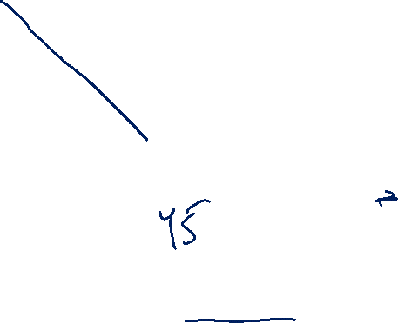
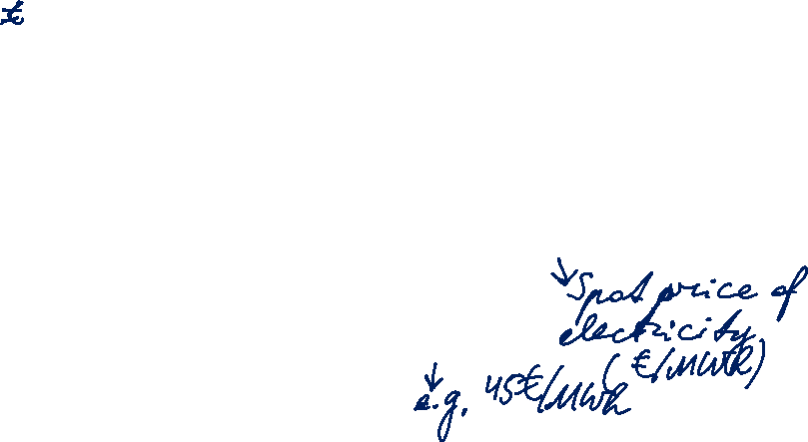
Put Option Payoff
Notes:
Zweifel, p. 292

Slide 53


Put Option Profits
Notes:
Zweifel, p. 292

Slide 54

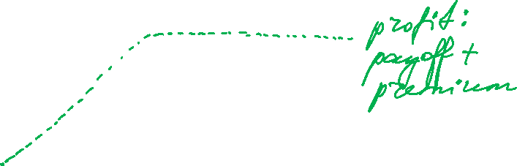
Put Option Writer’s Payoffs
Notes:
Zweifel, p. 292

Slide 55
Call Option Payoffs
Notes:
Zweifel, p. 292

Slide 56
Call Option Profits
Notes:
Zweifel, p. 292

Slide 57

Call Option Writer’s Payoffs
Notes:
Zweifel, p. 292

Slide 58
Options terminology (continued)
In-the-money: positive payoff in case of option excercise.
At-the-money: zero payoff in case of option excercise.
Out-of-the-money: negative payoff in case of option excercise.
Call option is in-the-money if strike price < spot price.
Put option is in-the-money if strike price > spot price.

Slide 59
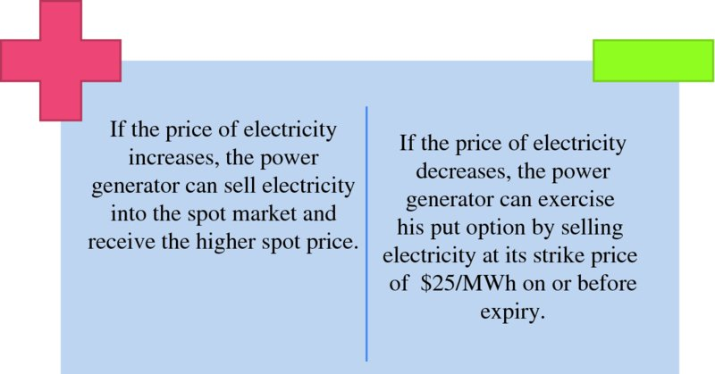
Generator hedging with put options
A power generator uses put options to guarantee a minimum selling price for its generated electricity. Suppose the electricity futures contract price is $25/MWh. The power generator wishes to receive at least $25/MWh for the physical sale of power. To accomplish this, the power generator purchases a put option for a premium of $1/MWh.
Source: Mack, Energy trading and risk management, 2014
Notes:
Zweifel, p. 292

Slide 60
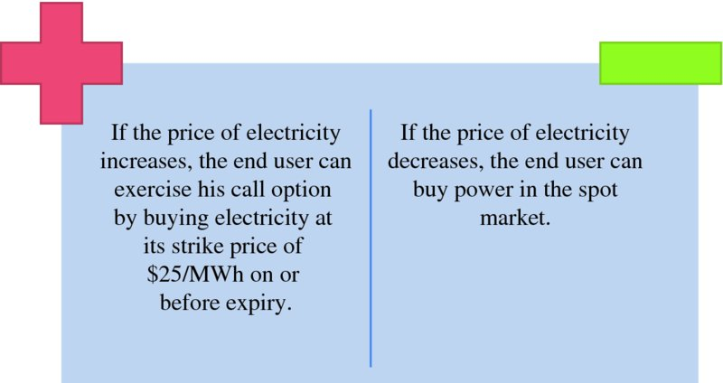
Consumer hedging with call options
A power consumer can hedge against price increases by purchasing a call option. Suppose the electricity futures contract price is $25/MWh. The end user wishes to pay no more than $25/MWh. To accomplish this, the end user purchases a call option for a premium of $0.75/MWh.
Source: Mack, Energy trading and risk management, 2014
Notes:
Zweifel, p. 292

