Slide 1
Integrated course „Energy Economics“
- Electricity markets fundamentals -
Chair of Energy Systems | Department of Energy Systems
Technische Universität Berlin

Slide 2
Outline – Electricity Markets
Electricity Markets Fundamentals
Economics of electricity generation
Energy trading – Wholesale markets
Economics of electricity grid
Retail markets

Slide 3
Outline – Electricity Markets Fundamentals
Electricity demand: Load duration curve
Electricity supply: Merit order
Electricity value chain
Market participants
Market structures

Slide 4
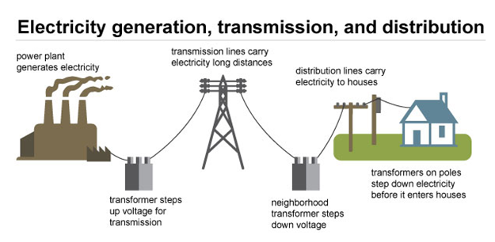
Electricity market: Technical view
Source: U.S. EAI
Notes:
Value chain is a framework that describes the full range of activities needed to create a product or service.
Physics of electricity. Real-time balance of electricity generation and consumption.

Slide 5
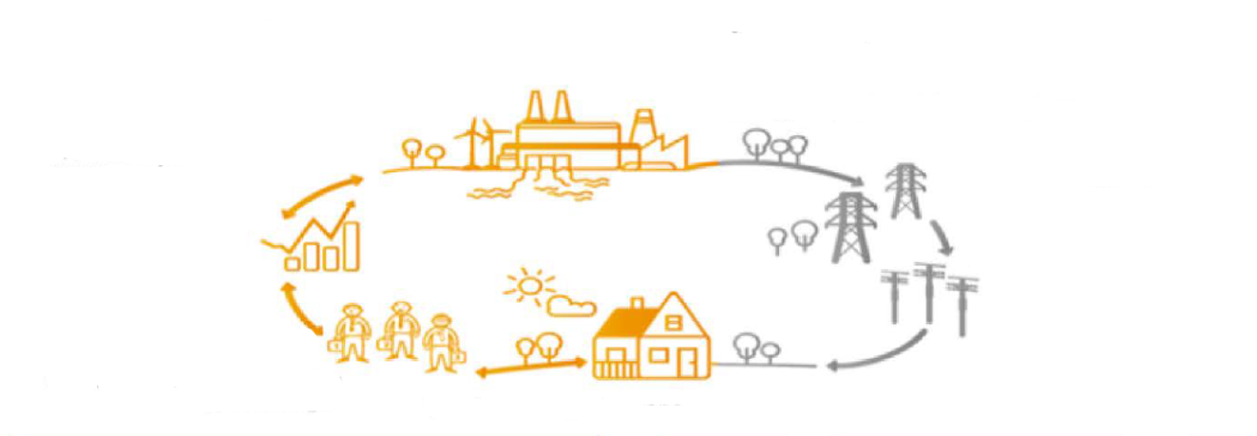
Electricity market: Economic view
Commercial infrastructure
Electricity is produced in power plants.
Technical infrastructure
Produced electricity is offered/traded in the wholesale market.
Produced electricity is transported to final consumers via transmission and distribution grid.
Electricity retailers procure electricity in the wholesale market for supplying final consumers.
Final consumers buy electricity from retailers.

Slide 6
Electricity market: Historical development
Historically, a vertically integrated company (often state-owned) performed all the activities from generation to supply to final consumers.
Since early 1990s: liberalisation (deregulation/restructuring)
introduction of competition to the activities where competition is considered possible
state regulation in the areas of natural monopoly
Notes:
Monopoly still have an incentive to underserve and overcharge the market.

Slide 7
Electricity market: Natural monopoly
Natural monopolies occur in industries for which it is only economically efficient to have a single provider due to economies of scale (decreasing average costs with increasing scale of production).
Electricity transmission and distribution is a decreasing cost industry: Duplicating the grid is economically inefficient.
Yet, natural monopolies – like monopolies in general – tend to overcharge and underserve.

Slide 8
Electricity market: Unbundling
Competitive conditions for electricity generation and retail can be created by state regulation aiming at:
Costs transparency
→ prevent cross-subsidies*
Non-discriminatory access to the grid
→ grid connection and transmission/distribution services
Unbundling is a set of organisational measures to separate transmission and distribution networks from generation and retail activities.
It aims at ensuring independence of a grid operator from other activities in a vertically integrated company and at preventing discrimination of other market participants.
* allocating costs from competitive
activities to grid operation

Slide 9
Electricity market: Unbundling types
Accounting u.: separate book-keeping for regulated activities
Legal u.: separate legal entity operates a regulated activity
Management u.: personal requirements for members of management bodies of a grid operator
Operational u.: TSO/DSO should have sufficient resources for operations (rather than relying on other parts of the vertically integrated undertaking). Restrictions for shared services (HR, IT, legal, finance etc.)
Informational u.: non-disclosure of commercially sensitive information from regulated activities (grid operation) to other units; otherwise - non-discriminatory disclosure to all market participants
Ownership u.: grid is operated by an entity with a separate ownership control.

Slide 10
Electricity market: Unbundling in the EU
1996: 1st Energy Package – Directive 96/92/EC
accounting and informational unbundling for vertically integrated undertakings (VIU)
2003: 2nd Energy Package – Directive 2003/54/EC
legal, management, operational and informational unbundling
2009: 3rd Energy Package – Directive 2009/72/EC
TSO: ownership unbundling; alternatively ISO or ITO model
  ISO: while the VIU keeps ownership control, an independent system operator operates the grid, incl. decisions on third-party access and investment planning
  ITO: TSO remains part of VIU but is subject to additional stricter requirements for effective independence
DSO: legal, management, operational and informational unbundling

Slide 11
Electricity value chain: Main actors
Generation
Wholesale
Transmission incl. dispatch
Distribution and metering
Retail
Primary energy is transformed into electricity and injected into the grid
Energy is sold/traded on the wholesale market
Electricity is transmitted via high voltage grid until the local distribution grid
Electricity is transformed from high to medium/low voltage and distributed to final consumers
Electricity is supplied to final consumers based on their demand
Power plant operators
Energy traders
Transmission system operators (TSO)
Distribution system operators (DSO)
Retailers
Notes:
Wholesale market helps to match supply and demand

Slide 12
Competitive and natural monopoly activities
Generation
Wholesale
Transmission incl. dispatch
Distribution and metering
Retail
Primary energy is transformed into electricity and injected into the grid
Energy is sold/traded on the wholesale market
Electricity is transmitted via high voltage grid until the local distribution grid
Electricity is transformed from high to medium/low voltage and distributed to final customers
Electricity is supplied to final consumers based on their demand
Power plant operators
Energy traders
Transmission system operators (TSO)
Distribution system operators (DSO)
Retailers
Competition
Competition
Regulated
Regulated
Competition
Natural monopoly

Slide 13
Electricity market: Objectives
Objectives of an electricity market design:
Short-run efficiency
  → making the best use of existing resources (generation capacities etc.)
Long-run efficiency
  → promoting efficient investment into new resources (generation assets, grid, storage etc.)
Reliability
  → reserve for satisfying demand at times of generation shortage
Source: Crampton, Oxford Review of Economic policy, Vol. 33, No. 4, 2017, p. 591.

Slide 14
Electricity market structure types
Single buyer
Power pool
Free wholesale competition
Fully liberalised market with retail competition

Slide 15
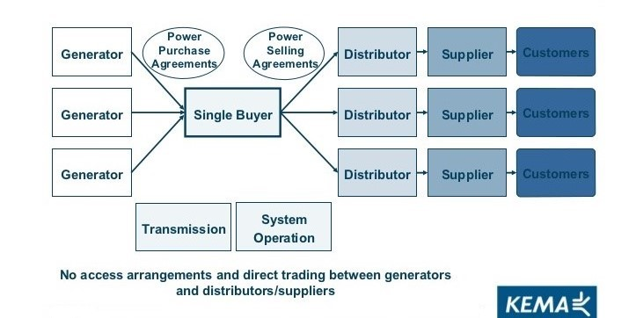
Electricity market structures: Single buyer

Slide 16
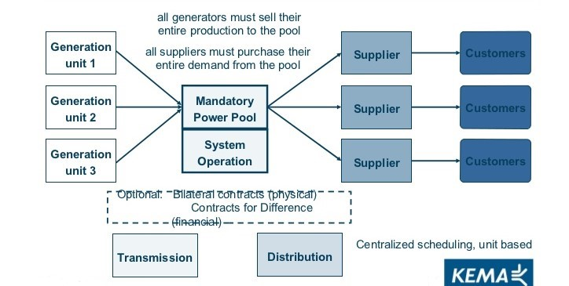
Electricity market structures: Power pool

Slide 17
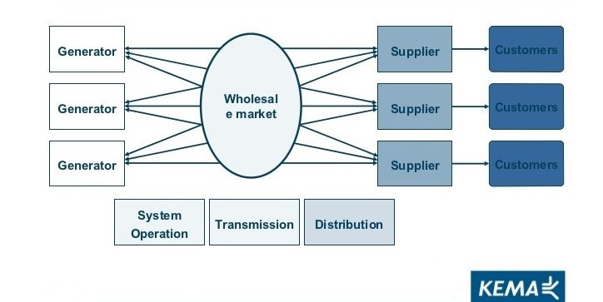
Electricity market structures: Wholesale competition

Slide 18
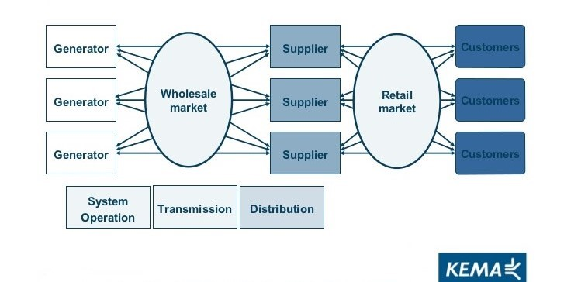
Electricity market structures: Retail competition

Slide 19
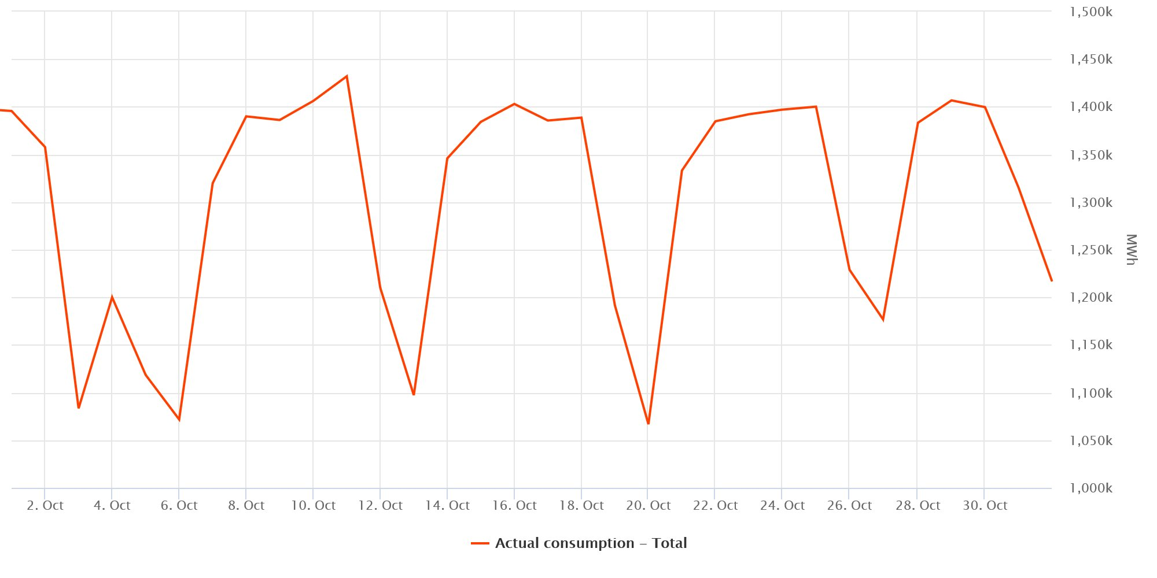
Load curve Germany – October 2019
Electricity demand fluctuates throughout the day, the week and across seasons.
Source: SMARD

Slide 20
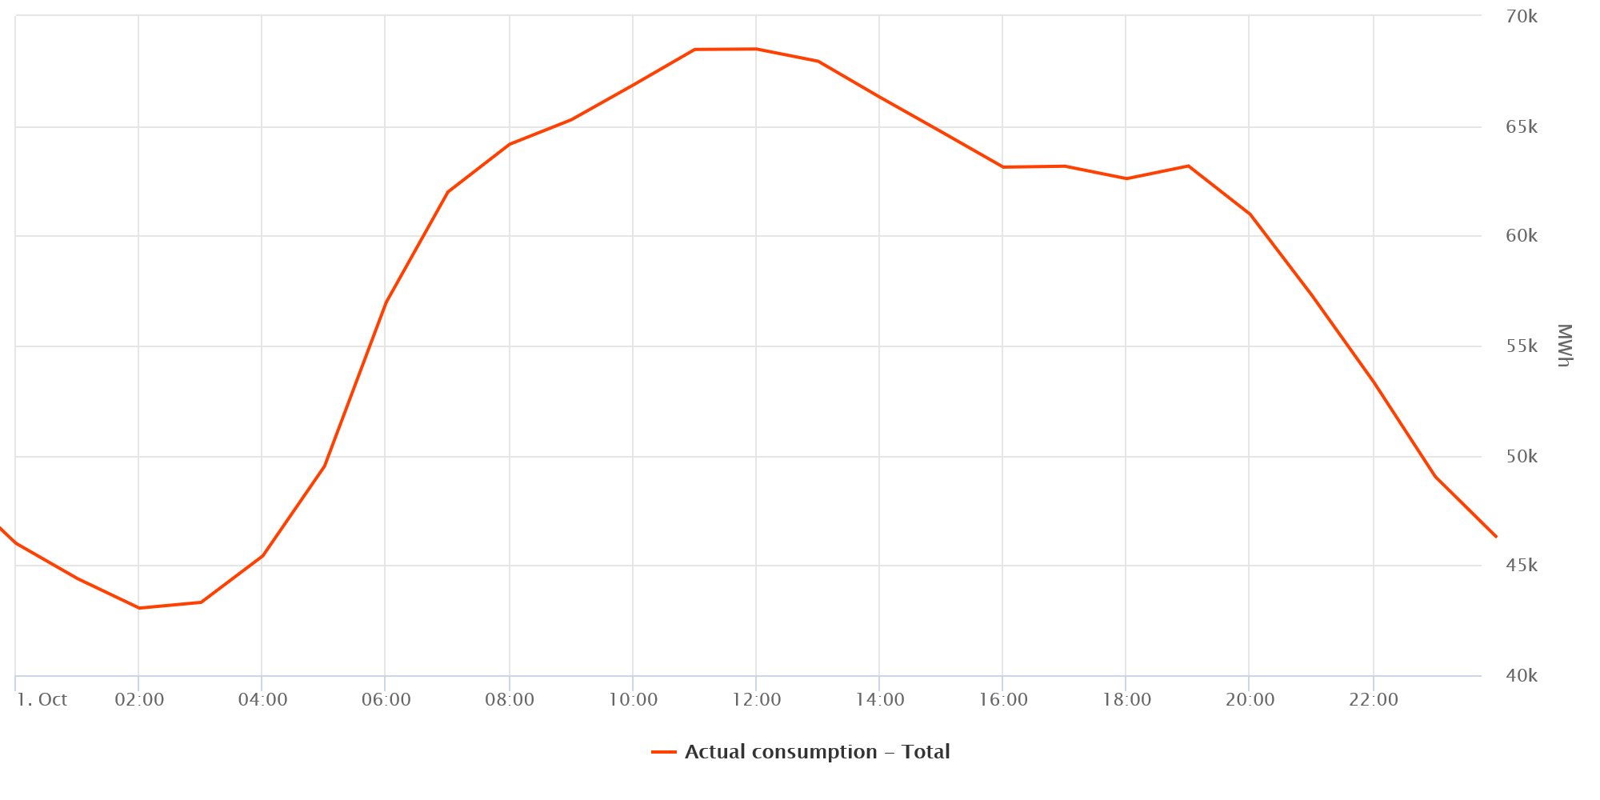
Load curve Germany – 1st October 2019
Source: SMARD

Slide 21
Load Curve and Load Duration Curve
P[MW]
P[MW]
Load Curve
Load Duration Curve
1
1
P_{max}
2
2+3
3
4
4
P_{min}
Time of day
Cumulative hours

Slide 22
Matching supply and demand
Electricity is virtually non-storable.
Demand is barely responsive to wholesale price fluctuations.
Thus, electricity supply and demand are balanced by continuous adjustment of generation.

Slide 23
Categories of costs in power production
 | Relevance for
 | Operational Decisions | Decommissioning Decisions | Investment and Expansion Decisions
Costs depending on capacity | [€/MW]
Capital costs (annuity) Labour costs Fixed O&M costs
Costs depending on operation | [€/MWh]
Fuel costs CO2 costs Other variable costs (e.g variable O&M costs, ramping costs, start-up costs)

Slide 24
Merit Order
Oil
Marginal costs
Gas
Coal
Nuclear
Hydro
Installed Capacity
Notes:
The merit order is a way of ranking available sources of energy, especially electrical generation, based on ascending order of price (which may reflect the order of their short-run marginal costs of production) together with amount of energy that will be generated. In a centralized management, the ranking is so that those with the lowest marginal costs are the first ones to be brought online to meet demand, and the plants with the highest marginal costs are the last to be brought on line. Dispatching generation in this way minimizes the cost of production of electricity

Slide 25
Merit Order
Available generation capacities arranged by their STMGC.
The market clearing price equals the marginal cost of the last (i.e. most expensive) generation unit required for matching the load.
Load
Oil
Marginal costs
Gas
Coal
Nuclear
Hydro
Installed Capacity
Notes:
The merit order is a way of ranking available sources of energy, especially electrical generation, based on ascending order of price (which may reflect the order of their short-run marginal costs of production) together with amount of energy that will be generated. In a centralized management, the ranking is so that those with the lowest marginal costs are the first ones to be brought online to meet demand, and the plants with the highest marginal costs are the last to be brought on line. Dispatching generation in this way minimizes the cost of production of electricity

Slide 26
Merit Order Effect of Renewables
Load
Oil
Marginal costs
Gas
Coal
Nuclear
Renewables
Hydro
Installed Capacity
Notes:
Merit Order Effect of the Renewables can be shown by changing the load curve or the generation curve.
In this case: Load is uncanged, Renewables shift the conventional merit order to the right, since they have the lowest marginal generation costs.
The merit order effect of renewable energy sources (RES) describes the impact of feed-in of renewable (must run) electricity on electricity prices. As renewable electricity feed-in such as wind or photovoltaic virtually comes at zero costs, the demand for conventional generation capacity is reduced by the amount of renewable feed-in. As a result the prices for electricity decrease: the merit order effect

Slide 27
Merit Order
Residual Load
Load
Oil
Renewables
Marginal costs
Gas
Coal
Nuclear
Hydro
Installed Capacity
Notes:
Residual Load = Load of consumers, reduced by RES, and inflexible must-run capacities

Slide 28
Merit Order - Impact of CO₂ – Prices
Load
CO₂-
Price
Oil
Marginal costs
Windfall-
Profit
Windfall-Profit
CO₂-Price
CO₂-Price
Gas
Coal
Nuclear
Hydro
Installed Capacity
Notes:
CO2-Price has to be priced into the marginal generation costs. Thereby changing the merit order.
There is a CO2 price at which generation technologies switch position in the merit order.

Slide 29
Task 1) Load Duration Curve
The peak load in a power system is 16 000 MW. Other load values and their durations in a year are given in the table.
Sketch a load duration curve.
What are the limitations of electricity market analyses based on a load duration curve?
What is the so called “residual load” and what does it imply?
Load [MW] | Duration [h]
≥ 12 000 | 1 500
≥ 8 000 | 4 500
≥ 6 500 | 7 000
≥ 4 000 | 8 760

Slide 30
Task 1) Load Duration Curve
Load [MW] | Duration [h]
≥ 12 000 | 1 500
≥ 8 000 | 4 500
≥ 6 500 | 7 000
≥ 4 000 | 8 760
The peak load in a power system is 16 000 MW. Other load values and their durations in a year are given in Table 1.
Sketch a load duration curve.

Slide 31
Task 1) Load Duration Curve
What are the limitations of electricity market analyses based on a load duration curve?
c) What is the so called “residual load” and what does it imply?

Slide 32
Load and Residual Load
to be covered by
adjustable generation
storage discharge
Load
reduced by must-run
(RES, inflexible conventional technologies)
Demand
Residual Load
Surplus
applicable for
storage charge
additional consumption: intersectoral technologies

Slide 33
Integrated course „Energy Economics“
- Electricity markets fundamentals (continued) -
Chair of Energy Systems | Department of Energy Systems
Technische Universität Berlin

Slide 34
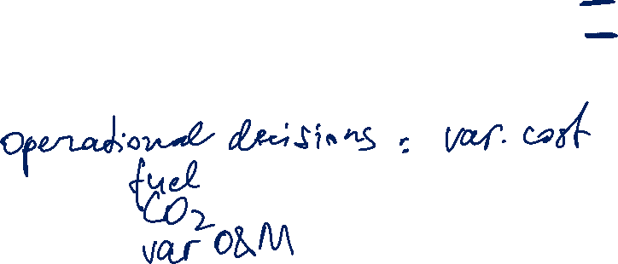
Task 2) Merit Order and Dispatch Decisions
Which categories of costs in the power sector are relevant i) for operational decisions ii) for decommissioning decisions and iii) for investment decisions? Explain why.
Notes:
a) See slide 5

Slide 35
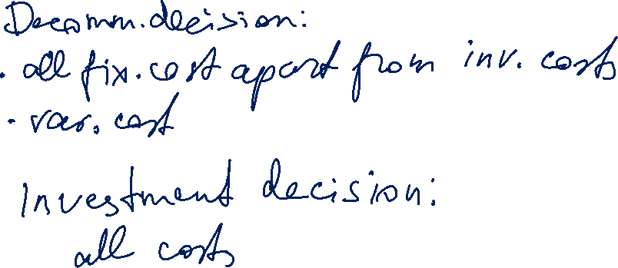
Task 2) Merit Order and Dispatch Decisions
Which categories of costs in the power sector are relevant i) for operational decisions ii) for decommissioning decisions and iii) for investment decisions? Explain why.
Notes:
a) See slide 5

Slide 36
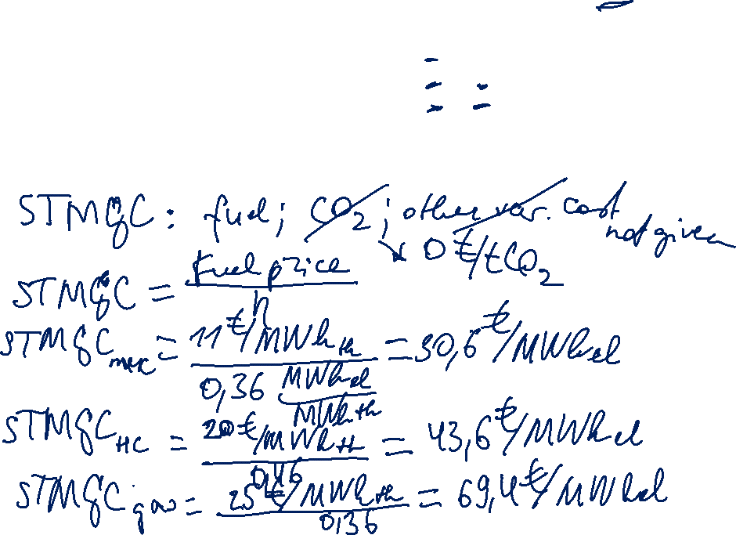
Task 2)
Dispatch Decisions
Assume the power plants given in table 2 have been constructed already. Sketch the merit order for these power plants. What is the electricity price at a load of 1.7 GW?

Slide 37
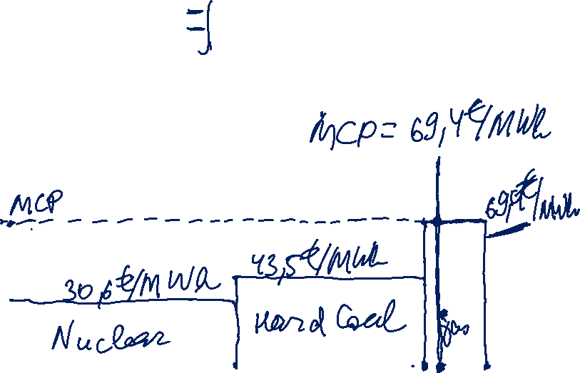
Task 2)
Dispatch Decisions
Assume the power plants given in table 2 have been constructed already. Sketch the merit order for these power plants. What is the electricity price at a load of 1.7 GW?

Slide 38
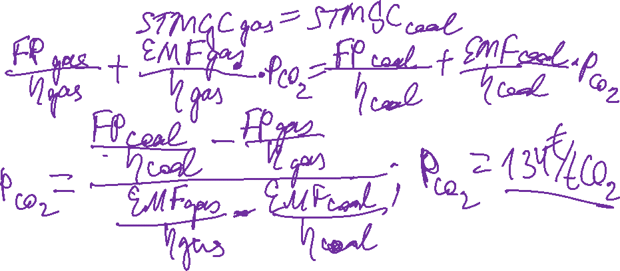
Task 2)
Dispatch Decisions
Now assume that there is a CO2 trading system. Calculate the emissions price (€/t CO2) at which the coal fired units show the same short-term marginal generation costs as the gas fired ones.

Slide 39
Task 2)
Dispatch Decisions
(continued)

Slide 40
Integrated course „Energy Economics“
- Energy Trading – Wholesale markets for electricity
Chair of Energy Systems | Department of Energy Systems
Technische Universität Berlin

Slide 41
Outline – Electricity Trading
Role of energy trading
Submarkets and trading forms
Trading products
Balance group concept
Credit risk management

Slide 42

What is energy trading
Trading is buying and selling, i.e. exchanging commodities.
Electricity is a homogeneous product – uniform and standardised: a commodity.
Other commodities: agricultural (wheat, coffee), metals (gold, steel) etc.
Other energy commodities: natural gas, crude oil, LNG, coal Related markets: freight, CO₂ emission allowances
Energy trading has parallels to financial markets (shares, bonds and other financial instruments) – even with its particularities due to the physical nature of electricity (gas/oil/coal etc.) as underlying.
Notes:
Market participants are buying and selling at the same time – in contrast to supplier – final consumer relationship. Purchased commodity can be resold.

Slide 43
Energy trading and Financial markets
Future prices cannot be predicted based on historical prices.
The best prediction of tomorrow’s price P_{t+1} is today’s price P_{t}.
The unique reason for a change in price is arrival of “news” not correlated with information available at time t.
Transparency (availability of information to all market participants) is a crucial prerequisite for efficient market functioning.

Slide 44

Trading forms: Exchange vs. OTC
Mediated trading: power pool or power exchange
organised auction resulting in a uniform price
highly standardised products; no room for negotiation
transparency
regulated
clearing and colateral costs
Bilateral trading: over-the-counter (OTC)
intermediation cost (opportunity cost or broker fee)
individual prices agreed between pairs of buyers and sellers
(≈pay-as-bid principle)
standard framework agreements: EFET/GTMA; ISDA; DRV etc.
unregulated
Typically: Combination of exchange and OTC trading.
Notes:
Transparency: exchange publishes traded volumes and prices.

Slide 45

Energy trading: Submarkets
Time
Delivery time (t0)
Forward /
Futures /
Term
Spot /
Short-term /
Cash
Day-ahead
Intraday
years, quarters, months ahead of delivery
day ahead delivery
up to 5 min ahead of delivery
Notes:
Transparency: exchange publishes traded volumes and prices.

Slide 46

Energy Trading: Submarkets
Time
Delivery time (t0)
EEX Futures
until 24:00 on the last day of M-2
Mo-Fr (no trading on weekend and public holidays)
Day-Ahead Auction EXAA
until 10:12 on D-1
hours and 15 min
Mo-Fr (no trading on weekend and public holidays)
Day-Ahead Auction EPEX Spot
until 12:00 on D-1
hours and blocks
Intraday Auction EPEX Spot
until 15:00 on D-1
15 min
Intraday continuous EPEX Spot
from 15:00 on D-1 until 5 min before t0
15 min [16:00 D-1 until 5 min before t0)
Exchange
Bilateral
Forward / Term
Spot / Short-term
until 15 min before t0 across control areas; immediately before t0 for trades within the same
control area. Forward and spot All products are negotiated bilaterally.
Control power
Primary reserve
until Tue 15:00 for Mo from 00:00
Time blocks: one week
Secondary reserve
daily until 8:00 for following day from 00:00
Time blocks: six 4-hour blocks
Minute reserve
daily until 8:00 for following day from 00:00
Time blocks: six 4-hour blocks
Source: Adapted from Next Kraftwerke
Notes:
Submarkets with different lead times between trade conclusion and actual delivery.
Forward/futures: hedging
Spot: day-ahead market, 15-min intraday auction, continuous intraday market

Slide 47
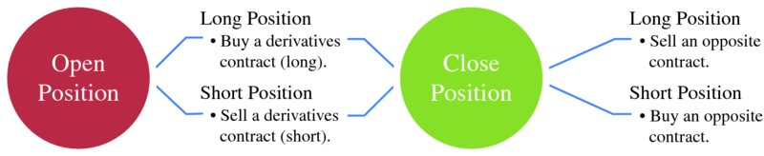
Forward markets: Continuous trading
Traders take up forward positions based on market expectations but can reverse them later up until delivery by offsetting (back-to-back) purchases or sales.
Buy a contract to cancel out an earlier sale (cover a short).
Sell a contract to close an earlier purchase (cover a long).
Source: Mack, Energy trading and risk management, 2014
Notes:
Buying a commodity at a price a year from now is a short position.
Purchasing a commodity at a market price and selling it at a fixed price: two

Slide 48
Forward markets: Long and short positions
Long position: trader benefits from a price increase.
E.g. trader buys electricity forward at today’s market price. If the market price rises, the trader will be able to sell the contract later at a higher price and realise a profit.
Short position: trader benefits from a price decrease.
E.g. trader sells electricity forward at today‘s market price. If the market price goes down, the trader will be able to buy the same product later at a lower price and realise a profit.
But: Long ≠ Buy, and Short ≠ Sell For example:
1. Buying a commodity at a price a year from now is a short position. The position benefits the trader only if the current market higher than the market price in one year (i.e. in falling price case)
2. Purchasing a commodity at the market price and selling it at a fixed price (both short) is an open position, rather than a closed one. Trader benefits from selling at a fixed price (other than the current market price) if the price falls.
See: Edwards, Energy trading & investing, 2010, p. 5

Slide 49
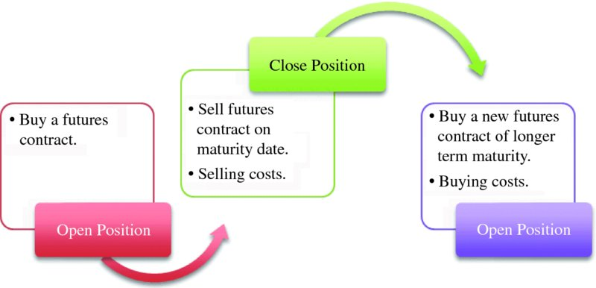
Rolling of futures
A futures trader has two options:
closing the contract on or before the maturity date (delivery period) by selling or
rolling over the contract
Source: Mack, Energy trading and risk management, 2014

Slide 50
Rolling of futures (continued)
At the beginning of the delivery period, the initial product splits into a set of equivalent shorter-term products.
Longer maturities cascade into corresponding shorter marturities.
„
„
Source: EEX Contract Specifications
Notes:
Forward=Term trading

Slide 51
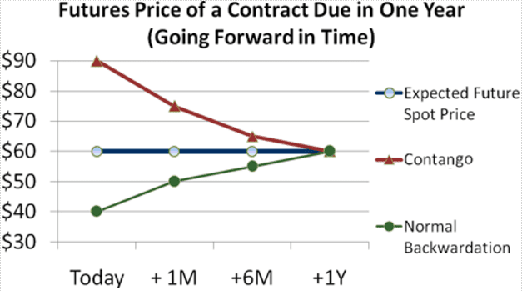
Forward market: Price development patterns
Contango: forward price exceeds the spot price.
Backwardation: spot price exceeds the forward price.
Market participants are driving the forward price up/down in line with their expectations.
Source: Mack, Energy trading and risk management, 2014
Notes:
Contango: Traders anticipate decrease in supply or increase in demand. Trading activities to hedge against the potential price increase drives the forward price up.
Backwardation: traders anticipate price decline and drive the forward price down.

Slide 52
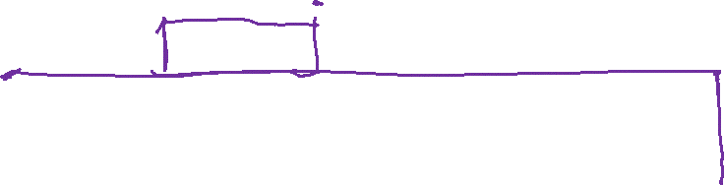
Sample power purchase portfolio
Standardised futures do not match with typical load schedules.
© Prof. Dr. Georg Erdmann
Notes:
Flat deliveries (blocks) under forward/futures contracts are matched with actual load profile by trading in the day-ahead and intraday market (or by balancing power).

Slide 53


Portfolio management of a power retailer
© Prof. Dr. Georg Erdmann
Notes:
Flat deliveries (blocks) under forward/futures contracts are matched with actual load profile by trading in the day-ahead and intraday market (or by balancing power).

Slide 54


Day-ahead contracts for singular hours
© Prof. Dr. Georg Erdmann
Notes:
Flat deliveries (blocks) under forward/futures contracts are matched with actual load profile by trading in the day-ahead and intraday market (or by balancing power).

Slide 55
Market liquidity
Churn rate is the ratio of traded volume to physically delivered volume.
i.e. how many times the electricity generated/consumed has been traded before delivery
Bid-ask spread is the difference between the ask price (sell side) and the bid price (buy side).
Market depth is the volume of buy and sell orders.
Liquidity impacts:
the intermediation costs and the bid/ask spread
the time horizon and costs for closing a position
Notes:
Liquidity is an indicator of the market quality.
A liquid market is where you can buy or sell quickly.
Mor illiquid/thinner markets are more volatile.
The more liquid a market it, the more reliable the technical patterns.

Slide 56
EPEX Spot Day-ahead auction
Double-sided auction: bid and ask order book (order book trading)
Uniform price auction: market clearing price for each product (hour or block)
Hourly contracts and blocks (base, peak etc.)
Occurs daily at 12h for delivery on the following day (0-24h)
Price publication time: asap from 12:42h
Volume tick (min order amount/amount increment): 0,1 MWh
Min price: -500 €/MWh; Max price: 3.000 €/MWh
Notes:
Auction market is a centrally managed market (central clearing house) under uniform rules.

Slide 57

Bidding curves at EEX
[delivery period Monday, 6.11.2006, 8-9 h]
[Euro/MWh]
Demand
Supply
150
100
50
0
0
5000
10000
15000
20000
25000
[MWh]

Slide 58
Auction design
Goal of an auction is the least-cost dispatch of generation.
Source: Morey, Power market auction design, EEI, 2001, p. 20.
Notes:
Supply offer reflects the seller’s individual supply schedule.
Demand bid reflects the buyer’s individual demand schedule.

Slide 59
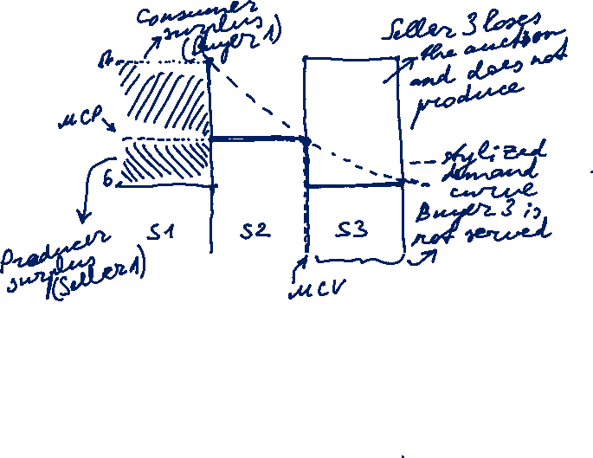
Power auction: Stylised example
$
Uniform price: market clearing price
vs Pay-as-bid: units are sold at different prices (e.g. control power)
Revenue equivalence theorem: equal outcome in both settings under the assumption that all bidders know each other’s cost (perfect information) and adjust their bidding behaviour to auction rules.
 | No. of units | Price [$/unit]
Buyer 1 | 5 | 17
Buyer 2 | 5 | 10
Buyer 3 | 5 | 6
Seller 1 | 5 | 6
Seller 2 | 5 | 10
Seller 3 | 5 | 17
15
10
5
5
10
15
Volume [units]
Source: Morey, EEI, 2001, p. 21-22.
Notes:
Supply offer reflects the seller’s individual supply schedule.
Demand bid reflects the buyer’s individual demand schedule.
At the market equilibrium point, the value of the last unit purchased equals the cost of the last unit supplied.

Slide 60
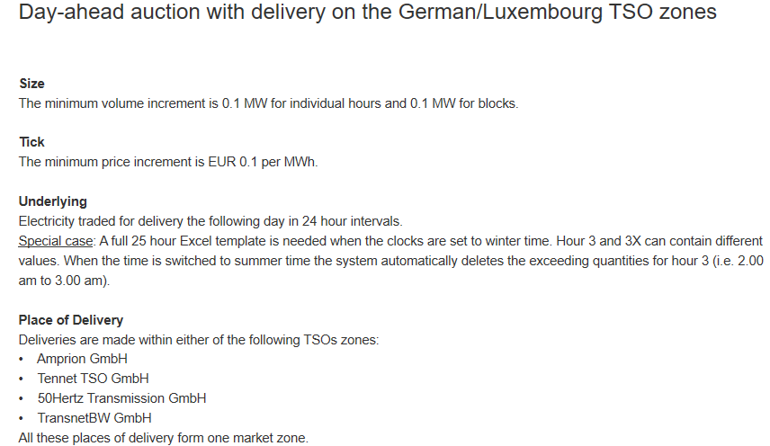
EPEX Spot Day-ahead auction: Product description
https://www.epexspot.com/en/product-info/auction/germany-luxembourg

Slide 61
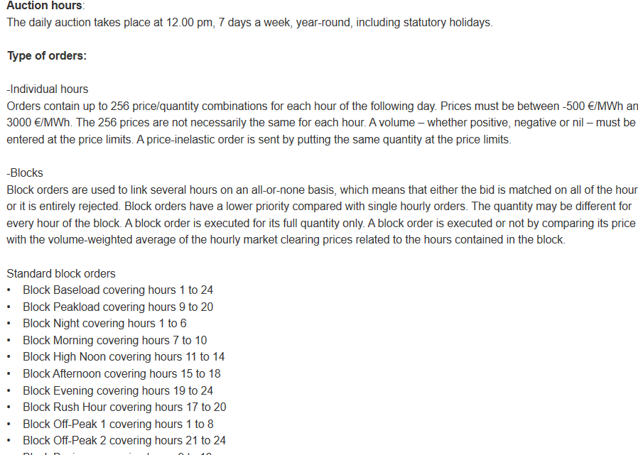
Product description (continued)

Slide 62
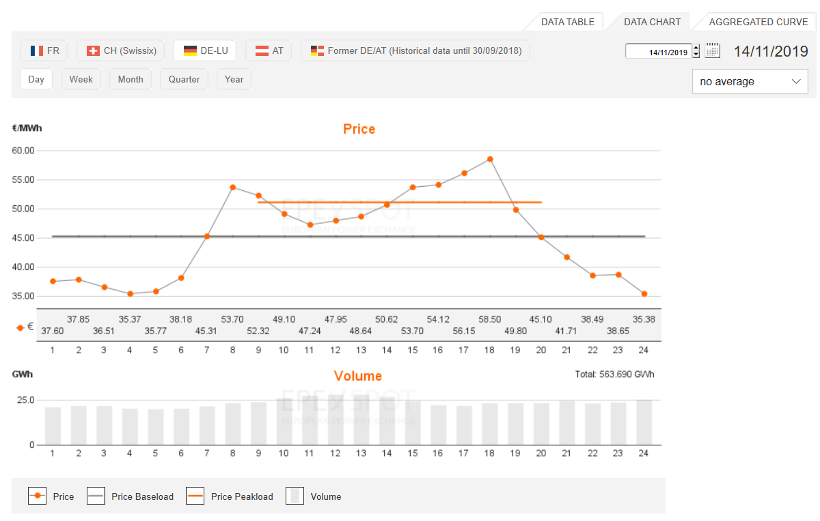

EPEX Spot Day-ahead auction

Slide 63
Intraday market
Intraday market reflects a growing need for flexibility close to delivery due to a growing share of volatile renewables.
Intraday market serves for adjusting trading positions based on corrected forecasts closer to real-time.
uniform price auction for hourly products; daily at 3 pm (d-1)
uniform price auction for 15-min products; daily at 4 pm (d-1)
continuous intraday market for hourly products
The German spot power market for hourly contracts
Source: Balardy, 2018
Notes:
Less liquid than day-ahead markets
Price range: -9.999€ to 9.999€
Intraday market reduces imbalance costs, helps to optimise production and consumption and promotes flexibility.

Slide 64
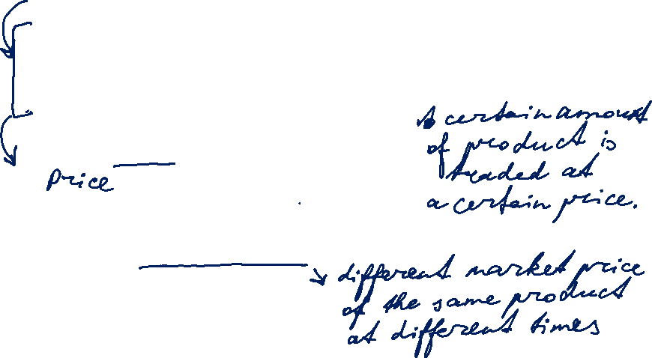

What is a trading product
Trading product is combination of transaction features:
Underlying asset electricity
Delivery point TSO control area
Delivery period start date / end date
Delivery amount contract capacity [MW]
  contract quantity [MWh]
A bid (offer to buy) or ask (offer to sell) is characterised by: product, price, trading day and time.

Slide 65
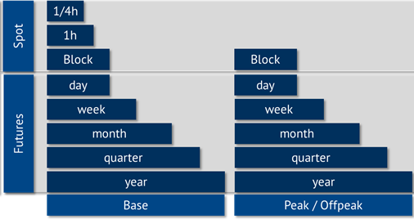
Electricity product types based on delivery period
Source: Energy Brainpool

Slide 66
Product types
Physical vs. Financial
Physical product implies physical delivery of the underlying (i.e. electricity).
Financial product implies exchange of cash without physical delivery (no set-up with TSO required) → Swap
Fixed-price vs. floating price (index-based)
Fixed price is stated as an amount of money per unit of underlying
Floating price is determined by reference to a price index publication at a time point after deal conclusion.
Fixed-amount vs. options

Slide 67
Product types: Swaps
Swaps is a general category of financial products
fixed-for-floating swap: Party A is fixed price payer; Party B is floating price payer (=reference price based on a price index published in the future → market price); only the difference is exchanged each month
e.g. large consumer (as Party A – fixed price payer) hedging price risk from their long-term supply contract with an index-based price
floating-for-floating swap: both Party A and Party B pay their respective floating price
swaption: option to enter into a swap
floor, cap, collar etc.

Slide 68
Options: Terminology
An option gives the holder the right, but not the obligation, to buy or sell a specified quantity of an underlying on (or before) a specified future date, at a predetermined price.
Excercising the option is buying or selling the underlying.
- Call option is a right to buy.
- Put option is a right to sell.
Expiry (expiration/maturity date) is the date on (or until) which the option can be excercised.
- European options can be excercised only at expiry.
- American options can be excercised at any time up to expiry.
Strike (excercise) price is the pre-agreed buy or sell price.
Option premium is a fixed amount paid by the holder (option buyer) to the writer (option seller) upon concluding an option.

