Slide 1
Integrated course „Energy Economics“
- Microeconomics: basic concepts
Chair of Energy Systems
Prof. Dr. Boris Heinz | Dr. Elena Timofeeva
elena.timofeeva@tu-berlin.de

Slide 2
Outline
Particularities of energy sector
Market structures
Supply and demand
Welfare effect of markets
Tax effect – deadweight loss
Price elasticity of demand
Cost of production - terminology

Slide 3
Particularities of energy markets
Energy is an essential factor of production.
Energy is necessary for satisfying basic human needs.
Long time horizons for infrastructure planning
Public sector stake
Energy sector causes the largest CO₂ emissions
Risk of large-scale accidents
Public interest in speeding up market entry of new technologies
Natural monopolies (or oligopolies) instead of perfect competition
Market failure: state of a market where resources are not allocated efficiently (e.g. externality, market power).

Slide 4
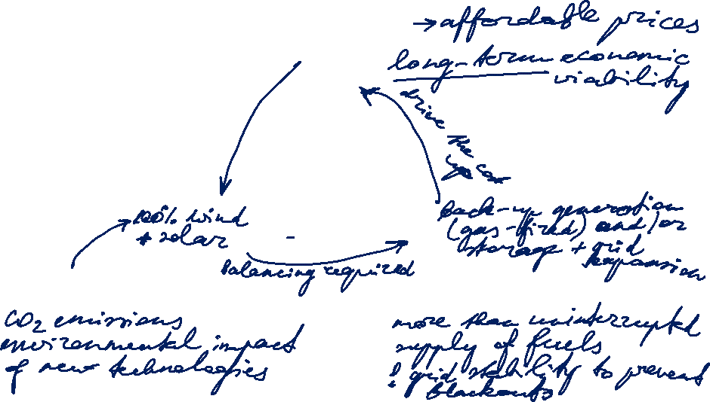
Energy Policy: Magical triangle of energy policy goals
Economic viability
Environment and climate
Security of supply

Slide 5
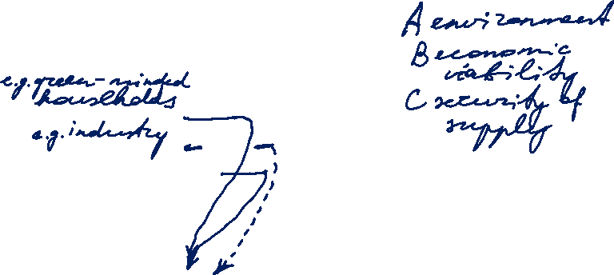
Aggregation of individual preferences
Three social groups and three alternatives A, B and C
Group 1 A > B > C
Group 2 B > C > A
Group 3 C > A > B
Aggregation through pairwise majority of votes (Arrow paradox)
        A : B 2:1
        B : C 2:1 => A > C
        A : C 1:2

Slide 6
Economics and energy sector
General economic concepts hold as a basis.
In particular: analysis of monopolistic markets.
Energy markets are governed by rules that do not correspond to perfect markets.
They require a more complex analysis.

Slide 7
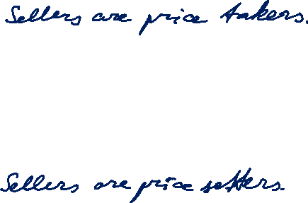
Market structures
Market is a group of sellers and a group of buyers of a particular good or service.
Perfect competition:
many buyers and many sellers > cannot influence the price
goods at exactly the same (homogeneous)
consumers have perfect information
no entry or exit barriers
Monopoly:
seller is the sole producer and can influence the price of its output
Market power is the ability to maintain a price above the price under competition.

Slide 8

Market structures

Slide 9
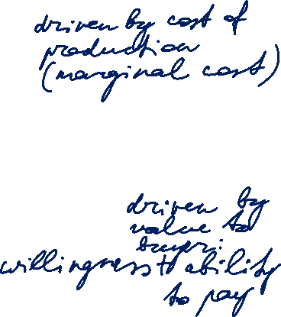
Demand and Supply
Price p
Supply function
p(QS)
Demand function
p(QD)
Q
Notes:
The demand curve reflects the value to the buyers.
The supply curve reflects the costs to the sellers.

Slide 10
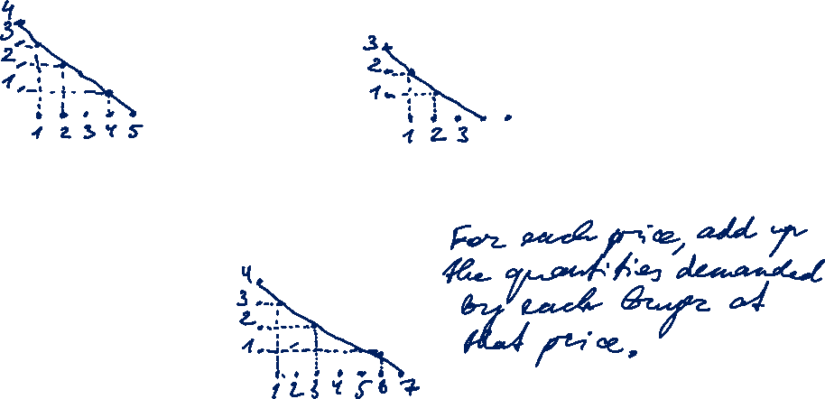
Demand and Supply
Buyer A
Buyer B
P
P
Q
Q
Market demand
(Buyer A + Buyer B)
P
Q
Notes:
The demand curve reflects the value to the buyers.
The supply curve reflects the costs to the sellers.

Slide 11
Demand and Supply
Price p
Supply function
p(QS)
MCP
At the equilibrium price, the quantity supplied equals the quantity demanded.
Market clearing price
Demand function
p(QD)
Market clearing volume
MCV
Q
Notes:
The demand curve reflects the value to the buyers.
The supply curve reflects the costs to the sellers.

Slide 12
Bidding curves at EEX
[delivery period Monday, 6.11.2006, 8-9 h]
[Euro/MWh]
Demand
Supply
150
100
50
0
0
5000
10000
15000
20000
25000
[MWh]

Slide 13
Price reaction to change in demand
p
Income
Supply
p_{max}
p₁*
A₁
p₀*
A₀
Shift of demand curve
Q₀*
Q₁*
Q

Slide 14
Price reaction to change in supply
Shift of supply curve
p
Supply
p_{max}
p₁*
A₁
p₀*
A₀
Demand
Q₁*
Q₀*
Q

Slide 15
State regulation: Minimum price (floor price)
P
Excess
Supply
p_{min}
p₀*
A₀
Examples:
EU agriculture politics:
milk overproduction discarded
Minimum wages
Demand
Q_{D}
Q_{S}
Quantity demanded
Q₀*
Quantity supplied
Q

Slide 16
State regulation: Maximum price (price cap)
P
Supply
p₀*
A₀
Examples:
apparment rent,
bread/staples,
energy products
Shortage
p_{max}
Demand
Q_{S}
Q_{D}
Q₀*
Q
Quantity supplied
Quantity demanded

Slide 17
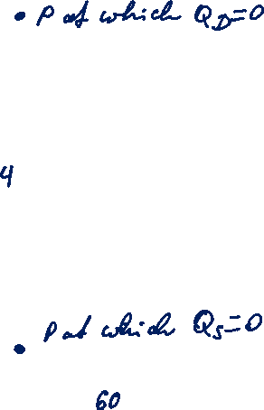
Demand and Supply: Welfare effect of markets
Price p
Some buyers are willing to pay a price larger than the market clearing price but pay MCP.
Supply function
p(QS)
MCP
Some sellers are able to produce at a marginal cost lower than the market clearing price but sell at MCP.
Demand function
p(QD)
MCV
Q
Notes:
The demand curve reflects the value to the buyers.
The supply curve reflects the costs to the sellers.

Slide 18
Demand and Supply: Welfare effect of markets
Price p
The amount the buyer is willing to pay for a good minus the amount the buyer actually pays for it.
Supply function
p(QS)
(CS)
Consumer Surplus
MCP
Producer Surplus
(PS)
The amount the seller is paid for a good minus the seller‘s cost of providing it.
Demand function
p(QD)
CS + PS = TS
Q
MCV
Total surplus indicates the degree of efficiency of resource allocation.
Notes:
Willingness to pay determines the value to buyers.
CS = value to buyers – amount paid by buyers
PS = amount received by sellers – cost of production
Free markets allocate goods to buyers who value them most highly and to sellers that produce at the least cost.

Slide 19

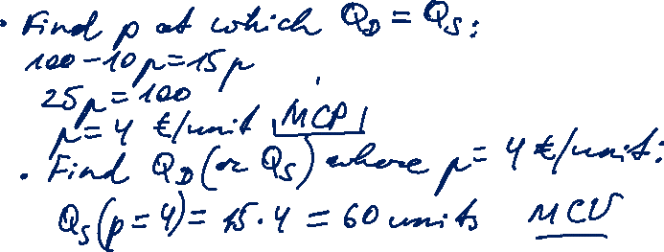
Task 1) Supply and demand
Given are the supply and demand functions for fuel depending on the price [€/unit] in a competitive market:
Demand $Q_{D}\left(p\right)=100−10p$
Supply $Q_{S}\left(p\right)=15p$
What is the market clearing price (MCP) and what are the quantities being traded (MCV)?

Slide 20

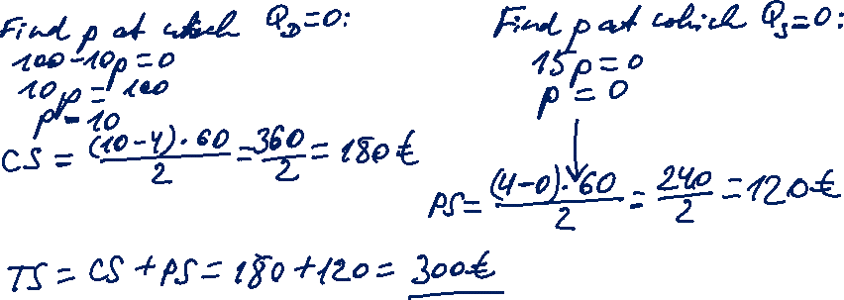
Task 1) Supply and demand
Given are the supply and demand functions for fuel depending on the price [€/unit] in a competitive market:
Demand $Q_{D}\left(p\right)=100−10p$
Supply $Q_{S}\left(p\right)=15p$
How much is the consumer surplus (CS) and how much is the producer surplus (PS)?

Slide 21
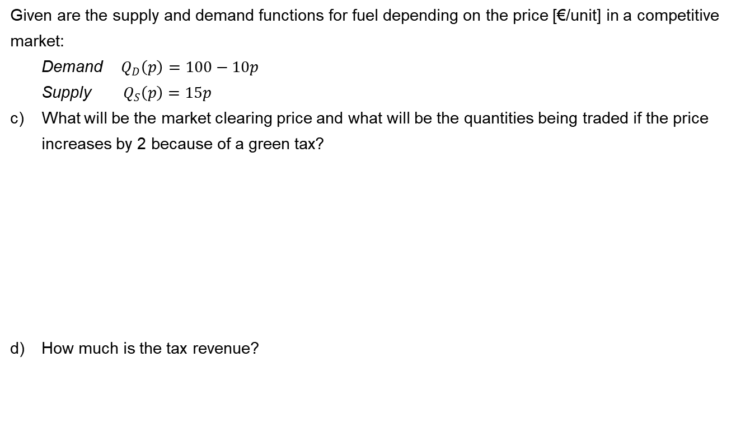
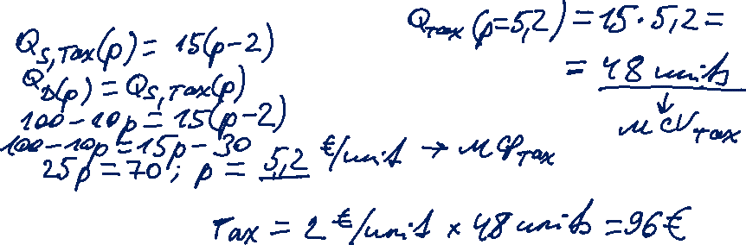
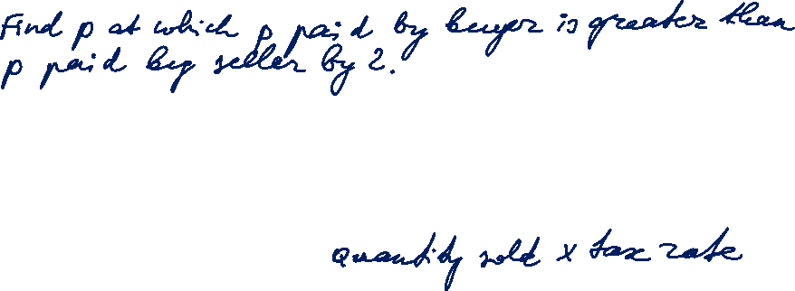
Task 1) Supply and demand
Given are the supply and demand functions for fuel depending on the price [€/unit] in a competitive market:
Demand $Q_{D}\left(p\right)=100−10p$
Supply $Q_{S}\left(p\right)=15p$
What will be the market clearing price and what will be the quantities being traded if the price increases by 2 because of a green tax?
How much is the tax revenue?

Slide 22

Task 1) Supply and demand with a tax
Supply function with tax
ptax(QS)
Price p
(CS)
Supply function
p(QS)
(PS)
MCPtax
MCP
Deadweight loss
Tax
Demand function
p(QD)
tax rate
MCVtax
MCV
Q

Slide 23

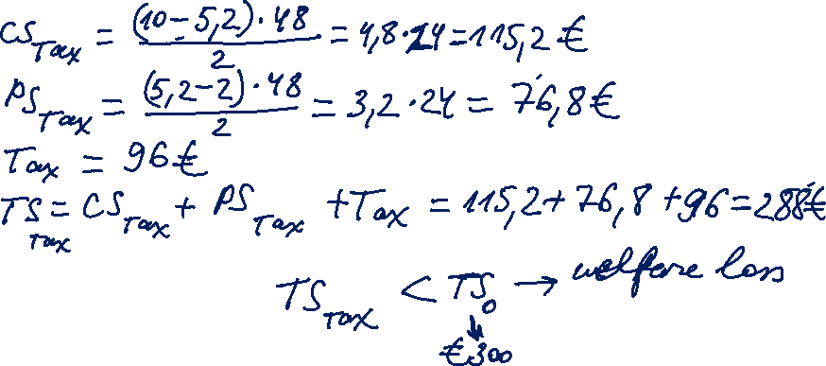
Task 1) Supply and demand
Given are the supply and demand functions for fuel depending on the price [€/unit] in a competitive market:
Demand $Q_{D}\left(p\right)=100−10p$
Supply $Q_{S}\left(p\right)=15p$
How much is the consumer and the producer surplus now? How much is the welfare now?

Slide 24
Price elasticity
Elasticity is a measure of how much buyers and sellers respond to changes in market conditions (e.g. prices – price elasticity).
Price elasticity of demand is a measure of how much the quantity demanded of a good responds to a change in the price of that good.
% change in quantity demanded
Price elasticity of demand =
% change in price

Slide 25
Price elasticity (continued)
-1 < η_{p,Q} ≤ 0 inelastic demand
-∞ < η_{p,Q} ≤ -1 elastic demand
η_{p,Q} = -1 if price increases by 1%, demand
decreases by 1%
Convention to operate with absolute values │η_{p,Q} │:
η_{p,Q} > 1 elastic demand
0 ≤ η_{p,Q} ≤ 1 inelastic demand

Slide 26
Price elasticity of demand: Electricity
Demand for electricity is largely inelastic.
General reasons for inelastic demand (0 – 1):
Buyers do not perceive the price changes
Switching to alternative products (substitutes) is cumbersome
Lack of substitutes
Time:
Goods tend to have more elastic demand over longer time horizons

Slide 27

Task 2) Price elasticity
The price for electricity is 0.2 €/kWh. The demand function of a private household (per month) is given by:
Demand $q_{Di}\left(p\right)=625−625p$ q [kWh], p [€/kWh]
How much electricity does the single household consume per month? How much does it pay?

Slide 28

Task 2) Price elasticity
The price for electricity is 0.2 €/kWh. The demand function of a private household (per month) is given by:
Demand $q_{Di}\left(p\right)=625−625p$ q [kWh], p [€/kWh]
What is the price elasticity at this point? Is it elastic or inelastic?

Slide 29

Task 2) Price elasticity
The price for electricity is 0.2 €/kWh. The demand function of a private household (per month) is given by:
Demand $q_{Di}\left(p\right)=625−625p$ q [kWh], p [€/kWh]
How will the single household react if price doubles? How do demand, price and price elasticity change?

Slide 30
Supply side: Cost of production
The price at which a seller is willing to sell their goods is determined by their cost of production:
explicit cost: out-of-pocket expenses - money actually paid
opportunity cost: potential benefit or income that is foregone as a result of selecting one alternative over another

Slide 31
Terms and definitions of cost accounting
Fixed Costs are the share of the total costs that do not change with a variation of the produced quantity
Variable Costs are the share of the total costs that do change with a variation of the produced quantity
Total Costs are the sum of fixed and variable costs

Slide 32
Terms and definitions of cost accounting (continued)
Average costs are total cost per unit: TC divided by the produced quantity Q.
Marginal costs are costs incurred for producing one additional unit of production volume.
Contribution margin is selling price minus variable cost per unit.

Slide 33
Terms and definitions of cost accounting
Fixed Costs are the share of the total costs that do not change with a variation of the produced quantity
Variable Costs are the share of the total costs that do change with a variation of the produced quantity
Total Costs are the sum of fixed and variable costs
Average Costs are the total costs C divided by the produced quantity Q
Contribution margin is price minus variable costs
Marginal Costs are the costs that incur due to an increase of the produced quantity by one

Slide 34
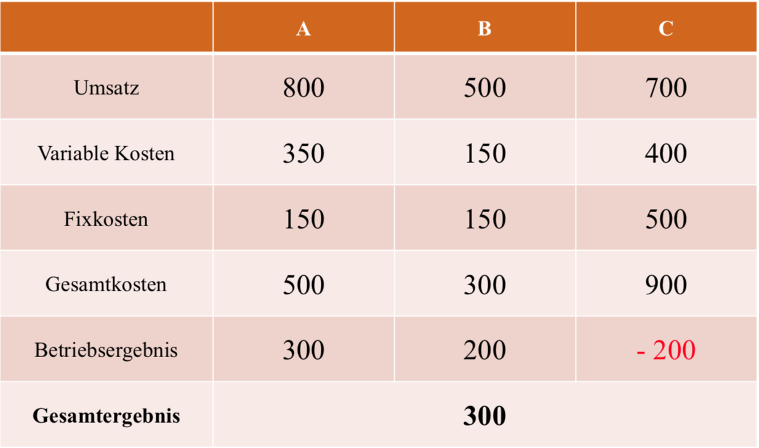
Total cost consideration
Turnover
Variable Cost
Fixed Cost
Total Cost
Operating income
Overall outcome

Slide 35
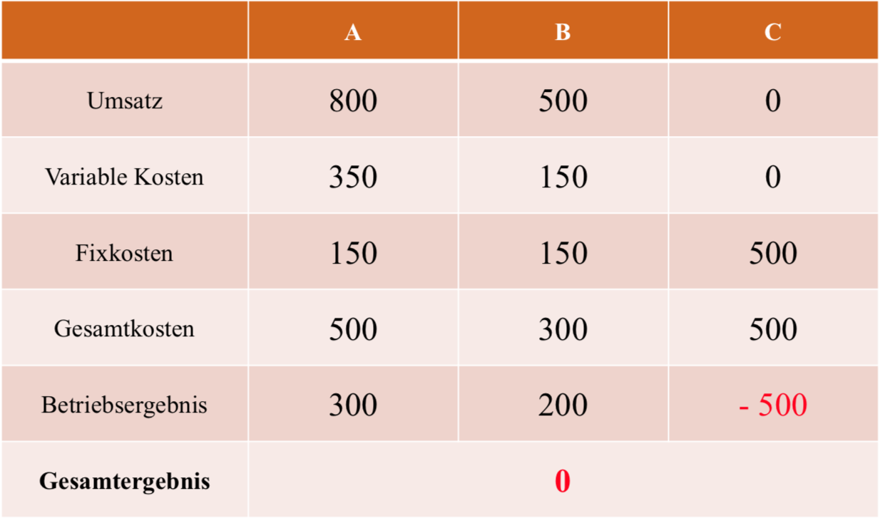
Total cost consideration without product C
Turnover
Variable Cost
Fixed Cost
Total Cost
Operating income
Overall outcome

Slide 36
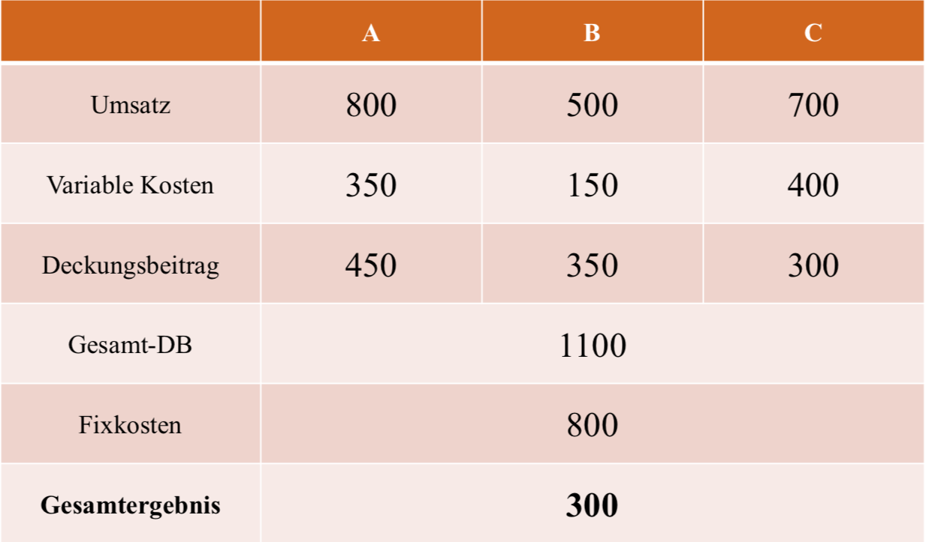
Variable cost
Turnover
Variable Cost
Contribution margin
Total contribution margin
Fixed cost
Overall outcome

Slide 37
Cost considerations

Slide 38
Cubic cost structure – cost structure
c
[EUR/unit]
dC/dQ
c (Q)
c_{var} (Q)
c_{fix}
Q
[unit]

Slide 39
Cubic cost structure – conclusions for a price taker
c
[EUR/unit]
dC/dQ
c (Q)
c_{var} (Q)
Market Price
[EUR/unit]
Profit
C_{fix}
C_{var}
c_{fix}
Q
[unit]

Slide 40
Market structures - 1
Market is a group of sellers and a group of buyers of a particular good or service.
Perfect competition:
many buyers and many sellers > cannot influence the price
goods at exactly the same (homogeneous)
consumers have perfect information
no entry or exit barriers
Monopoly:
seller is the sole producer and can influence the price of its output
Market power is the ability to maintain a price above the price under competition.

Slide 41
Market structures - 2
Cournot oligopoly:
More than one firm
All firms produce one homogeneous product (no product differentiation)
No cooperation among firms (no collusion)
Firms have market power - each firm's output decision affects the good's price
Fixed number of firms
Firms compete in quantities, and choose them simultaneously
Economically rational and strategically acting firms, seeking to maximize profit given their competitors' decisions

Slide 42

Supply and pricing – profit maximization of the firm
Π Profit (per period)
p Sales price
Q Output (Quantity)
C Production costs
Competitive markets
„Marginal cost = Price rule“
Monopoly markets
„Marginal costs = marginal revenue rule“

Slide 43
Perfect competition - pricing

Slide 44
Monopoly - pricing 1

Slide 45
Monopoly - pricing 2

Slide 46
Cournot oligopoly - pricing 1

Slide 47
Cournot oligopoly - pricing 2

Slide 48
Cournot oligopoly - pricing 3

Slide 49
Comparison

Slide 50
Cournot oligopoly - pricing 5
Comparison

Slide 51

Task 3) Offer of a price taker: competitive market
A price taker has the following cost function:
$C\left(Q\right)=\frac{1}{3}Q^{3}−2Q^{2}+5Q+15$
What are the total costs, the variable costs and the fixed costs?
How much will the company offer if the market price is 10?
What is the price for break-even?
What is the price for production threshold (shut-down)?

Slide 52

Task 3) Offer of a price taker: competitive market
A price taker has the following cost function:
$C\left(Q\right)=\frac{1}{3}Q^{3}−2Q^{2}+5Q+15$
What are the total costs, the variable costs and the fixed costs?

Slide 53

Task 3) Offer of a price taker: competitive market
A price taker has the following cost function:
$C\left(Q\right)=\frac{1}{3}Q^{3}−2Q^{2}+5Q+15$
How much will the company offer if the market price is 10?

Slide 54

Task 3) Offer of a price taker: competitive market
A price taker has the following cost function:
$C\left(Q\right)=\frac{1}{3}Q^{3}−2Q^{2}+5Q+15$
What is the price for break-even?

Slide 55

Task 3) Offer of a price taker: competitive market
A price taker has the following cost function:
$C\left(Q\right)=\frac{1}{3}Q^{3}−2Q^{2}+5Q+15$
What is the price for production threshold (shut-down)?

Slide 56
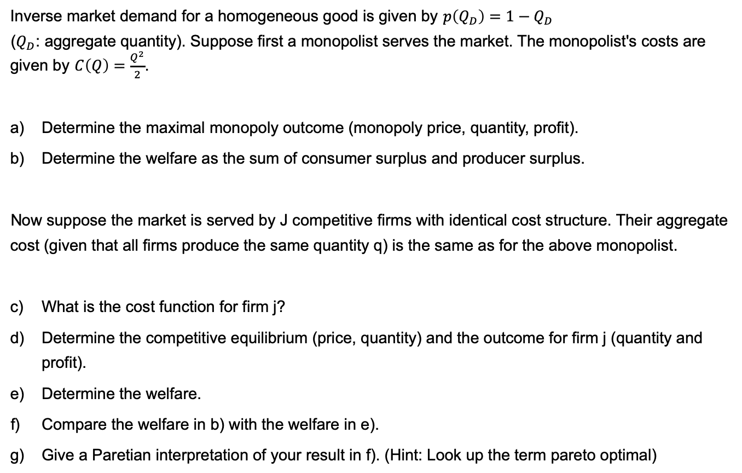
Task 4) Monopoly
Inverse market demand for a homogeneous good is given by $p\left(Q_{D}\right)=1−Q_{D}$
($Q_{D}$: aggregate quantity). Suppose first a monopolist serves the market. The monopolist's costs are given by $C\left(Q\right)=\frac{Q^{2}}{2}$.
Determine the maximal monopoly outcome (monopoly price, quantity, profit).
Determine the welfare as the sum of consumer surplus and producer surplus.
Now suppose the market is served by J competitive firms with identical cost structure. Their aggregate cost (given that all firms produce the same quantity q) is the same as for the above monopolist.
What is the cost function for firm j?
Determine the competitive equilibrium (price, quantity) and the outcome for firm j (quantity and profit).
Determine the welfare.
Compare the welfare in b) with the welfare in e).
Give a Paretian interpretation of your result in f). (Hint: Look up the term pareto optimal)

Slide 57

Task 4) Monopoly
Inverse market demand for a homogeneous good is given by $p\left(Q_{D}\right)=1−Q_{D}$ ($Q_{D}$: aggregate quantity). Suppose first a monopolist serves the market. The monopolist's costs are given by $C\left(Q\right)=\frac{Q^{2}}{2}$.
Determine the maximal monopoly outcome (monopoly price, quantity, profit).

Slide 58

Task 4) Monopoly
Inverse market demand for a homogeneous good is given by $p\left(Q_{D}\right)=1−Q_{D}$ ($Q_{D}$: aggregate quantity). Suppose first a monopolist serves the market. The monopolist's costs are given by $C\left(Q\right)=\frac{Q^{2}}{2}$.
Determine the welfare as the sum of consumer surplus and producer surplus.

Slide 59

Task 4) Monopoly
Inverse market demand for a homogeneous good is given by $p\left(Q_{D}\right)=1−Q_{D}$ ($Q_{D}$: aggregate quantity). Suppose first a monopolist serves the market. The monopolist's costs are given by $C\left(Q\right)=\frac{Q^{2}}{2}$.
Now suppose the market is served by J competitive firms with identical cost structure. Their aggregate cost (given that all firms produce the same quantity q) is the same as for the above monopolist.
What is the cost function for firm j?

Slide 60

Task 4) Monopoly
Inverse market demand for a homogeneous good is given by $p\left(Q_{D}\right)=1−Q_{D}$ ($Q_{D}$: aggregate quantity). Suppose first a monopolist serves the market. The monopolist's costs are given by $C\left(Q\right)=\frac{Q^{2}}{2}$.
Now suppose the market is served by J competitive firms with identical cost structure. Their aggregate cost (given that all firms produce the same quantity q) is the same as for the above monopolist.
Determine the competitive equilibrium (price, quantity) and the outcome for firm j (quantity and profit).

Slide 61
Task 4) Monopoly

Slide 62

Task 4) Monopoly
Inverse market demand for a homogeneous good is given by $p\left(Q_{D}\right)=1−Q_{D}$ ($Q_{D}$: aggregate quantity). Suppose first a monopolist serves the market. The monopolist's costs are given by $C\left(Q\right)=\frac{Q^{2}}{2}$.
Now suppose the market is served by J competitive firms with identical cost structure. Their aggregate cost (given that all firms produce the same quantity q) is the same as for the above monopolist.
Determine the welfare.

Slide 63

Task 4) Monopoly
Inverse market demand for a homogeneous good is given by $p\left(Q_{D}\right)=1−Q_{D}$ ($Q_{D}$: aggregate quantity). Suppose first a monopolist serves the market. The monopolist's costs are given by $C\left(Q\right)=\frac{Q^{2}}{2}$.
Now suppose the market is served by J competitive firms with identical cost structure. Their aggregate cost (given that all firms produce the same quantity q) is the same as for the above monopolist.
Compare the welfare in b) with the welfare in e).

Slide 64

Task 4) Monopoly
Inverse market demand for a homogeneous good is given by $p\left(Q_{D}\right)=1−Q_{D}$ ($Q_{D}$: aggregate quantity). Suppose first a monopolist serves the market. The monopolist's costs are given by $C\left(Q\right)=\frac{Q^{2}}{2}$.
Now suppose the market is served by J competitive firms with identical cost structure. Their aggregate cost (given that all firms produce the same quantity q) is the same as for the above monopolist.
Give a Paretian interpretation of your result in f). (Hint: Look up the term pareto optimal)

Slide 65
Load Curve and Load Duration Curve
P[MW]
P[MW]
Load Curve
Load Duration Curve
1
1
P_{max}
2
2+3
3
4
4
P_{min}
Time of day
Cumulative hours

Slide 66
Load and Residual Load
to be covered by
adjustable generation
storage discharge
Load
reduced by must-run
(RES, inflexible conventional technologies)
Demand
Residual Load
Surplus
applicable for
storage charge
additional consumption: intersectoral technologies

Slide 67
Merit Order
Load
Oil
Marginal costs
Gas
Coal
Nuclear
Hydro
Installed Capacity
Notes:
The merit order is a way of ranking available sources of energy, especially electrical generation, based on ascending order of price (which may reflect the order of their short-run marginal costs of production) together with amount of energy that will be generated. In a centralized management, the ranking is so that those with the lowest marginal costs are the first ones to be brought online to meet demand, and the plants with the highest marginal costs are the last to be brought on line. Dispatching generation in this way minimizes the cost of production of electricity

Slide 68
Merit Order Effect of Renewables
Load
Oil
Marginal costs
Gas
Coal
Nuclear
Renewables
Hydro
Installed Capacity
Notes:
Merit Order Effect of the Renewables can be shown by changing the load curve or the generation curve.
In this case: Load is uncanged, Renewables shift the conventional merit order to the right, since they have the lowest marginal generation costs.
The merit order effect of renewable energy sources (RES) describes the impact of feed-in of renewable (must run) electricity on electricity prices. As renewable electricity feed-in such as wind or photovoltaic virtually comes at zero costs, the demand for conventional generation capacity is reduced by the amount of renewable feed-in. As a result the prices for electricity decrease: the merit order effect

Slide 69
Merit Order
Residual Load
Load
Oil
Renewables
Marginal costs
Gas
Coal
Nuclear
Hydro
Installed Capacity
Notes:
Residual Load = Load of consumers, reduced by RES, and inflexible must-run capacities

Slide 70
Merit Order - Impact of CO₂ – Prices
Load
CO₂-
Price
Oil
Marginal costs
Windfall-
Profit
Windfall-Profit
CO₂-Price
CO₂-Price
Gas
Coal
Nuclear
Hydro
Installed Capacity
Notes:
CO2-Price has to be priced into the marginal generation costs. Thereby changing the merit order.
There is a CO2 price at which generation technologies switch position in the merit order.

Slide 71
Task 1) Load Duration Curve
The peak load in a power system is 16 000 MW. Other load values and their durations in a year are given in the table.
Sketch a load duration curve.
What are the limitations of electricity market analyses based on a load duration curve?
What is the so called “residual load” and what does it imply?
Load [MW] | Duration [h]
≥ 12 000 | 1 500
≥ 8 000 | 4 500
≥ 6 500 | 7 000
≥ 4 000 | 8 760

Slide 72
Task 1) Load Duration Curve
Load [MW] | Duration [h]
≥ 12 000 | 1 500
≥ 8 000 | 4 500
≥ 6 500 | 7 000
≥ 4 000 | 8 760
The peak load in a power system is 16 000 MW. Other load values and their durations in a year are given in Table 1.
Sketch a load duration curve.

Slide 73
Task 1) Load Duration Curve
The peak load in a power system is 16 000 MW. Other load values and their durations in a year are given in Table 1.
What are the limitations of electricity market analyses based on a load duration curve?
What is the so called “residual load” and what does it imply?

Slide 74
Task 2) Merit Order and Dispatch Decisions
Which categories of costs in the power sector are relevant i) for operational decisions ii) for decommissioning decisions and iii) for investment decisions? Explain why!
Assume the power plants given in table 2 have been constructed already. Sketch the merit order for these power plants. What is the electricity price at a load of 1.7 GW?
Now assume that there is a CO₂ trading system. Calculate the emissions price (€/t CO₂) at which the coal fired units show the same short-term marginal generation costs as the gas fired ones.
Notes:
a) See slide 5

Slide 75
Task 2)
Dispatch Decisions
Assume the power plants given in table 2 have been constructed already. Sketch the merit order for these power plants. What is the electricity price at a load of 1.7 GW?

Slide 76
Task 2)
Dispatch Decisions
Assume the power plants given in table 2 have been constructed already. Sketch the merit order for these power plants. What is the electricity price at a load of 1.7 GW?

Slide 77
Task 2)
Dispatch Decisions
Now assume that there is a CO2 trading system. Calculate the emissions price (€/t CO2) at which the coal fired units show the same short-term marginal generation costs as the gas fired ones.

Slide 78
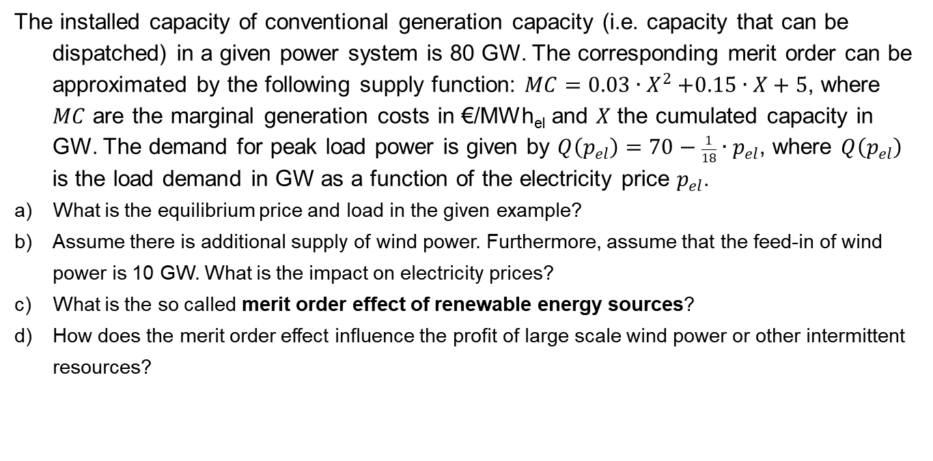
Task 3) Merit Order Effect of Renewables
The installed capacity of conventional generation capacity (i.e. capacity that can be dispatched) in a given power system is 80 GW. The corresponding merit order can be approximated by the following supply function: $MC=0.03{∙X}^{2}+0.15∙X+5$, where $MC$ are the marginal generation costs in €/MWh_{el} and $X$ the cumulated capacity in GW. The demand for peak load power is given by $Q\left(p_{el}\right)=70−\frac{1}{18}∙p_{el}$, where $Q\left(p_{el}\right)$ is the load demand in GW as a function of the electricity price $p_{el}$.
What is the equilibrium price and load in the given example?
Assume there is additional supply of wind power. Furthermore, assume that the feed-in of wind power is 10 GW. What is the impact on electricity prices?
What is the so called merit order effect of renewable energy sources?
How does the merit order effect influence the profit of large scale wind power or other intermittent resources?

Slide 79
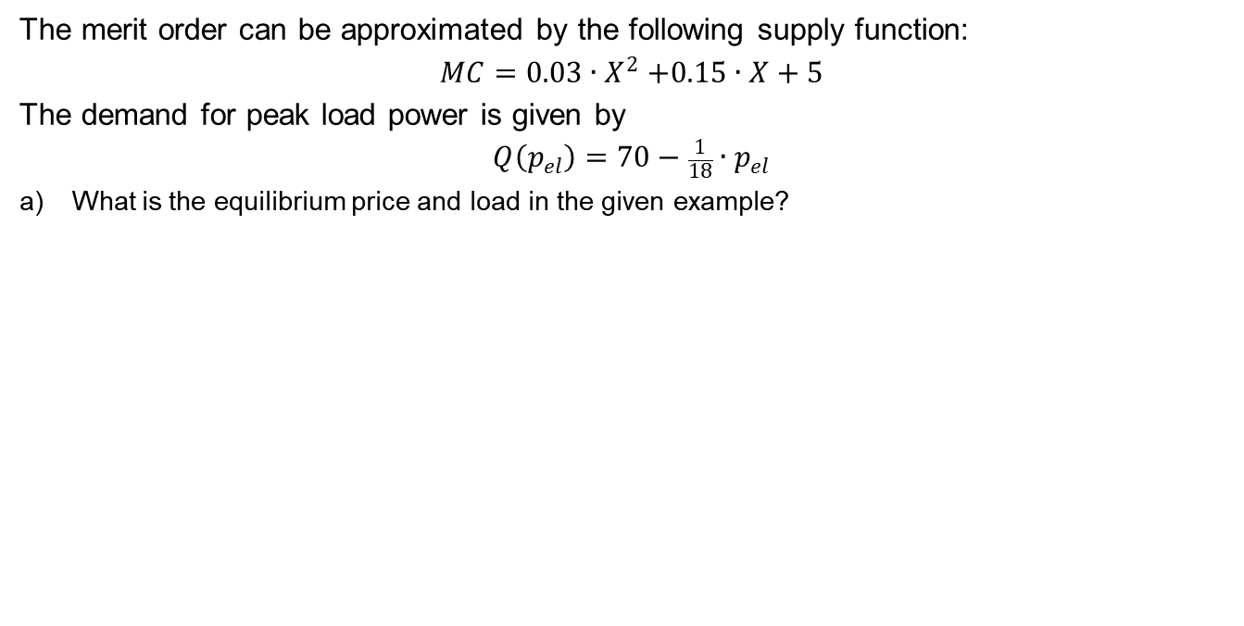
Task 3) Merit Order Effect of Renewables
The merit order can be approximated by the following supply function:
$$MC=0.03{∙X}^{2}+0.15∙X+5$$
The demand for peak load power is given by
$$Q\left(p_{el}\right)=70−\frac{1}{18}∙p_{el}$$
What is the equilibrium price and load in the given example?

Slide 80
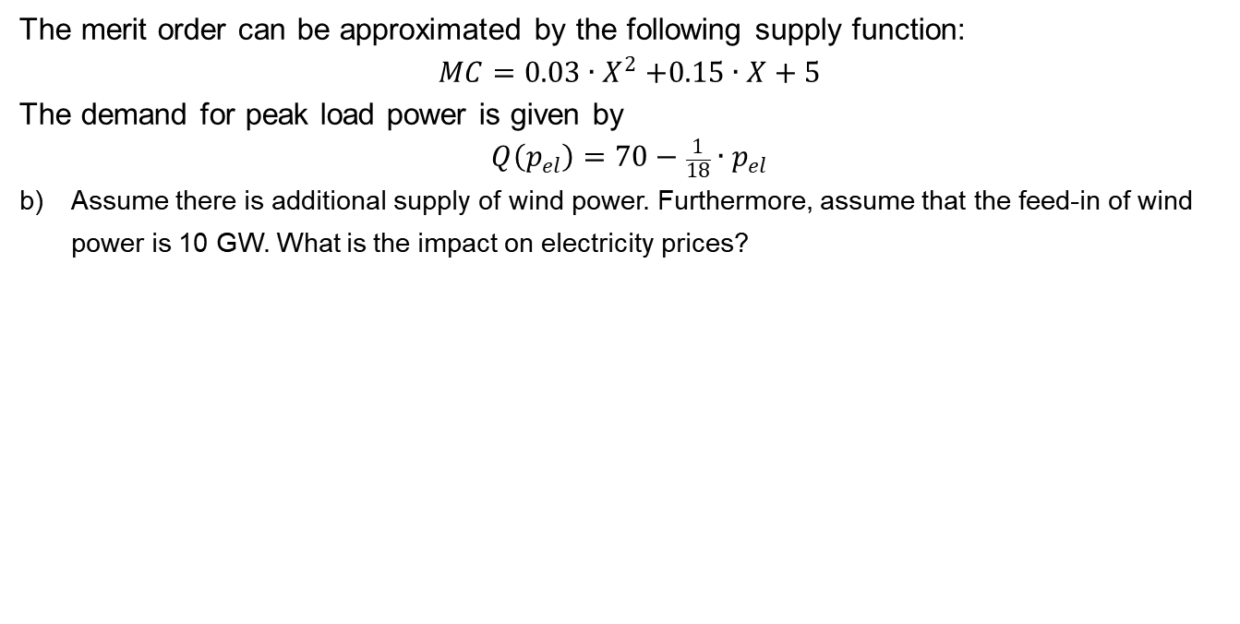
Task 3) Merit Order Effect of Renewables
The merit order can be approximated by the following supply function:
$$MC=0.03{∙X}^{2}+0.15∙X+5$$
The demand for peak load power is given by
$$Q\left(p_{el}\right)=70−\frac{1}{18}∙p_{el}$$
Assume there is additional supply of wind power. Furthermore, assume that the feed-in of wind power is 10 GW. What is the impact on electricity prices?

Slide 81
Task 3) Merit Order Effect of Renewables

Slide 82
Task 3) Merit Order Effect of Renewables
What is the so called merit order effect of renewable energy sources?
How does the merit order effect influence the profit of large scale wind power or other intermittent resources in a purely market-based system?
Notes:
c) See slide 11

