Slide 1

Integrated course „Energy Economics“
- Markets for CO₂ Emission Allowances
Chair of Energy Systems
Prof. Dr. Boris Heinz | Dr. Elena Timofeeva
elena.timofeeva@tu-berlin.de

Slide 2
Outline
External costs
Quantification of external costs
Greenhouse gas problem
European Cap-and-Trade system

Slide 3
Definitions
Emissions: Substances exhausted from a facility into the atmosphere, the hydrosphere etc. Likewise noise, tremor, odour, contamination, and radiation
Immissions: distribution, transformation and metamorphosis of the emitted substances in the receiving ecosphere media
Damages: Impacts of immissions that are somehow negatively valued by humans
External effects: Impacts of economic activities on outsiders without compensation. In the case of damages, these impacts are “negative external effects”; if the impacts represent advantages, they are called “positive external effects”
External cost: Negative external effects expressed in money units
© Prof. Dr. Georg Erdmann

Slide 4
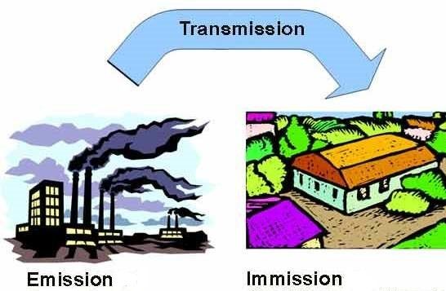
Definitions

Slide 5
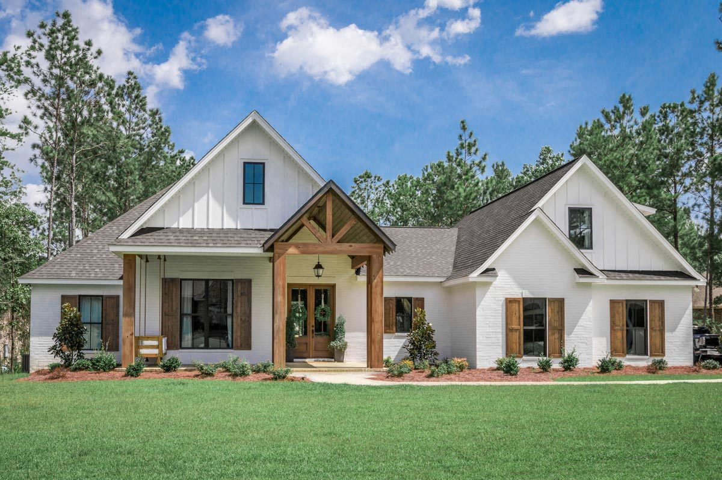
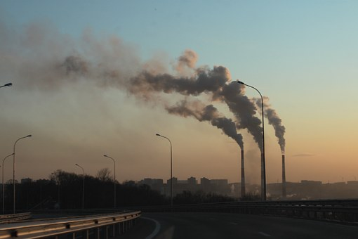
Coase Theorem
If private parties can negotiate about allocation of resources at no cost, the market will solve the problem of externalities and allocate resources efficiently.
Pareto efficiency: outcome where no player can be made better off without hurting at least one other player.

Slide 6
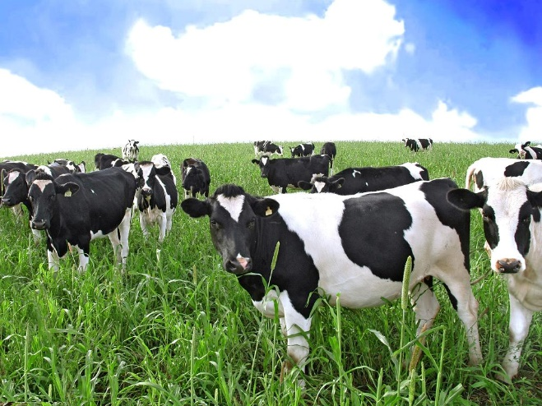


Coase Theorem: Rancher vs Farmer
The problem is reciprocal: meat or crops.
Put up a fence:
rancher pays
farmer pays
Allow crops damage:
rancher reimburses
farmer absorbs
Rancher stops raising cattle.
Farmer stops growing crops.

Slide 7
Coase Theorem: Rancher vs Farmer
More crops get damaged as the herd count increases.
Annual cost of fencing: $9
Price of crop: $1 per ton
Value of crops: $12
Cost of cultivation: $10
Value of damaged crops: $1
Source: Coase (1960)

Slide 8

Optimal Emmision Levels
Profit Π
External Costs C_{ext}
External Costs C_{ext}
Maximize
C_{ext,0}
Π*
Π₀
Profit Π
0
Em*
Em₀
Emissions Em

Slide 9
Marginal Damages and Marginal Abatement Costs
Marginal Profits,
External Marginal Costs
0
Em*
Em₀
Emissions Em

Slide 10
Assumptions and Limitations
Property rights are clearly allocated and enforceable.
Areas with no property rights – e.g. oceans.
Monitoring is not always possible.
No transaction costs
Small number of parties affected
Equal bargaining power
Costs for future generations

Slide 11
External Costs and Market Failure
Individuals may suffer economic losses from emissions associated with energy activities that are not included in energy prices and thus are not compensated by the polluter
No Pareto-Optimum (some individuals can be better off without negatively affecting the situation of any other individual)
Coase-Theorem: Negotiations between polluters and affected parties could produce the Pareto-optimal condition, but negotiations may not be possible or successful due to
many perpetrators and victims
unclear cause-effect relationships
high transaction costs
⇒ Market Failure
© Prof. Dr. Georg Erdmann

Slide 12
Strategies to Correct Market Failure
Voluntary agreement with sanctions (Klemmer et al. 1999): Polluters voluntarily agree to reduce emissions; the government threatens to apply other instruments if the agreement fails to be honored
Environmental Liability
  with mandatory insurance; insurance premiums provide the internalization of external cost
  Lawmakers and courts determine the admissible amount of external effects beyond which the injurer must come up with a compensation
© Prof. Dr. Georg Erdmann

Slide 13
Strategies to Correct Market Failure (Cont.)
Emission standards and norms (e.g. mandatory emission controls)
Emission taxes (Pigou-Tax). By taxing emissions, the government puts a price on them
Standard Price Approach (Baumol, Oates 1988)
  Government auctions tradable allowances (fiscal instrument)
  Free allocation of tradable allowances by government (Grandfathering, Benchmarking)
© Prof. Dr. Georg Erdmann

Slide 14
Emission Taxes versus Standard Price
Energy price
Energy price
Pigovian
Tax
Price in a
standard price model
Time
Time
Fixed tax rate
Tax rate adjusts to emissions level

Slide 15
GHG Abatement Costs and a Pigou Tax
Euro/t CO₂
CO₂ tax rate
Starting point
Implicit CO₂ emissions
CO₂ emissions

Slide 16
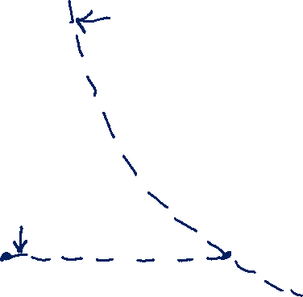
Uncertain GHG Abatement Costs Under Cap and Trade
Euro/t CO₂
Required GHG
reductions
Implicit price
of the
emission allowance
CO₂ cap
CO₂ emissions

Slide 17
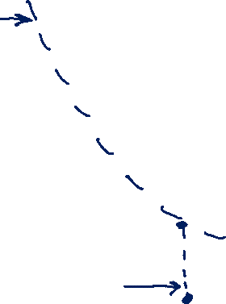
Unknown GHG Abatement Costs and Pigou Tax
Euro/t CO₂
CO₂ tax rate
Starting point
Implicit CO₂ emissions
CO₂ emissions

Slide 18
Pigou Tax
Optimal tax rate must be equal to the marginal cost of emissions.
Without technology differences, all companies reduce their emissions to the same optimal level.
In case of technology differences, the company with lower abatement costs has a higher optimal level.
→ Tax needs to be higher.

Slide 19
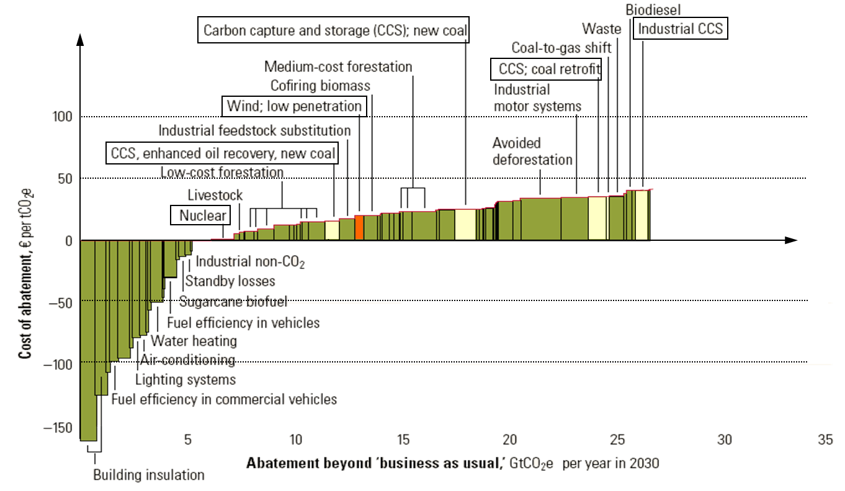
Costs of abating CO₂-Emissions
(Source: McKinsey & Company 2007)

Slide 20
Content of the Lecture
External costs
Quantification of external costs
Greenhouse gas problem
European Cap-and-Trade system

Slide 21
Quantification of External Costs
Emissions
Immissions: Atmospheric chemistry, Water Chemistry, …
Damages depending on Dose Response Functions:
initial level of other substances, duration, delay until the damage appears, presence of receptors
Monetization of damages
© Prof. Dr. Georg Erdmann

Slide 22
Categories of Damages [VDI-directive No. 3780]
Economic damages in the narrow sense: destruction of physical assets that cause income losses, cleanup and repair costs
Losses to human life and health: number of concerned persons, number of years of life lost, duration and degree of medical treatment
Losses of environmental assets and environmental quality as far as not yet captured by category “economic damages”
Losses of quality of life: exposure to noise and vibration, but also fear of catastrophes, reduced autonomy and self-fulfilment;
Social institutions that are temporarily prevented from normal functioning (civil protection, health system, …): number of days times number of concerned persons
© Prof. Dr. Georg Erdmann

Slide 23
Monetization of Damages
Cost of repair
Human capital approach (cost of education and training, present value of future labor income forgone)
Hedonic price approach (market transactions): individuals who expose themselves to a risk to life, noisy environment etc. for a financial return
Contingent Valuation: Survey on individual willingness to pay for avoiding an environmental damage (strategic responses)
Contingent Valuation (Cummings et al. 1986): Evaluation of alternatives to the status quo in order to determine the individual indifference curve through the status quo. Because the alternatives are associated with financial effects, they can be determined from the slope of the interpolated indifference curve
© Prof. Dr. Georg Erdmann

Slide 24
External Costs [Source: ExternE 2003]
 | Hard Coal | Lignite | Natural Gas CCPP | Nuclear Energy | PV (multi) | PV amorph | Wind Energy | Hydro
Damage Costs [Euro-Cent/kWh]
Noise |  |  |  |  |  |  | 0,01
Health | 0,7 | 0,97 | 0,33 | 0,16 | 0,62 | 0,44 | 0,07 | 0,05
Material | 0,02 | 0,02 | 0,007 | 0,002 | 0,02 | 0,012 | 0,002 | 0,001
Field Crops |  |  |  | 0,0007 |  |  | 0,0007 | 0,0002
Sum | 0,7 | 1,0 | 0,3 | 0,2 | 0,6 | 0,5 | 0,1 | 0,1
Abatement costs [Standard-Price-Approach; Euro-Cent/kWh]
Ecosystem | 0,2 | 0,77 | 0,04 | 0,05 | 0,41 | 0,04 | 0,04 | 0,03
Greenhouse Gas Effect | 1,57 | 1,96 | 0,72 | 0,03 | 0,59 | 0,33 | 0,04 | 0,03
Total | 2,5 | 3,7 | 1,1 | ,2 | 1,6 | 0,8 | 0,2 | 0,1

Slide 25
Content of the Lecture
External costs
Quantification of external costs
Greenhouse gas problem
European Cap-and-Trade system

Slide 26
The Greenhouse Gas Problem
[Data Source IPCC 1990; 2014]
 | Carbon dioxide CO₂ | Methane CH₄ | Nitrous oxide N₂O
Pre industrial concentration [ppmv] | 280 | 0.7–0.8 | 0.23
Average atmospheric lifetime [years] | 5–200 | 9-15 | 120
Global warming potential in 20 years | 1 | 72 | 289
Global warming potential in 100 years | 1 | 25 | 298
Contribution to the GHG problem [%] | 77 | 14 | 8
Reduction target of the IPCC 1990 [%] | 60–80 | 15–20 | 70–80

Slide 27
Global CO₂ Emissions [Source: BP 2010]
Global CO₂ emissions [bn. tons]
40
30
20
Rest of the world
10
North America
Europe
0
1990
1995
2000
2005
2010

Slide 28
Global Coal Extraction [source: BP]
4000
Coal extraction [Mt.c.e.]
3000
2000
ROW
China
1000
Australia
FSU
USA
0
1980
1990
2000
2010

Slide 29
Characteristics of the Greehouse Problem
Globalism: The location of emissions does not matter (Leakage problem)
Timeline: Damages affect future generations while the current generation has relatively minor impairments
Unavailability of reliable abatement technologies
Politics against Free riding: Solutions require an internationally coordinated and future-oriented approach: Who should provide what contributions? (International and intra-national distributive conflicts; Developing countries against grandfathering)
Measurement, Reporting and Verification
© Prof. Dr. Georg Erdmann

