Slide 1
Integrated course „Energy Economics“
- Financial Management
Chair of Energy Systems
Prof. Dr. Boris Heinz | Dr. Elena Timofeeva
elena.timofeeva@tu-berlin.de

Slide 2
Outline
Fundamentals of finance: Balance sheet model of the firm
Time value of money: Compounding, discounting, annuity
Capital structure and cost of capital
Capital budgeting: NPV method
NPV vs IRR
Levelised cost of electricity (LCOE)
Real options

Slide 3
Levelised cost of electricity (LCOE)
lifetime costs divided by
lifetime electricity output
Lifetime costs: PV of total cost of building and operating
LCOE allows comparison of technologies regardless of lifetime, installed capacity, cost of capital, risk and return.
initial capital cost*
* specific investment costs: investment costs divided by capacity
annual operating expenses
capacity factor
discount rate
operational life
Notes:
Least cost approach > LCOE

Slide 4
Task 3) NPV and Levelized Cost of Energy (LCOE)
The table below describes the investment conditions for a 5 kW_{peak} PV system in Germany and in Spain:
What is the Net Present Value (NPV) of the investment in Spain and in Germany, given a feed-in tariff (FIT) of 11.83 ct/kWh?
What are the levelised cost of electricity (LCOE) of the photovoltaic system in Germany and in Spain (LCOE = electricity generation costs in ct/kWh based on full costing)?
Assume that electricity retail prices in Spain and Germany are 29 ct/kWh. What does your result in b) imply for the self-consumption of the generated electricity?
Description | Germany | Spain | Unit
Specific investment costs | 1 500 | 1 500 | €/kW_{peak}
Operation and maintenance (O&M) costs | 9 | 9 | €/kW_{peak}/a
Full load hours | 900 | 1 500 | hours/a
Capacity | 5 | 5 | kW_{peak}
Lifetime | 20 | 20 | a
Interest rate | 3 | 3 | %

Slide 5
Task 3) NPV and Levelized
Cost of Energy (LCOE)
Description | Germany | Spain | Unit
Specific investment costs | 1 500 | 1 500 | €/kW_{peak}
Operation and maintenance (O&M) costs | 9 | 9 | €/kW_{peak}/a
Full load hours | 900 | 1 500 | hours/a
Capacity | 5 | 5 | kW_{peak}
Lifetime | 20 | 20 | a
Interest rate | 3 | 3 | %
The table describes the investment conditions for a 5 kW_{peak} PV system in Germany and in Spain:
Assume that electricity retail prices in Spain and Germany are 29 ct/kWh. What does your result in b) imply for the self-consumption of the generated electricity?
The PV system operator is at the same time an electricity consumer (prosumer).
The operator has an option to cover their electricity demand either from
a supplier at the retail price (and feed the electricity generated in the PV system into the grid), or
the electricity generated in their PV system (self-consumption).
In simplified terms, given the retail price of 29 ct/kWh, the PV system operator should choose self-consumption.
We may revisit this question to cover additional aspects in one of the coming classes.

Slide 6
Task 4) Investment appraisal
There are two power plants as investment options. The data is given below:
  What are the specific investment costs in €/kW of the two options?
  What are the (short-term) marginal generation costs?
  What are the annual capital costs?
  What are the total annual fixed costs per MW installed?
  What are the levelised cost of electricity (LCOE)?
  What must the full load hours of the natural gas power plant be so that the long-term marginal generation costs are equal for both technologies?
 | Natural gas power plant | Hard coal power plant | Units
Capacity | 900 | 900 | MW
Efficiency | 55 | 43 | %
Investment costs | 585 | 900 | Million €
Interest rate | 8 | 8 | %
Lifetime | 20 | 20 | a
Employees | 66 | 140 | Number
Labor costs | 60 000 | 60 000 | €/a/employee
O&M costs | 4 | 8 | Million €/a
Fuel price | 22 | 14 | €/MWh_{th}
Emission factor fuel | 56 | 92 | kg CO₂ / GJ_{th}
Full load hours | 4 000 | 5 500 | hours/a

Slide 7
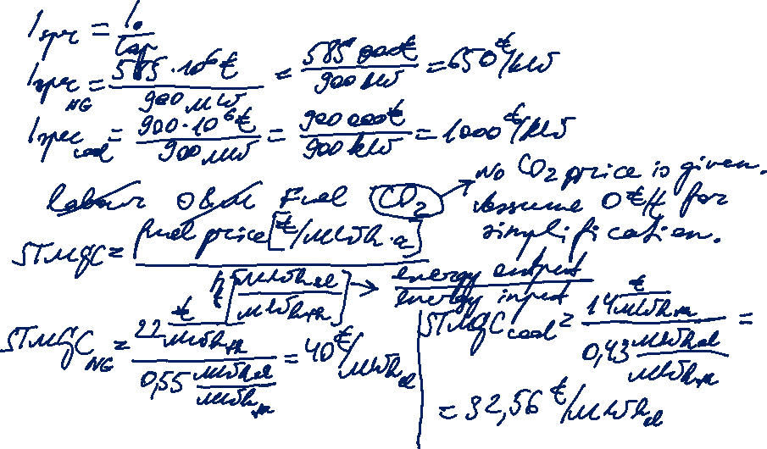
Task 4) Investment appraisal
There are two power plants as investment options.
  What are the specific investment costs in €/kW of the two options?
  What are the (short-term) marginal generation costs?

Slide 8
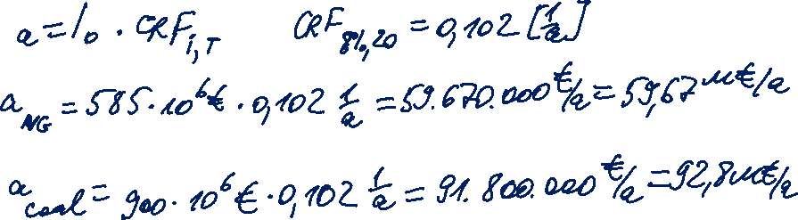
Task 4) Investment appraisal
There are two power plants as investment options.
  What are the annual capital costs?

Slide 9
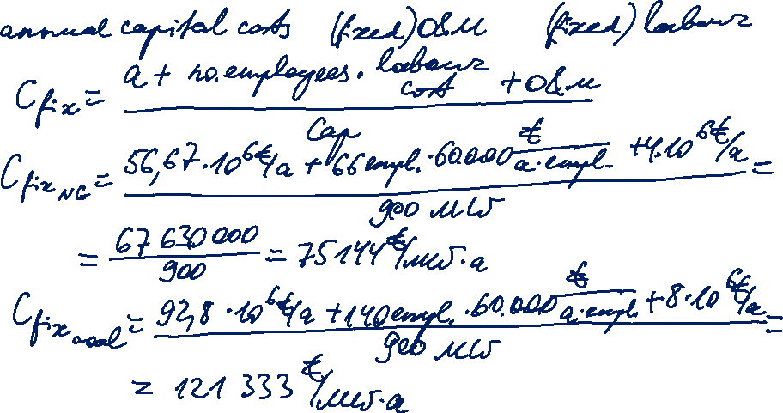
Task 4) Investment appraisal
There are two power plants as investment options.
  d) What are the total annual fixed costs per MW installed?

Slide 10

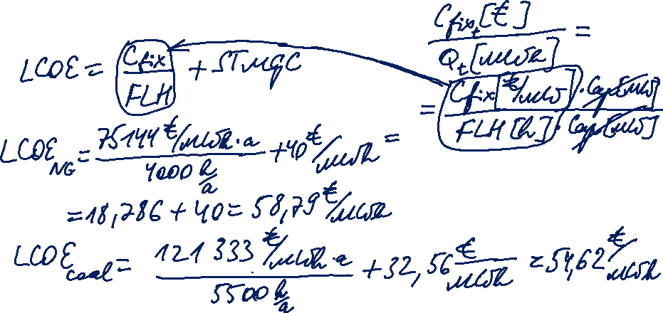
Task 4) Investment appraisal
There are two power plants as investment options.
  What are the levelised cost of electricity (LCOE)?

Slide 11
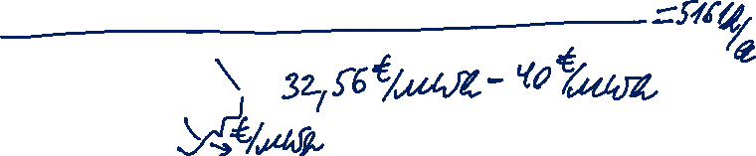
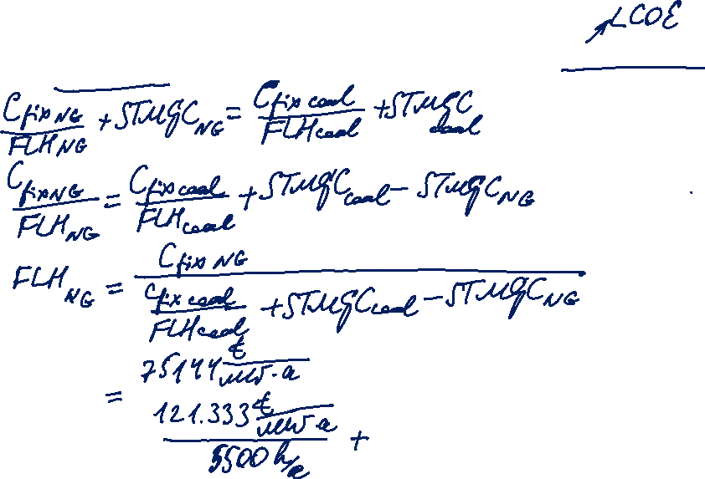
Task 4) Investment appraisal
There are two power plants as investment options.
  What must the full load hours of the natural gas power plant be so that the long-term marginal generation costs are equal for both technologies?
C_{fix NG} 75.144 €/MW/a
C_{fix coal} 121.333 €/MW/a
STMGC _{NG} 40 €/MWh
STMGC _{coal} 32,56 €/MWh
FLH _{coal} 5.500 hours/a

Slide 12
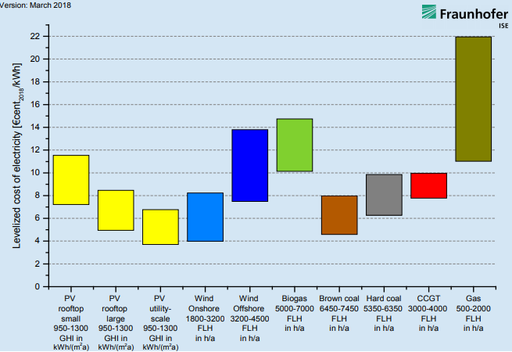
LCOE of renewables and conventional generation at different locations in Germany in 2018
Source: Fraunhofer ISE

Slide 13
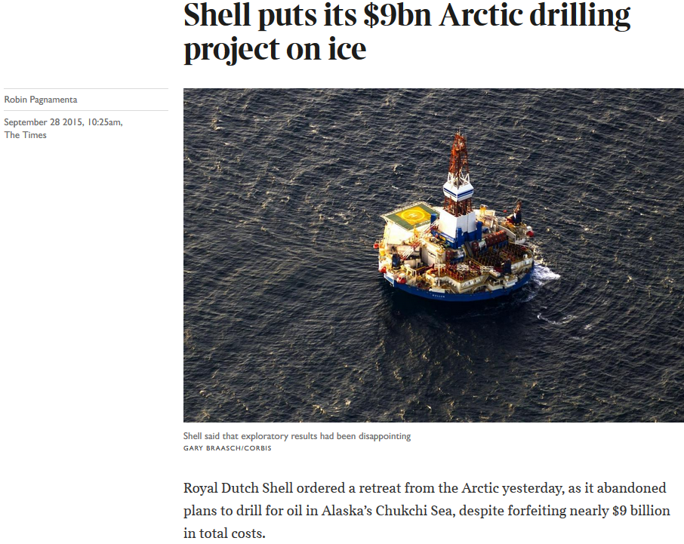
What happened?

Slide 14
What happened?
FP │ by David Fracis │Sep 28,2015:
“The decision to abandon oil exploration at the top of the world is at once both surprising and to be expected. It comes just two months after President Barack Obama signed off on Shell’s operations off the coast of Alaska, and after the company defended its actions to environmental groups.”

Slide 15

Shell updates on Alaska exploration
Sep 28, 2015
Shell today provides an update on the Burger J exploration well, located in Alaska’s Chukchi Sea. The Burger J well is approximately 150 miles from Barrow, Alaska, in about 150 feet of water. Shell safely drilled the well to a total depth of 6800 feet this summer in a basin that demonstrates many of the key attributes of a major petroleum basin. For an area equivalent to half the size of the Gulf of Mexico, this basin remains substantially under-explored.
Shell has found indications of oil and gas in the Burger J well, but these are not sufficient to warrant further exploration in the Burger prospect. The well will be sealed and abandoned in accordance with U.S. regulations.
[…] "Shell continues to see important exploration potential in the basin, and the area is likely to ultimately be of strategic importance to Alaska and the US. However, this is a clearly disappointing exploration outcome for this part of the basin.”
Shell will now cease further exploration activity in offshore Alaska for the foreseeable future. This decision reflects both the Burger J well result, the high costs associated with the project, and the challenging and unpredictable federal regulatory environment in offshore Alaska.
Source: www.shell.com

Slide 16
Real options
Cash flows used for calculation under NPV method are future projections and, thus, estimated values.
Uncertainty determining the risk of a project may be resolved during its lifetime.
Flexibility to react to changes is part of investment evaluation.
Financial options theory has been applied to physical investments.
Option is the right to buy [or sell] the underlying asset at a specified price during [or at] a specified time. Option holder pays option premium to option writer.
Notes:
Timing option: wait until uncertainty is resolved.

Slide 17
Real options: Valuating managerial flexibility
„A real option is a right, but not an obligation, to do something for a certain cost within or at a specific time.“ Source: He, 2007.
Options to make adjustments to the project once it is accepted based on new information:
delay investment until an uncertainty disappears (timing option)
expand or reduce the scale of the project
change the input or output of the project
abandon the project if a pessimistic scenario materialises
Example: oil or gas field with production costs exceeding the current oil/gas price but still valuable with a view to a potential future rise in the price.
Notes:
Timing option: wait until uncertainty is resolved.
ROT helps to „identify and assess manager’s options to adjust projects in response to the evolution of uncertainty”.

Slide 18
Real options: Compared to NPV method
NPV method: more uncertain assets have relatively less economic value → riskier investments are penalised by higher discount rates.
Real options theory: uncertainty means not only possibility of future loss but also opportunity to create value from flexibilities by adapting the project to evolving conditions.
Energy projects:
long time horizons
large amounts of capital
high uncertainty
Valuation complexity vs. Way of thinking
Notes:
NPV takes a static approach and gives managers a false sence of security.
ROT enhances the value of projects under uncertainty.
Different valuation methods are available. Some are characterised by mathematical complexity.

Slide 19
Oil drilling problem: Bayesian decision theory
Consider the problem faced by an oil company that is trying to decide whether to drill an exploratory oil well on a given site. Drilling costs are $200.000. If oil is found, it is worth $800.000. If the well is dry, it is worth nothing. However, the $200.000 cost of drilling is incurred, regardless of the outcome of the drilling.
Suppose that the oil company estimates that the probability that the site has oil (“Wet”) is 40%.
Decision | State of nature
 | Wet | Dry
Drill Do not drill | 600T 0 | -200T 0
Prior probability | 0,4 | 0,6
Source: M. Hillier
Notes:
Bayesian degrees

Slide 20
Real options: Expected pay-off
Expected pay-off = x + x
In reference to the waste truck excercise in a previous class:
Annual revenue from truck operation of 120.000€ is an expected value.
Alternative 1: 80.000€/a 0,167
Alternative 2: 120.000€/a 0,5
Alternative 3: 140.000€/a 0,333
EV = 80.000€ * 0,167 +120.000€ * 0,5 + 140.000€ * 0,333
Probability of success
Pay-off if successful
Probability of failure
Pay-off if failure

Slide 21
Decision tree method
Decision tree method is used for modelling sequential decision problems under uncertainty.
Decisions mutually exclusive and collectively exhaustive
        set of possible alternatives of courses of action
Events mutually exclusive and collectively exhaustive
set of possible outcomes (states of nature) with assigned probabilities. The sum of probabilities in a set of events is equal to one.
Payoffs sum of costs and revenues associated with an alternative

Slide 22
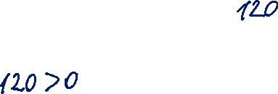

Oil drilling problem: Decision tree solved (rolled-back)
1. At an event node, calculate the probability-weighted average payoff (EV).
Payoff [Drill]: 600*0,4 + (-200)*0,6 = 240 – 120 = $120T
Payoff [Do not drill]: $ 0
2. At a decision node, choose the branch with the highest EV.
Drill
Source: M. Hillier
Notes:
square=decision; circle=event; bar/triangle=terminal (node)

Slide 23
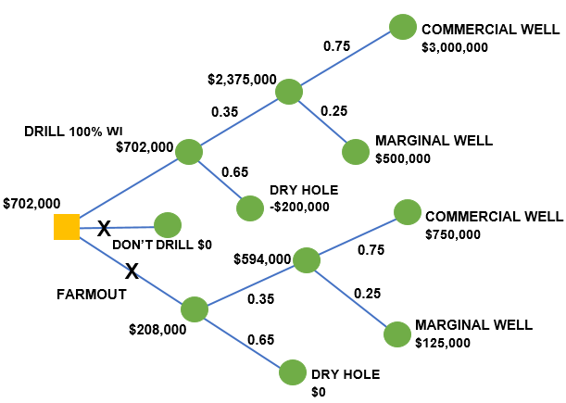
Oil drilling problem: Advanced decision tree
Source: Seba, 2008
Notes:
Decision points coincide with changes in uncertainty.

Slide 24
Uncertainties in oil drilling
Oil and gas upstream industry is characterised by sequential investments.
Source: Jafarizadeh, Bratvold, 2009
Notes:
Timing option: wait until uncertainty is resolved.

Slide 25
Real options: Application examples
Oil and gas exploration and production projects
Developing a new technology → high R&D cost and risk
Change in regulation, e.g. climate policies → future CO₂ price
Notes:
If flexibility is integrated into the project: the higher the uncertainty, the higher the value of the project.

