Slide 1
Integrated course „Energy Economics“
- Financial Management
Chair of Energy Systems
Prof. Dr. Boris Heinz | Dr. Elena Timofeeva
elena.timofeeva@tu-berlin.de

Slide 2
Outline
Fundamentals of finance
Time value of money
Capital structure and cost of capital
Capital budgeting: NPV method
NPV vs IRR
Levelised cost of electricity (LCOE)
Real options

Slide 3
Introduction to corporate finance
Understanding how companies invest in new projects
Starting a firm takes investment into assets:
inventory (raw materials), machinery, land, and labour.
The amount of cash invested into the assets has to be matched by the amount of cash raised by financing.
By producing and selling products, the firm generates cash – the basis of value creation for the firm’s owner.

Slide 4
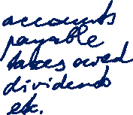
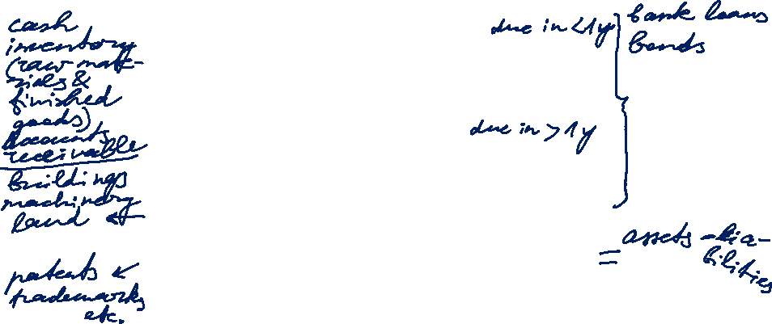
Balance sheet model of the firm
Current assets
Current liabilities
Net working capital
Non-current liabilities
Non-current assets:
Tangible non-current assets
Intangible non-current assets
Shareholders’ equity
Total value of assets
Total value of the firm to investors
Source: Hillier, Ross, Westerfield, Jaffe, Jordan, 2016
Notes:
Snapshot of what a company owns and owes plus the amount invested by shareholders.

Slide 5

Balance sheet model of the firm
Current assets
How to manage short-term operating cash flows?
Current liabilities
Non-current liabilities
How to raise cash for capital expenditures?
Non-current assets:
Tangible non-current assets
Intangible non-current assets
Net working capital
Which long-lived assets to invest in?
Shareholders’ equity
Total value of assets
Total value of the firm to investors
Goal: Maximise the value of a company’s equity shares.
Source: Hillier, Ross, Westerfield, Jaffe, Jordan, 2016
Notes:
Capital budgeting: buy assets that generate more cash than they cost.
Capital structure: sell bonds and shares etc. (financial instruments/securities) that raise more cash than they cost.
Net working capital – matching the amount and timing of operating cash inflows and outflows.
Shareholders are residual owners – after employees, suppliers and creditors.
Corporate finance as the study of the relationship between business decisions and the value of the shares in the business.

Slide 6
Methods of project valuation
Static methods
(single-period)
Cost comparison statement
  + operating costs p.a.
  + average capital costs p.a.
  + depreciation p.a.
  annual costs
Profit comparison
  revenues ./. annual costs
Return on investment
  EBIT = earnings before interest and tax +
  interest on debt
  ROI = EBIT / avg. capital employed p.a.
Pay-back period
Break even = investment / avg. cash flow p.a.
Dynamic methods
(time value of money)
Net present value
PV = sum of discounted cash flows
NPV = PV - Investition > 0?
Equivalent annual annuity
transformation of cash flow series into annuity
Internal rate of return
IRR = discount rate at which [NPV=0]
Notes:
Cost comparison: for chosing between functionally similar assets (equal capability) > lowest average periodic cost
unequal capabilities -> lowest average unit cost
Profit comparison: if type of project influences product prices -> highest average annual profit
If different levels of capital expenditure: ROI = average periodic profit / average capital employed > predetermined minimum
Pay-back period: the shorter, the more attractive. Indicates project liquidity and, thus, risk.

Slide 7
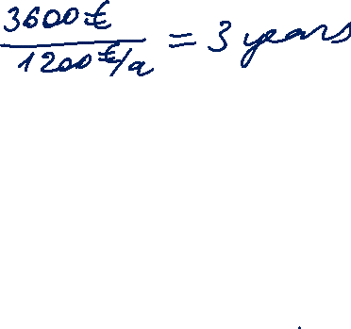
Example: Simple payback period method
Energy saving project:
New equipment costs €3.600.
Projected annual energy cost savings: €1.200.
Payback period:
Change in annual maintenance costs due to the new equipment has to be considered.
Notes:
Time horizon of an investment project in the energy industry is, typically, very long.
PV, wind turbines: 20 years
gas turbines: 35 years
→ Dynamic assessment plays an important role.

Slide 8
Time value of money
Value of an investment depends on the timing of cash flows.
Cash flow is an amount of money paid or received (revenue or expenditure).
Cash flows are characterised by the amount (+/-) and due date.
Time value of money: value of a cash flow at the time it becomes due.
Present value: value of a cash flow at present.
For a cash flow due and payable today:
  present value = time value
For a cash flow due and payable at a future time:
  present value = time value – interest
Notes:
Opportunity cost of an investment: risk-free investment on a savings account or government bond earning interest.
Preference for earlier cash: One euro received today is worth more than one euro received in one year.

Slide 9
Time value of money (continued)
Two proposals for new products to chose between:
Initial cost: €10.000 in each case.
The investment opportunities cannot be compared immediately.
Year | New product A (€) | New product B (€)
1 | 0 | 4.000
2 | 0 | 4.000
3 | 0 | 4.000
4 | 20.000 | 4.000
Total | 20.000 | 16.000
Source: Hillier, Ross, Westerfield, Jaffe, Jordan, 2016
Notes:
Preference for earlier cash: One euro received today is worth more than one euro received in one year.

Slide 10
Cashflows: Discounting and compounding
To be able to compare cashflows, they have to be discounted or compounded to the same reference period.
Choice between spending a sum of money or lending it.
Interest rate is the price for obtaining funds for a specified time.
It reflects the opportunity cost in view of other investment options and risk of credit default.
Notes:
Risk premium depends on the investment type and location (country risk).

Slide 11
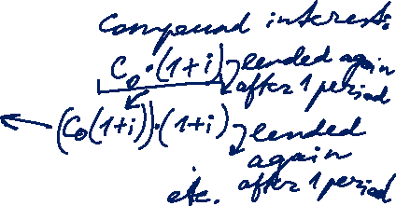
Cash flows: Compounding
Compounding: Present value → future value
C_{T} = C₀ · (1 + i)^{T}
  C₀ = the cash flow at date 0 (today) = present value
  i = interest rate per period
  T = number of periods (time horizon)
  C_{T} = value of the cash flow at time T = future value
Final value
Present value
C_{T}
C₀
0
1
2
3
T
Notes:
Compounding: leaving the money in the market and lending it for another financial year.
Compound interest: each interest payment is reinvested.

Slide 12
Cash flows: Discounting
Discounting: Future value → present value
1
C₀ = C_{T} ·
(1 + i)^{T}
  C₀ = value of the cash flow at date 0 (today) = present value
  i = interest rate per period
  T = number of periods (time horizon)
  C_{T} = the cash flow at time T = future value
K_{T}
K₀
0
1
2
3
T
Notes:
Compounding: leaving the money in the market and leaving it for another financial year.
Compound interest: each interest payment is reinvested.

Slide 13

Present value of a future cash flow
1,0
NPV factor
0,8
0,6
2 %
0,4
4 %
0,2
10 %
6 %
0,0
0
5
10
15
20
25
30
35
40
Time of payment (year)
Notes:
Compounding: leaving the money in the market and leaving it for another financial year.
Compound interest: each interest payment is reinvested.

Slide 14
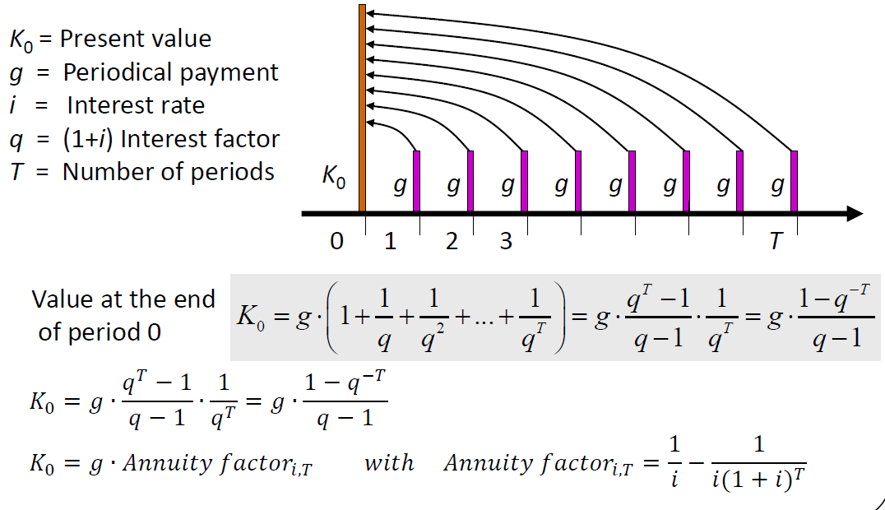
Annuity: NPV with constant cash flows
Annuity is a level stream of regular payments during a fixed number of periods.
Notes:
Regular cashflows are uncommon in the energy sector but nevertheless used for simplification.
The formula values the annuity as of one period before the first payment.

Slide 15
Annuity factor
A fixed periodical payment multiplied with applicable ANF returns the present value of the annuity.
Notes:
Used to calculate PV of annuity

Slide 16
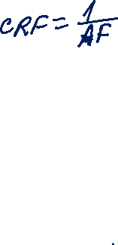
Capital recovery factor
A loan amount multiplied with applicable CRF returns a constant annual amount needed to repay the loan.
Notes:
Constant annual amount needed to repay a loan amount.
Annual capital user cost.

Slide 17
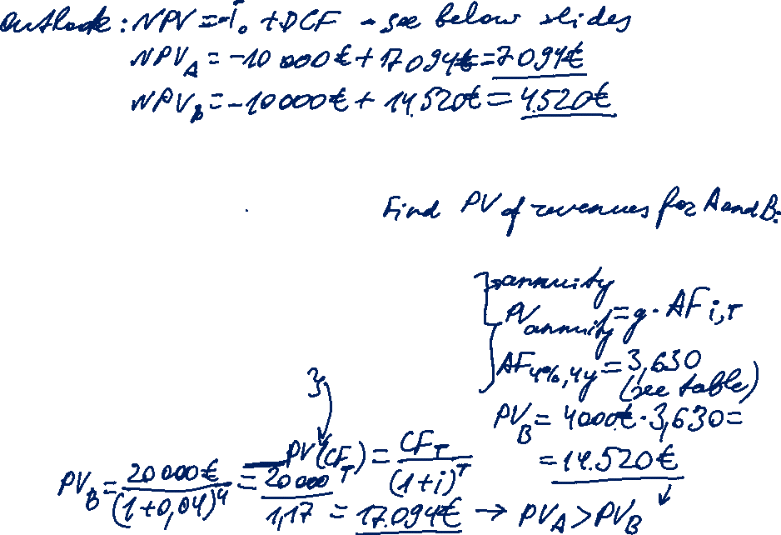
Solution to previous example
Two proposals for new products to chose between:
Initial cost: €10.000 in each case.
The interest rate is 4%.
Year | New product A (€) | New product B (€)
1 | 0 | 4.000
2 | 0 | 4.000
3 | 0 | 4.000
4 | 20.000 | 4.000
Total | 20.000 | 16.000
Source: Hillier, Ross, Westerfield, Jaffe, Jordan, 2016
Notes:
Preference for earlier cash: One euro received today is worth more than one euro received in one year.

Slide 18

Capital structure
The discount rate represents cost of capital and project risk.
Risk-free interest rate + risk premium
How to raise cash for capital expenditures?
Equity (own capital) – raised from shareholders
  rewarded by dividends + the difference in the market price of shares (if positive)
  right to share in assets remaining after liabilities in case of liquidation
  participate in managing the firm
Debt (borrowed capital) – borrowed from creditors /debtholders
  rewarded through interest
  preferred over shareholders (incl. in case of bankruptcy)

Slide 19
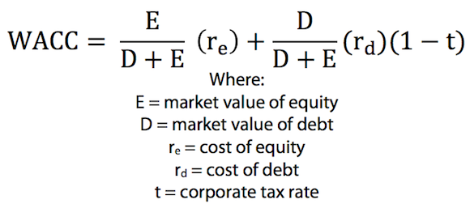

Capital structure: Weighted average cost of capital
50% debt
50% equity
25% debt
50% equity
Capital structure 1
Capital structure 2
The amount of interest paid on debt is deducted from the taxable income. This reduces the income tax paid by the company.

Slide 20
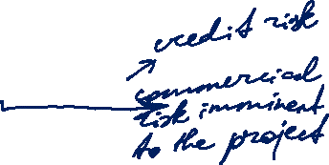
Cost of capital: Hurdle rate of return
Position | Unit | Equity | Debt
Capital structure | % | 30 | 70
Interest rate and risk premium
risk-free rate | %/a | 5,0% | 5,0%
investment risk premium | %/a | 6,0% | 1,0%
technology risk premium | %/a | 0,0% | 0,0%
country risk premium | %/a | 0,0% | 0,0%
Balance after tax | %/a | 11,0% | 6,0%
tax rate e.g. 25% | %/a | 3,7% | 0,0%
Cost of capital before tax | %/a | 14,7% | 6,0%
WACC, nominal | %/a | 8,60%
./. Inflation | %/a | 2,00%
WACC, inflation-adjust. before tax | %/a | 6,47%
Source: Konstantin, 2017

Slide 21

Interest rates and inflation
A bank offers a one-year interest rate of 10%.
An individual who deposits €1.000 will receive €1.100 in a year.
Rate of inflation is 6% p.a.
A restaurant that charges €10 for a meal today will be charging €10.60 for the same meal in a year.
Today, the individual could buy €1.000 / €10 = 100 meals.
In a year, they will be able to buy €1.100 / €10,60 = 103,8 meals.
The resulting increase in consumption is 3,8% (and not 10%).
1+Nominal interest rate = (1+Real interest rate) x (1+Inflation rate)
1 + Nominal interest rate
Real interest rate = – 1
1 + Inflation rate
Notes:
Nominal interest rate

Slide 22
Cash flow and inflation
real
Cash flow
nominal
Nominal cash flow: actual money in cash to be received / paid.
Real cash flow: the cash flow’s purchasing power.
Nominal cash flows must be discounted at the nominal rate.
Real cash flows must be discounted at the real rate.
Notes:
Nominal interest rate

Slide 23
Capital budgeting: NPV (DCF) method
The value of a project is measured by its net present value (NPV):
present value of the future cash flows minus the initial investment outlay.
Identify forecast all cash flows (revenues and costs) associated with a project (forecast).
Map the cashflows on a cash flow time chart.
Discount each cashflow using an applicable interest rate.
Sum up all the discounted cashflows (DCF) to obtain NPV
Invest only if NPV > 0 [NPV = 0 indifferent]

Slide 24
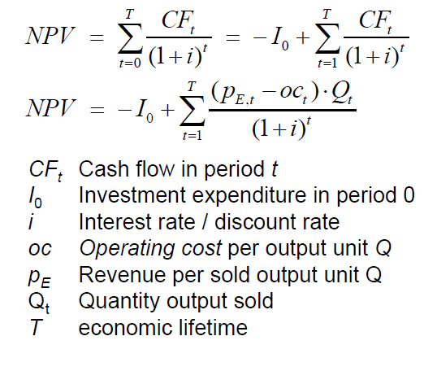
Capital budgeting: NPV (DCF) method
CF_{t} = Cash Flow in period t
I₀ = Investment in period 0
i = Interest rate / Discount rate
T = Time horizon / Economic lifetime
t = Period

Slide 25
Relevant cash flows
CF from financing activities:
capital expenditures
sale of assets
CF from operating activities:
revenues
operating expenses
depreciation
taxes
change in working capital
Notes:
Opportunity cost: e.g. unused storage facility to be used for storing a new product.
Salvation value: technical service life vs. economic service life

Slide 26

Relevant cash flows (continued)
Opportunity cost: potential benefit or income that is foregone as a result of selecting one alternative over another are considered.
Sunk cost: Cost incurred in the past that cannot be changed by any decision are ignored.
Salvation value: In case of abandonment (divestment), assets, typically, retain a residual value (future revenue).
Depreciation tax shield: Yearly depreciation amount is deducted from the income tax base.
The resulting tax saving [depreciation amount x tax rate] is added as a positive cash flow.
Notes:
Opportunity cost: e.g. unused storage facility to be used for storing a new product.
Salvation value: technical service life vs. economic service life

Slide 27
NPV method: Calculation example
Discount rate: 7%

Slide 28
Task 1) NPV and IRR
A company in the waste disposal sector plans to buy a garbage truck to transport waste from a landfill to a waste incineration plant. The truck costs 500 000 €. Due to the operation of the truck, an annual constant cash flow of 120 000 € is estimated. The estimated lifetime of the truck is 6 years, after this period its residual value is 20 000 €.
Is the investment profitable? (Assuming an interest rate of 10%)?

