Slide 1
Integrated course „Energy Economics“
- Energy Balances
Chair of Energy Systems
Prof. Dr. Boris Heinz | Dr. Elena Timofeeva
elena.timofeeva@tu-berlin.de

Slide 2
Outline
Energy balances recap
Group presentations

Slide 3
Energy Balances: Recap
Define the components of an energy flowchart and draw a scheme with the given components.
Energy imports
Domestic extraction
Gross Energy
Export
Total Final Consumption (TFC)
Losses
Non-energy consumption
Industry, Transport, Households, Commercial
Useful Energy
Notes:
Water wheel converts kinetic energy of water is converted into mechanical movement.

Slide 4
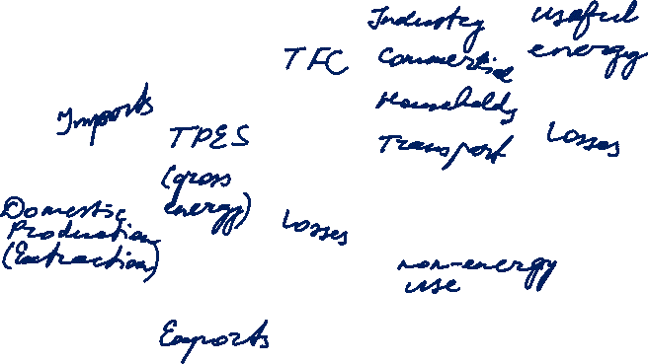
Energy Balances: Recap
Define the components of an energy flowchart and draw a scheme with the given components.
Notes:
Water wheel converts kinetic energy of water is converted into mechanical movement.

Slide 5
Question 2: RES in German energy balance
Energy balances of Germany 2017 (AGEB)
Avr efficiency of RES power pl.: 769.673 PJ / 1.797.459 PJ = 42%
But: Hydro, wind and PV cannot be separated from biomass and renewable waste.
 | PJ | TWh | Cell
Total electricity output | 2.353.457 | 653.738 | AD39
Hydro, wind, PV and other | 769.673 | 213.798 | AD33
RES share in total output | 32,7%
TPES | 13.522.990 | 3.756.386 | AI15
RES in TPES | 1.797.459 | 499.294 | SUM(Z15:AB15)
RES share in TPES | 13,29%
Notes:
Water wheel converts kinetic energy of water is converted into mechanical movement.

Slide 6
Question 2: RES in German energy balance (continued)
IEA Atlas of Energy: Germany
AGEB uses IEA method to account for RES in TPES.
But: these is a slight discrepancy in RES generation (in TWh).
Apart from „Hydro, wind, PV and other“, the German energy balances list „Industrial power stations“ (lines 19 and 13), part of which may be based on RES.
Electricity generation (TWh) | 647,7
RES generation (TWh) | 216
RES share in electricity (%) | 33,0
RES share in TPES (%) | 13,0

Slide 7
Question 10: TFC of road transport
Energy balances of Germany 2010 and 2017 (AGEB)
See line 69 Road transport
PJ | 2010 | 2017
Motor gasoline | 791.416 | 719.580
Diesel oil | 1.168.063 | 1.425.424
LPG | 21.823 | 15.377
Natural gas | 8.768 | 5.848
Biomass & ren. wastes | 119.371 | 108.349
Electricity | - | 565
Total | 2.109.441 | 2.275.144

Slide 8
Question 10: TFC of road transport
Energy balances of Germany 2010 and 2017 (AGEB)
Increase in diesel share (55%→63%): taxation and engine efficiency as possible reasons.
2017: electricity comes in

Slide 9
Question 10: TFC of road transport
Energy balances of Germany 2010 (AGEB)
Notes:
Water wheel converts kinetic energy of water is converted into mechanical movement.

Slide 10
Question 10: TFC of road transport (continued)
Energy balances of Germany 2017 (AGEB)
Notes:
Water wheel converts kinetic energy of water is converted into mechanical movement.

