Slide 1
Integrated course „Energy Economics“
- Exam Preparation: Key Theories Revisited
Chair of Energy Systems
Prof. Dr. Boris Heinz | Dr. Elena Timofeeva
elena.timofeeva@tu-berlin.de

Slide 2
Outline
Energy balances
Economics fundamentals
Financial management
Electricity markets
Market structure
Electricity generation
Energy trading
Renewables support
Resources and sustainability
Gas and oil markets

Slide 3
Introduction: Energy economics
Economics is a social science studying production, distribution and consumption of goods and services.
Economics deals with allocation of scarce resources.
Energy is abundant in the nature but mostly not immediately applicable for doing useful work.
Engineering know-how + Economic viability
Notes:
Water wheel converts kinetic energy of water is converted into mechanical movement.

Slide 4
Energy Balances: Energy sources
Primary energy sources are in the form as found in nature and have not undergone any transformation.
  oil, coal, natural gas, nuclear, wind, solar, biomass, geothermal, hydropower
Secondary energy sources are forms of energy after conversion, either chemical or physical.
  electricity, refined fuels (e.g. gasoline), synthetic fuels (e.g. hydrogen)
  easily usable form
Notes:
Synthetic fuels are produced through chemical conversion.

Slide 5
Energy Balances: Energy flow chart
Source: Zweifel / Praktiknjo / Erdmann, 2017
Notes:
Energy flow chart helps understand and analyse interrelations in the energy industry.
Energy flow chart / energy balances refer to a territory (country or region) and to aggregate amounts of energy over a period of time (year).
Final energy includes energy sold to end users for energetic use and treatment for non-energetic use.
Energy services

Slide 6
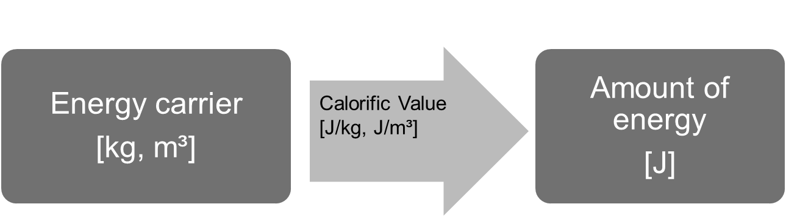
Energy Balances: Measuring primary energy
Primary energy sources are originally measured in units corresponding to their natural form: volume, mass etc.
Original units can be converted into energy units.
Calorific value is used for energy sources that can be converted into heat through combustion: coal, gas, oil, biomass.
@ Ensys
Notes:
calorific / heating / energy value
Calorific value: amount of heat released by complete combustion of a unit quantity of fuel under specified conditions.
Energy stored in a unit of volume -> energy density
Energy stored in a uni mass -> specific energy

Slide 7
Energy Balances: Lower calorific value of energy fuels
@ Prof. Dr. Georg Erdmann
Notes:
calorific / heating / energy value
Heat energy can be converted into electrical energy.

Slide 8
Energy Balances: Units of energy
Source: Zweifel / Praktiknjo / Erdmann, 2017
Tonne of oil equivalent (t.o.e.): energy generated by burning one metric ton (7,4 barrels) of oil, or 1270 m³ of natural gas, or 1,4 metric tons of coal.
Notes:
Basic: calorie, Joule, kWh, Btu
Source-based: t.c.e., t.o.e.

Slide 9
Energy Balances: Measuring RES
How to value energy carriers which do not have a calorific value, e.g. wind, PV, nuclear energy, electricity imports, water, geothermal heat?
Substitution Principle: amount of fuel that would be necessary to produce that amount of electricity in a thermal powerplant (35-40%)
Efficiency Principle: actual efficiency of respective technology (hydro 80-90%, wind 30-55%, solar 10-25%)
Fictive Efficiency Principle (IEA): 100% for wind, solar, hydro
(underestimated RES share)
Source: IEA

Slide 10
Energy Balances: Energy flow chart for Germany in 2018
Source: AGEB, 2019
Petajoule (PJ)
Notes:
TPES = Imports + Extraction – Exports – Int. Marine & Aviation Bunkers +/- Stock changes

Slide 11
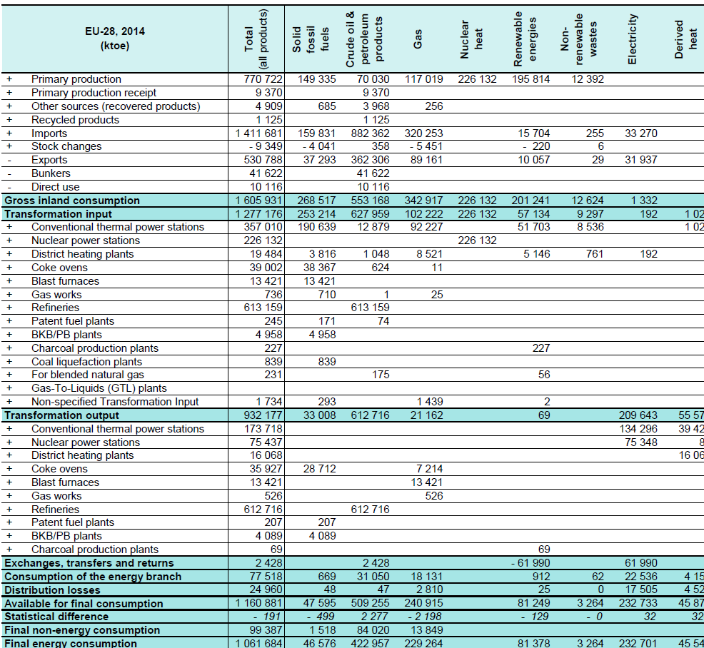
Energy Balance: Simplified structure
Source: Eurostat
+ Industry
+ Transport
+ Other sectors
Notes:
Matrix: fuels – flows
Production – transformation – consumption
Accounting framework for compilation of data on all energy products entering, exiting and used within the territory of a country during a reference period.
Contribution of different fuels to the economy

Slide 12
Energy Balance: Cumulated energy requirement
Cumulated energy requirement is total primary energy amount required for production, use and disposal of a product over its lifetime.
CER = CER_{P} + CER_{U} + CER_{D}
CER is used in life-cycle assessment to account for all environmental impacts of an industrial process.
'Grey energy‘
Energy required for production/recycling is not reflected in the national energy balances in this case.

Slide 13
Outline
Energy balances
Economics fundamentals
Financial management
Electricity markets
Resources and sustainability
Gas and oil markets

Slide 14

Market structures
Market is a group of sellers and a group of buyers of a particular good or service.
Perfect competition:
many buyers and many sellers > cannot influence the price
goods at exactly the same (homogeneous)
consumers have perfect information
no entry or exit barriers
Monopoly:
seller is the sole producer and can influence the price of its output
Market power is the ability to maintain a price above the price under competition.

Slide 15

Market structures

Slide 16
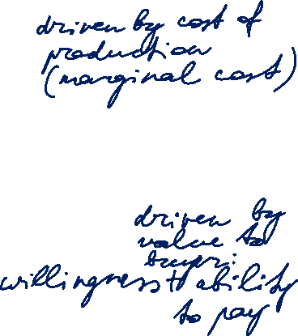
Demand and Supply
Price p
Supply function
p(QS)
Demand function
p(QD)
Q
Notes:
The demand curve reflects the value to the buyers.
The supply curve reflects the costs to the sellers.

Slide 17
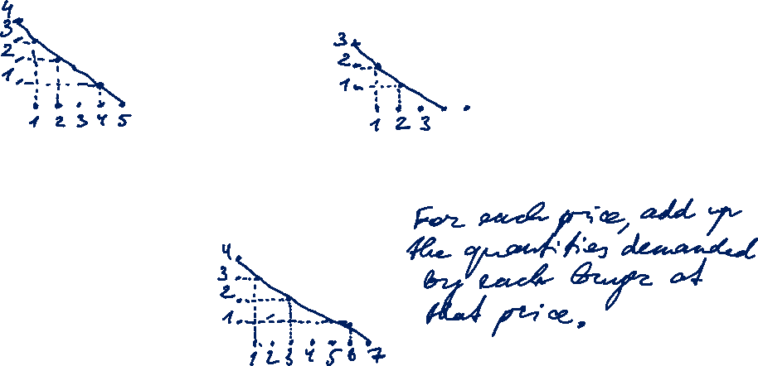
Demand and Supply
Buyer A
Buyer B
P
P
Q
Q
Market demand
(Buyer A + Buyer B)
P
Q
Notes:
The demand curve reflects the value to the buyers.
The supply curve reflects the costs to the sellers.

Slide 18
Demand and Supply
Price p
Supply function
p(QS)
MCP
At the equilibrium price, the quantity supplied equals the quantity demanded.
Market clearing price
Demand function
p(QD)
Market clearing volume
MCV
Q
Notes:
The demand curve reflects the value to the buyers.
The supply curve reflects the costs to the sellers.

Slide 19
Bidding curves at EEX
[delivery period Monday, 6.11.2006, 8-9 h]
[Euro/MWh]
Demand
Supply
150
100
50
0
0
5000
10000
15000
20000
25000
[MWh]

Slide 20
Price reaction to change in demand
p
Supply
Change factors:
Income
Prices of related goods (substitutes and complements)
Tastes
Expectations about the future
Number of buyers
p_{max}
p₁*
A₁
p₀*
A₀
Shift of demand curve
Q₀*
Q₁*
Q

Slide 21
Price reaction to change in supply
Shift of supply curve
p
Supply
p_{max}
Change factors:
Input prices
Technology reducing costs
Expectations about the future
Number of sellers
p₁*
A₁
p₀*
A₀
Demand
Q₁*
Q₀*
Q

Slide 22
State regulation: Minimum price (floor price)
P
Excess
Supply
p_{min}
p₀*
A₀
Examples:
EU agriculture politics:
milk overproduction discarded
Minimum wages
Demand
Q_{D}
Q_{S}
Quantity demanded
Q₀*
Quantity supplied
Q

Slide 23
State regulation: Maximum price (price cap)
P
Supply
p₀*
A₀
Examples:
apparment rent,
bread/staples,
energy products
Shortage
p_{max}
Demand
Q_{S}
Q_{D}
Q₀*
Q
Quantity supplied
Quantity demanded

Slide 24
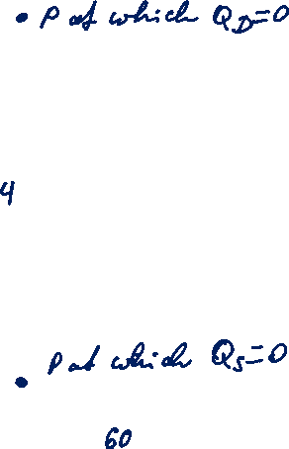
Demand and Supply: Welfare effect of markets
Price p
Some buyers are willing to pay a price larger than the market clearing price but pay MCP.
Supply function
p(QS)
MCP
Some sellers are able to produce at a marginal cost lower than the market clearing price but sell at MCP.
Demand function
p(QD)
MCV
Q
Notes:
The demand curve reflects the value to the buyers.
The supply curve reflects the costs to the sellers.

Slide 25
Demand and Supply: Welfare effect of markets
Price p
The amount the buyer is willing to pay for a good minus the amount the buyer actually pays for it.
Supply function
p(QS)
(CS)
Consumer Surplus
MCP
Producer Surplus
(PS)
The amount the seller is paid for a good minus the seller‘s cost of providing it.
Demand function
p(QD)
CS + PS = TS
Q
MCV
Total surplus indicates the degree of efficiency of resource allocation.
Notes:
Willingness to pay determines the value to buyers.
CS = value to buyers – amount paid by buyers
PS = amount received by sellers – cost of production
Free markets allocate goods to buyers who value them most highly and to sellers that produce at the least cost.

Slide 26
Price elasticity
Elasticity is a measure of how much buyers and sellers respond to changes in market conditions (e.g. prices – price elasticity).
Price elasticity of demand is a measure of how much the quantity demanded of a good responds to a change in the price of that good.
% change in quantity demanded
Price elasticity of demand =
% change in price

Slide 27
Price elasticity (continued)
-1 < η_{p,Q} ≤ 0 inelastic demand
-∞ < η_{p,Q} ≤ -1 elastic demand
η_{p,Q} = -1 if price increases by 1%, demand
decreases by 1%
Convention to operate with absolute values │η_{p,Q} │:
η_{p,Q} > 1 elastic demand
0 ≤ η_{p,Q} ≤ 1 inelastic demand

Slide 28
Price elasticity of demand: Electricity
Demand for electricity is largely inelastic.
General reasons for inelastic demand (0 – 1):
Buyers do not perceive the price changes
Switching to alternative products (substitutes) is cumbersome
Lack of substitutes
Time:
Goods tend to have more elastic demand over longer time horizons.
A more narrowly defined market has a more elastic demand than a broader market.

Slide 29
Supply side: Cost of production
The price at which a seller is willing to sell their goods is determined by their cost of production:
explicit cost: out-of-pocket expenses - money actually paid
opportunity cost: potential benefit or income that is foregone as a result of selecting one alternative over another

Slide 30
Terms and definitions of cost accounting
Fixed Costs are the share of the total costs that do not change with a variation of the produced quantity
Variable Costs are the share of the total costs that do change with a variation of the produced quantity
Total Costs are the sum of fixed and variable costs

Slide 31
Terms and definitions of cost accounting (continued)
Average costs are total cost per unit: TC divided by the produced quantity Q.
Marginal costs are costs incurred for producing one additional unit of production volume.
Contribution margin is selling price minus variable cost per unit.

Slide 32
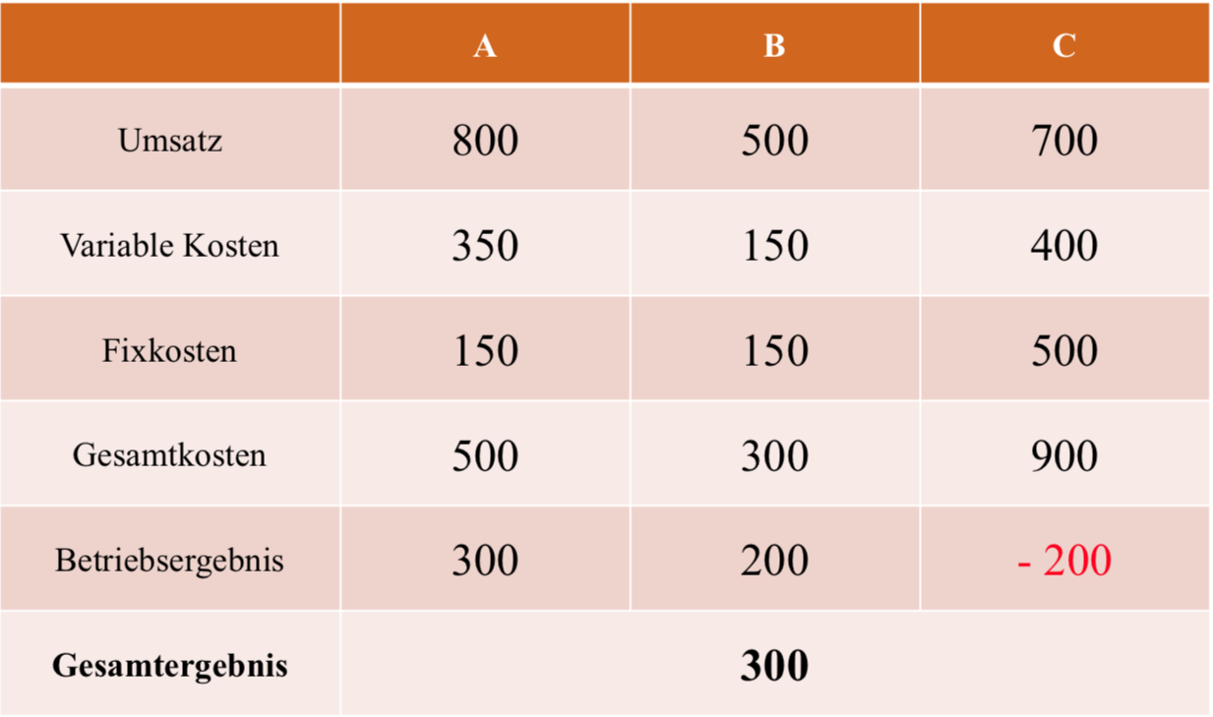
Total cost consideration
Turnover
Variable Cost
Fixed Cost
Total Cost
Operating income
Overall outcome

Slide 33
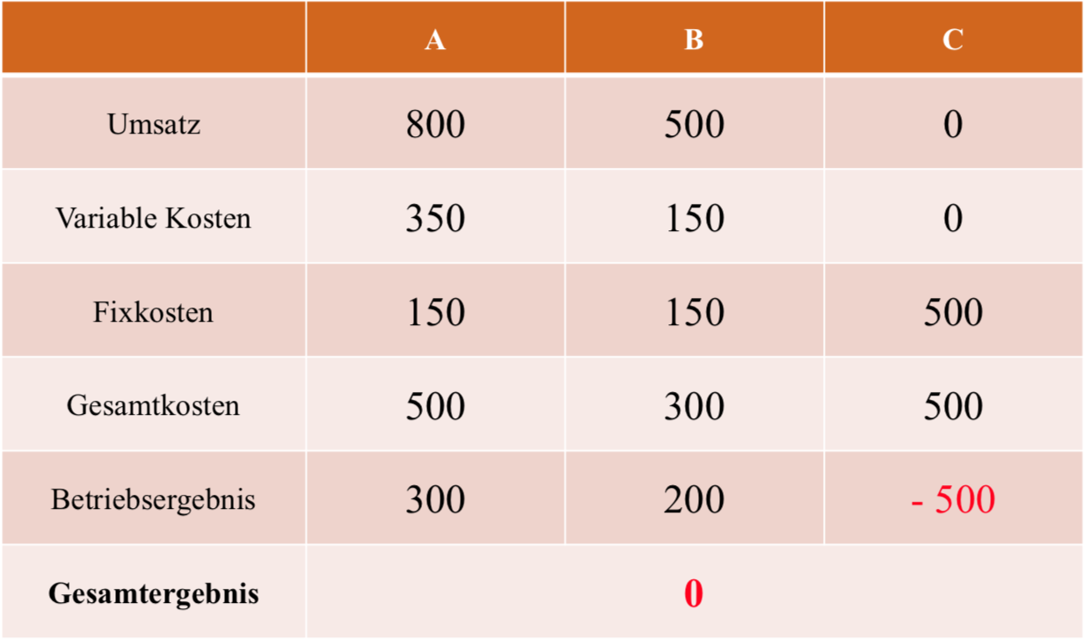
Total cost consideration without product C
Turnover
Variable Cost
Fixed Cost
Total Cost
Operating income
Overall outcome

Slide 34
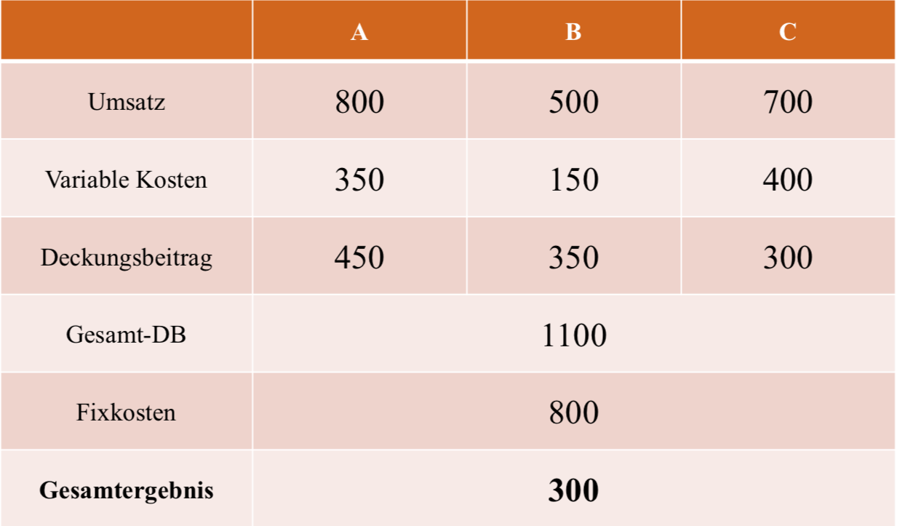
Variable cost
Turnover
Variable Cost
Contribution margin
Total contribution margin
Fixed cost
Overall outcome

Slide 35
Cubic cost structure – cost structure
c
[EUR/unit]
dC/dQ
c (Q)
c_{var} (Q)
c_{fix}
Q
[unit]

Slide 36
Cubic cost structure – conclusions for a price taker
c
[EUR/unit]
dC/dQ
c (Q)
c_{var} (Q)
Market Price
[EUR/unit]
Profit
C_{fix}
C_{var}
c_{fix}
Q
[unit]

Slide 37
Market structures - 1
Market is a group of sellers and a group of buyers of a particular good or service.
Perfect competition:
many buyers and many sellers > cannot influence the price
goods at exactly the same (homogeneous)
consumers have perfect information
no entry or exit barriers
Monopoly:
seller is the sole producer and can influence the price of its output
Market power is the ability to maintain a price above the price under competition.

Slide 38
Monopoly Pricing

Slide 39

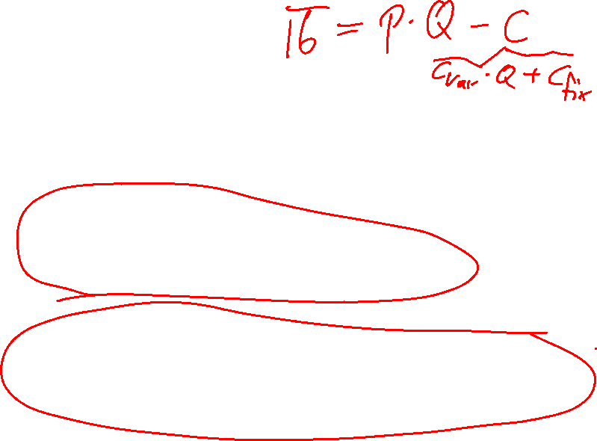
Supply and pricing
Π Profit (per period)
p Sales price
Q Output (Quantity)
C Production costs
Competitive markets
„Marginal cost = Price rule“
Monopoly markets
„Marginal costs = marginal revenue rule“

Slide 40
Market structures - 2
Cournot oligopoly:
More than one firm
All firms produce one homogeneous product (no product differentiation)
No cooperation among firms (no collusion)
Firms have market power - each firm's output decision affects the good's price
Fixed number of firms
Firms compete in quantities, and choose them simultaneously
Economically rational and strategically acting firms, seeking to maximize profit given their competitors' decisions

Slide 41
Outline
Energy balances
Economics fundamentals
Financial management
Electricity markets
Resources and sustainability
Gas and oil markets

Slide 42
Introduction to corporate finance
Understanding how companies invest in new projects
Starting a firm takes investment into assets:
inventory (raw materials), machinery, land, and labour.
The amount of cash invested into the assets has to be matched by the amount of cash raised by financing.
By producing and selling products, the firm generates cash – the basis of value creation for the firm’s owner.

Slide 43

Balance sheet model of the firm
Current assets
How to manage short-term operating cash flows?
Current liabilities
Non-current liabilities
How to raise cash for capital expenditures?
Non-current assets:
Tangible non-current assets
Intangible non-current assets
Net working capital
Which long-lived assets to invest in?
Shareholders’ equity
Total value of assets
Total value of the firm to investors
Goal: Maximise the value of a company’s equity shares.
Source: Hillier, Ross, Westerfield, Jaffe, Jordan, 2016
Notes:
Capital budgeting: buy assets that generate more cash than they cost.
Capital structure: sell bonds and shares etc. (financial instruments/securities) that raise more cash than they cost.
Net working capital – matching the amount and timing of operating cash inflows and outflows.
Shareholders are residual owners – after employees, suppliers and creditors.
Corporate finance as the study of the relationship between business decisions and the value of the shares in the business.

Slide 44
Methods of project valuation
Static methods
(single-period)
Cost comparison statement
  + operating costs p.a.
  + average capital costs p.a.
  + depreciation p.a.
  annual costs
Profit comparison
  revenues ./. annual costs
Return on investment
  EBIT = earnings before interest and tax +
  interest on debt
  ROI = EBIT / avg. capital employed p.a.
Pay-back period
Break even = investment / avg. cash flow p.a.
Dynamic methods
(time value of money)
Net present value
PV = sum of discounted cash flows
NPV = PV - Investition > 0?
Equivalent annual annuity
transformation of cash flow series into annuity
Internal rate of return
IRR = discount rate at which [NPV=0]
Notes:
Cost comparison: for chosing between functionally similar assets (equal capability) > lowest average periodic cost
unequal capabilities -> lowest average unit cost
Profit comparison: if type of project influences product prices -> highest average annual profit
If different levels of capital expenditure: ROI = average periodic profit / average capital employed > predetermined minimum
Pay-back period: the shorter, the more attractive. Indicates project liquidity and, thus, risk.

Slide 45
Time value of money
Value of an investment depends on the timing of cash flows.
Cash flow is an amount of money paid or received (revenue or expenditure).
Cash flows are characterised by the amount (+/-) and due date.
Time value of money: value of a cash flow at the time it becomes due.
Present value: value of a cash flow at present.
For a cash flow due and payable today:
  present value = time value
For a cash flow due and payable at a future time:
  present value = time value – interest
Notes:
Opportunity cost of an investment: risk-free investment on a savings account or government bond earning interest.
Preference for earlier cash: One euro received today is worth more than one euro received in one year.

Slide 46
Cashflows: Discounting and compounding
To be able to compare cashflows, they have to be discounted or compounded to the same reference period.
Choice between spending a sum of money or lending it.
Interest rate is the price for obtaining funds for a specified time.
It reflects the opportunity cost in view of other investment options and risk of credit default.
Notes:
Risk premium depends on the investment type and location (country risk).

Slide 47
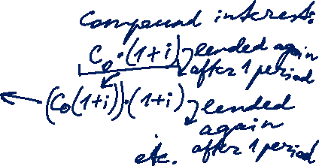
Cash flows: Compounding
Compounding: Present value → future value
C_{T} = C₀ · (1 + i)^{T}
  C₀ = the cash flow at date 0 (today) = present value
  i = interest rate per period
  T = number of periods (time horizon)
  C_{T} = value of the cash flow at time T = future value
Final value
Present value
C_{T}
C₀
0
1
2
3
T
Notes:
Compounding: leaving the money in the market and lending it for another financial year.
Compound interest: each interest payment is reinvested.

Slide 48
Cash flows: Discounting
Discounting: Future value → present value
1
C₀ = C_{T} ·
(1 + i)^{T}
  C₀ = value of the cash flow at date 0 (today) = present value
  i = interest rate per period
  T = number of periods (time horizon)
  C_{T} = the cash flow at time T = future value
K_{T}
K₀
0
1
2
3
T
Notes:
Compounding: leaving the money in the market and leaving it for another financial year.
Compound interest: each interest payment is reinvested.

Slide 49

Present value of a future cash flow
1,0
NPV factor
0,8
0,6
2 %
0,4
4 %
0,2
10 %
6 %
0,0
0
5
10
15
20
25
30
35
40
Time of payment (year)
Notes:
Compounding: leaving the money in the market and leaving it for another financial year.
Compound interest: each interest payment is reinvested.

Slide 50
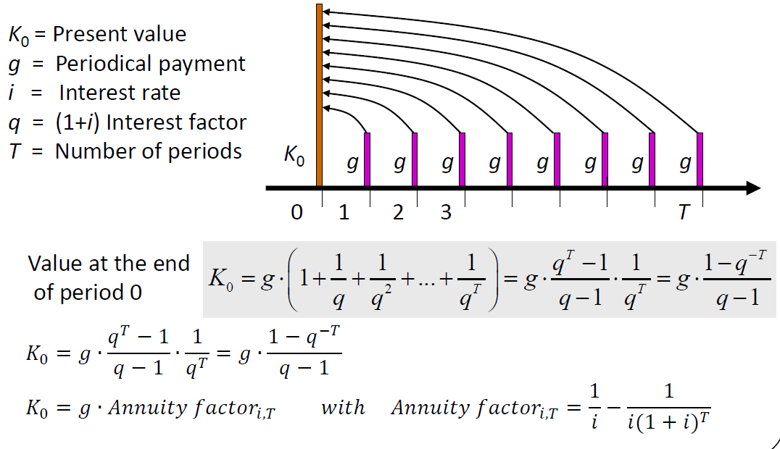
Annuity: NPV with constant cash flows
Annuity is a level stream of regular payments during a fixed number of periods.
Notes:
Regular cashflows are uncommon in the energy sector but nevertheless used for simplification.
The formula values the annuity as of one period before the first payment.

Slide 51
Annuity factor
A fixed periodical payment multiplied with applicable ANF returns the present value of the annuity.
Notes:
Used to calculate PV of annuity

Slide 52


Capital recovery factor
A loan amount multiplied with applicable CRF returns a constant annual amount needed to repay the loan.
Notes:
Constant annual amount needed to repay a loan amount.
Annual capital user cost.

Slide 53
Capital structure
The discount rate represents cost of capital and project risk.
Risk-free interest rate + risk premium
How to raise cash for capital expenditures?
Equity (own capital) – raised from shareholders
  rewarded by dividends + the difference in the market price of shares (if positive)
  right to share in assets remaining after liabilities in case of liquidation
  participate in managing the firm
Debt (borrowed capital) – borrowed from creditors /debtholders
  rewarded through interest
  preferred over shareholders (incl. in case of bankruptcy)

Slide 54
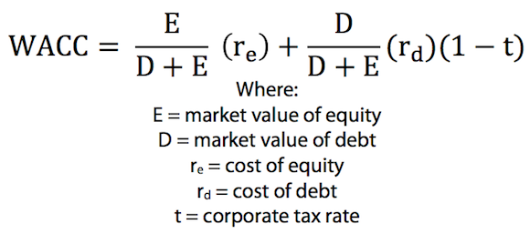
Capital structure: Weighted average cost of capital
50% debt
50% equity
25% debt
50% equity
Capital structure 1
Capital structure 2

Slide 55
Capital budgeting: NPV (DCF) method
The value of a project is measured by its net present value (NPV):
present value of the future cash flows minus the initial investment outlay.
Identify forecast all cash flows (revenues and costs) associated with a project (forecast).
Map the cashflows on a cash flow time chart.
Discount each cashflow using an applicable interest rate.
Sum up all the discounted cashflows (DCF) to obtain NPV
Invest only if NPV > 0 [NPV = 0 indifferent]

Slide 56
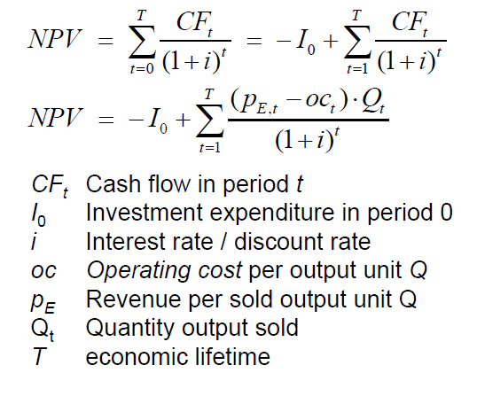
Capital budgeting: NPV (DCF) method
CF_{t} = Cash Flow in period t
I₀ = Investment in period 0
i = Interest rate / Discount rate
T = Time horizon / Economic lifetime
t = Period

Slide 57
Relevant cash flows
CF from financing activities:
capital expenditures
sale of assets
CF from operating activities:
revenues
operating expenses
depreciation
taxes
change in working capital
Notes:
Opportunity cost: e.g. unused storage facility to be used for storing a new product.
Salvation value: technical service life vs. economic service life

Slide 58

Relevant cash flows (continued)
Opportunity cost: potential benefit or income that is foregone as a result of selecting one alternative over another are considered.
Sunk cost: Cost incurred in the past that cannot be changed by any decision are ignored.
Salvation value: In case of abandonment (divestment), assets, typically, retain a residual value (future revenue).
Depreciation tax shield: Yearly depreciation amount is deducted from the income tax base.
The resulting tax saving [depreciation amount x tax rate] is added as a positive cash flow.
Notes:
Opportunity cost: e.g. unused storage facility to be used for storing a new product.
Salvation value: technical service life vs. economic service life

Slide 59
NPV method: Calculation example
Discount rate: 7%

Slide 60
Levelised cost of electricity (LCOE)
Generic formula:
For electricity generation: CF are derived from operating cost and revenues from selling electricity
  oc operating cost per unit of energy Q
  p_{E} revenue per unit of energy Q
  Q total amount of electricity output over lifetime
Solving for p_{E} results in levelised cost of electricity (LCOE):
I₀
p_{E} = + oc
Q ∙ AF_{i,T}
Notes:
Least cost approach > LCOE

Slide 61
Levelised cost of electricity (LCOE)
lifetime costs divided by
lifetime electricity output
Lifetime costs: PV of total cost of building and operating
LCOE allows comparison of technologies regardless of lifetime, installed capacity, cost of capital, risk and return.
initial capital cost*
* specific investment costs: investment costs divided by capacity
annual operating expenses
capacity factor
discount rate
operational life
Notes:
LCOE is the present value of the revenue from produced electricity over the economic life of the plant and the costs incurred in the construction, operation and maintenance, and the fuel costs.

Slide 62
Levelised cost of electricity (LCOE)
How to calculate the generation costs per unit of electricity?
I₀ ∙ CRF_{i, t}
LCOE = + oc
Q
E_{t} = Cap * FLH
  E_{t} annual electricity output
  Cap installed capacity (rated power)
  FLH full load hours: annual output divided by Cap
E_{t} [kWh]
Capacity factor =
Cap [kW] * 8.760h
Notes:
Generation costs of wind depend on lifetime, interest rate, investment and operation costs and full load hours.

Slide 63
Outline
Energy balances
Economics fundamentals
Financial management
Electricity markets: Market structure
Resources and sustainability
Oil markets
Gas markets

Slide 64
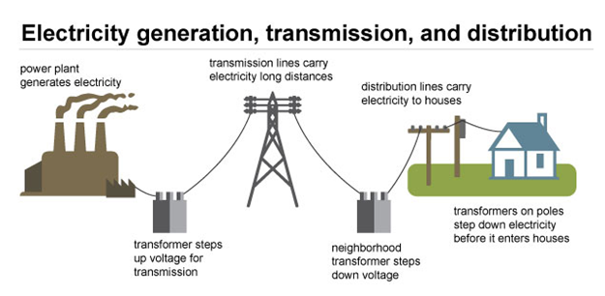
Electricity market: Technical view
Source: U.S. EAI
Notes:
Value chain is a framework that describes the full range of activities needed to create a product or service.
Physics of electricity. Real-time balance of electricity generation and consumption.

Slide 65
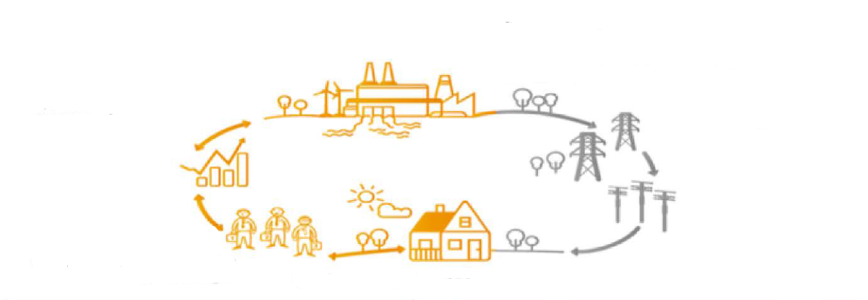
Electricity market: Economic view
Commercial infrastructure
Electricity is produced in power plants.
Technical infrastructure
Produced electricity is offered/traded in the wholesale market.
Produced electricity is transported to final consumers via transmission and distribution grid.
Electricity retailers procure electricity in the wholesale market for supplying final consumers.
Final consumers buy electricity from retailers.

Slide 66
Electricity market: Natural monopoly
Natural monopolies occur in industries for which it is only economically efficient to have a single provider due to economies of scale (decreasing average costs with increasing scale of production).
Electricity transmission and distribution is a decreasing cost industry: Duplicating the grid is economically inefficient.
Yet, natural monopolies – like monopolies in general – tend to overcharge and underserve.

Slide 67
Electricity market: Unbundling
Competitive conditions for electricity generation and retail can be created by state regulation aiming at:
Costs transparency
→ prevent cross-subsidies*
Non-discriminatory access to the grid
→ grid connection and transmission/distribution services
Unbundling is a set of organisational measures to separate transmission and distribution networks from generation and retail activities.
It aims at ensuring independence of a grid operator from other activities in a vertically integrated company and at preventing discrimination of other market participants.
* allocating costs from competitive
activities to grid operation

Slide 68
Competitive and natural monopoly activities
Generation
Wholesale
Transmission incl. dispatch
Distribution and metering
Retail
Primary energy is transformed into electricity and injected into the grid
Energy is sold/traded on the wholesale market
Electricity is transmitted via high voltage grid until the local distribution grid
Electricity is transformed from high to medium/low voltage and distributed to final customers
Electricity is supplied to final consumers based on their demand
Power plant operators
Energy traders
Transmission system operators (TSO)
Distribution system operators (DSO)
Retailers
Competition
Competition
Regulated
Regulated
Competition
Natural monopoly

Slide 69
Outline
Energy balances
Economics fundamentals
Financial management
Electricity markets: Electricity generation
Resources and sustainability
Oil markets
Gas markets

Slide 70
Matching supply and demand
Electricity is virtually non-storable.
Demand is barely responsive to wholesale price fluctuations.
Thus, electricity supply and demand are balanced by continuous adjustment of generation.

Slide 71

Load Curve and Load Duration Curve
P[MW]
P[MW]
Load Curve
Load Duration Curve
1
1
P_{max}
2
2+3
3
4
4
P_{min}
Time of day
Cumulative hours

Slide 72
Load and Residual Load
to be covered by
adjustable generation
storage discharge
Load
reduced by must-run
(RES, inflexible conventional technologies)
Demand
Residual Load
Surplus
applicable for
storage charge
additional consumption: intersectoral technologies

Slide 73
Categories of costs in power production
 | Relevance for
 | Operational Decisions | Decommissioning Decisions | Investment and Expansion Decisions
Costs depending on capacity | [€/MW]
Capital costs (annuity) Labour costs Fixed O&M costs
Costs depending on operation | [€/MWh]
Fuel costs CO2 costs Other variable costs (e.g variable O&M costs, ramping costs, start-up costs)

Slide 74
Merit Order
Oil
Marginal costs
Gas
Coal
Nuclear
Hydro
Installed Capacity
Notes:
The merit order is a way of ranking available sources of energy, especially electrical generation, based on ascending order of price (which may reflect the order of their short-run marginal costs of production) together with amount of energy that will be generated. In a centralized management, the ranking is so that those with the lowest marginal costs are the first ones to be brought online to meet demand, and the plants with the highest marginal costs are the last to be brought on line. Dispatching generation in this way minimizes the cost of production of electricity

Slide 75

Merit Order
Available generation capacities arranged by their STMGC.
The market clearing price equals the marginal cost of the last (i.e. most expensive) generation unit required for matching the load.
Load
Oil
Marginal costs
Gas
Coal
Nuclear
Hydro
Installed Capacity
Notes:
The merit order is a way of ranking available sources of energy, especially electrical generation, based on ascending order of price (which may reflect the order of their short-run marginal costs of production) together with amount of energy that will be generated. In a centralized management, the ranking is so that those with the lowest marginal costs are the first ones to be brought online to meet demand, and the plants with the highest marginal costs are the last to be brought on line. Dispatching generation in this way minimizes the cost of production of electricity

Slide 76
Merit Order Effect of Renewables
Load
Oil
Marginal costs
Gas
Coal
Nuclear
Renewables
Hydro
Installed Capacity
Notes:
Merit Order Effect of the Renewables can be shown by changing the load curve or the generation curve.
In this case: Load is uncanged, Renewables shift the conventional merit order to the right, since they have the lowest marginal generation costs.
The merit order effect of renewable energy sources (RES) describes the impact of feed-in of renewable (must run) electricity on electricity prices. As renewable electricity feed-in such as wind or photovoltaic virtually comes at zero costs, the demand for conventional generation capacity is reduced by the amount of renewable feed-in. As a result the prices for electricity decrease: the merit order effect

Slide 77
Merit Order
Residual Load
Load
Oil
Renewables
Marginal costs
Gas
Coal
Nuclear
Hydro
Installed Capacity
Notes:
Residual Load = Load of consumers, reduced by RES, and inflexible must-run capacities

Slide 78
Merit Order - Impact of CO₂ – Prices
Load
CO₂-
Price
Oil
Marginal costs
Windfall-
Profit
Windfall-Profit
CO₂-Price
CO₂-Price
Gas
Coal
Nuclear
Hydro
Installed Capacity
Notes:
CO2-Price has to be priced into the marginal generation costs. Thereby changing the merit order.
There is a CO2 price at which generation technologies switch position in the merit order.

Slide 79
Technologies: Summary
Source: Zweifel / Praktiknjo / Erdmann, 2017, p. 276
Notes:
Cost of additional fuel consumption caused by shut-on and shut-off processes

Slide 80
Ramp rates and start-up times of termal power plants
Source: Agora Energiewende, 2017, with ref. to: Fichtner (2017), VDE (2012), Steck & Mauch (2008), Balling (2010)
Notes:
Flexible: fast ramp-up / ramp-down

Slide 81
Power plants in the merit order
Power plant types based on their place in merit order:
Power plant type | FLH [h/a] | Operation features | Technologies
Baseload | > 7.000 | continuous | lignite
Intermedium load | 4.500 – 5.500 | during peak hours (wd 8-8) | hard coal
Peak load | < 1.250 | at times of peak demand | pumped-storage hydro, gas
Reserve |  | during power plant shut-downs | old power plants
Source: Konstantin, 2017

Slide 82
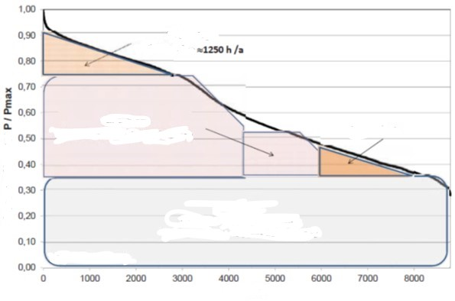
Power plants in the merit order
Peak load 1250 h/a
Intermedium load
FLH 4500-5500 h/a
Base load
FLH 7500 to 8000 h/a
Hours
Source: Konstantin, 2017

Slide 83
Outline
Energy balances
Economics fundamentals
Financial management
Electricity markets: Energy trading
Resources and sustainability
Oil markets
Gas markets

Slide 84
Trading forms: Exchange vs. OTC
Mediated trading: power pool or power exchange
organised auction resulting in a uniform price
highly standardised products; no room for negotiation
transparency
regulated
clearing and colateral costs
Bilateral trading: over-the-counter (OTC)
intermediation cost (opportunity cost or broker fee)
individual prices agreed between pairs of buyers and sellers
(≈pay-as-bid principle)
standard framework agreements: EFET/GTMA; ISDA; DRV etc.
unregulated
Typically: Combination of exchange and OTC trading.
Notes:
Transparency: exchange publishes traded volumes and prices.

Slide 85
Energy trading: Submarkets
Time
Delivery time (t0)
Forward /
Futures /
Term
Spot /
Short-term /
Cash
Day-ahead
Intraday
years, quarters, months ahead of delivery
day ahead delivery
up to 45 min ahead of delivery
Notes:
Transparency: exchange publishes traded volumes and prices.

Slide 86
Energy Trading: Submarkets
Time
Delivery time (t0)
EEX Futures
until 24:00 on the last day of M-2
Mo-Fr (no trading on weekend and public holidays)
Day-Ahead Auction EXAA
until 10:12
hours and 15 min
Mo-Fr (no trading on weekend and public holidays)
Day-Ahead Auction EPEX Spot
until 12:00 on D-1
hours and blocks
Intraday Auction EPEX Spot
until 15:00 on D-1
15 min
Intraday continuous EPEX Spot
from 15:00 on D-1 until 5 min before t0
15 min [16:00 D-1 until 5 min before t0)
Exchange
Bilateral
Forward / Term
Spot / Short-term
until 15 min before t0 across control areas; immediately before t0 for trades within the same
control area. Forward and spot All products are negotiated bilaterally.
Control power
Primary reserve
until Tue 15:00 for Mo from 00:00
Time blocks: one week
Secondary reserve
daily until 8:00 for following day from 00:00
Time blocks: six 4-hour blocks
Minute reserve
daily until 8:00 for following day from 00:00
Time blocks: six 4-hour blocks
Source: Adapted from Next Kraftwerke
Notes:
Submarkets with different lead times between trade conclusion and actual delivery.
Forward/futures: hedging
Spot: day-ahead market, 15-min intraday auction, continuous intraday market

Slide 87
Sample power purchase portfolio
Standardised futures do not match with typical load schedules.
© Prof. Dr. Georg Erdmann
Notes:
Flat deliveries (blocks) under forward/futures contracts are matched with actual load profile by trading in the day-ahead and intraday market (or by balancing power).

Slide 88
Portfolio management of a power retailer
© Prof. Dr. Georg Erdmann
Notes:
Flat deliveries (blocks) under forward/futures contracts are matched with actual load profile by trading in the day-ahead and intraday market (or by balancing power).

Slide 89
Day-ahead contracts for singular hours
© Prof. Dr. Georg Erdmann
Notes:
Flat deliveries (blocks) under forward/futures contracts are matched with actual load profile by trading in the day-ahead and intraday market (or by balancing power).

Slide 90
What is a trading product
Trading product is combination of transaction features:
Underlying asset electricity
Delivery point TSO control area
Delivery period start date / end date
Delivery amount contract capacity [MW]
  contract quantity [MWh]
A bid (offer to buy) or ask (offer to sell) is characterised by: product, price, trading day and time.

Slide 91
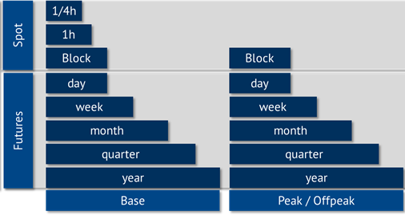
Electricity product types based on delivery period
Source: Energy Brainpool

Slide 92
EPEX Spot Day-ahead auction
Double-sided auction: bid and ask order book (order book trading)
Uniform price auction: market clearing price for each product (hour or block)
Hourly contracts and blocks (base, peak etc.)
Occurs daily at 12h for delivery on the following day (0-24h)
Price publication time: asap from 12:42h
Volume tick (min order amount/amount increment): 0,1 MWh
Min price: -500 €/MWh; Max price: 3.000 €/MWh
Notes:
Auction market is a centrally managed market (central clearing house) under uniform rules.

Slide 93
Auction design
Goal of an auction is the least-cost dispatch of generation.
Source: Morey, Power market auction design, EEI, 2001, p. 20.
Notes:
Supply offer reflects the seller’s individual supply schedule.
Demand bid reflects the buyer’s individual demand schedule.

Slide 94
Power auction: Stylised example
$
Uniform price: market clearing price
vs Pay-as-bid: units are sold at different prices (e.g. control power)
Revenue equivalence theorem: equal outcome in both settings under the assumption that all bidders know each other’s cost (perfect information) and adjust their bidding behaviour to auction rules.
 | No. of units | Price [$/unit]
Buyer 1 | 5 | 17
Buyer 2 | 5 | 10
Buyer 3 | 5 | 6
Seller 1 | 5 | 6
Seller 2 | 5 | 10
Seller 3 | 5 | 17
15
10
5
5
10
15
Volume [units]
Source: Morey, EEI, 2001, p. 21-22.
Notes:
Supply offer reflects the seller’s individual supply schedule.
Demand bid reflects the buyer’s individual demand schedule.
At the market equilibrium point, the value of the last unit purchased equals the cost of the last unit supplied.

Slide 95
Balancing group: Linking the virtual and physical worlds
Balancing group (BG) is a virtual energy volume account associated with one or more grid users within a control area.
each grid connection point is allocated to one balancing group
balance responsible party (BRP) is responsible for balancing its BG’s saldo (feed-in and consumption) for each 15 min – incl. through trading on spot markets
deviations are penalised by imbalance fees
Analogy to a bank account:
TSO | ≈Bank
Balance responsible party | ≈Account holder
EIC | ≈Account number
Balancing circle | ≈Bank account
Energy deliveries | ≈Payments
Notes:
Control area is a power system or part thereof within a certain geographical area that is operated by one TSO.
BG focuses on electricity amounts only – not the prices.
Any imbalance that BRP is not able to mitigate through trading, is tackled by TSO via ancilliary services.

Slide 96
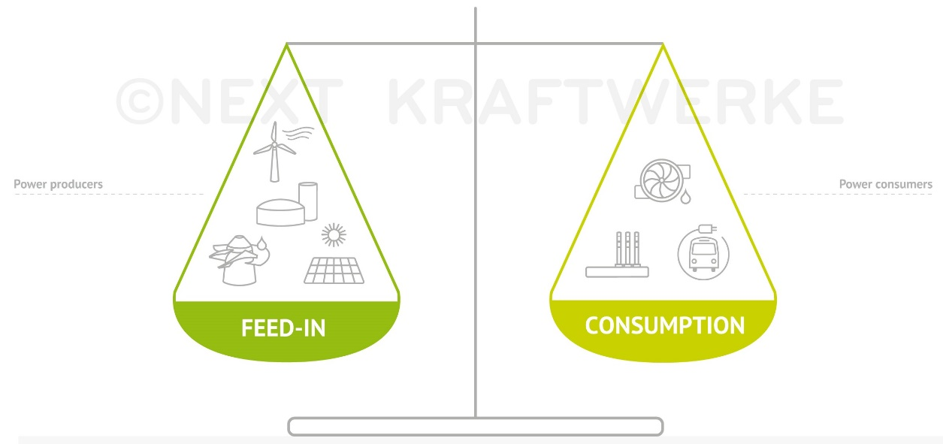
Balancing group (continued)
Trading on transmission grid level, i.e. performing delivery by scheduling to TSO, assumes no physical restrictions within a market area.
Depending on the nature and composition of a balancing group, the BGR transmits to the TSO forecasted load or generation and/or buy and sell amounts.
Imbalance fee is uniform for the control area (in Germany: for all four control areas), symmetric and based on actual activation of control power.
Notes:
Imbalance vs control power

Slide 97
Market roles and processes at TSO level
© Prof. Dr. Georg Erdmann
Notes:
Imbalance vs control power

Slide 98
Tasks of the Balancing group management
© Prof. Dr. Georg Erdmann
Notes:
Imbalance vs control power

Slide 99
Reasons for imbalances
Unplanned outage of generation units
Unplanned outage or activation of large loads
Forecast gap in volatile RES generation
Inaccurate forecast of demand
≈
Notes:
Imbalance vs control power

Slide 100
Credit risk management: Terminology
„Exposure is a measure of loss if an adverse materialisation of uncertainties occurs for a particular decision.“ *
Mark-to-market accounting is regular (daily) valuation of all open trading positions based on the current market price of the product.
* Perreira et al, IEEE Computer Applications in Power, vol. 13, 2000, p. 22

Slide 101
Credit risk management: Credit risk exposure – OTC
transaction date
delivery period
counterparty default
payment date for M1
Product: Q4 2019
Settlement exposure: delivered but unpaid amount * contract price (≈50 days; credit exposure updated after payment)
Mark-to-market exposure: contract amount from default date until end of delivery period * mark-to-market
Credit exposure for a portfolio depends on the netting rules:
Does the jurisdiction of the counterparty allow cherry-picking, i.e. performing under in-the-money transactions and dropping the ones that are out-of-the-money?
20th
M-1
M1
M2
M3
t
Notes:
MtM risk may aggravate or reduce credit risk exposure.
Settlement exposure is much lower for financial products compared to physical ones.

Slide 102
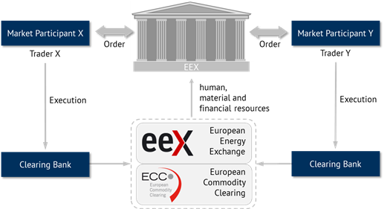
Clearing
Source: Energy Brainpool
Notes:
EEX, as Central Counterparty, covers counterparty risk of their customers

Slide 103
Clearing (continued)
Clearing is performed by European Clearing Counterparty (ECC).
Credit risk exposure is determined similarly to OTC trading.
Margining is the process of continuously recalculating the credit exposure under open positions based on the current market price and adjusting the amount of collateral required to cover it.
Initial margin: cash collateral or other first-class guarantee to ensure that the exchange member fulfills their obligations under open transactions.
Variation margin: daily margining based on mark-to-market calculation – resulting into a margin call as necessary.
Risk of clearing banks is limited to overnight risk.

Slide 104
Outline
Energy balances
Economics fundamentals
Financial management
Electricity markets: Renewables support
Resources and sustainability
Oil markets
Gas markets

Slide 105
Renewable Electricity Support Schemes in Europe
EU Clean Energy Package (2018): binding target of 32% for renewable energy sources in EU’s energy mix by 2030

Slide 106
RES support mechanisms: Administered fees (all-inclusive or premium)
The government fixes the price for each MWh produced or injected into the grid from RES.
Normally, the fee depends on renewable source and size of power plant.
Feed-in tarif (FIT)
Premium ensures that at least FIT is covered and gives incentives for selling RES output directly on the wholesale market
If the fee is coherent with the production cost, the government’s RES output target can be met; otherwise it would be not reached or exceeded.
The charges linked to the support system are paid by final customers.

Slide 107
RES support mechanisms: Green Certificates (GC)
Fossile fuel-fired generators are required to replace every year a certain percentage of their energy production with RES
The balance between demand (from generators and importers under the GC obligation) and supply (RES generators) determined the GC price
The charges linked to the GC are translated to the final customers through the electricity price (on wholesale or retail market).

Slide 108
Green Certificates Mechanism
© Prof. Carlo Andrea Bollino

Slide 109


Feed-in-tariff and Market Premium Mechanisms
revenues from
flexibility
guaranteed revenue
incl. management premium
fixed
feed-in tariff
market premium
variable
revenues from
wholesale market
fixed
(asset-specific)
Source: Next Kraftwerke

Slide 110
Renewables support levy (green fee)
RES support payments – RES marketing revenue
RES levy =
Adjusted non-preferred final electricity consumption
Adjusted final electricity consumption is equal to total final electricity consumption minus:
Share of electricity consumption of energy intensive industries, which are exempted from the levy
Own generation (self-consumption), which is partly exempted from the levy

Slide 111
Retail price composition: Household customers
Average composition of electricity price for a German household with an annual consumption of 3.500 kWh (2019)
Interruptible load levy (AbLaV)
Offshore levy
Levy to compensate reduced grid tariffs for certain grid users (§19 StromNEV)
CHP levy (KWK)
Green levy (EEG)
Electricity tax
Concession levy
VAT 19%
Taxes and levies
15,98 ct/kWh
Grid tariffs
(incl. metering)
7,39 ct/kWh
Electricity
procurement,
retail
7,06 ct/kWh
Source: BDEW, 2019

Slide 112
Outline
Energy balances
Economics fundamentals
Financial management
Electricity markets
Resources and sustainability
Oil markets
Gas markets

Slide 113
Brief theoretical summary of the topic: Exhaustible Resources
Resources and Reserves
Resource Extraction: Hotelling's Rule
The Green Paradox

Slide 114
Resources and Reserves
Finding and lifting cost
Uneconomic
resources
Finding & Lifting Cost
> Market price
Speculative
resources
Actual market price
Finding & Lifting Costs
Reserves
< Market price
known unknown Knowledge

Slide 115
Resource Extraction: Hotelling's Rule
Basic assumptions
  Perfectly Competitive Markets
  Resource Owners:
    Profit Maximizing Behavior
    Constant marginal extraction costs c
    Perfect information about the finite resource stock S
Basic Decision Problem of the Resource Owner:
  The market Price p_{t} cannot be influenced by the resource owner (“price taker”), therefore she just adjusts the extraction rate R_{t} in each period t
  Profit, Π_{t}, in each period follows as:
  To extract, or not to extract?

Slide 116
Resource Extraction: Hotelling's Rule
If the profit in the next period, Π_{t+1}, is greater than the Profit in the current period times the discount factor (Π_{t}*(1+i)), we do not extract
If the profit in the next period, Π_{t+1}, is less than the Profit in the current period times the discount factor (Πt*(1+i)), we extract (and put the profit on a bank to earn interest Π_{t} *(1+i))
If all resource owners behave profit maximizing, they adjust their extraction rates until:

Slide 117
Resource Extraction: Hotelling's Rule
The resource owners maximize the Net Present Values of profits by adjusting the extraction rates each period:
Extraction is constrained by the available resource stock, S and hence:
With Lagrange-Multiplier, λ>0, we introduce the constraint into the objective function:
The first order optimality conditions are:

Slide 118
Resource Extraction: Hotelling's Rule: Price Formation
Scarcity rent (Knappheitsrente) λ_{t}: λ_{t} = p_{t} – c = value of reserve
Decision criterion in t = 0 : λ₁ < λ₀ (1+i) or λ₁ > λ₀ (1+i)
with the capital market interest rate i)
Equilibrium (indifference condition): λ₁ = λ₀ (1+i)
Trajectory of the resource rent: λ_{t} = λ₀ (1+i)^{t}
Price trajectory under constant
extraction cost c: p_{t} = c + λ_{t} = c + λ₀ (1+i)^{t}
Resource rent at exhaustion T > t: λ_{T} = p_{subst} – c
with the backstop technology price p_{subst}
Optimal trajectory for t < T: λ_{t} = λ_{T} (1+i)^{t-T} = (p_{subst}-c) (1+i)^{t-T}

Slide 119
Hotelling Price Trajectory
Price P
Backstop Technology p_{subst}
p_{subst}
Price Trajectory
P_{t} = C + λ₀(1 + i)^{t}
λ_{t}
p₀
λ₀
Extraction costs c
0
t [a]

Slide 120
Hotelling Price Trajectory: Demand P(Q)
Price P
Price P
Backstop Technology p_{subst}
p_{subst}
Price Trajectory
P_{t} = C + λ₀(1 + i)^{t}
P(Q)
λ_{t}
p₀
λ₀
Extraction costs c
Q
0
t [a]

Slide 121
Task 2) Hotelling‘s Rule

Slide 122
Outline
Energy balances
Economics fundamentals
Financial management
Electricity markets
Resources and sustainability
Gas and oil markets

Slide 123
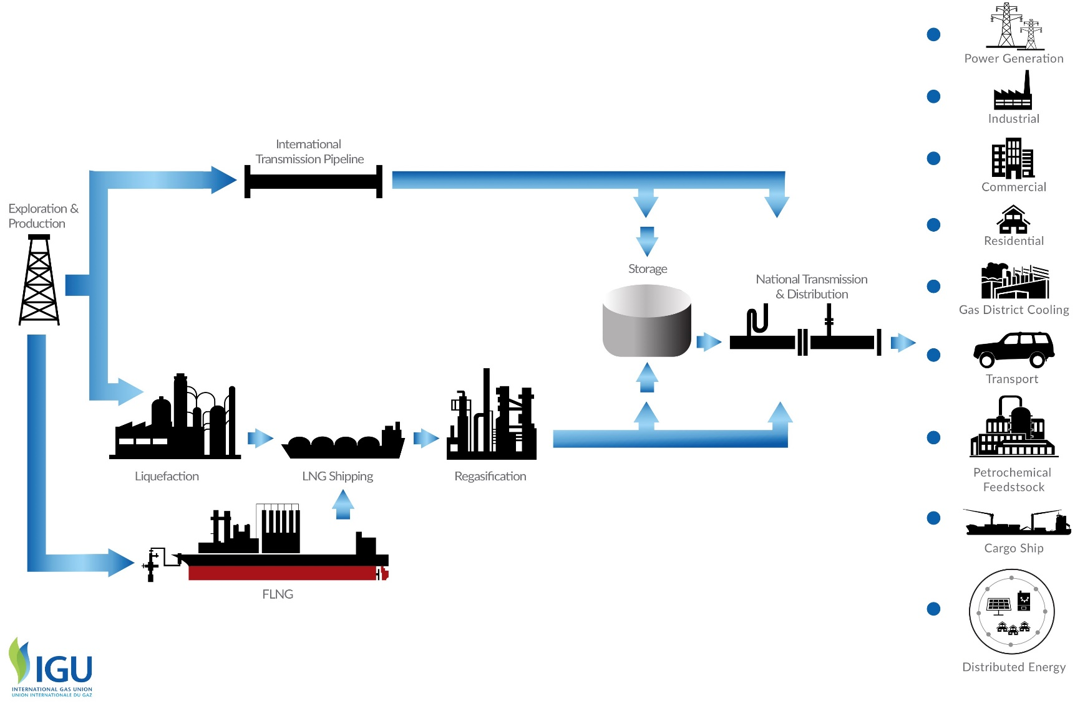
Natural gas value chain

Slide 124
Economics of Gas Pipelines
Throughput is the volume of gas passing through a pipeline in a period of time.
[m³/h]
Pipeline capacity is the maximum throughput.
© Prof. Dr. Georg Erdmann

Slide 125
Game Theory: Double Marginalisation
Gas producer is able to infer on the import price resulting from gas importer’s optimisation based on the domestic demand curve. It then optimises its profit at the given import price.
© Prof. Dr. Georg Erdmann

Slide 126
Monopoly Pricing

Slide 127
Retail Gas Price set by the Monopolistic Gas Importer
Willingness to pay for the first unit = max. retail price
Linear demand function
Importer’s marginal cost = import price
(neglecting other cost elements)
© Prof. Dr. Georg Erdmann

Slide 128

Game Theoretical View of the Gas Importer
© Prof. Dr. Georg Erdmann

Slide 129

Game Theoretical View of the Pipeline Operator
© Prof. Dr. Georg Erdmann

Slide 130

Solution under “Cooperation”
© Prof. Dr. Georg Erdmann

Slide 131
Decision of the Pipeline Investor
© Prof. Dr. Georg Erdmann

Slide 132
Dynamics of Gas Market Development
Source: Energy Charter Secretariat (2007) with reference to Konoplyanik

Slide 133
Take-or-Pay Clause in Long Term Contracts
© Prof. Dr. Georg Erdmann

Slide 134
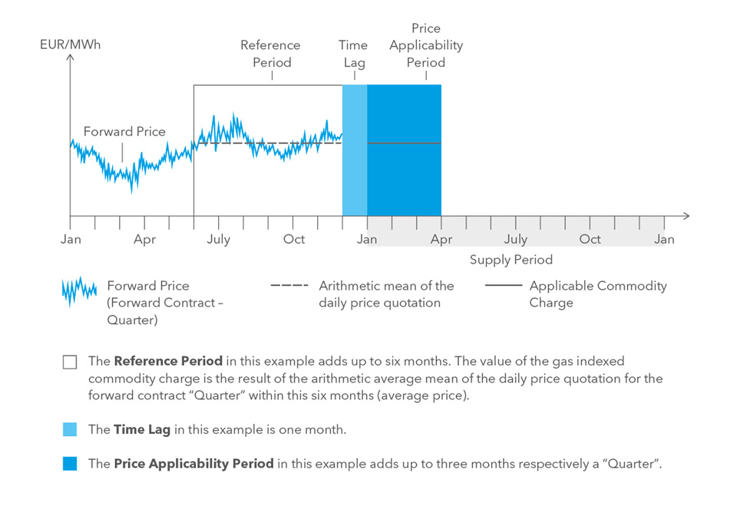
Index-based Gas Price
In this example: 6/1/3 rule
Typical indexation in long-term gas supply contracts: 6/3/3 rule
(6 months reference period; 3 months time lag; 3 months price applicability period)
Time period in or for which (depending on the specific index type) the index is published
Time lag between the reference period and price applicability period
Part of the delivery period to the calculated price applies.
Souce: WINGAS

Slide 135
Oil-product linked gas prices
Initial rationale for oil-based indexation is that users can choose between burning gas and oil products.
Early liberalised gas markets of the US and the UK with a liquid wholesale trading in natural gas resulted into gas-to-gas competition.
Long-term supply contracts for Continental Europe were initially linked to oil prices.
Since late 2000s European gas markets have shifted significantly from oil indexation towards hub-linked prices.
Renegotiation of price formulas in long-term supply contracts followed.

Slide 136
Third-party access: Point-to-point Model
Entry
Contract Path
Network
Shippers specify entry and exit points and the transportation path.
Actual physical flow may differ from the contracted path.
Entry and exit capacities cannot be separated from each other and from the gas (commodity) transaction.
Exit
Source: Hewicker & Kesting, 2009

Slide 137
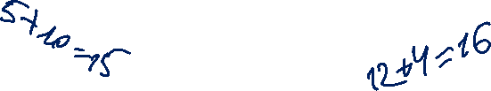
Third-party access: Entry-exit Model
Entry
Entry
7
5
Exit
4
Exit
Exit
10
Exit
12
Entry
10
5
Shippers book entry and exit capacity independently from each other.
No need to specify transportation path or distance.
Contracts for entry and exit capacities are independent from each other and from commodity transactions.
Entry and exit tariffs are set independently for each entry/exit point
Different tariffs for each point
All network operators in a network zone cooperate and set tariffs on a cost-reflective basis.
Source: Hewicker & Kesting, 2009
Notes:
Point-specific tariffs should, ideally, reflect the cost of capacity extension required to eliminate congestion.

Slide 138
European gas regions, markets and hubs
Source: OIES (2017) with reference to www.worldatlasbook.com and P. Heather

Slide 139
Transportation Cost of Hydrocarbons
Source: Zweifel / Praktiknjo / Erdmann, 2017

Slide 140
LNG Process Chain
Boiling point of methane −162 °C (−259.6 °F)
Approx. 600 times volume reduction
Source: Osaka Gas
Source: BV 2009 / GIIGNL

Slide 141
Cost Structure of LNG Process Chain
Liquefaction plant:
Investment outlay | 900M €
Operating expenses | 0,04 €/m³
LNG tanker fleet | e.g. 2 vessels á 135T t each
Investment outlay | 360M €
Operating expenses | 0,014 €/m³
Regasification plant w. storage | e.g. 80T m³ (Cartagena)
Investment outlay | 320M €
Operating expenses | 0,015 €/m³
Own gas requirement | 1/3 of transported gas
Source: Zweifel / Praktiknjo / Erdmann (2017), after Cayrade (2014)

Slide 142
LTC Renegotiation
Driving factors for transition to hub-linked gas prices:
US shale gas production
Qatari LNG available in Europe
Reduction in gas demand
Gas importers stayed bound by LTC at oil-linked prices incurring losses.
Renegotiation of LTC followed to introduce hub indexation.
Trends in newly signed contracts:
→ shorter duration period (10-15 years)
→ full hub indexation
→ new buyer/seller balance

Slide 143
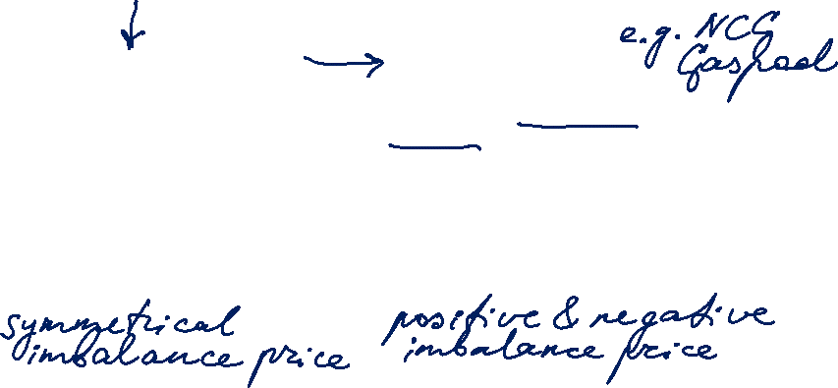
Comparison Electricity – Gas
Electricity Market
Transmission system operator (TSO)
Balance group coordinator
Distribution system operator (DSO)
Control area
BG per control area
Balance Responsible Party (BRP)
SLP and RLM customers
Gas Market
Transmission system operator (TSO)
Market area coordinator
Regional and local system operators (DSO)
Market area / Virtual trading point
BG per market area
Balance Responsible Party (BRP)
SLP and RLM customers
© Adapted from Prof. Dr. Georg Erdmann

Slide 144

Oil Market
Market participants:
Producers
Refiners
Marketers
Retailer*
Consumers
Gasoline
Diesel
Jet fuel
Fuel oil
Chemical feedstock
Lubricants
Source: Carollo (2012)
* oil products

Slide 145
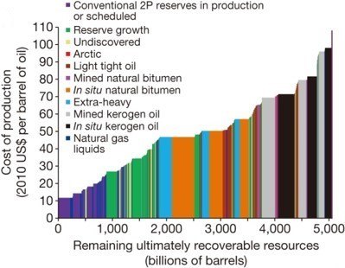
Cost of Production by Oil Source
Source: McGlade and Ekins (2015)
Notes:
Supply cost curve – cost of production depends on the deposit’s nature.
2P = proved plus probable

Slide 146
Cost of Production by Country
Source: Zweifel / Praktiknjo / Erdmann (2017) with reference to Oil Industry Trends
Notes:
Extraction of unconventional oil is more costly and may gain importance in the future. E.g. oil sands have to be heated and refined to crude oil (before further processing) – while already their extraction costs are significantly higher than those of conventional oil.

Slide 147
Crude Oil Specifications
Crude oil is a heterogeneous commodity.
density / viscosity:
light oil has low density
heavy oil has high density (large portion of low-value products to be removed through processing)
sulfur content:
sweet oil has low sulfur content
sour oil has high sulfur content (>0,5%)
  (Price spread on different markets depend on local environmental regulations.
  IMO limits sulfur content in marine fuels to max. 0,5% since 2020.)
Notes:
Sulfur causes adverse health effects and corrosion.

Slide 148
Properties of Crude Oil Varieties
Source: American Petroleum Institute API
© Prof. Dr. Georg Erdmann
Notes:
t/m3 is the measure of density
Viscosity is affected by oil composition, temperature, pressure and dissolved gas.

Slide 149
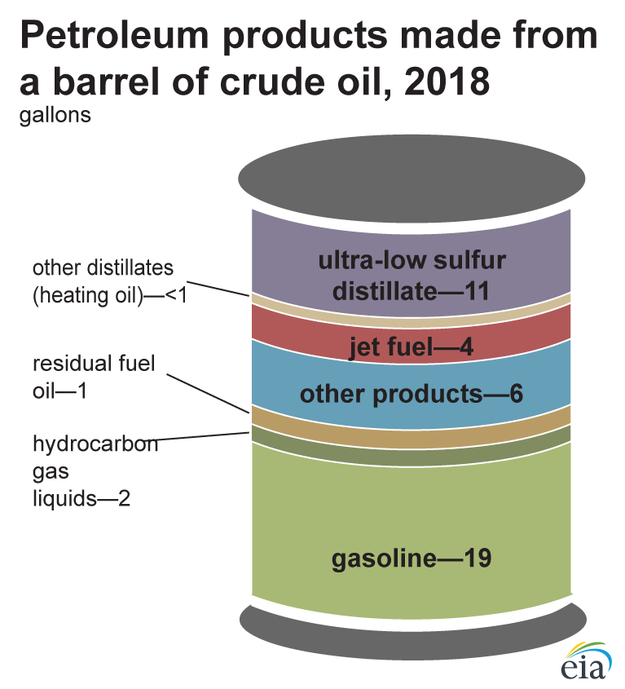
Petroleum Products
Refining: crude oil is separated into oil products through distillation.
Note: A 42-gallon (U.S.) barrel crude oil yields about 45 gallons of petroleum products because of refinery precessing gain. The sum of the product amounts in the image may not equal 45 because of independent rounding.
Source: U.S. Energy Information Administration, Petroleum Supply Monthly, April 2019, preliminary data
Notes:
Extraction of unconventional oil is more costly and may gain importance in the future.

Slide 150
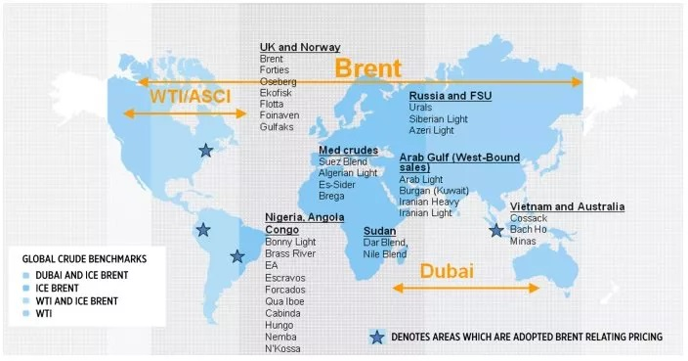


Crude Oil Benchmarks
West Texas Intermediate
- light (39,6° API)
- sweet (0,24%)
* WTI Cushing: delivered in Cushing, Oklahoma
(inland pipeline &
refining hub)
* Permian WTI: delivered at Magellan East Houston terminal (incl. for export)
North Sea: BFOE
- light (38° API)
- sweet (0,37%)
- Platts: FOB Sullom Voe terminal or CIF Rotterdam
Persian Gulf
- medium heavy (31° API); sour (2%)
- Platts: FOB Fateh terminal (Dubai, UAE)
Source: IntercontinentalExchange (ICE)

