Slide 1
Integrated course „Energy Economics“
- Energy Balances
Chair of Energy Systems
Prof. Dr. Boris Heinz | Dr. Elena Timofeeva
elena.timofeeva@tu-berlin.de

Slide 2
Outline
Introduction
Energy balances
Data sources
Explore energy statistics in groups

Slide 3
Introduction: Energy economics
Economics is a social science studying production, distribution and consumption of goods and services.
Economics deals with allocation of scarce resources.
Energy is abundant in the nature but mostly not immediately applicable for doing useful work.
Engineering know-how + Economic viability
Notes:
Water wheel converts kinetic energy of water is converted into mechanical movement.

Slide 4
Energy Balances: Energy sources
Primary energy sources are in the form as found in nature and have not undergone any transformation.
  oil, coal, natural gas, nuclear, wind, solar, biomass, geothermal, hydropower
Secondary energy sources are forms of energy after conversion, either chemical or physical.
  electricity, refined fuels (e.g. gasoline), synthetic fuels (e.g. hydrogen)
  easily usable form
Notes:
Synthetic fuels are produced through chemical conversion.

Slide 5

Energy Balances: Energy flow chart
Source: Zweifel / Praktiknjo / Erdmann, 2017
Notes:
Energy flow chart helps understand and analyse interrelations in the energy industry.
Energy flow chart / energy balances refer to a territory (country or region) and to aggregate amounts of energy over a period of time (year).
Final energy includes energy sold to end users for energetic use and treatment for non-energetic use.
Energy services

Slide 6
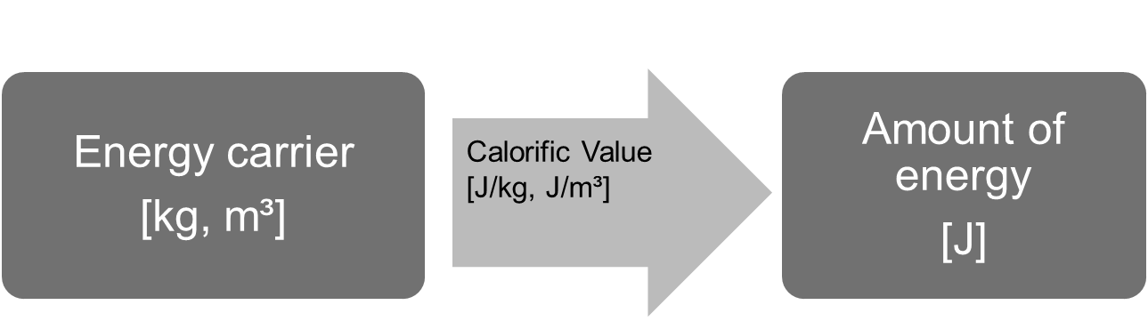
Energy Balances: Measuring primary energy
Primary energy sources are originally measured in units corresponding to their natural form: volume, mass etc.
Original units can be converted into energy units.
Calorific value is used for energy sources that can be converted into heat through combustion: coal, gas, oil, biomass.
@ Ensys
Notes:
calorific / heating / energy value
Calorific value: amount of heat released by complete combustion of a unit quantity of fuel under specified conditions.
Energy stored in a unit of volume -> energy density
Energy stored in a uni mass -> specific energy

Slide 7
Energy Balances: Lower calorific value of energy fuels
@ Prof. Dr. Georg Erdmann
Notes:
calorific / heating / energy value
Heat energy can be converted into electrical energy.

Slide 8
Energy Balances: Units of energy
Source: Zweifel / Praktiknjo / Erdmann, 2017
Tonne of oil equivalent (t.o.e.): energy generated by burning one metric ton (7,4 barrels) of oil, or 1270 m³ of natural gas, or 1,4 metric tons of coal.
Notes:
Basic: calorie, Joule, kWh, Btu
Source-based: t.c.e., t.o.e.

Slide 9
Energy Balances: Measuring RES
How to value energy carriers which do not have a calorific value, e.g. wind, PV, nuclear energy, electricity imports, water, geothermal heat?
Substitution Principle: amount of fuel that would be necessary to produce that amount of electricity in a thermal powerplant (35-40%)
Efficiency Principle: actual efficiency of respective technology (hydro 80-90%, wind 30-55%, solar 10-25%)
Fictive Efficiency Principle (IEA): 100% for wind, solar, hydro
(underestimated RES share)
Source: IEA

Slide 10
Energy Balances: Energy flow chart for Germany in 2018
Source: AGEB, 2019
Petajoule (PJ)
Notes:
TPES = Imports + Extraction – Exports – Int. Marine & Aviation Bunkers +/- Stock changes

Slide 11
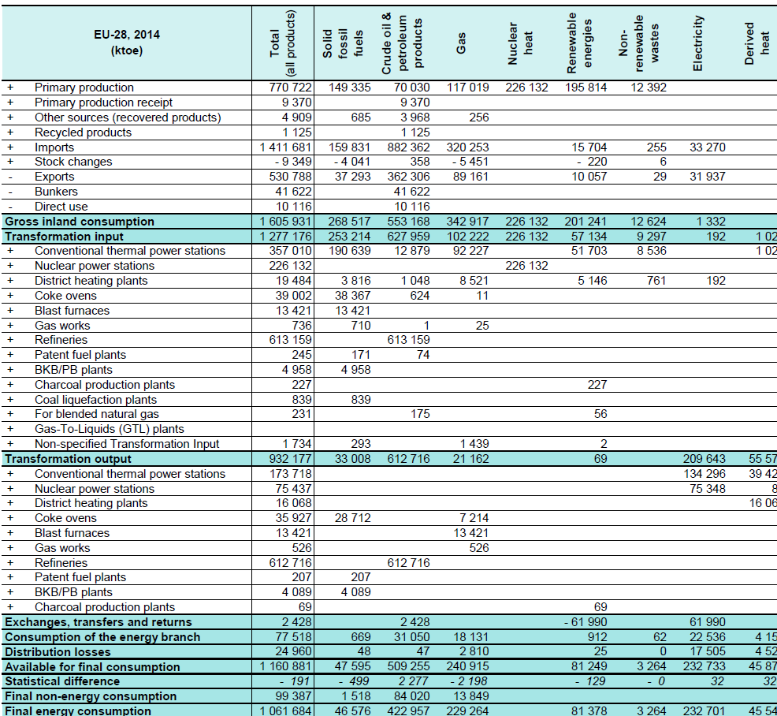
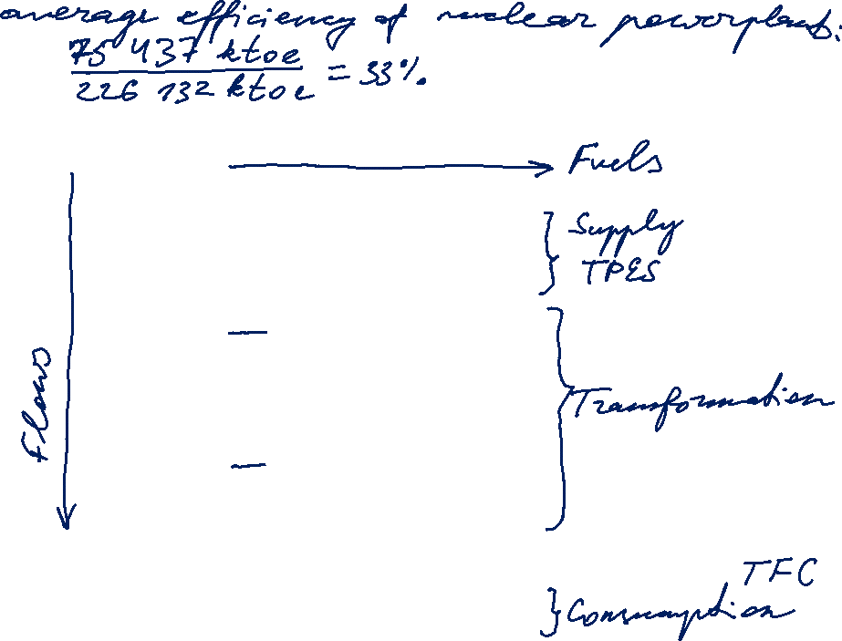
Energy Balance: Simplified structure
Source: Eurostat
+ Industry
+ Transport
+ Other sectors
Notes:
Matrix: fuels – flows
Production – transformation – consumption
Accounting framework for compilation of data on all energy products entering, exiting and used within the territory of a country during a reference period.
Contribution of different fuels to the economy

Slide 12

Energy Balance: Cumulated energy requirement
Cumulated energy requirement is total primary energy amount required for production, use and disposal of a product over its lifetime.
CER = CER_{P} + CER_{U} + CER_{D}
CER is used in life-cycle assessment to account for all environmental impacts of an industrial process.
'Grey energy‘
Energy required for production/recycling is not reflected in the national energy balances in this case.

Slide 13
Data sources: Energy statistics online
IEA
BP Review
U.S. Energy Information Administration
Eurostat
ENTSO-E, ENTSO-G
EEX
AGEB
BNetzA
BMWi

Slide 14
Data sources: IEA
International Energy Agency (IEA) is an automonous intergovernmental organisation providing authoritative analysis on global energy topics (publications, data and statistics, trainings).
OECD member countries (30 out of 36)
IEA World Energy Outlook
IEA Market Reports
Key World Energy Statistics
https://www.iea.org/statistics/

Slide 15
Data Sources: BP Review of World Energy
British Petroleum is a multinational oil and gas company.
BP Energy Outlook
BP Statistical Review of World Energy
https://www.bp.com/en/global/corporate/energy-economics.html

Slide 16
Data Sources: U.S. EIA
U.S. Energy Information Administration (EIA) is a federal agency responsible for energy statistics and analysis (part of the U.S. Federal Statistical System).
www.eia.gov
International Energy Statistics

Slide 17
Data Sources: Eurostat
Eurostat is a division of European Commission tasked with providing statistical information to the institutions of the European Union and with promoting harmonisation of statistics across EU member states.
https://ec.europa.eu/eurostat/web/energy/data/energy-balances

Slide 18
Data Sources: ENTSO-E
European Network of Transmission System Operators for Electricity (ENTSO-E) is an association of 43 electricity TSOs from 36 countries across Europe.
Policy positions
Technical cooperation among TSOs, network codes
Long-term pan-European network development plan
Reports on system adequacy
Research coordination
ENTSO-E Transparency Platform
pan-European generation, transportation and consumption data
https://transparency.entsoe.eu/

Slide 19
Data Sources: ENTSO-G
European Network of Transmission System Operators for Gas (ENTSO-G) is an association of 44 electricity TSOs (+3 associated partners and 8 observers).
Policy positions
Technical cooperation among TSOs, network codes
Long-term development plan for European gas infrastructure
Reports on security of supply
ENTSO-G Transparency
https://transparency.entsog.eu/

Slide 20
Data Sources: EEX
European Energy Exchange (EEX) in Leipzig is an exchange for energy and energy-related products.
electricity, gas, coal, crude oil, CO₂ emission certificates etc.
EEX, EPEX SPOT, PEGAS/Powernext
www.eex.com > Market Data

Slide 21
Data Sources: AG Energiebilanzen (AGEB)
Working Group on Energy Balances (Energy Balances Group)
German association tasked with scientific analysis of energy statistics (four federations of the energy industry and five research institutions).
Compiles yearly energy balances of Germany
www.ag-energiebilanzen.de

Slide 22
Data Sources: BNetzA
Federal Network Agency (BNetzA) is a German agency tasked with regulation in the electricity, gas, telecommunication, post and railway sectors.
SMARD – information platform
electricity generation, consumption, wholesale prices, imports/exports, system stability
www.smard.de
BNetzA Monitoring reports - key findings in English
https://www.bundesnetzagentur.de/EN/Areas/Energy/Companies/DataCollection_Monitoring/DataCollectionMonitoring_node.html

Slide 23
Data Sources: BMWi
German Federal Ministry of Economics and Energy (BMWi)
Energy Data: Complete Edition
Compilation of data from various sources
https://www.bmwi.de/Redaktion/EN/Artikel/Energy/energy-data.html

Slide 24
Questions: Overview
Total primary energy supply (TPES)
RES in German energy balance
Energy mix
Electricity price (wholesale)
Solar and base peak spread
System services
Electricity price (retail)
Grid losses
Weather
Road transport TPEC
Cost of battery storage
Economics of hydrogen
CO₂ certificate prices
Energy efficiency

Slide 25

Question 1: Total Primary Energy Supply (TPES)
What are the three countries with the highest TPES per capita ratio according to IEA?
Discuss similarities and differences in these countries’ energy flows.
Consult IEA Atlas of Energy

Slide 26
Question 2: RES in German energy balance
How much electricity was generated in Germany in 2017 (in GWh) and what was the share of renewables?
Compare your result to the RES share according to IEA.
Explain the discrepancy.
Consult energy balances by AGEB

Slide 27
Question 3: Energy mix
How has the energy mix in the Asia Pacific region developed since 2010?
Compare trends in China, India and the rest of the region.
Consult BP Review

Slide 28
Question 4: Electricity price (wholesale)
Track the development of electricity price in Germany in the last ten years.
Discuss possible price drivers.

Slide 29
Question 5: Solar and base peak spread
How has the share of solar generation in the German energy mix developed since 2012?
What is the impact of the rising PV share on the electricity price?

Slide 30
Question 6: System services
How have the costs for system services in Germany developed over the last years?
Compare the structure of these costs over time.
Consult Monitoring reports by BNetzA

Slide 31
Question 7: Retail Electricity Price
How has the structure of electricity prices for final consumers changed since 2012?
Discuss trends in the price structure.
Consult Monitoring reports by BNetzA

Slide 32
Question 8: Grid losses
Please compare grid losses worldwide.
What causes grid losses?
Discuss their economic, environmental and social impacts.
Consult information by the World Bank

Slide 33
Question 9: Weather
What was the weather like in Germany in summer 2018? Compare with historical data (temperature and percipitation).
Show and explain the impact of the weather on the electricity price.

Slide 34
Question 10: Road transport TPEC
What is the share of road transport in the total primary energy consumption in Germany in 2007 and in 2017, respectively?
How has the share of each primary energy source developed?
Discuss possible reasons.
Consult German energy balances by AGEB.

Slide 35
Question 11: Cost of battery storage
Show the development of cost for lithium-ion batteries (in €/kWh).
Discuss cost drivers and outlook.

Slide 36
Question 12: Economics of hydrogen
What are the technology options for producing hydrogen?
Discuss the economics of these options.
  Staffell et al, The role of hydrogen and fuel cells in the global energy system, Energy & Environmental Science, 2019,12, 463

Slide 37
Question 13: CO₂ certificate prices
How has the price of European Emission Allowances (EUA) developed over the past ten years?
Discuss the reasons for these developments.

Slide 38
Question 14: Energy efficiency
Compare the trends for the global energy demand and for the change in energy intensity (i. e. progress with energy efficiency).

Slide 39
Group Work
Please work in groups of 5 - 6 students
Preparation until end of this class
Questions and presentation template are on ISIS:
  '20191015 Data sources_and_Questions'
Please state your data sources
Presentations in the next class: 17.10.2019
5 minutes per group

