Slide 1

Integrated course „Energy Economics“
- Markets for CO₂ Emission Allowances
Chair of Energy Systems
Prof. Dr. Boris Heinz | Dr. Elena Timofeeva
elena.timofeeva@tu-berlin.de

Slide 2
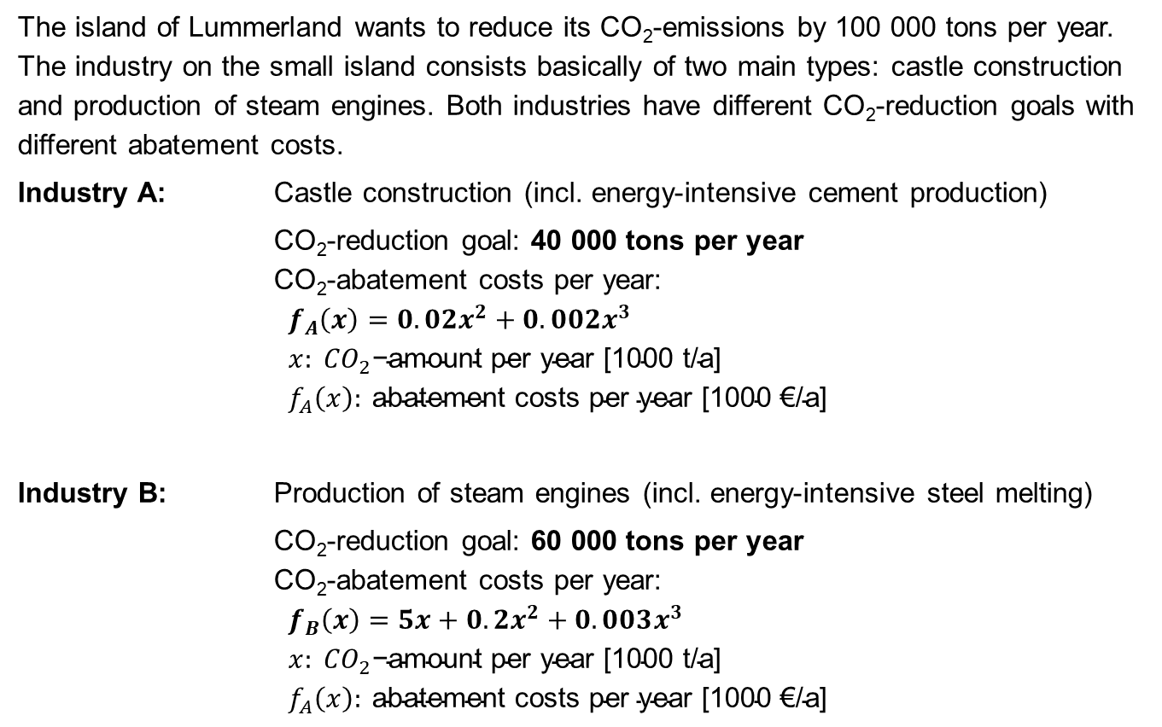
Task 3) CO₂ Reduction in Lummerland
The island of Lummerland wants to reduce its CO₂-emissions by 100 000 tons per year. The industry on the small island consists basically of two main types: castle construction and production of steam engines. Both industries have different CO₂-reduction goals with different abatement costs.
Industry A: Castle construction (incl. energy-intensive cement production)
CO₂-reduction goal: 40 000 tons per year
CO₂-abatement costs per year:
$$f_{A}\left(x\right)=0.02x^{2}+0.002x^{3} \\ x: {CO}_{2}\text{−}\text{amount} \text{per} \text{year}\text{ [1000 }\text{t}\text{/}\text{a}\text{] } \\ f_{A}\left(x\right): \text{abatement} \text{costs} \text{per} \text{year}\text{ [1000 €/}\text{a}\text{]}$$
Industry B: Production of steam engines (incl. energy-intensive steel melting)
CO₂-reduction goal: 60 000 tons per year
CO₂-abatement costs per year:
$$f_{B}\left(x\right)=5x+0.2x^{2}+0.003x^{3} \\ x: {CO}_{2}\text{−}\text{amount} \text{per} \text{year}\text{ [1000 }\text{t}\text{/}\text{a}\text{] } \\ f_{A}\left(x\right): \text{abatement} \text{costs} \text{per} \text{year}\text{ [1000 €/}\text{a}\text{]}$$

Slide 3
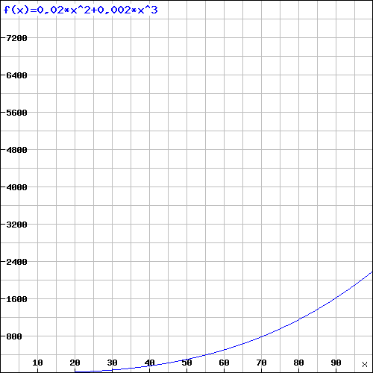
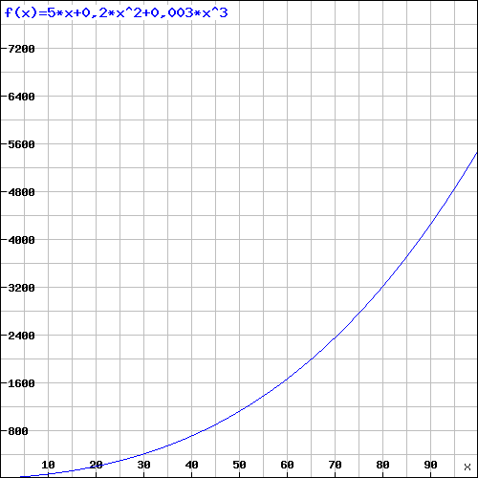
Task 3) CO₂ Reduction in Lummerland
Industry A’s annual CO₂ abatement costs
Industry B’s annual CO₂ abatement costs
T €
T €
CO₂ reduction amount p.a. [1000 t CO₂]
CO₂ reduction amount p.a. [1000 t CO₂]

Slide 4
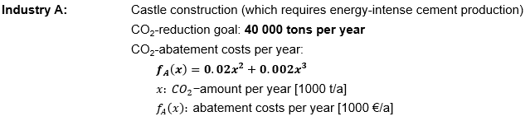

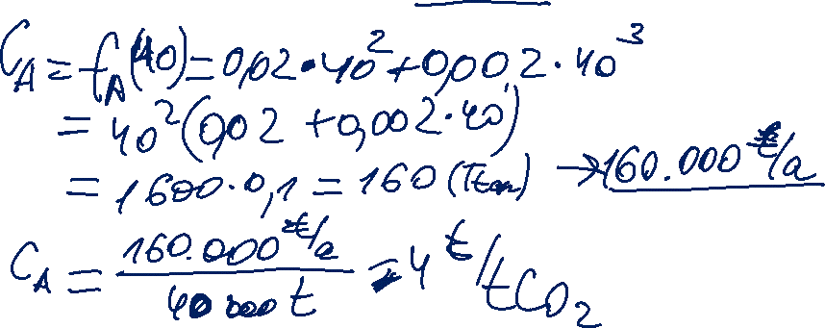
Task 3) CO₂ Reduction in Lummerland
What are the abatement costs per ton CO₂ for Industry A?

Slide 5
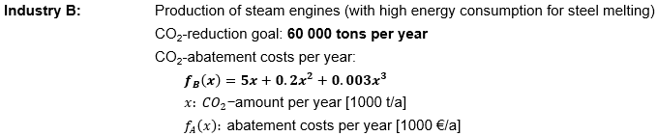

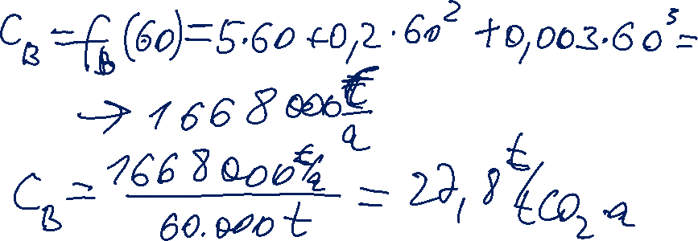
Task 3) CO₂ Reduction in Lummerland
What are the abatement costs per ton CO₂ for Industry B?

Slide 6


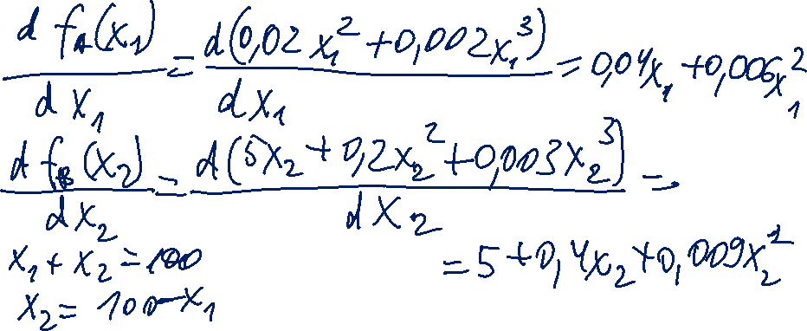
Task 3) CO₂ Reduction in Lummerland
In order to lower the costs for CO2 abatement, the government of Lummerland introduces a new emissions trading mechanism. What is the theoretical volume traded?
Find the volume at which the marginal abatement costs of both industries are equal.
Given functions are for annual abatement costs as a function of the annual amount of CO₂ reduction.
Total required reduction for both industries is 100.000 tons.

Slide 7
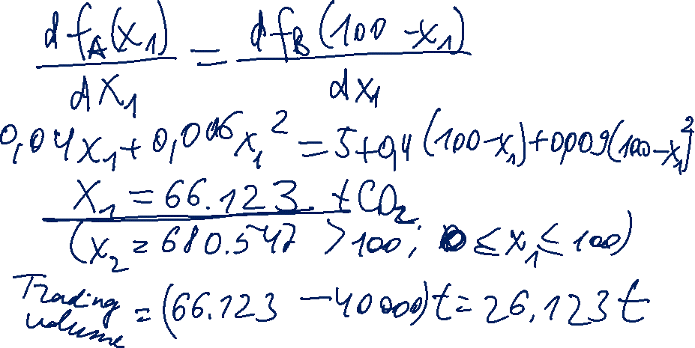
Second root does not meet the condition (just a matematical solution).
Under perfect market conditions 66.123 t CO₂ will be abated by industry A.
The difference between industry A’s abated amount and its reduction target will be traded.

Slide 8
Task 3) CO₂ Reduction in Lummerland
Cap B
Cap A
Arbitrage

Slide 9
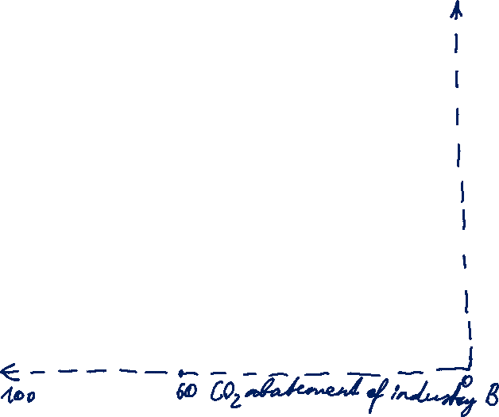
Task 3) CO₂ Reduction in Lummerland
Cap A + Cap B = 100
Cap B
Cap A

Slide 10
Task 3) CO₂ Reduction in Lummerland
60.000 t CO₂
40.000 t CO₂
Abatement Costs A
Abatement Costs B

Slide 11
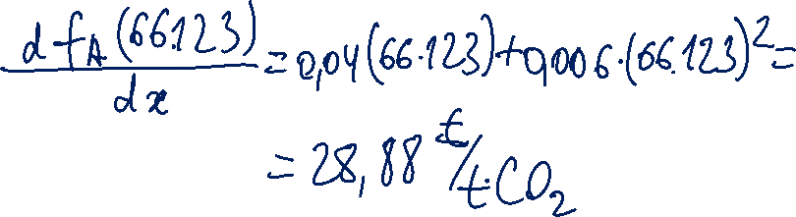
Task 3) CO₂ Reduction in Lummerland
What is the system price in the emissions trading system?

Slide 12

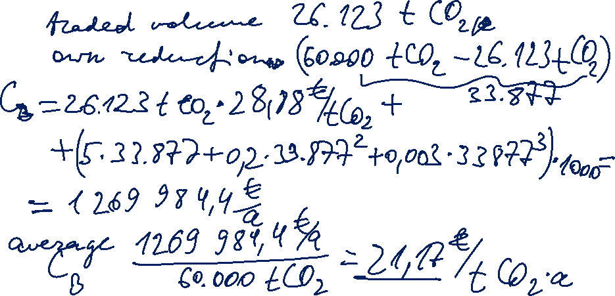
Task 3) CO₂ Reduction in Lummerland
What are the new overall abatement costs per ton CO2 for Industry B?

Slide 13
Task 3) CO₂ Reduction in Lummerland
26.123 t CO₂
33.877 t CO₂
40.000 t CO₂
Emissions Trade Volume
Abatement Costs A
Abatement Costs B
Notes:
Industrie A vermeidet zusätzlich 26.123 t CO₂ und würde die dadurch nicht benötigten Zertifikate an Industrie B zu einem Preis von 28,88 Euro/t verkaufen

Slide 14

Task 3) CO₂ Reduction in Lummerland
26.123 t CO₂
33.877 t CO₂
40.000 t CO₂
Emissions Trade Volume
Abatement Costs A
Abatement Costs B
Notes:
Industrie A vermeidet zusätzlich 26.123 t CO₂ und würde die dadurch nicht benötigten Zertifikate an Industrie B zu einem Preis von 28,88 Euro/t verkaufen

Slide 15
Task 3) Key Takeaways
Under a cap system with an industry-specific cap (questions a) and b)), Industry A and Industry B have different average abatement costs (4 €/t CO₂ and 27,8 €/t CO₂ respectively).
A cap-and-trade system (questions c) - e)) results in benefits for both industries:
Industry A earns a profit by selling emission allowances to Industry B at a price above its corresponding abatement cost.
At the same time, through buying emission allowances for 26.123 t CO₂ Industry B saves the difference between its own corresponding abatement costs and the market price of allowances.
Overall, the same reduction target is achieved at lower cost.

Slide 16

Trade of Emission Allowances
Abatement cost of company 1 (marginal cost)
Abatement cost of company 2 (marginal cost)
Surplus of company 2: difference between its abatement costs
and allowance price
ARBITRAGE
Surplus of company 1: difference between allowance price and its abatement costs
Allocated rights
Emission trade

Slide 17
EU Emissions Trading System
28 EU member states + Norway, Island and Liechtenstein
40% of EU emissions
4% of the world’s GHG emissions (approx. 2 billion GHG as of 2014)

Slide 18
EU Emissions Trading System
A quantitative limit is put on the aggregate annual amount of emissions for all plants participating in ETS (cap).
  a single EU-wide cap
  declining by 1,74% annually
Emission allowances are issued in an amount corresponding to the cap.
EUA (EU Allowance): An EUA permits operators of an industry installation or electricity generation unit to emit 1 t of CO₂ under the EU emissions trading system.
Auctioning as the main allocation principle:
for energy utilities – since 2013
for other industries – growing %, to be fully phased in by 2027
free allocation to industries threatened by carbon leakage
Each regulated operator must surrender every year the amount of EUA corresponding to the amount of its emissions. (→ 100 €/t CO₂)

Slide 19
Trends in Emissions and Economic Activity
%
Source: Ellerman / Marcatonini / Zaklan (2016)

Slide 20
Conventional Economic Theory
EUA price = abatement cost of the last project that is necessary to meet the cap (marginal abatement cost)
For understanding the EUA price, the distribution of the marginal abatement cost for the “Kyoto period” has to be quantified.

Slide 21
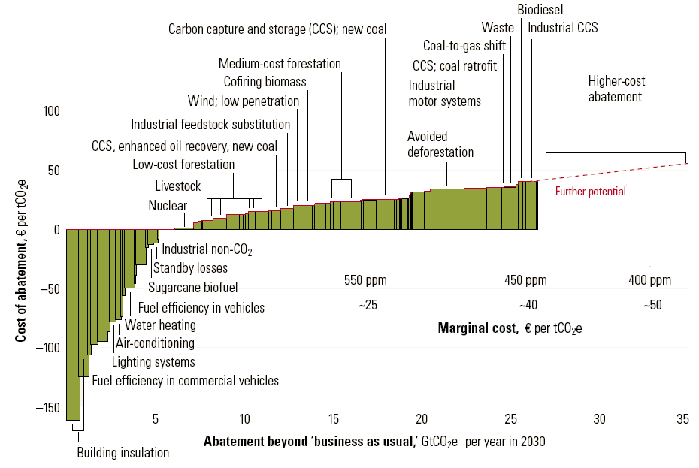
GHG Abatement Costs [Source: McKinsey&Co. 2007]
CO₂-emissions
2008 = 30.2 Gt

Slide 22
Price Drivers of CO₂-Allowances
Economic Theory: (Marignal-) Abatement Costs
Fuel prices
Fossil Fuel Alternatives
Natural gas instead of coal
Burning of natural gas and/or biomass
Improvement of Fossil Fuel Utilization
Newly constructed power plants
Heat recovery (CHP)
Leakage effects
Volume of available CO₂ allowances
Penalties (40,- Euro until 2007, 100,- Euro/t CO₂ since 2008)

Slide 23
Additional Price Drivers of CO₂-Allowances
Expert opinions (ZEW-Survey July 2005):
Development of renewable electricity
Share of nuclear power
Weather conditions (demand for heating and cooling; availability of hydropower)
Economic growth, economic recessions
Emission credits from CDM-Projects (Clean Development mechanism) and JI-Projects (Joint Implementation)
Influence of speculators?
Impacts of market power?

Slide 24
Offsetting in EU ETS
Linkage of EU ETS to international emissions markets
Offsetting is making up for GHG emissions that cannot be avoided at one place by either reducing emissions or increasing GHG absorption elsewhere.

Slide 25

Offsetting
Project categories for issued CERs and ERUs
Country of origin for issued CERs and ERUs
Source: Ellerman / Marcatonini / Zaklan (2016)

Slide 26

Emission Allowances: Terminology
AAU: Assigned Amount Unit or Kyoto unit. An AAU permit to emit 1 t of CO₂ or 1 t CO₂ equivalent of greenhouse gases.
ERU: Emission Reduction Unit. An ERU is a certified emission reduction of 1 t of CO₂ resulting from a Joint Implementation project.
CER: Certified Emission Reduction. A CER is a certified emission reduction of 1 t of CO₂ resulting from a CDM project.
EUA: EU Allowance. An EUA permit operators of an industry installation or electricity generation unit to emit 1 t of CO₂ under the EU emissions trading system.
EUAA: EU Aviation Allowance. An EUAA permit airlines to emit 1 t of CO₂ under the EU emissions trading system.

Slide 27
EUA and CER Pricing
CERs were continously selling at a discount due to:
upper limit on using CERs in each EU member state
not all types of CERs can be used in the EU ETS
very limited acceptability of CERs in the EU ETS after 2012
absence of demand in the alternative Kyoto market
Source: Ellerman / Marcatonini / Zaklan (2016)

Slide 28
Actions along the Time Axis
“Borrowing”
“Banking”
EUA Auctions
EUA
allocation
EUA
allocation
EUA Auctions
EUA Auctions
3. Trading Period
2. (Kyoto) Trading Period (2008-12)
Jan 1
2011
Jan 1
2012
Jan 1
2013
April 30
April 30
March 31
March 31
Emission
report
for 2011
EUA
withdraw
for 2011
Emission
report
for 2012
EUA
withdraw
for 2012
83 million EUA surplus at the end of phase I
1,8 billion EUA surplus at the end of phase II
© Prof. Dr. Georg Erdmann

Slide 29
Market Price of CO₂-Allowances [Source: EPEX]
35
EU ETS Spot Price [EUR/t CO₂]
30
25
20
15
10
5
0
2005
2010
2014
© Prof. Dr. Georg Erdmann

Slide 30
Price of European Union Allowances (EUA)
40 Euro + EUA price 2008
EUA Price [Euro/t CO₂]
40
30
20
Political target
2011
10
2007
0
2005
2006
2007
2008
2009
© Prof. Dr. Georg Erdmann

Slide 31
EUA Trading Period 2008 - 2012
120
Euro/t CO₂
100 Euro
+ EUA price 2013
100
80
60
40
With banking:
EUA price 2013
2011
20
0
2005
2006
2007
2008
2009
2010
2011
2012
© Prof. Dr. Georg Erdmann

Slide 32
Assessment of the European Cap-and-Trade
The CO₂-price at the end of the trading period is
  either low (if market is long and cap is reached)
  or equivalent to the penalty defined by the regulator
  (100 Euro/t plus EUA price of next trading period)
Prices of 40-70 Euro/t should not be possible under the present cap-and-trade system
Further considerations
  EUA >100 Euro/t is politically unsustainable
  Introduction of a market stability reserve after 2021 with a minimum excess of 400 million allowances
  For moving to a tax system, EU would probably need a unanimous decision of EU member states
© Prof. Dr. Georg Erdmann

Slide 33
EU Proposals for an EUA Reform [October 2013]
Backloading von 900 Mio. emission allowances until 2019-2020
Permanent reduction of emission allowances
Higher reduction target (30% instead of 30% until 2020)
Higher annual reduction rate of emission rights
(currently 1,74 % per year)
Inclusion of additional economic sectors (chemical industry, …) without changing the number of emission allowances
Introduction of minimum (and maximum) prices for emission rights (would probably require a unanimous decision of EU member states)
© Prof. Dr. Georg Erdmann

Slide 34
Reform Idea: EUA Price Corridor
60
Euro/t CO₂
CO₂ target going to be reached
50
40
CO₂ target
In danger
EU provides more EUA than originally announced
30
20
EU provides less EUA than originally announced
10
0
2015
2020
2025
2030
2035
2040
2045
2050
© Prof. Dr. Georg Erdmann

Slide 35
Market Stability Reserve
Market stability reserve operating since January 2019:
addresses the current surplus of allowances
improves the system’s resilience to shocks
It triggers adjustments to annual auction volumes
in situations where the total number of allowances in circulation is outside a predefined range:
  Reducing allowances from future auction volumes if the EU ETS surplus exceeds 833 million allowances
  Adding allowances to future auction volumes provided the EU ETS surplus is below 400 million allowances

Slide 36
EU ETS Reform 2017
A higher linear reduction factor (LRF) for the annual cap
1,74 % p.a. → 2,2 % p.a. from 2021
A higher intake of allowances in the Market Stability Reserve (MSR)
24% instead of 12% of total the number of allowances in circulation (once 833 million threshold is exceeded)
Cancellation of allowances through the MSR
From 2023, allowances held in MSR above the previous year’s auction volume will no longer be valid.

Slide 37
EUA Price Development
Nearest December Futures Contracts
Source: Friedrich and Pahle, 2019

Slide 38
Recent Upward Trend in EUA Prices
Gas price
positive coefficient
short period of insignificance in 2014
Oil price
Coal price
significant negative effect 2010-2011, 2013-2015
positive coefficient 2016-2017
Temperature
Economic activity (e.g. Stoxx 50, Stoxx 600)
The relationship between allowance prices and the abatement-related fundamental price drivers is not stable over time:
For all variables, there are periods with a significant effect and periods of insignificance.
Source: Friedrich and Pahle (2019)

Slide 39
Price Drivers of CO₂-Allowances
Coefficient curves (blue) and 95% confidence intervals (orange) from regression of the return on EUA on the four main price price drivers
Source: Friedrich and Pahle (2019)

Slide 40
Recent Upward Trend in EUA Prices (cont)
Upward trend since mid 2017 cannot be explained by abatement-related fundamentals.
Changes in the fundamentals leading to new equilibrium price
Changes in the role of fundamentals, possibly as a result of the reform
Explosive behaviour / price bubble
Are analysts’ forecasts of the impact of the reform on EUA prices post-2020 a “ contagious story”?
Traded volumes increased in 2018 by 42% compared to 2017.
It could well be a period of adjustment to higher price level, given the long history of unexpectedly low prices.
Source: Friedrich and Pahle (2019)

Slide 41
Sector coupling
Sector coupling „summarizes efforts to realize carbon abatement through a gradual replacement of fossil fuel combustion in key sectors other than electricity generation – such as transportation, buildings and industry – with energy from renewable sources“.
Cost factors:
Investment and operating costs of technology
Efficiency factor
Price of replaced fuel
Electricity price
Source: Jarke-Neuert and Perino, 2019

Slide 42
Renewables Support and Sector coupling
If electricity production is covered by emissions trading, any additional electricity output will be carbon-free.
Abatement through fuel-electricity substitution is mitigated by electricity price adjustments.
Subsidising renewables indirectly subsidises electro-technology.
Renewables support yields a „double green dividend“:
supports clean energy and replacement of dirty power plants
supports clean mobility as electricity becomes cheaper than fossil fuels
Source: Jarke-Neuert and Perino, 2019

