Slide 1

Integrated course „Energy Economics“
- Markets for CO₂ Emission Allowances
Chair of Energy Systems
Prof. Dr. Boris Heinz | Dr. Elena Timofeeva
elena.timofeeva@tu-berlin.de

Slide 2
Outline
External costs
Quantification of external costs
Greenhouse gas problem
European Cap-and-Trade system

Slide 3
Task 1) External costs and internalisation
Explain the term externality in the context of GHG emissions.
Externality describes the impact of economic activities on outsiders without compensation. The external effect can be either positive or negative. GHG emissions are associated with a negative externality.
b) Why does the externatily of GHG emissions lead to insufficient energy markets?
If the external effect of GHG emissions was not included into energy prices, the polluter (e.g. operator of a power plant) would choose a profit optimising production level. By reducing his production he would be less badly off (makes less profit) than the damaged party better off (suffer less from GHG emissions). Therefore, we don’t have a Pareto-optimal market outcome (market failure). See next slide.

Slide 4

Optimal Emmision Levels
Profit Π
External Costs C_{ext}
External Costs C_{ext}
Maximize
C_{ext,0}
Π*
Π₀
Profit Π
0
Em*
Em₀
Emissions Em

Slide 5
Marginal Damages and Marginal Abatement Costs
Marginal Profits,
External Marginal Costs
0
Em*
Em₀
Emissions Em

Slide 6
Task 1) External costs and internalisation
c) Which policy instruments can correct this market failure in energy markets?
Emissions standard and norms (cap)
Emissions tax (Pigou tax)
Cap-and-trade system
The reason why a cap-and-trade system needs trade (and is not only a cap system) is that the govenment does not know the optimal cap for every installation (lack of information on the abatement costs of every company). Thus, the allocation of certificates is necessarily not optimal. If companies can trade the certificates, the same overall amount of emissions will be abated but at lower costs.
d) Explain the quantity risk and price risk in the context of these policy instruments.
With a tax system there is price stability. However, as the government lacks information about the shape of the marginal abatement cost function, there is no security of reaching the reduction target (quantity risk). If the tax is too low, emissions will be too high; if the tax will be too high, the emissions will be too low. Resulting costs of the companies are uncertain.
With a cap-and-trade system there is security of reaching the emissions target. However, as the government lacks information about the shape of the marginal abatement cost function, there is insecurity about the price of CO₂ emission certificates (price risk) and about resulting costs for the companies. See next slides.

Slide 7
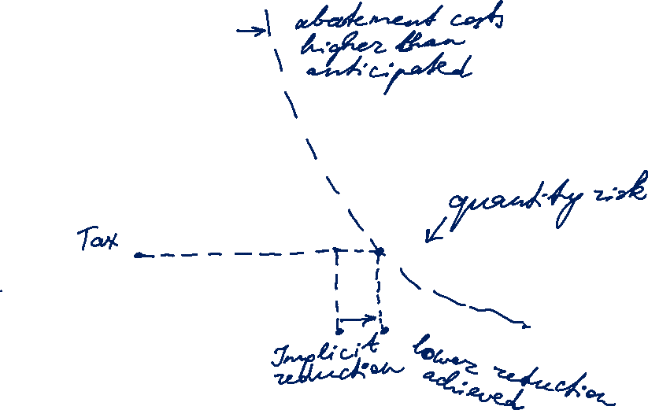
GHG Abatement Costs and a Pigou Tax
Marginal GHG abatement costs
[Euro/t CO₂]
Starting point
CO₂ emissions

Slide 8
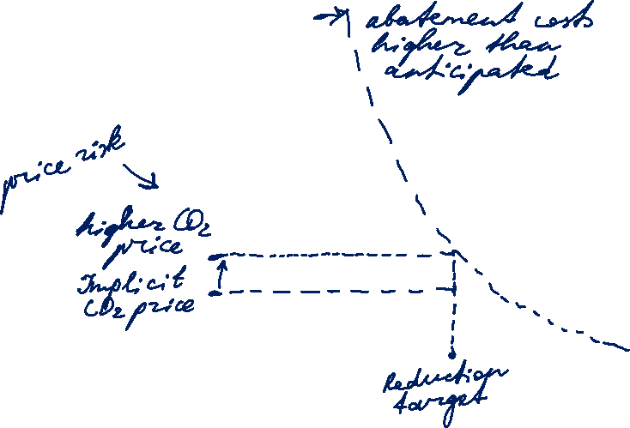
GHG Abatement Costs under Cap and Trade
Marginal GHG abatement costs
[Euro/t CO₂]
Starting point
CO₂ emissions

Slide 9
International Framework on Climate Change
1979 World Climate Conference in Geneva
1988 UN Weltklimarat (Intergovernmental Panel on Climate Change, IPCC)
1992 (1994) UN Klimarahmenkonvention (UNFCCC)
Annex I countries: Industrialised countries that have agreed to reduce their greenhouse gas emissions
Annex II countries: Developed countries that are responsible for bearing the costs of climate change mitigation in developing countries (subset of Annex I countries)
Developing countries: These countries have no immediate responsibilities.
1999 (2005) Kyoto Protocol to UNFCCC
Binding CO2 reduction targets:
1st commitment period 2008-2012
2012 Doha Amendment: 2nd commitment period 2013-2020
COP – annual Conference of Parties to UNFCCC
Notes:
Countries have common but differetiated responsibilities.

Slide 10
Kyoto Protocol
Greenhouse gases:
Sector and source categories:
Energy
Industrial processes
Solvents and other product uses
Agriculture
Waste
+ Impact of Land-Use, Land-Use Change and Forestry (LULUCF)

Slide 11
The Greenhouse Gas Problem
[Data Source IPCC 1990; 2014]
 | Carbon dioxide CO₂ | Methane CH₄ | Nitrous oxide N₂O
Pre industrial concentration [ppmv] | 280 | 0.7–0.8 | 0.23
Average atmospheric lifetime [years] | 5–200 | 9-15 | 120
Global warming potential in 20 years | 1 | 72 | 289
Global warming potential in 100 years | 1 | 25 | 298
Contribution to the GHG problem [%] | 77 | 14 | 8
Reduction target of the IPCC 1990 [%] | 60–80 | 15–20 | 70–80

Slide 12
Committed Emission Limits under Kyoto Protocol
Source: Burger / Graeber / Schindlmayr (2014)

Slide 13
Kyoto Protocol: Flexible Mechanisms
Cost-effective options for reducing emissions or removing CO₂
in other countries
Clean Development Mechanism
Project-based reduction of CO₂ emissions between non-Annex 1 countries and Annex 1 countries
Emission reductions must be additional (compared to baseline).
Independent certification
Joint Implementation Mechanism
Project-based reduction of emissions between two Annex 1 countries
International Emissions Trading
Emissions trading among Annex B countries
Not in use

Slide 14
Emission Allowances: Terminology
AAU: Assigned Amount Unit or Kyoto unit. An AAU permit to emit 1 t of CO₂ or 1 t CO₂ equivalent of greenhouse gases.
ERU: Emission Reduction Unit. An ERU is a certified emission reduction of 1 t of CO₂ resulting from a Joint Implementation project.
CER: Certified Emission Reduction. A CER is a certified emission reduction of 1 t of CO₂ resulting from a CDM project.
EUA: EU Allowance. An EUA permit operators of an industry installation or electricity generation unit to emit 1 t of CO₂ under the EU emissions trading system.
EUAA: EU Aviation Allowance. An EUAA permit airlines to emit 1 t of CO₂ under the EU emissions trading system.

Slide 15
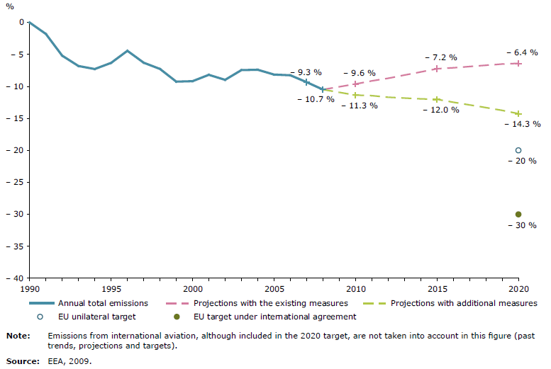
GHG-Emissions in the EU-27 [Source EEA 2009]
Unilateral target: -20% in 2020 compared to 1990
Source: European Environment Agency EEA 2009

Slide 16
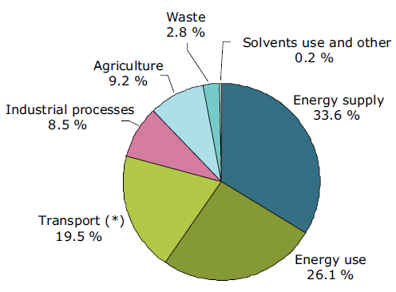
EU-27 Composition of GHG Emissions 2007
[Source EEA 2009]
(*) 24 % with intl. aviation
and intl. maritime navigation

Slide 17
EU Emission Trading System (ETS)
For tax issues all EU member states must agree,
but majority vote is sufficient for ETS system
Mandatory “CO₂ Cap and Trade” system for
  Installations of power, refinery, steel, glass, cement industries (2071 mio t CO₂ verified emissions in 2005)
  airline business (after 2011)
EU wide annual cap of tradable CO₂ Allowances (EUA)
Almost free allocation of emission rights in the first two
trading periods 2005/7 and 2008/12 → Windfall profits
System is intended to become the prototype for a global
“cap and trade” system

Slide 18
Emission Allowances and Abatement Cost
Abatement cost of company 1 (marginal cost)
Emission reduction requirements for company 1
Emissions of
company 1
Alllocated emissions Em₁
CO₂ emissions

Slide 19
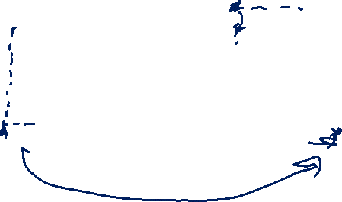
Trade of Emission Allowances
Abatement cost of company 1
Abatement cost of company 2
Reductions of company 2
Reductions of company 1
ARBITRAGE
Emission
right EM₁
CO₂ Emissions
Emission right EM₂
CO₂ Emissions

Slide 20
Trade of Emission Allowances
Effects of the trade:
The given emissions target can be attained at a lower cost.
At a given cost, a more ambitious emissions target can be achieved.

Slide 21
Designing Emissions Trading System
Trading period length:
If the trading period is too long, the incentives are weak.
If the trading period is too short, there is lack of certainty for investments.
Allocation of emissions allowances:
Grandfathering – free allocation → windfall profits
  CO₂ prices are opportunity costs of power plant operators (as certificates could be sold instead of covering emissions from electricity production) and, thus, included into the product price anyway, even if emission allowances are received for free.
Auctioning – operators buy allowances in auctions.
  Government collects and redistributes auctioning revenues.
  In the EU: min 50% for climate and energy related purposes

Slide 22
Trade of Emission Allowances
Abatement cost of company 1 (marginal cost)
Abatement cost of company 2 (marginal cost)
ARBITRAGE
Allocated rights
Emission trade

Slide 23
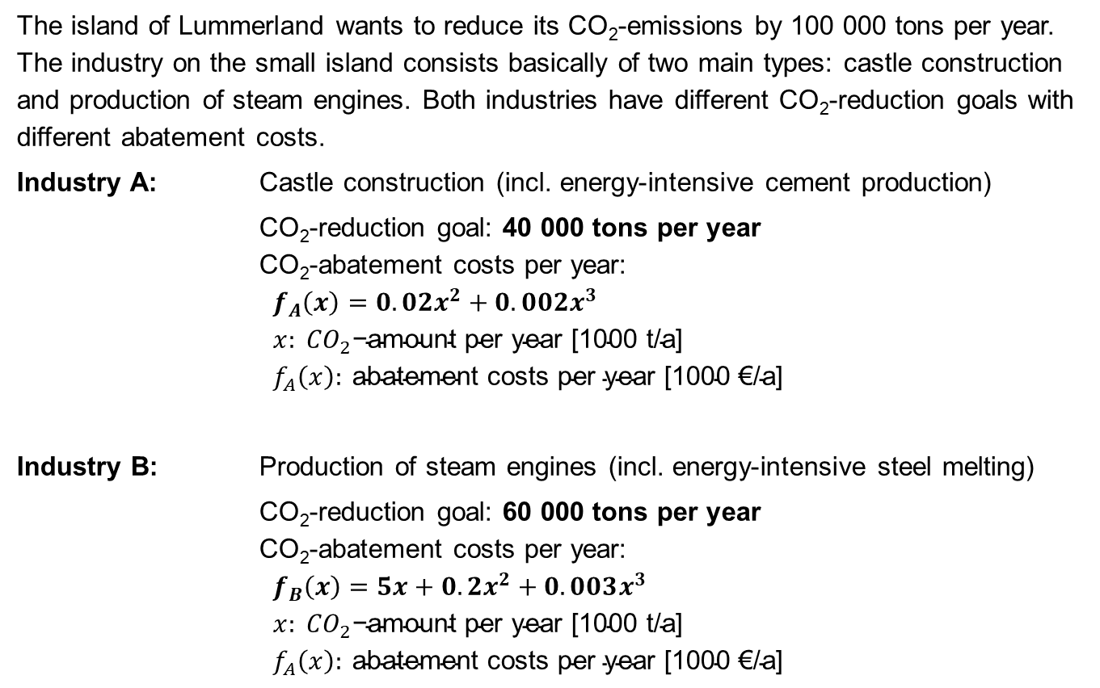
Task 3) CO₂ Reduction in Lummerland
The island of Lummerland wants to reduce its CO₂-emissions by 100 000 tons per year. The industry on the small island consists basically of two main types: castle construction and production of steam engines. Both industries have different CO₂-reduction goals with different abatement costs.
Industry A: Castle construction (incl. energy-intensive cement production)
CO₂-reduction goal: 40 000 tons per year
CO₂-abatement costs per year:
$$f_{A}\left(x\right)=0.02x^{2}+0.002x^{3} \\ x: {CO}_{2}\text{−}\text{amount} \text{per} \text{year}\text{ [1000 }\text{t}\text{/}\text{a}\text{] } \\ f_{A}\left(x\right): \text{abatement} \text{costs} \text{per} \text{year}\text{ [1000 €/}\text{a}\text{]}$$
Industry B: Production of steam engines (incl. energy-intensive steel melting)
CO₂-reduction goal: 60 000 tons per year
CO₂-abatement costs per year:
$$f_{B}\left(x\right)=5x+0.2x^{2}+0.003x^{3} \\ x: {CO}_{2}\text{−}\text{amount} \text{per} \text{year}\text{ [1000 }\text{t}\text{/}\text{a}\text{] } \\ f_{A}\left(x\right): \text{abatement} \text{costs} \text{per} \text{year}\text{ [1000 €/}\text{a}\text{]}$$

Slide 24
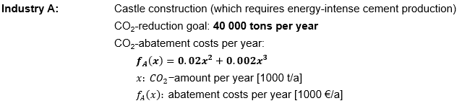

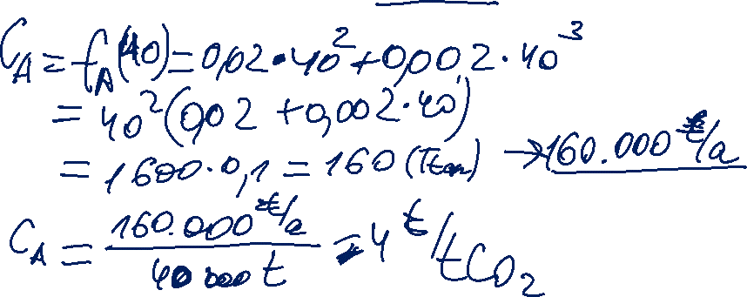
Task 3) CO₂ Reduction in Lummerland
What are the abatement costs per ton CO₂ for Industry A?

Slide 25
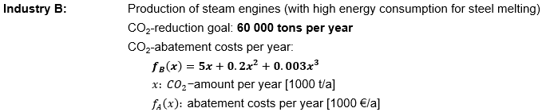

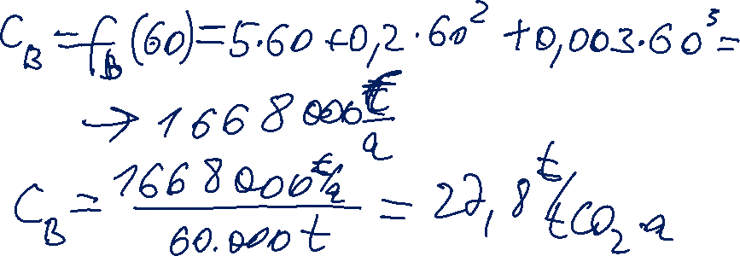
Task 3) CO₂ Reduction in Lummerland
What are the abatement costs per ton CO₂ for Industry B?

Slide 26

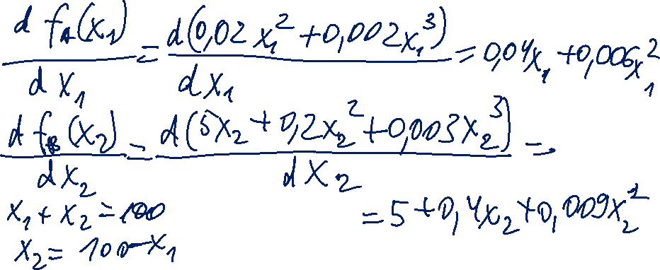
Task 3) CO₂ Reduction in Lummerland
In order to lower the costs for CO2 abatement, the government of Lummerland introduces a new emissions trading mechanism. What is the theoretical volume traded?
Find the volume at which the marginal abatement costs of both industries are equal.
Given functions are for annual abatement costs as a function of the annual amount of CO₂ reduction.
Total required reduction for both industries is 100.000 tons.

Slide 27
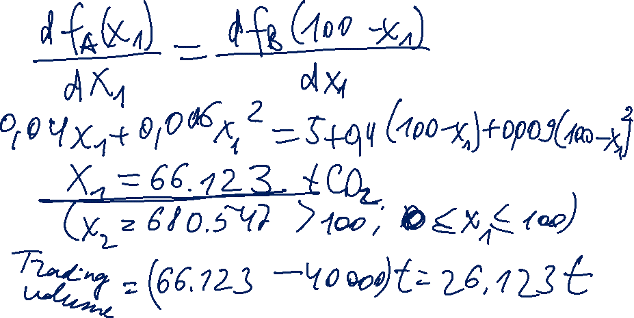
Second root does not meet the condition (just a matematical solution).
Under perfect market conditions 66.123 t CO₂ will be abated by industry A.
The difference between industry A’s abated amount and its reduction target will be traded.

Slide 28
Task 3) CO₂ Reduction in Lummerland
What is the system price in the emissions trading system?
What are now the overall abatement costs per ton CO₂ for Industry B?
To be continued

