Slide 1

Integrated course „Energy Economics“
- Natural Gas Markets
Chair of Energy Systems
Prof. Dr. Boris Heinz | Dr. Elena Timofeeva
elena.timofeeva@tu-berlin.de

Slide 2
Outline
Natural gas reserves and production
Long distance gas pipelines
Gas storage
LNG markets
Wholesale markets for natural gas
Retail gas markets

Slide 3
Gaseous Fuels
Natural gas – mainly methane
  H gas – high-calorific natural gas (higher CH₄ content → heat value)
  L gas – low-calorific natural gas (produced in GE &NL)
Liquefied petroleum gas (LPG) – mainly propane and butane, byproduct of oil refinery process
Town gas (cooking gas) – byproduct of coke plants

Slide 4

Properties of Gaseous Fuels
© Prof. Dr. Georg Erdmann
Notes:
Latent heat of vaporisation of water vapour. Same types of fuel are compared by HHV, different types of fuel – by LHV (due to different hydrogen content).

Slide 5
Natural gas
Conventional natural gas
Extracted from gas deposits by conventional means
Associated gas – released during oil extraction (often flared but can be utilised)
Unconventional natural gas
Shale gas (>1000 m deep) – extracted by fracking
Coal bed methane – found in coal formations (300-1000 m deep)
Methane hydrates – found on ocean seabed

Slide 6
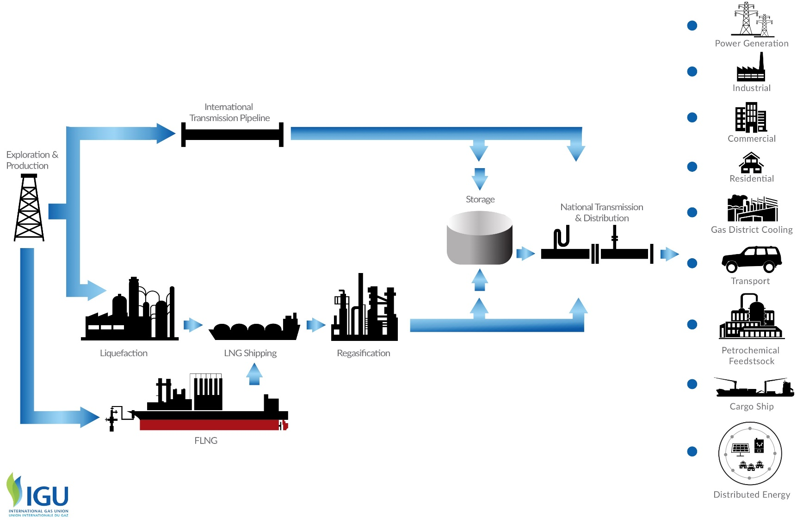
Natural gas value chain

Slide 7

Global Gas Resources
Source: BGR, 2013
Resources are all useful raw materials available in nature.
Reserves are resources existing with high probability and economically feasible for extraction.

Slide 8

Reserves and extraction of natural gas
*
The Persian Gulf and the Caspian Sea areas
  (Bahrain, Iran, Iraq, Kuwait, Oman, Qatar, Saudi Arabia, Syria, UAE, Yemen, other Middle East;
  Azerbaijan, Kazakhstan, Russia, Turkmenistan, Uzbekistan, other Europe & Eurasia)
Source: Zweifel / Praktiknjo / Erdmann (2017) after BP (2014)

Slide 9
LNG imports by source (billion cubic meters)
Source: BP Statistical Review of World Energy 2019

Slide 10
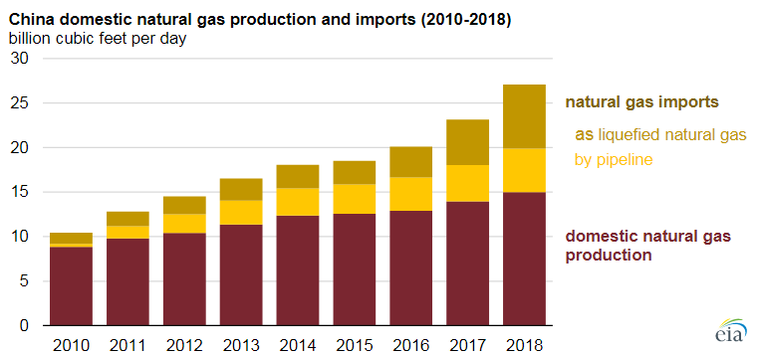
For reference: LNG imports Japan vs China 2018
Primary energy: consumption by fuel [million toe]
 | Oil | Natural gas | Coal | Nuclear | Hydro | RE | Total
Japan | 182,4 | 99,5 | 117,5 | 11,1 | 18,3 | 25,4 | 454,1
China | 641,2 | 243,3 | 1906,7 | 66,6 | 272,1 | 143,5 | 3273,5
Source: BP Statistical Review of World Energy 2019
Natural gas:
Inter-regional trade
China [billion cubic metres]
Pipeline imports | 47,9
LNG imports | 73,5
Total imports | 121,3
Source: BP, 2019
Source: U.S. Energy Administration, based on China National Bureau of Statistics and IHS Markit

Slide 11
Natural Gas in the EU
© Prof. Dr. Georg Erdmann

Slide 12
German Gas Imports
Source: BAFA, 2015
[TJ]
© Prof. Dr. Georg Erdmann

Slide 13
Economics of Gas Pipelines
Throughput is the volume of gas passing through a pipeline in a period of time.
[m³/h]
Pipeline capacity is the maximum throughput.
© Prof. Dr. Georg Erdmann

Slide 14
Game Theory: Double Marginalisation
Gas producer is able to infer on the import price resulting from gas importer’s optimisation based on the domestic demand curve. It then optimises its profit at the given import price.
© Prof. Dr. Georg Erdmann

Slide 15
Monopoly Pricing

Slide 16
Retail Gas Price set by the Monopolistic Gas Importer
Willingness to pay for the first unit = max. retail price
Linear demand function
Importer’s marginal cost = import price
(neglecting other cost elements)
© Prof. Dr. Georg Erdmann

Slide 17

Game Theoretical View of the Gas Importer
© Prof. Dr. Georg Erdmann

Slide 18

Game Theoretical View of the Pipeline Operator
© Prof. Dr. Georg Erdmann

Slide 19

Solution under “Cooperation”
© Prof. Dr. Georg Erdmann

Slide 20
Decision of the Pipeline Investor
© Prof. Dr. Georg Erdmann

Slide 21
Transportation Cost of Hydrocarbons
Source: Zweifel / Praktiknjo / Erdmann, 2017

Slide 22
LNG Process Chain
Boiling point of methane −162 °C (−259.6 °F)
Approx. 600 times volume reduction
Source: Osaka Gas
Source: BV 2009 / GIIGNL

Slide 23
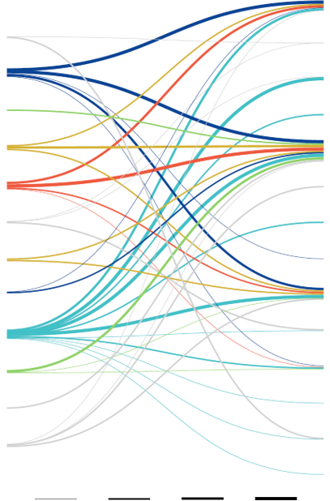
Major LNG Trading Flows in 2018
EXPORT
IMPORT
China
Algeria
France
Australia
India
Brunei
Italy
Indonesia
Japan
Malaysia
Mexico
Nigeria
Pakistan
Oman
Singapore
Papua New Guinea
South Korea
Quatar
Spain
Russia
Taiwan
UAE
Thailand
USA
Turkey
2 - 3 MT
3 - 5 MT
5 - 10 MT
>10 MT
United Kingdom
Source: GIIGNL, 2019

Slide 24
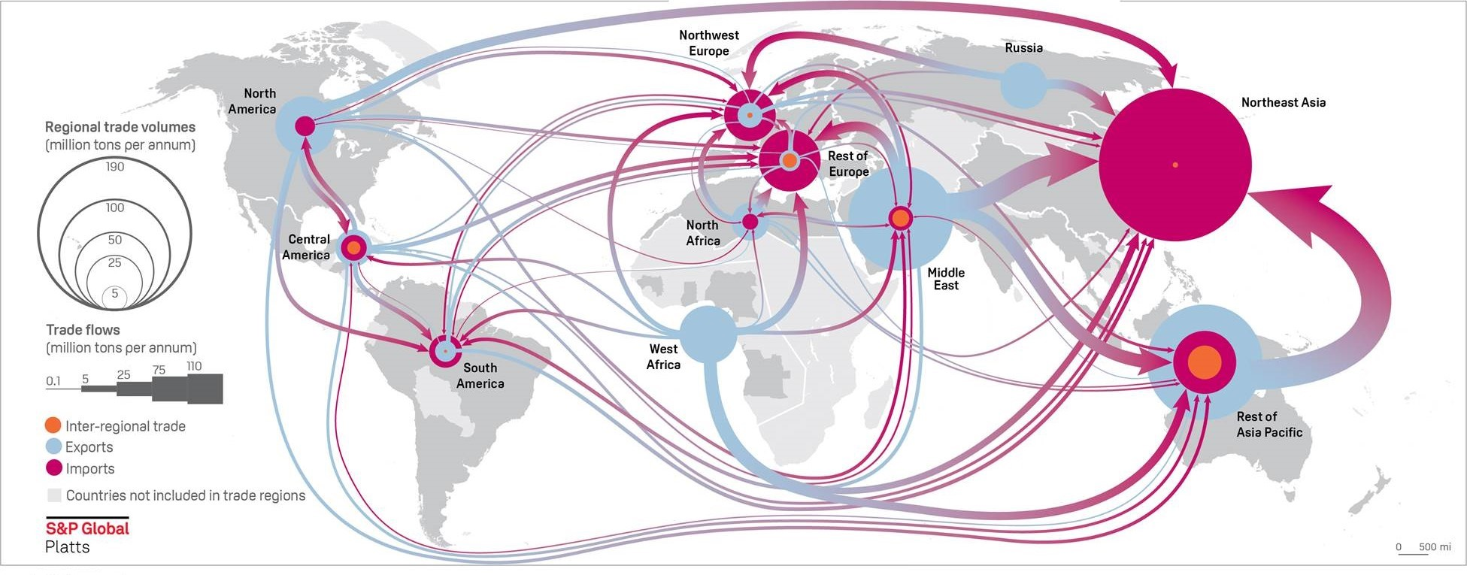
LNG Flows in 2018

Slide 25
Cost Structure of LNG Process Chain
Liquefaction plant:
Investment outlay | 900M €
Operating expenses | 0,04 €/m³
LNG tanker fleet | e.g. 2 vessels á 135T t each
Investment outlay | 360M €
Operating expenses | 0,014 €/m³
Regasification plant w. storage | e.g. 80T m³ (Cartagena)
Investment outlay | 320M €
Operating expenses | 0,015 €/m³
Own gas requirement | 1/3 of transported gas
Source: Zweifel / Praktiknjo / Erdmann (2017), after Cayrade (2014)

Slide 26
Cost Comparison of LNG Projects
Source: Songhurst, OIES, 2018

Slide 27
LNG Impact on Global Gas Markets
LNG trade leads to integration of regional gas markets
LNG supply chain is more flexible
LNG helps to develop more remote gas fields
Diversification helps mitigate the holdup problem
Source: Zweifel / Praktiknjo / Erdmann, 2017

Slide 28
Gas storage technologies
Station
Station
Observation well
Aquifer/
Production field
Source: E.ON Ruhrgas
Porous rock storage
Cavern storage

Slide 29
Gas storage facilities: Underground
Porous rock storage
  uses existing geological underground formations (e.g. depleted oil and gas fields, aquifers)
  relatively inexpensive (but higher investment costs for aquifers)
  large storage volume
  more cushion gas required
  low injection and withdrawal rate
Cavern storage
  artificial hollows carved out in underground rock or salt formations
  higher investment
  less cushion gas required
  higher withdrawal rate
  fast switching between injection and withdrawal mode
  provide short-term flexibility

Slide 30
Gas storage facilities: Above ground
LNG storage
Insulated tanks at LNG terminals
No cushion gas needed
High injection/withdrawal rates
Gas tanks
Law or high pressure
Not economical for high volumes
Local storage
Line pack
Gas stored inside pipeline through increased pressure
Used to balance daily demand fluctuations

Slide 31
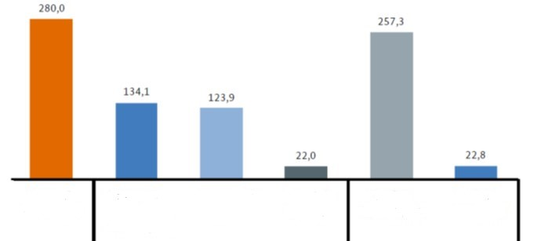
Gas storage facilities in Germany
Max. usable working gas volume as of 31.12.2018, in TWh
Total
33 storage facilities
Cavern storage
17 facilities
Porous rock storage
15 facilities
Other
1 facility
H-Gas
29 facilities
L-Gas
4 facilities
BNetzA, 2019

Slide 32
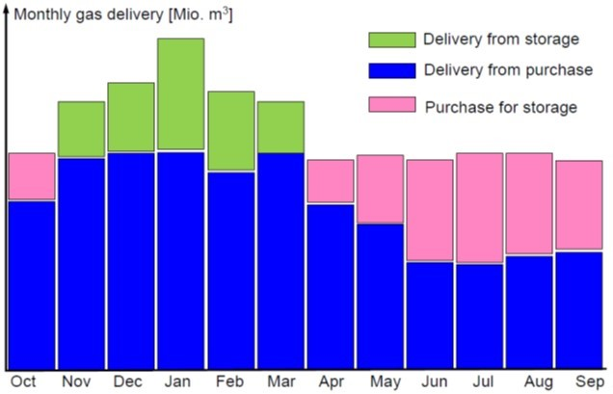
Merchant Use of a Gas Storage
© Prof. Dr. Georg Erdmann

Slide 33
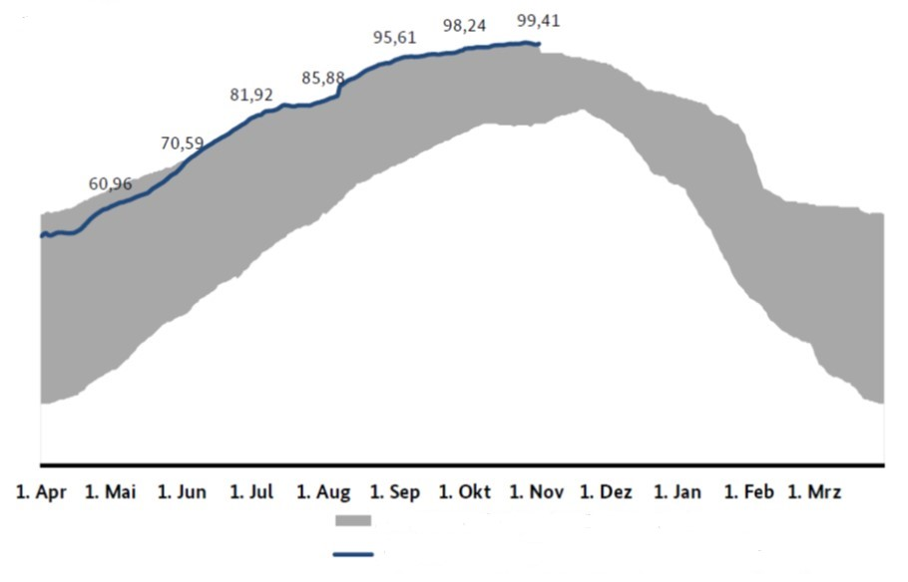
German gas storage: Filling level development
Storage year 2018/19 – compared to previous years
[%]
Range of storage filling level since 04/2011
Filling level for current storage year – as of 1 Nov 2019
Source: BNetzA, 2019

Slide 34
Value of gas storage
Storage buffers supply and (daily & seasonally fluctuating) demand
Value of storage is determined by the cost of alternative sources of flexibility (transportation and capacity charges):
production swing, take-or-pay, interruptible contracts, spot market
Intrinsic value
  ability to inject a certain amount of gas in summer and withdraw it in winter
  price during withdrawal minus price during injection, i.e. seasonal spread
Extrinsic value
  ability to utilise the storage volume more than once (inject and withdraw gas) during the season to profit from short-term price volatility

Slide 35
Third-Party Access to Gas Infrastructure
Non-discriminatory (effective and transparent) access to gas transportation systems is a crucial prerequisite for a liquid market for natural gas.
Unbundling for gas TSOs (see EU Gas Directive 2009/73/EC):
Transmission and distribution activities are separated from the rest of the value chain
Ownership unbundling
Independent system operator (ISO)
Independent transmission operator (ITO)
Certification to ensure compliance with unbundling requirements for transmission system owner or TSO controlled by person(s) from third country(ies)
„Gazprom clause“
See lecture 10
on unbundling: equivalent rationale and requirements apply for the gas sector.

Slide 36
Gas Network Access Models
Point-to-point system
gas traders book specific transportation route from an entry to an exit point
distance-based or flatrate fee
Entry-exit system
entry and exit capacities are booked separately
entry fee and exit fee – no distance-related fee
traders with entry capacities can sell gas to traders with exit capacities
each exit point can be supplied from any entry point
Entry-exit system enables wholegas gas trading on virtual trading point (virtual hub) / market area level: gas is traded independently of its location in a market area.

Slide 37
European gas regions, markets and hubs
Source: OIES (2017) with reference to www.worldatlasbook.com and P. Heather

