Slide 1

Integrated course „Energy Economics“
- Renewable Energy Support Schemes
- Electricity Generation -
Chair of Energy Systems
Prof. Dr. Boris Heinz | Dr. Elena Timofeeva
elena.timofeeva@tu-berlin.de

Slide 2
Renewable Electricity Support Schemes in Europe
EU Clean Energy Package (2018): binding target of 32% for renewable energy sources in EU’s energy mix by 2030

Slide 3
RES support mechanisms: Administered fees (all-inclusive or premium)
The government fixes the price for each MWh produced or injected into the grid from RES.
Normally, the fee depends on renewable source and size of power plant.
Feed-in tarif (FIT)
Premium ensures that at least FIT is covered and gives incentives for selling RES output directly on the wholesale market
If the fee is coherent with the production cost, the government’s RES output target can be met; otherwise it would be not reached or exceeded.
The charges linked to the support system are paid by final customers.

Slide 4
RES support mechanisms: Green Certificates (GC)
Fossile fuel-fired generators are required to replace every year a certain percentage of their energy production with RES
The balance between demand (from generators and importers under the GC obligation) and supply (RES generators) determined the GC price
The charges linked to the GC are translated to the final customers through the electricity price (on wholesale or retail market).

Slide 5
Green Certificates Mechanism
© Prof. Carlo Andrea Bollino

Slide 6
Feed-in-tariff and Market Premium Mechanism
© Prof. Carlo Andrea Bollino

Slide 7

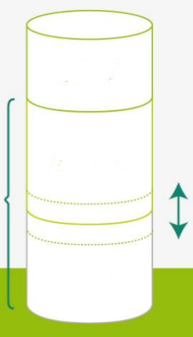
Feed-in-tariff and Market Premium Mechanisms
revenues from
flexibility
guaranteed revenue
incl. management premium
fixed
feed-in tariff
market premium
variable
revenues from
wholesale market
fixed
(asset-specific)
Source: Next Kraftwerke

Slide 8

Direct and Indirect Costs of Renewables
Cost of new RES capacity invested in Germany in January 2012
© Prof. Carlo Andrea Bollino

Slide 9
Expenditures for Electricity
© Prof. Carlo Andrea Bollino

Slide 10

Renewables support levy (green fee)
RES support payments – RES marketing revenue
RES levy =
Adjusted non-preferred final electricity consumption
Adjusted final electricity consumption is equal to total final electricity consumption minus:
Share of electricity consumption of energy intensive industries, which are exempted from the levy
Own generation (self-consumption), which is partly exempted from the levy

Slide 11
Integrated course „Energy Economics“
- Retail markets for electricity
Chair of Energy Systems
Prof. Dr. Boris Heinz | Dr. Elena Timofeeva
elena.timofeeva@tu-berlin.de

Slide 12
Outline
Market participants
Supplier switching
Prosumers

Slide 13
Recap: Electricity market structure types
Single buyer
Power pool
Free wholesale competition
Fully liberalised market with retail competition

Slide 14
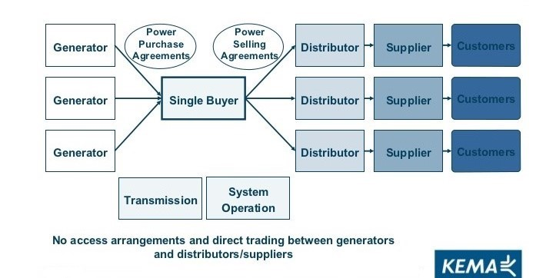
Electricity market structures: Single buyer

Slide 15
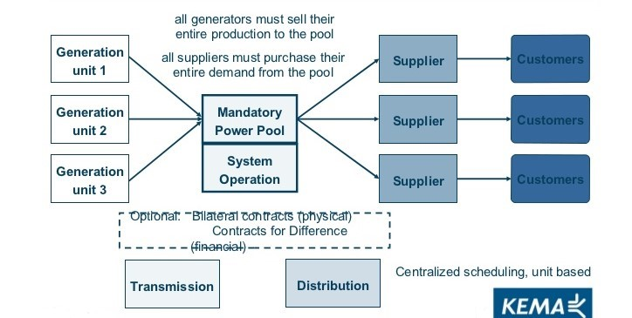
Electricity market structures: Power pool

Slide 16
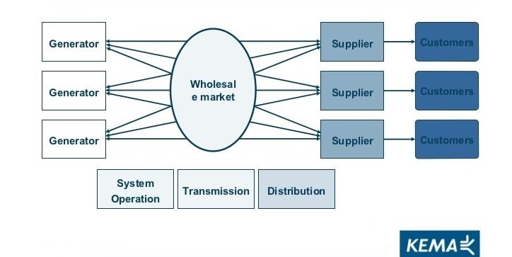
Electricity market structures: Wholesale competition

Slide 17
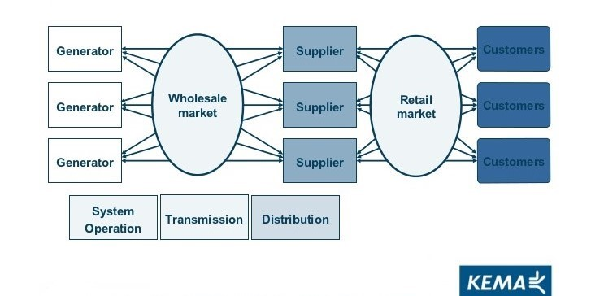
Electricity market structures: Retail competition

Slide 18
Electricity retail under different market structures
Single buyer → regulated retail prices
Power pool → regulated retail prices;
Free wholesale competition
Fully liberalised market → retail competition
                unregulated retail prices
large consumers may be eligible to participate in the wholesale market

Slide 19
Retail competition
The ultimate rationale of liberalisation/restructuring of the electricity sector is the prospect of lower prices for electricity consumers achievable through competition.
The option for final customer to switch supplier creates a competitive pressure for market players along the electricity supply chain.

Slide 20
Categories of suppliers in the German market
Large vertically integrated utilities: E.ON, RWE, Vattenfall, EnBW
Municipal utilities
Retailers with mixed ownership structure
Small independent retailers
Electricity retail markets are regional: distribution network level.
Default supplier is the designated supplier obliged to supply any customer in their supply area (in Germany: the entity supplying the largest number of grid connection points).
Apart from the baseline contract, the default supplier can offer alternative tariffs.

Slide 21
Categories of final customers
Industrial
Commercial
Residential
Household customers: up to 10.000 kWh yearly consumption
  residential & small commercial
  standard load profile (SLP) - approximation
RLM customers: all other
  commercial (> 10.000 kWh yearly consumption) & industrial
  registered load profile measurement (RLM)

Slide 22
Contractual set-up for electricity consumer
Contract with supplier
  Types:
    default supply
    alternative tariff with default supplier
    alternative supplier
  Typically, supplier has BRP role.
Contract with the grid operator (Network contract)
  Grid tariffs
  Metering and metering charges
Network connection contract – technical connection to the grid.
Metering responsibility:
by default – grid operator
by opt-in – independent metering company

Slide 23

Supplier structure: Industrial and household customers
Household customers
RLM customers
Contract with alternative supplier
37,10 TWh
31,0%
Baseline
contract with default supplier
33,20 TWh
27,8%
Contract with alternative supplier
189 TWh
72%
Baseline
contract with default supplier
0,7 TWh
< 1%
Alternative tariff with default supplier
72 TWh
27%
Alternative tariff with default supplier
49,30 TWh
41,2%
Source: BNetzA, 2018

Slide 24
Retail price composition: Household customers
Average composition of electricity price for a German household with an annual consumption of 3.500 kWh (2019)
Average price:
30,43 ct/kWh
Taxes and levies
State-induced
Grid tariffs
(incl. metering)
Regulated
Electricity
procurement,
retail
Market-based
Source: BDEW, 2019

Slide 25
Retail price composition: Household customers
Average composition of electricity price for a German household with an annual consumption of 3.500 kWh (2019)
Interruptible load levy (AbLaV)
Offshore levy
Levy to compensate reduced grid tariffs for certain grid users (§19 StromNEV)
CHP levy (KWK)
Green levy (EEG)
Electricity tax
Concession levy
VAT 19%
Taxes and levies
15,98 ct/kWh
Grid tariffs
(incl. metering)
7,39 ct/kWh
Electricity
procurement,
retail
7,06 ct/kWh
Source: BDEW, 2019

Slide 26
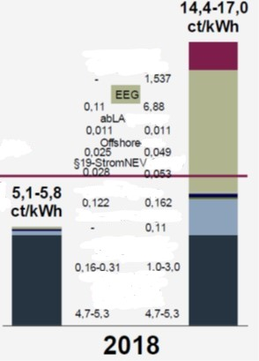
Retail price composition: Industrial consumers
Range of electricity prices for large industrial consumers with an annual consumption of 100 GWh/a:
Max. available cost relief vs. No cost relief
El. tax
Average price 2018:
8,96 ct/kWh
Source: Eurostat
KWK
Concession levy
Grid tariff
Procureme
nt, retail
Source: BDEW, 2019
(with reference to Eurostat)

Slide 27
Retail competition
% of grid areas with given number of suppliers:
In almost all grid areas the number of operating suppliers is more than 20.
In approx. 90% of grid areas more than 50 suppliers are operating.
1 – 20 suppliers
21 – 50 suppliers
51 – 100 suppliers
> 100 suppliers
Source: BDEW, 2019 (after BNetzA, 2018)

Slide 28
Supplier switching among household customers
%
household customers
Cumulated switching rate since liberalisation
Mio households
Souce: BDEW, 2019

Slide 29
Retail competition: Pass-through rate
Pass-through rate is the percentage to which an electricity retailer passes on a change in their cost to their customers/ electricity consumers.

Slide 30
Retail market: Pass-through rate
Incumbents in regional retail markets in Germany in 2010
Source: Duso / Szücs, 2017

Slide 31
Retail market: Heterogeneity in baseline tariffs
Baseline tariff in € per MWh at 2800 kWh yearly consumption
Source: Duso / Szücs, 2017

Slide 32
Retail market: Within-network price dispersion (2010)
Difference between baseline and best-available tariff in € per MWh at 2800 kWh yearly consumption
Source: Duso / Szücs, 2017

Slide 33
Pass-through rate in the German retail market
Duso and Szücs / European Economic Review 98 (2017) 354-372
Summarised findings:
Supplier and customer types
Pass-through rate to baseline tariffs is quite similar across firms.
Pass-through rate to competitive tariffs is 12-23% higher for independent suppliers.
Thus, the pass-through rate depends on the customer segment, rather than supplier segment.
Time differentiation
Pass-through rates to baseline tariffs remain stable over time.
Pass-through rate to the best available tariff increases to almost unity.
Ability to switch supplier is the main driving factor for pass-through.

Slide 34
Self-consumption: Prosumers
Prosumers: producers + consumers
Households that produce electricity that they consume themselves (self-consumption) and/or feed into the grid.

Slide 35
Recap: Levelised cost of electricity (LCOE)
I₀ lifetime costs* divided by
LCOE = + oc
Q_{T} ∙ AF_{i, t} lifetime electricity output
* Lifetime costs: PV of total cost of building and operating
I₀ ∙ CRF_{i, t}
LCOE = + oc
Q_{T}
initial capital cost*
* specific investment costs: investment costs divided by capacity
annual operating expenses
capacity factor
discount rate
operational life
See: EnEco_8_Financial Management II
Notes:
LCOE is the present value of the revenue from produced electricity over the economic life of the plant and the costs incurred in the construction, operation and maintenance, and the fuel costs.

Slide 36

Task 3) NPV and Levelized Cost of Energy (LCOE)
The table below describes the investment conditions for a 5 kW_{peak} PV system in Germany and in Spain:
What is the Net Present Value (NPV) of the investment in Spain and in Germany, given a feed-in tariff (FIT) of 11.83 ct/kWh?
What are the levelised cost of electricity (LCOE) of the photovoltaic system in Germany and in Spain (LCOE = electricity generation costs in ct/kWh based on full costing)?
Assume that electricity retail prices in Spain and Germany are 29 ct/kWh. What does your result in b) imply for the self-consumption of the generated electricity?
Description | Germany | Spain | Unit
Specific investment costs | 1 500 | 1 500 | €/kW_{peak}
Operation and maintenance (O&M) costs | 9 | 9 | €/kW_{peak}/a
Full load hours | 900 | 1 500 | hours/a
Capacity | 5 | 5 | kW_{peak}
Lifetime | 20 | 20 | a
Interest rate | 3 | 3 | %

Slide 37
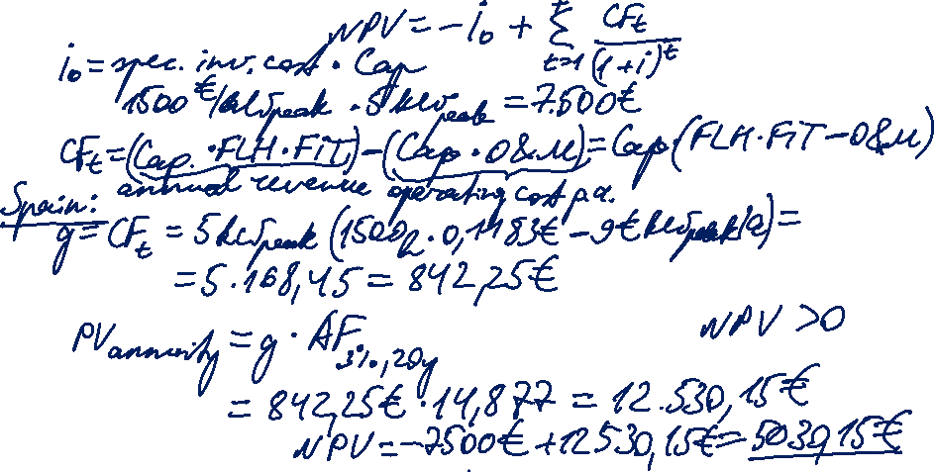
Task 3) NPV and Levelized
Cost of Energy (LCOE)
Description | Germany | Spain | Unit
Specific investment costs | 1 500 | 1 500 | €/kW_{peak}
Operation and maintenance (O&M) costs | 9 | 9 | €/kW_{peak}/a
Full load hours | 900 | 1 500 | hours/a
Capacity | 5 | 5 | kW_{peak}
Lifetime | 20 | 20 | a
Interest rate | 3 | 3 | %
The table describes the investment conditions for a 5 kW_{peak} PV system in Germany and in Spain:
What is the Net Present Value (NPV) of the investment in Spain and in Germany, given a feed-in tariff (FIT) of 11.83 ct/kWh?

Slide 38
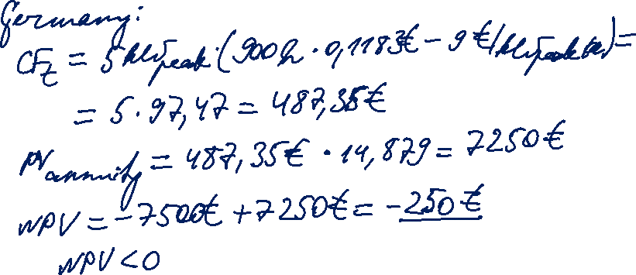
Task 3) NPV and Levelized
Cost of Energy (LCOE)
Description | Germany | Spain | Unit
Specific investment costs | 1 500 | 1 500 | €/kW_{peak}
Operation and maintenance (O&M) costs | 9 | 9 | €/kW_{peak}/a
Full load hours | 900 | 1 500 | hours/a
Capacity | 5 | 5 | kW_{peak}
Lifetime | 20 | 20 | a
Interest rate | 3 | 3 | %

Slide 39
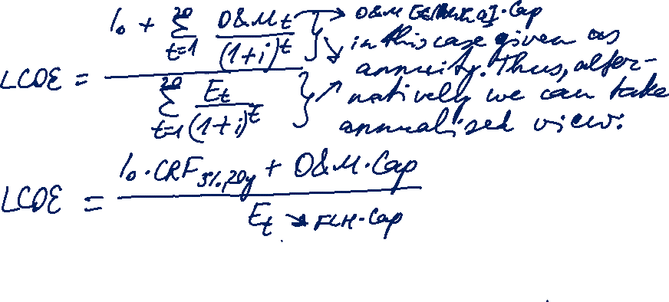
Task 3) NPV and Levelized
Cost of Energy (LCOE)
Description | Germany | Spain | Unit
Specific investment costs | 1 500 | 1 500 | €/kW_{peak}
Operation and maintenance (O&M) costs | 9 | 9 | €/kW_{peak}/a
Full load hours | 900 | 1 500 | hours/a
Capacity | 5 | 5 | kW_{peak}
Lifetime | 20 | 20 | a
Interest rate | 3 | 3 | %
The table describes the investment conditions for a 5 kW_{peak} PV system in Germany and in Spain:
What are the levelised cost of electricity (LCOE) of the photovoltaic system in Germany and in Spain (LCOE = electricity generation costs in ct/kWh based on full costing)?

Slide 40
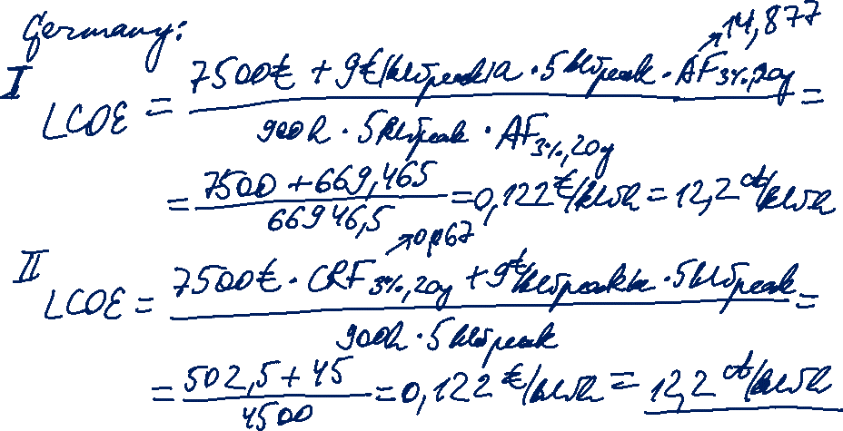
Task 3) NPV and Levelized
Cost of Energy (LCOE)
Description | Germany | Spain | Unit
Specific investment costs | 1 500 | 1 500 | €/kW_{peak}
Operation and maintenance (O&M) costs | 9 | 9 | €/kW_{peak}/a
Full load hours | 900 | 1 500 | hours/a
Capacity | 5 | 5 | kW_{peak}
Lifetime | 20 | 20 | a
Interest rate | 3 | 3 | %

Slide 41
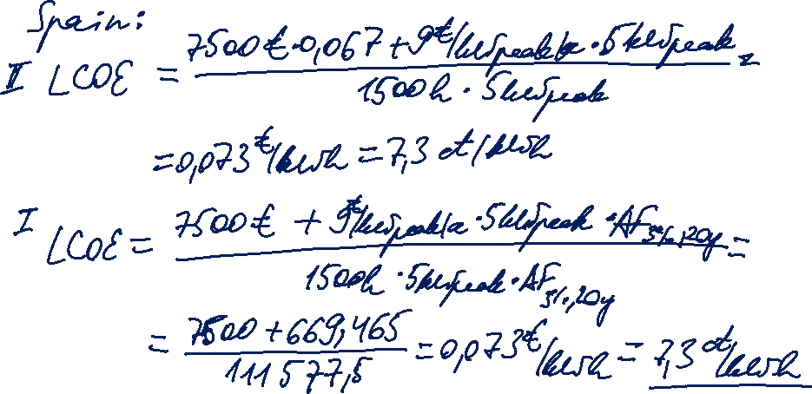
Task 3) NPV and Levelized
Cost of Energy (LCOE)
Description | Germany | Spain | Unit
Specific investment costs | 1 500 | 1 500 | €/kW_{peak}
Operation and maintenance (O&M) costs | 9 | 9 | €/kW_{peak}/a
Full load hours | 900 | 1 500 | hours/a
Capacity | 5 | 5 | kW_{peak}
Lifetime | 20 | 20 | a
Interest rate | 3 | 3 | %

Slide 42
Task 3) NPV and Levelized
Cost of Energy (LCOE)
Description | Germany | Spain | Unit
Specific investment costs | 1 500 | 1 500 | €/kW_{peak}
Operation and maintenance (O&M) costs | 9 | 9 | €/kW_{peak}/a
Full load hours | 900 | 1 500 | hours/a
Capacity | 5 | 5 | kW_{peak}
Lifetime | 20 | 20 | a
Interest rate | 3 | 3 | %
The table describes the investment conditions for a 5 kW_{peak} PV system in Germany and in Spain:
Assume that electricity retail prices in Spain and Germany are 29 ct/kWh. What does your result in b) imply for the self-consumption of the generated electricity?

Slide 43
Task 3) NPV and Levelized
Cost of Energy (LCOE)
Description | Germany | Spain | Unit
Specific investment costs | 1 500 | 1 500 | €/kW_{peak}
Operation and maintenance (O&M) costs | 9 | 9 | €/kW_{peak}/a
Full load hours | 900 | 1 500 | hours/a
Capacity | 5 | 5 | kW_{peak}
Lifetime | 20 | 20 | a
Interest rate | 3 | 3 | %
The table describes the investment conditions for a 5 kW_{peak} PV system in Germany and in Spain:
Assume that electricity retail prices in Spain and Germany are 29 ct/kWh. What does your result in b) imply for the self-consumption of the generated electricity?
The PV system operator is at the same time an electricity consumer (prosumer).
The operator have an option to cover their electricity demand either from
a supplier at the retail price (and feed the electricity generated in the PV system into the grid), or
the electricity generated in their PV system (self-consumption). For Germany: E_{t} = 4500 kWh
Alt. I. 1. cost of electricity from supplier: 4500 kWh * 0,29 €/kWh = 1305 €
2. revenue from feed-in (FIT): 4500 kWh * 11,83 ct/kWh = 532,35 € Total: -1101,15 €
3. LCOE: 4500 kWh * 7,3 ct/kWh = 388,5 €
Alt. II. 1. LCOE: 4500 kWh * 7,3 ct/kWh = 388,5 €
no cost of ext. consumption; no revenue from feeding into the grid; but additional costs:
green & CHP fee, electricity tax (but saves on grid fees) Total: -388,5 € plus fees
LCOE_{Spain} = 7,3 ct/kWh and LCOE_{Germany} = 12,2 ct/kWh are both below the retail price of 29 ct/kWh.
→ Self-consumption is preferred over buying electricity from the supplier (retail grid parity is reached).

Slide 44
Definitions: Levels of grid parity
© Lars Dittmar, 2011

Slide 45
Grid parity of roof installations
[Capacity < 30 kW_{p}, generation 800-1000 kWh/kW_{p}∙a, Interest rate = 5-8%]
Source: Henkel and Dittmar, 2011

Slide 46
Feed-in Tariff and PV Generation Cost
[Capacity < 30 kW_{p}, generation 800-1000 kWh/kW_{p}∙a, Interest rate = 5-8%]
Source: Henkel and Dittmar, 2011

