Slide 1
Energy Economics – Winter Term 2020/21
- Getting started -
Chair of Energy Systems | Department of Energy Systems
Technische Universität Berlin
Notes:
Please note that lectures will be held live via Zoom and a recording will be made available for replay for 24 hours after each lecture
In case you are not able to attend the class, make sure to listen in shortly after.
The recordings will be available via streaming only. Downloading them is prohibited. Also, we would like to remind you that course participants are not allowed to record.

Slide 2
All course material is available on the ISIS course webpage EE 20/21

Slide 3
Lectures and tutorials on Monday, Wednesday & Thursday
Lecture and tutorials
  Mondays, 14-16 h
  Wednesdays, 14-16 h
  Thursdays, 12-14 h
  First lecture in 20: 2 November
  Last lecture in 20: 17 December
  First lecture in 21: 4 January
  Last lecture in 21: 25 February
Exam
  6 ECTS for a written exam of 90 minutes
  Date to-be-confirmed
  Location to-be-confirmed

Slide 4
In this class, offer for additional seminar stand alone (3 ECTS each) or module Energiesysteme (9 ECTS)
Vortragsreihe „Neue Entwicklungen auf den Energiemärkten“ / Lecture series „New developments on the Energy Markets“
  Lecture series and discussion on current topics in energy economics and systems
  Language: German / English
  ISIS: Vortragsreihe WS 20/21 | Password: Meritorder20
  Please register via the course database to facilitate a smooth planning process
  Introduction of the topics will be within this lecture on 26 November 2020
  The dates for your presentation will be planned thereafter with your supervisor

Slide 5

Questions?
?
What are the parts of this module?
Where do I find information and news concerning this module?
Where do I find the material for the lecture and the tutorial?
When is the exam?
Who do I contact with unclarities?

Slide 6

Reading recommendation
English
Erdmann, G., Praktiknjo, A., Zweifel, P. (2017) Energy Economics – Theory and Applications, Berlin, etc.: Springer
Bhattacharyya, Subhes C. (2011) Energy Economics. Concepts, Issues, Markets and Governance. Springer
Dahl, C. A. (2004) International Energy Markets: Understanding Pricing, Policies, and Profits. Tulsa (Oklahoma): PennWell
Stoft, S. (2002) Power System Economics: Designing Markets for Electricity. Piscataway (N.Y.): IEEE Press
German
Erdmann, G., Zweifel, P. (2007) Energieökonomik - Theorie und Anwendungen, Berlin, etc.: Springer
Hensing, I.; Pfaffenberger, W.; Ströbele, W. (1998) Energiewirtschaft. Einführung in Theorie und Politik. München: Oldenbourg
BNetzA/BKartA (2016) Monitoring-Bericht Strom und Gas
Economic Fundamentals
Hal R. Varian, "Intermediate Microeconomics: A Modern Approach - Ninth Edition", W. W. Norton & Company, Inc., New York, USA, April 9, 2014
K. Spremann, "Wirtschaft, Investition und Finanzierung", München: Oldenbourg, 6. Auflage 2013.(ISBN 3-486-23565-6) (German)

Slide 7
Topics in class
  Energy Balances
  Economic Fundamentals
  Financial Management
  Electricity Markets
  One class – presentation of seminar “new development on energy markets”
  Electricity grid
  Homework and self-paced study time
  Retail Markets
  Emissions markets
  Resources and Sustainability
  Oil Markets
  Gas Markets
  Energy and Development
  Exam Preparation
⚡️Homework on a class relevant topic
  Voluntary group work (up to 5 students)
  Report and possibly a presentation
  Rewards: Deeper understanding of the topic, methodological competence and extra bonus points for the exam
  Dates probably from 4-Jan-21 to 11-Feb-21

Slide 8
Let’s start with a look into the past
-Energy-related CO₂ emissions in regions-

Slide 9
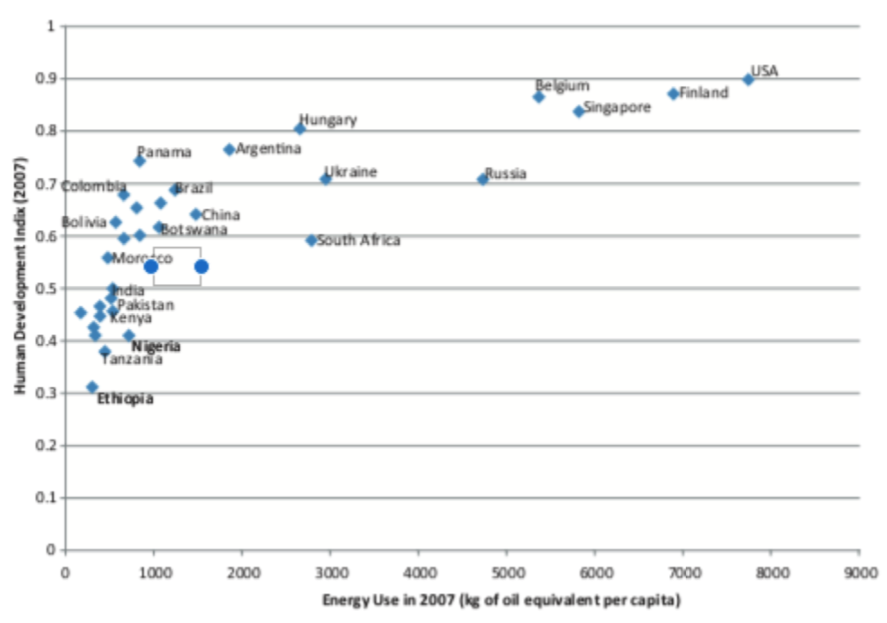
What goes together
-Economic development and energy consumption-
The prosperity of our society depends on a functioning energy supply. Modern life would be unimaginable without electricity, warmth, and mobility

Slide 10
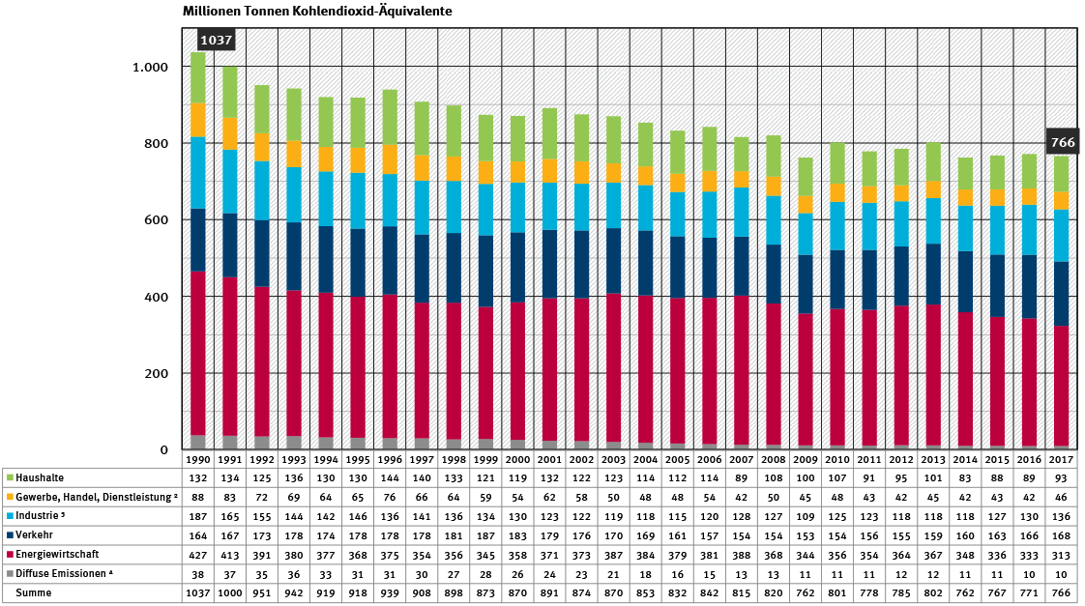
A closer look at Germany
-Energy-related emissions-

Slide 11
Overview
-The German Energy Transition-
→ The burning of fossil fuels generates heat and releases the greenhouse gas carbon dioxide - a serious pollutant and major contributor to global warming
→ The key to climate mitigation is an energy transition that reduces our consumption of fossil fuels, through the increased use of renewable energies and a more efficient use of fossil fuels
→ The realization of a sustainable energy supply depends on a reduction in our consumption of fossil fuels such as oil, gas, and coal
→ Essential tool in increasing energy efficiency is, power-heat coupling, where exhaust heat from the production of electricity is used for heating, or in production processes (combined heat and power)
Wind, water and solar power – renewable energies are the key to sustainable energy supply

Slide 12
A big step in the right direction
-The German Energy Transition-
Renewable energies, such as hydro and solar power, wind and geothermal power, and regenerative resources are replacing fossil fuels
→ by 2050 renewable energies should make up 60 percent of final
consumption of energy, and 80 percent of the gross electricity consumption
Energy efficiency is following the expansion of renewable energy supplies. Potential solutions range from the modernization of power stations, to energy efficient motors and energy saving industrial processes, to energy efficient building renovation and household goods
→ by 2020 a 20 percent reduction in primary energy consumption,
and 50 percent reduction by 2050, compared to 2008

Slide 13
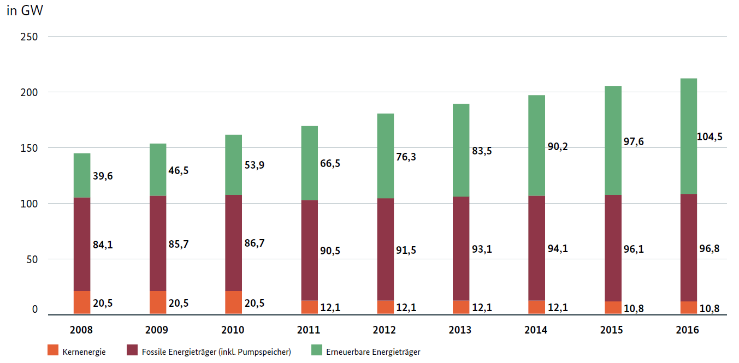
Snapshots
-Production capacity for electricity in Germany-
Quelle: Monitoringbericht 2016

Slide 14
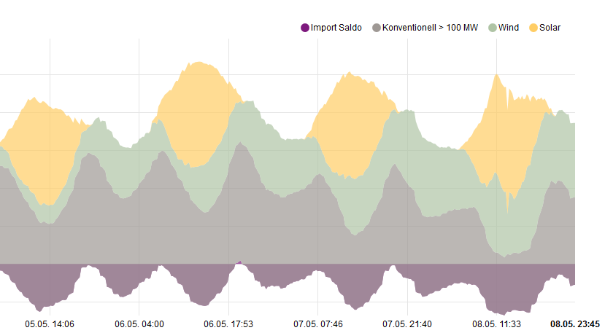
Electricity production in Germany
-high share of renewable electricity at times-
Electricity production mix (5.5.- 8.5.2016)
Quelle: www.energy-charts.de

Slide 15
Central elements of a renewable energy system
-Energy storage-
Developing storage solutions
→ New storage concepts
→ Intelligent power grids
Wind and solar power are not continuously available meaning the supply of energy is less stable compared to large traditional power stations
Power-to-X
→ Usage of excess electricity to produce heat, gas or liquids
→ Transfer renewable electricity into other sectors to replace fossil energy (warmth, mobility)
Hydrogen production with wind electricity. Fuel cells convert hydrogen back to electricity when needed, or feed hydrogen into the natural gas grid
It is also conceivable that excess wind or solar power could be converted into heat (Power-to-Heat), into liquid fuels (Power-to-Fuel), or into basic chemicals (Power-to-Chemicals)

Slide 16
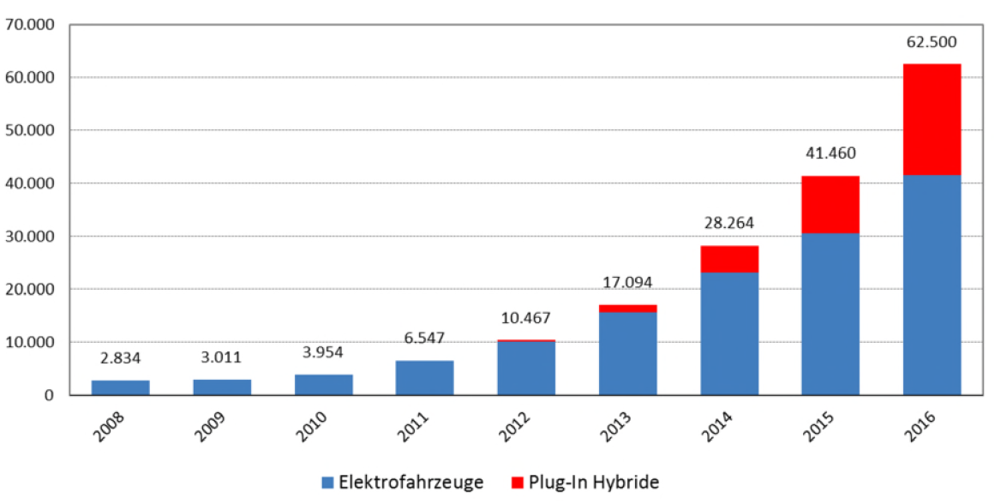
E-mobility in Germany
To keep in mind: around 45 Mio cars in Germany

Slide 17
Central elements of a renewable energy system
-Decentralised supply is the future-
The nature of our energy supply system is changing
→ from a system reliant on conventional, centralized large power stations,
→ to a decentralized structure with numerous smaller power generation systems.
As the transformation continues, regional and municipal distribution networks must change too. The trend is towards smart grids that connect
→ producers
→ consumers
→ storage facilities, and
→ network structures

Slide 18
Decentralised supply is the future
-characteristics-
  → Flexibility to adjust production to consumption of energy (more dynamic)
  → Local production, closer to consumption, potential to use excess heat (higher efficiency)
→ Higher number of energy systems reduce risk of outages
→ Mass market for energy systems and reduced costs (economies of scale)

Slide 19
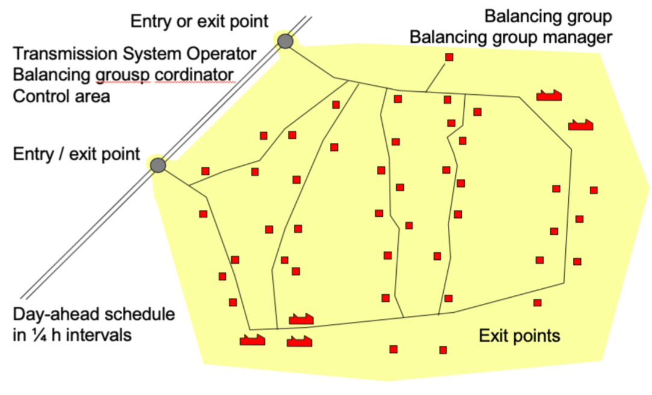
Decentralised supply is the future
-balancing groups-

Slide 20
Decentralised supply is the future
-real world insights / fuel cells for energy production-
  What can a small energy production system in a household do (alone / together with many)?
  → Blue dot below the line – when there is too much electricity produced for the household
  → Blue dot above the line – when there is too little electricity produced for the household
13 BZ und HH
17 BZ und HH
1 BZ und HH
5 BZ und HH
9 BZ und HH

Slide 21
Wrap up
The energy transition has two pillars
→ More energy generation from renewable energies
→ Higher energy efficiency at the point where energy is consumed
But remember
→ More renewable energy production in the electricity sector alone won’t do it (it’s called energy transition, not electricity transition!)
→ Mobility, warmth, industry to be included as well (Power-to-X)
Decentralized energy systems
→ Cost effective
→ Efficiency (local production/usage of byproducts)
→ Environmental friendly technologies

Slide 22
Next class is on Wednesday
Time: 14 – 16 h
→ Work on “energy balances”

