Slide 1
Integrated course „Energy Economics“
- Energy Trading
Chair of Energy Systems
Prof. Dr. Boris Heinz | Dr. Elena Timofeeva
elena.timofeeva@tu-berlin.de

Slide 2
Outline – Electricity Trading
Role of energy trading
Submarkets and trading forms
Trading products
Balance group concept
Credit risk management
Market transparency
Cross-border trading
Trading strategies

Slide 3
Trading motives and trader types
Trader categories:
asset-backed – trade to optimise assets / hedge price risk
merchant / proprietary – speculate / gamble
Generators have a natural net long position: their value increases with rising prices.
Final consumers have a natural net short position: they benefit from falling prices.
Marketers who buy and resell power can be long or short.
Generators are exposed to volatile fuel prices / fixed selling prices.
Retailers are exposed to volatile purchase prices / fixed selling prices.

Slide 4
Trading strategies: Managing price risk
Risk is a source of uncertainty.
There is a fundamental tradeoff between risk and return.
Risk management is identifying and analysing risks and deciding if to accept or mitigate uncertainty.
The goal is to achieve an optimal risk-return profile of a portfolio.

Slide 5
Hedging
Hedging is reducing risk (i.e. uncertainty) by taking a position that offsets the risk of the existing position (equal and opposite exposure to the same underlying asset).
Hedging limits a potential loss and reduces a potential profit.
Final consumers (industrial and commercial), typically, lack trading capability and sufficient market insight and resort to hedging for better cost planning.
Traders hedge positions that they are not able or willing to close (e.g. long-term supply contract at a fixed price).
Generators like wind and solar projects may hedge the price risk via long-term fixed-price power purchase agreements (PPA) to facilitate financing.
Notes:
Market (systemic) risk cannot be hedged.
Securing against price risk by fixing the price ahead of delivery.

Slide 6
Recap: Options terminology
An option gives the holder the right, but not the obligation, to buy or sell a specified quantity of an underlying on (or before) a specified future date, at a predetermined price.
Excercising the option is buying or selling the underlying.
- Call option is a right to buy.
- Put option is a right to sell.
Expiry (expiration/maturity date) is the date on (or until) which the option can be excercised.
- European options can be excercised only at expiry.
- American options can be excercised at any time up to expiry.
Strike (excercise) price is the pre-agreed buy or sell price.
Option premium is a fixed amount paid by the holder (option buyer) to the writer (option seller) upon concluding an option.

Slide 7
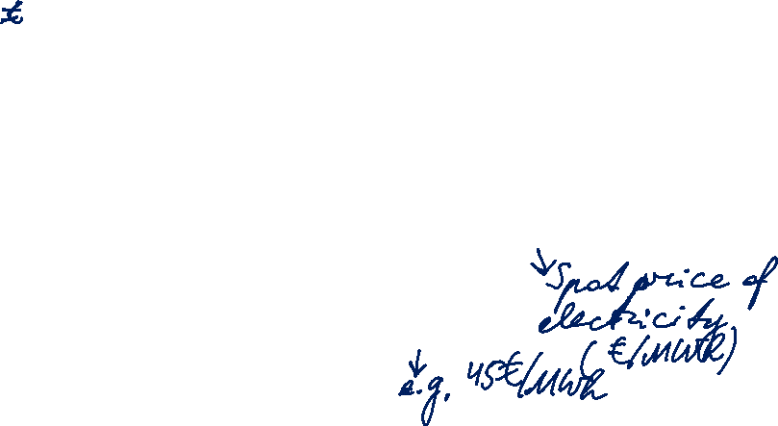
Put Option Payoff
Notes:
Zweifel, p. 292

Slide 8

Put Option Profits
Notes:
Zweifel, p. 292

Slide 9
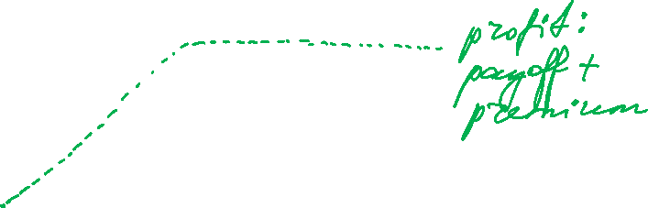
Put Option Writer’s Payoffs
Notes:
Zweifel, p. 292

Slide 10
Call Option Payoffs
Notes:
Zweifel, p. 292

Slide 11
Call Option Profits
Notes:
Zweifel, p. 292

Slide 12

Call Option Writer’s Payoffs
Notes:
Zweifel, p. 292

Slide 13
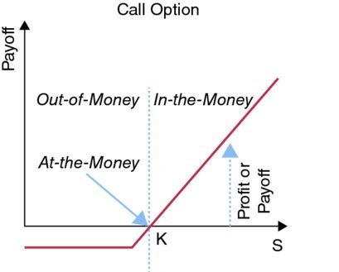
Intrinsic value of Call option
The intrinsic value of a call option is the difference between the underlying asset price and the strike price.
The call option is in-the-money if
S_{T} > K
where:
  S_{T} is price of underlying asset at time T
  K is the strike price
Source: Mack, Energy trading and risk management, 2014
Notes:
Zweifel, p. 292

Slide 14
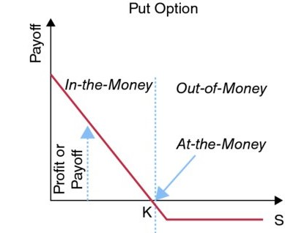
Intrinsic value of Put option
The intrinsic value of a put option is the difference between the strike price and the underlying asset’s price.
A put option is in-the-money if
S_{T} < K
where:
  S_{T} is price of underlying asset at time T
  K is the strike price
Source: Mack, Energy trading and risk management, 2014
Notes:
Zweifel, p. 292

Slide 15
Options terminology (continued)
In-the-money: positive payoff in case of option excercise.
At-the-money: zero payoff in case of option excercise.
Out-of-the-money: negative payoff in case of option excercise.
Call option is in-the-money if strike price < spot price.
Put option is in-the-money if strike price > spot price.

Slide 16
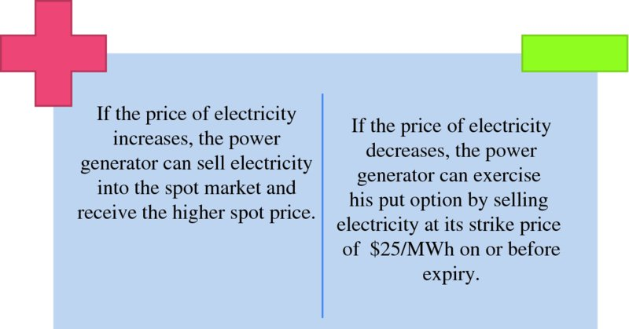
Generator hedging with put options
A power generator uses put options to guarantee a minimum selling price for its generated electricity. Suppose the electricity futures contract price is $25/MWh. The power generator wishes to receive at least $25/MWh for the physical sale of power. To accomplish this, the power generator purchases a put option for a premium of $1/MWh.
Source: Mack, Energy trading and risk management, 2014
Notes:
Zweifel, p. 292

Slide 17
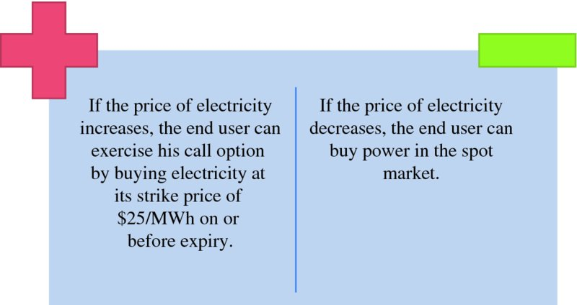
Consumer hedging with call options
A power consumer can hedge against price increases by purchasing a call option. Suppose the electricity futures contract price is $25/MWh. The end user wishes to pay no more than $25/MWh. To accomplish this, the end user purchases a call option for a premium of $0.75/MWh.
Source: Mack, Energy trading and risk management, 2014
Notes:
Zweifel, p. 292

Slide 18
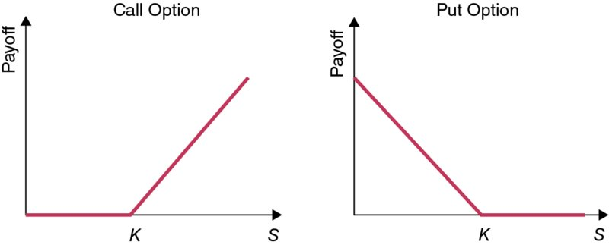
Put-Call parity
European options with identical strike price, expiration date and underlying asset:
Call price + Strike price = Futures price + Put price
(assuming that there is no arbitrage opportunity)
Notes:
Zweifel, p. 292

Slide 19
Put-Call parity
For two European options – call and put – with identical strike price, expiration date and underlying asset:
C(t) is the value of the call at time t
P(t) is the value of the put at time t, that has the same expiration date as that of the call
S(t) is the price of the underlying asset at time t
K is the strike price
B(t, T) is the risk-free interest rate (present value at time t of a zero-coupon bond that matures to $1 at time T – present value factor for K)
Notes:
Zweifel, p. 292

Slide 20
Option value
Intrinsic value – the value the option would have if it was excercised immediately:
  Call: Max[S_{T} – K, 0]
  Put: Max [K – S_{T}, 0]
Speculative value (time value):
  The difference between the option premium and the intrinsic value of the option.
Option
Premium
Intrinsic
Value
Speculative
Value
=
+
Notes:
Zweifel, p. 292

Slide 21
Asset-backed trading
Interaction between physical production and electricity contracts:
Contracts build up a replicating portfolio of a power plant
flexible production units (e.g. gas) relate to options
inflexible productions units (e.g. coal) relate to futures
Trading on both electricity and fuel markets
Portfolio analysis and physical production limits
Power portfolio differs substantially from a traditional financial portfolio.

Slide 22
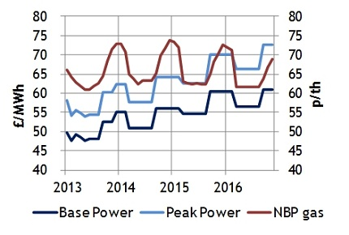
UK Base and Peak power and NBP gas curves
Source: ICE monthly futures

Slide 23
Spark spread
Spark spread is the gross margin of a gas-fired power plant from selling a unit of electricity, having bought the fuel required to produce this unit of electricity. (peak load electricity future – gas future, corrected by power plant efficiency)
Clean spark spread is the gross margin after substracting the cost of CO₂ emissions.
Hedging: Buying gas and emission allowances on forward markets

Slide 24
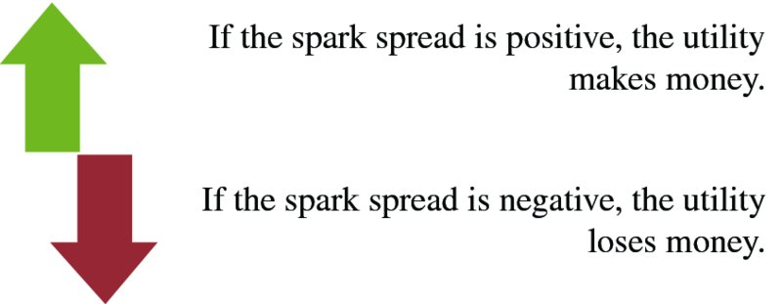
Spark spread (continued)
The value of a strip of spark-spread options gives the value of the power plant over a given time period.
This value will be higher than that calculated based on DCF method due to embedded real options valuation (additional value of the flexibility to shut down the power plant at times of unfavourable prices).
Source: Mack, Energy trading and risk management, 2014

Slide 25
Spark spread (continued)
Price of gas
Spark spread = Price of electricity –
Efficiency factor
Spark spread > 0: It is more economical to buy gas
Spark spread < 0: It is more economical to buy power from the grid
  Underlying assumptions:
  no transaction costs
  no electricity transmission costs (where relevant)
  no gas transportation costs
  no start costs (cost of starting the power plant)
Source: Mack, Energy trading and risk management, 2014

Slide 26
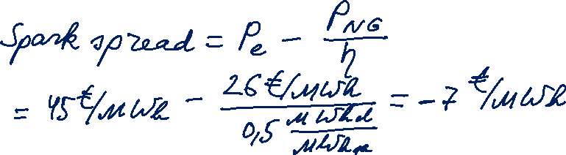
Task 1
Calculate the spark spread, given that:
  Price of natural gas = 26 €/MWh
  Price of electricity = 45 €/MWh
  Natural gas-fired power plant with
  Efficiency factor = 50%

Slide 27
Spark spread
Dark spread is the gross margin of a coal-fired power plant from selling a unit of electricity, having bought the fuel required to produce this unit of electricity.
Base load electricity future – coal future, corrected by the power plant efficiency factor
Clean dark spread is the gross margin after substracting cost of CO₂ emissions.
Hedging: Buying coal and emission allowances on forward markets

Slide 28
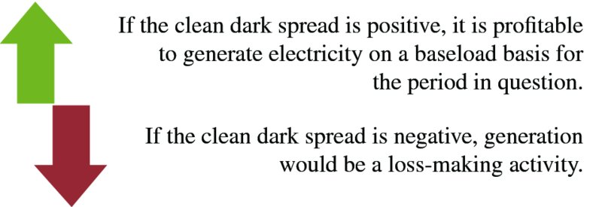
Spark spread (continued)
Source: Mack, Energy trading and risk management, 2014

Slide 29
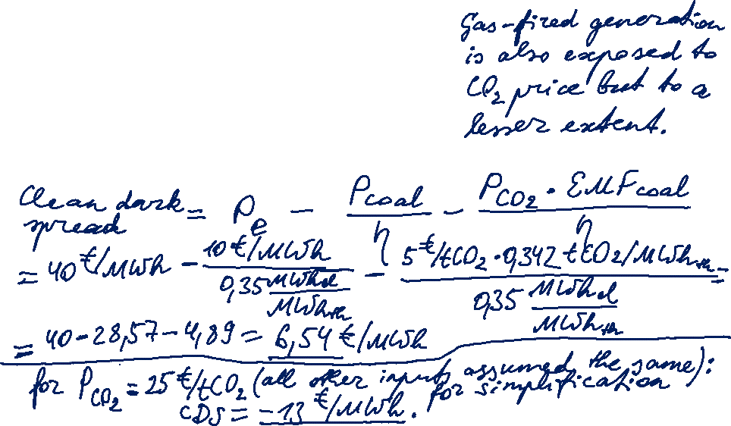
Task 2
Calculate the clean dark spread, given that:
  Price of coal = 10 €/MWh
  Price of electricity = 40 €/MWh
  Natural gas-fired power plant with
  Efficiency factor = 35%
  CO₂ emission factor = 0,342 tCO₂/MWh_{th}
  CO₂ price = 5 €/tCO₂
Please note corrected CO₂ emission factor!

Slide 30
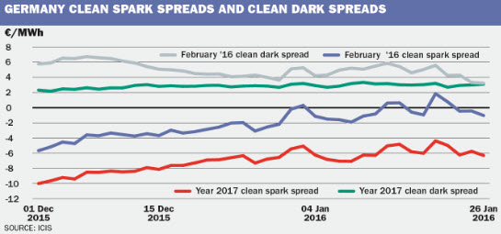

Germany Clean spark spreads and Clean dark spreads
Notes:
Zweifel, p. 292

Slide 31
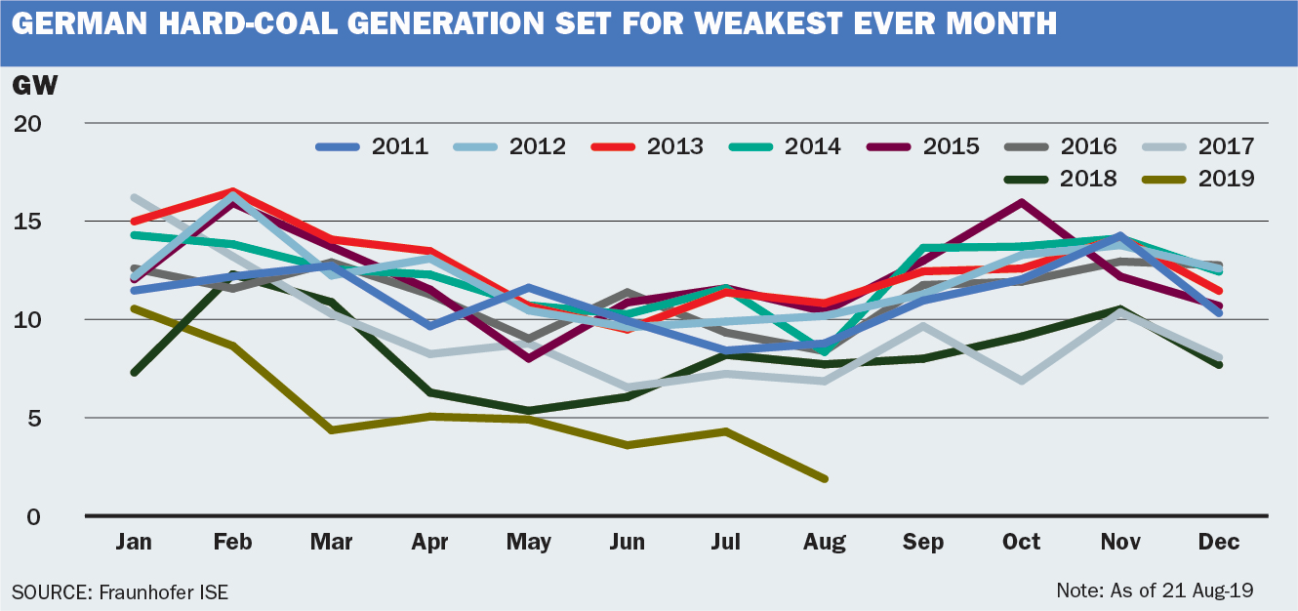
German hard-coal generation in 2019
Growing share of renewables
Lower gas prices
High CO₂ price

Slide 32
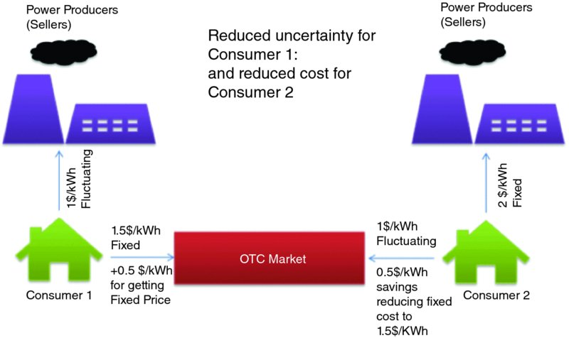
Electricity fixed-for-floating swap
aka „contract for differences“
Consumer 2 believes that the electricity price is going to fall.
By entering into the swap as floating-price payer, they hope to benefit from the expected price decrease (by receiving the difference between fixed and floating price in that case).
Consumer 1 believes that the electricity price is going to rise.
By entering into the swap as fixed-price payer, they seek to limit their electricity cost to 2 $/kWh.
Source: Mack, Energy trading and risk management, 2014
Notes:
Zweifel, p. 292

Slide 33
Energy Trading: Price and volume risk
© Prof. Dr. Georg Erdmann

Slide 34
Weather derivatives: Hedging volume risk
Weather has an impact on economic activities.
Risk for energy companies: lower sales during warm winters or cool summers
Risk for energy consumers: higher heating costs during cold winters or higher cooling costs during hot summers.
Weather exposure is the sensitivity of revenue or cost to weather indices.
Instead of an underlying price index, weather derivatives are based on weather indicators, most commonly temperature.
Source: Brockett et al, Risk Management and Insurance Review, 2005, Vol. 8, No. 1, 127-140.
Notes:
Weather risk is the uncertainty of cash flows (revenues and/or costs) caused by (noncatastrophic) weather events. Insurance provides protection (only) against capastrophic damage.

Slide 35
Weather derivatives: Weather indices
HDD: Degree day measures the deviation of a day’s average temperature from 18°C (65°F).
CAT: Cumulative average temperature is the mean of daily average temperatures over a calendar month at a given location.
Weather derivatives are traded mostly OTC
CME (Chicago Mercantile Exchange)
LIFFE (London International Financial Futures Exchange)
Source: Brockett et al, Risk Management and Insurance Review, 2005, Vol. 8, No. 1, 127-140.
Notes:
Weather risk is the uncertainty of cash flows (revenues and/or costs) caused by (noncatastrophic) weather events. Insurance provides protection (only) against capastrophic damage.

Slide 36
Intraday Trading: Passive balancing
Christopher Koch and Philipp Maskos, Passive Balancing through Intraday Trading, 2019
Please read:
  1. Introduction and 2. Background p. 1-5
  3. Data and Method p. 5-9
  6. Discussion and 7. Conclusion p. 20-22
Please identify:
Familiar facts
New facts
Authors’ research question / hypothesis
Notes:
Weather risk is the uncertainty of cash flows (revenues and/or costs) caused by (noncatastrophic) weather events. Insurance provides protection (only) against capastrophic damage.

Slide 37
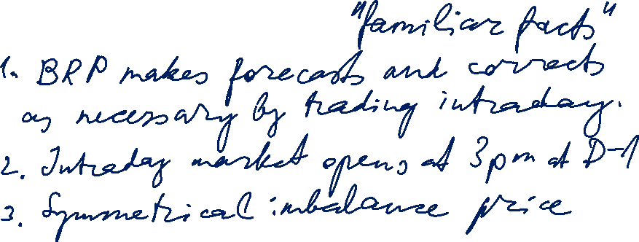
Passive balancing: Introduction
Notes:
Weather risk is the uncertainty of cash flows (revenues and/or costs) caused by (noncatastrophic) weather events. Insurance provides protection (only) against capastrophic damage.

Slide 38
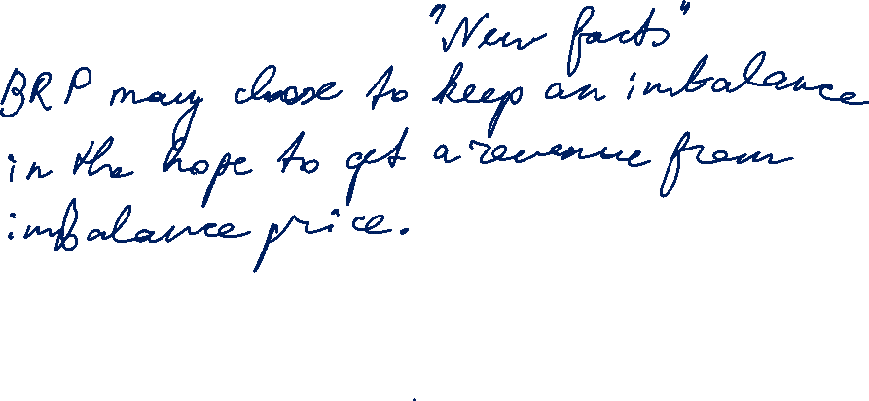
Passive balancing: Introduction
Notes:
Weather risk is the uncertainty of cash flows (revenues and/or costs) caused by (noncatastrophic) weather events. Insurance provides protection (only) against capastrophic damage.

Slide 39
[Backup] Unplanned generation unit outage:
Impact on merit order
Source: Morey, EEI, 2001, p. 37.

Slide 40
[Backup] Control power markets
Source: Hirth, Ziegenhagen / Renewable and Sustainable Energy Reviews 50 (2015), p.1039

