Slide 1
Integrated course „Energy Economics“
- Economics of Electrical Grids
Chair of Energy Systems
Prof. Dr. Boris Heinz | Dr. Elena Timofeeva
elena.timofeeva@tu-berlin.de

Slide 2
Outline
Grid structure and system operator tasks
System services
Markets for control power
Congestion management
Grid access
Grid tariff regulation
Security of supply

Slide 3
Categories of power grids
© Prof. Dr. Georg Erdmann

Slide 4
Tasks of system operator
Grid operation
system security
reliability
cost-efficiency
Grid extension
Various organisational set-ups in different countries
Unbundling see class on electricity markets fundamentals

Slide 5
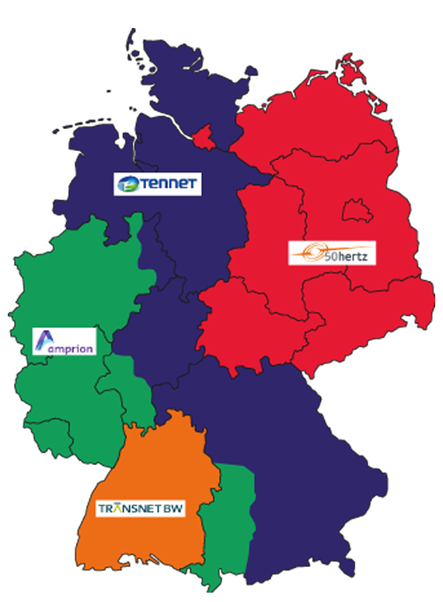
Germany’s electrical grid
4 TSOs
approx. 900 DSOs

Slide 6
Regionalisation of generation and load
© Prof. Dr. Georg Erdmann

Slide 7
Grid extension Germany
Source: BNetzA, 2019

Slide 8
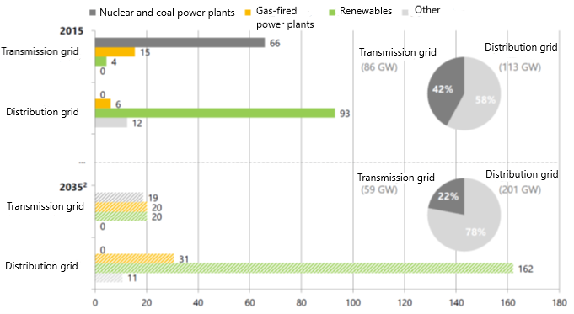
Energy transition in distribution grids
² 50Hertz, Energiewende Outlook 2035, 2016 Source: E-Bridge, MITNETZ Strom, 2016
Notes:
Installed generation capacities connected to distribution grid prevailed over transmission grid already in 2015. This trend will continue with the growing RES share.

Slide 9
Energy transition in distribution grids
More complexity for the DSO tasks:
Congestion management
Voltage control
Grid restauration after blackout
(Frequency control – only in isolated systems)
Notes:
Installed generation capacities connected to distribution grid prevailed over transmission grid already in 2015. This trend will continue with the growing RES share.

Slide 10
Nuclear phase-out in Germany
Power plant | Operating until | Installed capacity (MW)
Philippsburg 2 | 2019 | 1.402
Grohnde Gundremmingen C Brokdorf | 2021 | 1.360 1.288 1.410
Isar 2 Emsland Neckarswestheim 2 | 2022
Source: BNetzA, Monitoringbericht 2018

Slide 11
Fossil generation
Coal phase-out by 2038
Power plant | Operating until | Installed capacity (MW)
Jänschwalde E Neurath C | 2019 | 757 (in total)
Hard coal power plants Gas-fired power plant Lignite p/plant block Other technologies | 2021 | 852 MW in total 760 11 14 67
Source: BNetzA, Monitoringbericht 2018
Notes:
Coal phase-out until 2038

Slide 12
System services
Frequency control
Voltage control
Black-start capacities for grid restauration after black-outs
Compensation for transmission losses
Cross-border interconnection management
General modes of provision:
Compulsory
Bilateral
Tendering
Wholesale market

Slide 13
Markets for control power
Control power markets serve for frequency control.
Frequency is determined by balance of supply and demand.
Target frequency in Europe: 50 Hz
Excessive demand → frequency drops → positive balancing energy is procured by TSO
Excessive generation → frequency rises → negative balancing energy is procured by TSO
Source: Zweifel / Praktiknjo / Erdmann, 2017

Slide 14
Netting of balancing power
© Prof. Dr. Georg Erdmann

Slide 15
European balancing markets
European balancing target model has following goals:
Effective competition
Non-discrimination
Transparency
Integration
European platforms and projects under development:
IGCC, International Grid Control Cooperation – imbalance netting
PICASSO, Platform for the International Coordination of Automated Frequency Restoration and Stable System Operation – aFRR
MARI, Manually Activated Reserves Initiative – mFRR
TERRE, Trans-European Restoration Reserves Exchange – RR

Slide 16
Markets for control power
Balancing service providers:
generators
demand response providers
storage facilities operators
System imbalance vs BG imbalance
Source: ENTSO-E, 2018
Notes:
Each BRP is responsible for their individual position.

Slide 17
Balancing market processes
+ Imbalance netting (IN): exchange of imbalances between TSOs
Source: ENTSO-E, 2018
Notes:
Each BRP is responsible for their individual position.

Slide 18
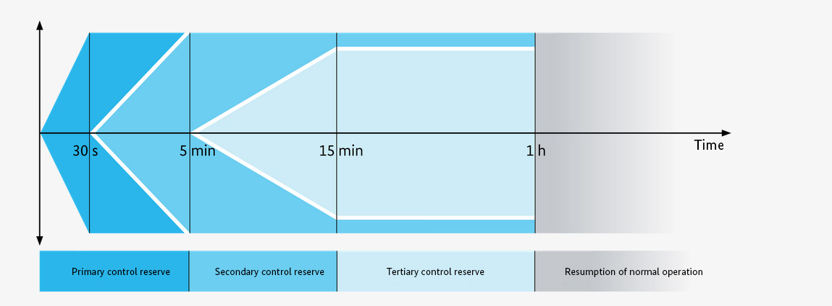
Markets for control power
Source: Bundesnetzagentur
Notes:
Positive balancing energy – additional generation or less consumption.
Negative balancing energy – less generation or additional consumption.

Slide 19
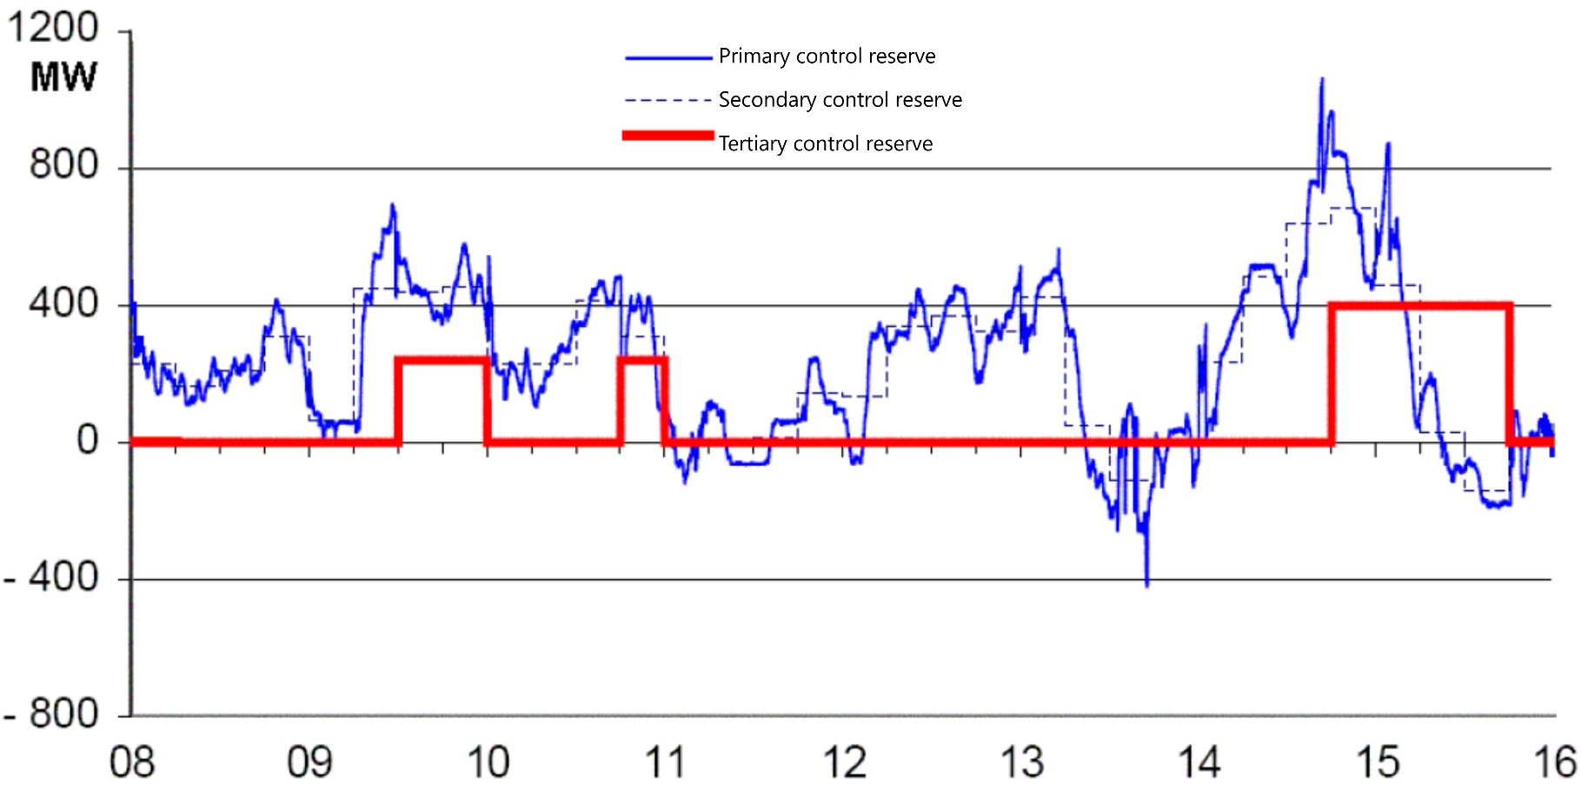
Utilisation of control power
© Prof. Dr. Georg Erdmann
Notes:
Positive balancing energy – additional generation or less consumption.
Negative balancing energy – less generation or additional consumption.

Slide 20
Control power markets
Primary reserve – procured in weekly auction (Tue)
Secondary and tertiary reserves are procured in pay-as-bid auctions.
Prequalification required for participating in the control power markets.
Primary reserve
until Tue 15:00 for Mo from 00:00
Time blocks: one week
Secondary reserve
daily until 8:00 for following day from 00:00
Time blocks: six 4-hour blocks
Minute reserve
daily until 8:00 for following day from 00:00
Time blocks: six 4-hour blocks

Slide 21
Control power markets
Source: Zweifel / Praktiknjo / Erdmann, 2017
Entry barriers are in focus of market design.

Slide 22
Cost allocation of control power
© Prof. Dr. Georg Erdmann
Notes:
Socialisation of balancing power capacity costs

Slide 23
Control power markets
Link between energy and anciliary services:
A supplier can choose to either use a certain generation unit for supplying electricity on the wholesale market or offer its generation capacity on the control power market – not both simultaneously.
Generator’s costs:
higher fuel consumption
higher wear and tear
etc.

Slide 24
Opportunity costs: Energy vs. Ancillary Services
Source: Morey, EEI, 2001, p. 52.

Slide 25
Control power markets
Source: Hirth, Ziegenhagen / Renewable and Sustainable Energy Reviews 50 (2015), p.1039

Slide 26
Congestion management
Congestion management relieves expected grid bottlenecks due to limited transmission capacity by correcting (cost-based) power plant dispatch decisions.
Countertrading
TSO counter-trades against the flow of congestion between bidding zones.
Redispatch
ramping up certain power plants while ramping down certain other power plants
Feed-in management (Einsman)
ramping down renewable power plants
Grid reserve
power plants kept available for service but not operational
against remuneration

Slide 27
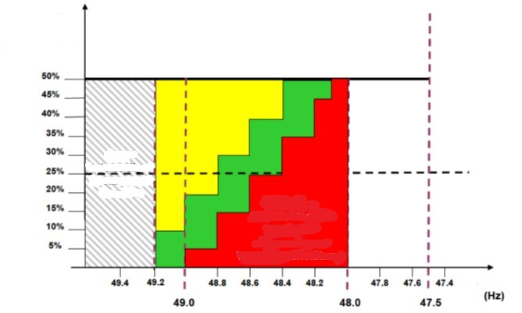
Automatic frequency control
Automatic low frequency demand disconnection scheme
Load to be diconnected
Disconnecting load is not required at this level.
Minimum required % of load to be disconnected
Frequency
Source: VNN VDE

Slide 28
Grid restoration
Grid operator coordinates grid restoration after a black-out by step-by-step activation of generation units and matching (appropriate) loads.
Blackstart capability: while most power plants require electricity to get running after a black-out, certain generation units are able to start operation when disconnected from the grid.
Associated costs for blackstart capability provider:
Maintenance
Regular tests
Personnel and training
Documentation

Slide 29
Access to electrical grids
Grid operation is a natural monopoly, as network infrastructure is prohibitively costly to replicate.
As any monopoly, it is prone to eliminating newcomers (potential competition for affiliated generation/retail unit) by overcharging or denying technical feasibility.
Non-discrimination
Transparency
Cost recovery
Cost reflectiveness
Grid is an essential facility.
→ non-discriminatory third-party access
Source: Lévêque, 2010
Notes:
Economies of scale: single firm can transport any amount of electricity at least cost.

Slide 30

Electrical grid as a natural monopoly
Source: Zweifel / Erdmann / Praktiknjo, 2017
Notes:
Average cost declines with rising quantity.
Downward sloping demand function (vs. price-taker under perfect competition)
Average revenue = price
Marginal revenue is always less than the price.
Increased amount tends to increase total revenue; the lower price tends to decrease total revenue.
Marginal revenue curve lies below demand curve.
Profit maximisation: Quantity at which marginal revenue equals marginal cost. Price corresponding to that quantity on the demand curve.

Slide 31
Grid tariff regulation: Regulation approaches
Regulation approach
Cost-based
Incentive-based
Cost-plus:
a pre-defined profit margin is added to the costs
Rate-of-return:
a pre-defined rate of return on the regulatory asset base is guaranteed.
RAB is determined by amount of invested capital and cost of capital.
Price cap:
max. prices (per unit) are determined for the regulatory period
Revenue cap:
higher profit realised within allowed revenues, the regulated entity keeps it.
Quality regulation: indicators for service quality and reliability
Notes:
Water wheel converts kinetic energy of water is converted into mechanical movement.

Slide 32
Averch-Johnson effect (1)
© Prof. Dr. Georg Erdmann
Notes:
Principle-agent problem

Slide 33
Averch-Johnson effect (2)
© Prof. Dr. Georg Erdmann

Slide 34
Incentive regulation in Germany
5-year regulatory period (current period 2019-2024)
Revenue that TSO/DSO is allowed to earn is fixed for the regulatory period at a level.
Revenue cap: total cost + depreciation + return on equity
Investment costs into grid extension are allowed above cap.
Costs:
permanently non-controllable
temporarily non-controllable
controllable
volatile
Efficiency benchmarking – based on cost examination and structural data validation of individual TSO/DSO
The most efficient entity as benchmark

Slide 35
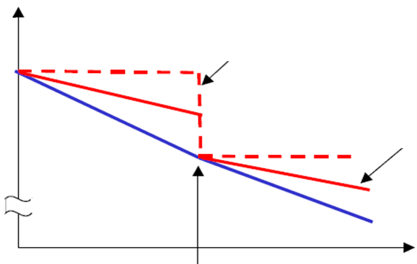
Incentive Regulation
Revenue
costs
Revenue without anticipated cost reductions
Revenue with anticipated cost reductions
Tariff
regulation
Time
© Prof. Dr. Georg Erdmann

Slide 36
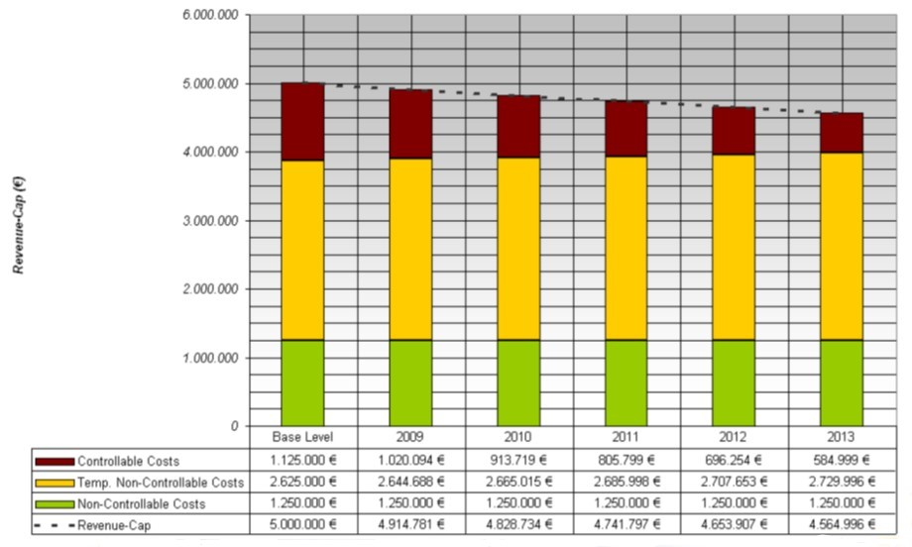
Incentive Regulation in Germany (cont.)
Source: CEER/BNetzA (2014)

Slide 37
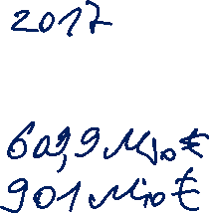
Composition of grid tariffs
O&M
Grid extension
Control power (capacity component)
Feed-in management (Einsman)
Redispatch
Grid reserve
Capacity reserve
Security reserve (coal/climate reserve)
Reactive power
Grid losses
Other

Slide 38
Cost allocation of control power
© Prof. Dr. Georg Erdmann

Slide 39
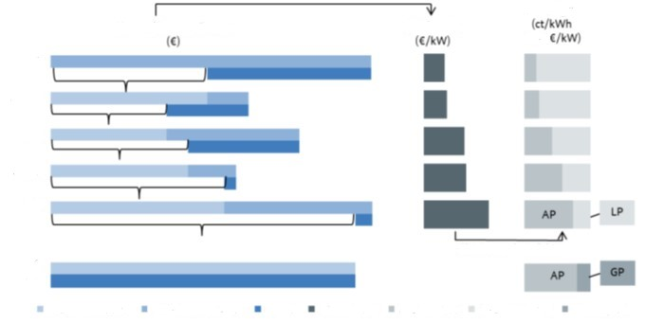
Grid tariffs structure
Starting point
divided by annual Pmax (kW)
Grid tariffs
Cost/revenues of grid level
Total annual cost
HV
HV/MV
MV
MV/LV
LV
LV without power measuring
simultaneity factor
transferred cost
own cost of
Grid level
total annual cost (€/kW)
energy
price (AP)
power
price (LP)
basis
price (BP) (household consumers)
revenues
Starting from the highest voltage level, part of the grid costs (based on that level’s aggregated annual consumption peak – Pmax) are paid by grid users connected to that grid level. The residue is transferred to and distributed after the same logic – etc.
Source: BNetzA, 2015
Notes:
Grid tariffs are determined top-down for each grid level.

Slide 40
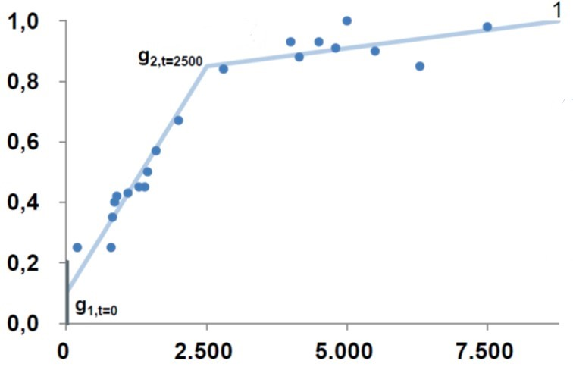
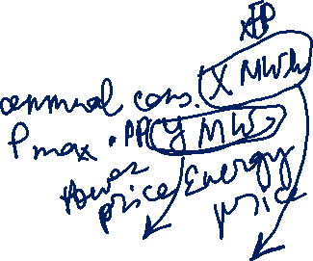
Simultaneity (diversity) function
Grid users with low FLH pay lower power price (PP) and higher energy price (EP)
Grid users with high FLH pay higher PP and lower EP
FLH | PP [€/kW*a] | EP [ct/kWh]
< 2.500 | a | x
> 2.500 | b | y
Source: BNetzA, 2015

Slide 41
Security of supply indicators
SAIDI – System Average Interruption Duration Index
SAIFI – System Average Interruption Frequency Index
MAIFI – Momentary Average Interruption Frequency Index
ENS – Energy Not Served – amount of demand not served
LLD – Loss of Load Duration – number of hours of ENS
LOLE – Loss of Load Expectation
ENTSO-E Mid-term adequacy forecast
Notes:
Unplanned interruptions

Slide 42
SAIDI – System Average Interruption Index
Unplanned SAIDI, including exceptional events (minutes per customer)
(2002 or later – 2016)
Source: CEER, 2018

Slide 43
Reliability and Investment policy
Price spikes induce investment into new generation capacities, which supports reliability.
The duration and height of the price spikes are determined by regulatory framework.
Sufficiently high prices for a sufficient number of hours per year have to be ensured, so that generators can cover their fixed costs and invest into new generation capacities.
The market on its own would underinvest, and reliability would suffer.
Prices charged by the system operator is the limit that consumers are willing to pay.
Source: Stoft, 2002

Slide 44
Benefits of grid integration (positive externalities)
Backup generation available in case of a power plant failure
More uniform aggregated load leads to more regular power plant operation
Economies of scale for power plants
Long-distance transmission reduces grid losses

Slide 45
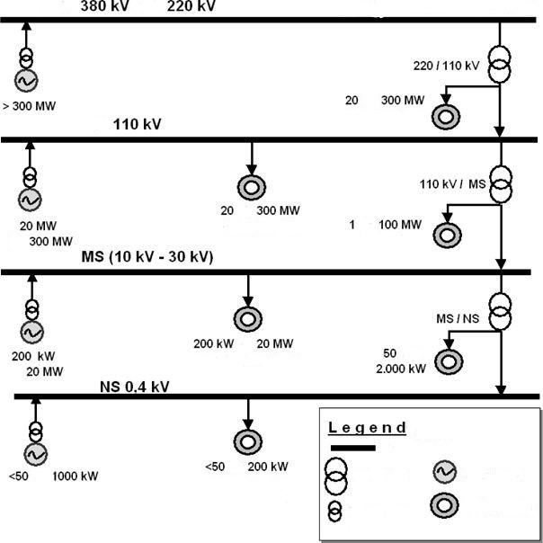
[Backup] Electrical grid structure
Extra-high voltage
&
(Europe’s interconnected electricity grid)
-
High voltage
Large industry
-
-
Large industry
-
Medium voltage
Industry
-
-
-
Industry, Commercial
Low voltage
grid level
-
-
mains
transformer
power plant
Households,
Small Enterprises
consumer
Source: translated from Konstantin, 2017.
generator
transformer

