Slide 1
Integrated course „Energy Economics“
- Energy Trading
Chair of Energy Systems
Prof. Dr. Boris Heinz | Dr. Elena Timofeeva
elena.timofeeva@tu-berlin.de

Slide 2
Outline – Electricity Trading
Role of energy trading
Submarkets and trading forms
Trading products
Balance group concept
Credit risk management
Market transparency
Cross-border trading
Trading strategies

Slide 3
Trade life cycle - OTC
Deal conclusion → (Confirmation) → Nomination → Settlement
Possible by any means of communication:
written contract
via phone (on recorded line) – with or without broker
via email
via electronic broker platform (screen)
Deal capture in the company’s trading system
In case of non-written deal conclusion for forward transactions
Objective: align the parties’ understanding of the terms of the transaction > identify and resolve any discrepancy before delivery
Delivery obligations are performed by nominating to TSO:
Trader (balance responsible party) submits (net) delivery amount with each counterparty for each day before 14:30h on D-1
Invoice and payment for each delivery month in the following month
Standardised payment terms:
Invoice in the beginning of the following month; payment date on the 20th (5th working day for financial contracts)

Slide 4
Trade life cycle - EEX
EPEX SPOT transmits trade information to the central counterparty European Commodity Clearing (ECC) for settlement and delivery.
ECC nominates deliveries to the relevant TSO on behalf of the exchange member until applicable nomination deadline (14:30 pm).
Souce: EPEX SPOT

Slide 5
Balancing group: Linking the virtual and physical worlds
Balancing group (BG) is a virtual energy volume account associated with one or more grid users within a control area.
each grid connection point is allocated to one balancing group
balance responsible party (BRP) is responsible for balancing its BG’s saldo (feed-in and consumption) for each 15 min – incl. through trading on spot markets
deviations are penalised by imbalance fees
Analogy to a bank account:
TSO | ≈Bank
Balance responsible party | ≈Account holder
EIC | ≈Account number
Balancing circle | ≈Bank account
Energy deliveries | ≈Payments
Notes:
Control area is a power system or part thereof within a certain geographical area that is operated by one TSO.
BG focuses on electricity amounts only – not the prices.
Any imbalance that BRP is not able to mitigate through trading, is tackled by TSO via ancilliary services.

Slide 6
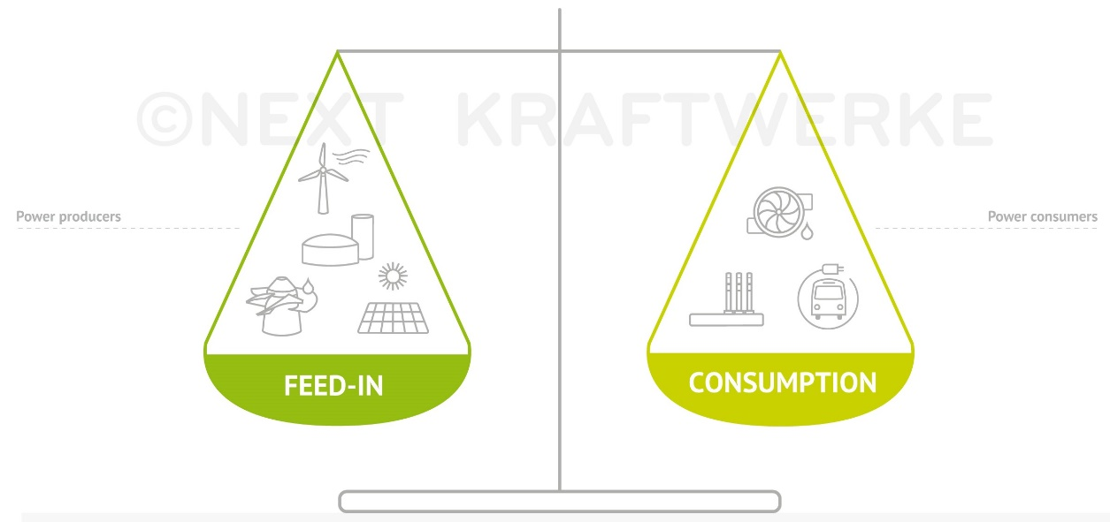
Balancing group (continued)
Trading on transmission grid level, i.e. performing delivery by scheduling to TSO, assumes no physical restrictions within a market area.
Depending on the nature and composition of a balancing group, the BGR transmits to the TSO forecasted load or generation and/or buy and sell amounts.
Imbalance fee is uniform for the control area (in Germany: for all four control areas), symmetric and based on actual activation of control power.
Notes:
Imbalance vs control power

Slide 7
Market roles and processes at TSO level
© Prof. Dr. Georg Erdmann
Notes:
Imbalance vs control power

Slide 8
Market roles and processes at DSO level
Default/
© Prof. Dr. Georg Erdmann
Notes:
Imbalance vs control power

Slide 9
Tasks of the Balancing group management
© Prof. Dr. Georg Erdmann
Notes:
Imbalance vs control power

Slide 10
Reasons for imbalances
Unplanned outage of generation units
Unplanned outage or activation of large loads
Forecast gap in volatile RES generation
Inaccurate forecast of demand
≈
Notes:
Imbalance vs control power

Slide 11
Credit risk management: Terminology
„Exposure is a measure of loss if an adverse materialisation of uncertainties occurs for a particular decision.“ *
Mark-to-market accounting is regular (daily) valuation of all open trading positions based on the current market price of the product.
* Perreira et al, IEEE Computer Applications in Power, vol. 13, 2000, p. 22

Slide 12
Credit risk management: Credit risk exposure – OTC
transaction date
delivery period
counterparty default
payment date for M1
Product: Q4 2019
Settlement exposure: delivered but unpaid amount * contract price (≈50 days; credit exposure updated after payment)
Mark-to-market exposure: contract amount from default date until end of delivery period * mark-to-market
Credit exposure for a portfolio depends on the netting rules:
Does the jurisdiction of the counterparty allow cherry-picking, i.e. performing under in-the-money transactions and dropping the ones that are out-of-the-money?
20th
M-1
M1
M2
M3
t
Notes:
MtM risk may aggravate or reduce credit risk exposure.
Settlement exposure is much lower for financial products compared to physical ones.

Slide 13
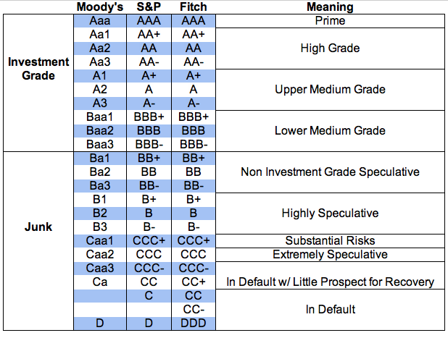
Creditworthiness: Long-term corporate credit ratings

Slide 14
Creditworthiness: Financial ratios
EBIT to Interest – interest coverage ratio
Funds from operations to Total debt
Total debt to Total capitalisation – leverage ratio
Credit risk management involves continuous monitoring of each counterparty‘s creditworthiness and utilisation of the credit line by outstanding (live) trading transactions.
Breach of pre-agreed threshold indicators for creditworthiness triggers a credit call – request to provide additional colateral.

Slide 15
Colateral types
Stand-alone credit line – no initial colateral
Parent company guarantee
Stand-by letter of credit
Bank guarantee
Cash collateral
Colateral amount:
Expected loss given default = Expected value of collateral
Collateral cost:
= Unencumbered asset return – return on posted collateral
Creditworthiness impacts transaction costs.

Slide 16
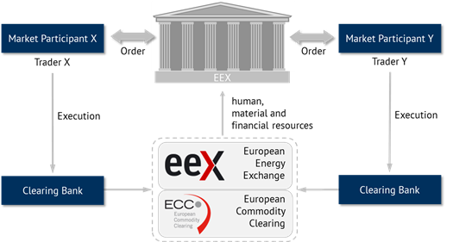
Clearing
Source: Energy Brainpool
Notes:
EEX, as Central Counterparty, covers counterparty risk of their customers

Slide 17
Clearing (continued)
Clearing is performed by European Clearing Counterparty (ECC).
Credit risk exposure is determined similarly to OTC trading.
Margining is the process of continuously recalculating the credit exposure under open positions based on the current market price and adjusting the amount of collateral required to cover it.
Initial margin: cash collateral or other first-class guarantee to ensure that the exchange member fulfills their obligations under open transactions.
Variation margin: daily margining based on mark-to-market calculation – resulting into a margin call as necessary.
Risk of clearing banks is limited to overnight risk.

Slide 18

Clearing at EEX (via ECC)
Source: ECC

Slide 19
Margining process
To cover the counterparty risk, each trader is obliged to sustain a margin account at the energy exchange (or the clearing house). In addition, the trader has to open a maintenance account and to transfer an initial margin that depends, among others, on the expected volume of his open positions
If a trader holds an open position and the futures price exceeds the contracted price, the clearing house transfers the price difference times contract size from the maintenance account to the margin account of the seller and from the margin account to the maintenance account of the buyer.
© Prof. Dr. Georg Erdmann

Slide 20
Margining process (continued)
Debits and credits are adjusted at the end of each trading day according to the market price at closure
If the maintenance account drops below a maintenance margin, the trader has to remargin the maintenance accounts within short time. Otherwise all open positions of the trader are closed by the clearing house at market conditions
© Prof. Dr. Georg Erdmann

Slide 21
Calculation of Spot Margin
Spot Initial Margin (IMSM) is called for expected transactions.
The daily exposure at day t comprises all spot transactions that have been concluded between the accounting cut-off of the previous ECC business day and the latest point in time where a trading participant in default would be suspended from trading.
Source: ECC
Notes:
IMSM is based on statistical daily exposures.

Slide 22
Market transparency: REMIT
EU Regulation No 1227/2011 on wholesale energy market integrity and transparency (REMIT) Art. 4:
Market participants are obliged to publicly disclore in an effective and timely manner inside information regarding business or facilities that they control or operate for production, storage, consumption or transmission (of electricity and gas). Information relevant to the capacity and use of facilities, incl. planned or unplanned availability.
Prohibited activities:
Insider trading → non-discriminatory disclosure of inside information (see above); prohibition to trade or recommend trading on its basis unless published
Market manipulation: giving misleading signals as to supply, demand or price; actions to secure an artificial price level (incl. in collusion with other market participants/persons)
Notes:
Goal is to ensure that wholesale prices reflect a fair and competitive interplay between supply and demand, and no profits can be drawn from market abuse (REMIT rec. (1)).

Slide 23
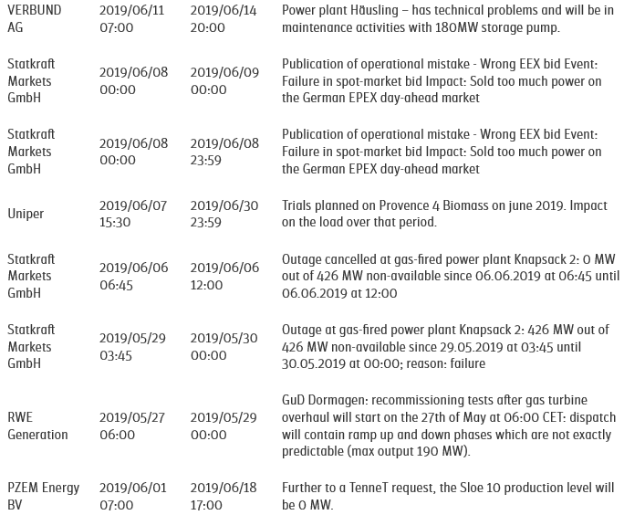
EEX Market transparency platform
← unplanned maintenance of an Austrian storage pump power plant
← to avoid accusation of attempted market manipulation
← short outage of a gas power plant
← redispatch for a Dutch CCGT
Source: www.eex-transparency.com

Slide 24
European single market for electricity
Goal: Creation of a Single market for electricity in Europe
Technical constraints lead to congestion
Adequate allocation of this scarce resouce:
Congestion management
Curative measure:
  Redispatch
Pre-emptive measure:
  Explicit auctions
  Implicit auctions
© Prof. Dr. Georg Erdmann
Notes:
Imbalance vs control power

Slide 25
Benefits of market integration
Level out price differences between bidding zones
Strengthen competition between suppliers
Improve system integration of volatile RES
Improve network security
Notes:
Imbalance vs control power

Slide 26
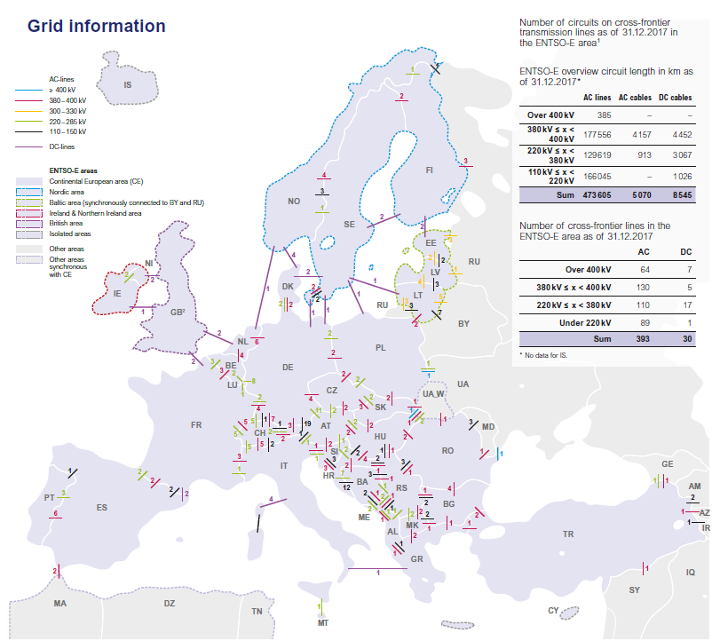
Interconnection lines Europe
≈
Source: ENTSO-E, 2017
Notes:
Imbalance vs control power

Slide 27
Trade among different bidding zones (1)
≈
© Prof. Dr. Georg Erdmann
Notes:
Imbalance vs control power

Slide 28
Trade among different bidding zones (2)
≈
Notes:
Imbalance vs control power

Slide 29
Trade among different bidding zones (3)
≈
Notes:
Imbalance vs control power

Slide 30
Crossborder transmission capacity trading
Goal: efficient allocation of cross-border transmission capacities in order to optimise social welfare.
Explicit auction: transmission rights are auctioned separately and independently from the electricity market.
annual, monthly and daily auctions
bilaterally or via exchange
Implicit auction: transmission rights and energy are coupled and traded simultaneously (i.e. buyers bid for electricity supplied by generators from the neighbouring market area). The price per area reflects both the cost of energy and congestion.
via exchange
≈
Notes:
Imbalance vs control power

Slide 31
Explicit auction
≈
© Prof. Dr. Georg Erdmann
Notes:
Imbalance vs control power

Slide 32
Implicit auction
≈
© Prof. Dr. Georg Erdmann
Notes:
Imbalance vs control power

Slide 33
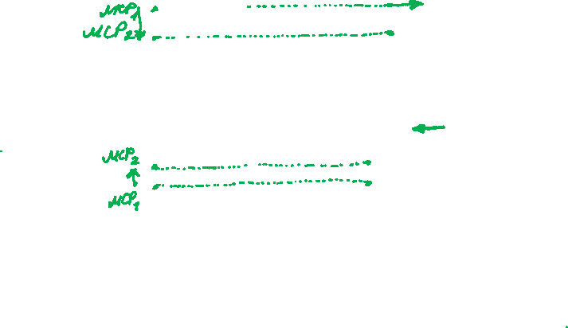
Example of trading between two markets
≈
© Prof. Dr. Georg Erdmann
Notes:
Imbalance vs control power

Slide 34
Example of trading between two markets (continued)
≈
© Prof. Dr. Georg Erdmann
Notes:
Imbalance vs control power

