Slide 1
Integrated course „Energy Economics“
- Energy Trading - Wholesale markets for electricity
Chair of Energy Systems
Prof. Dr. Boris Heinz | Dr. Elena Timofeeva
elena.timofeeva@tu-berlin.de

Slide 2
Outline – Electricity Trading
Role of energy trading
Submarkets and trading forms
Trading products
Balance group concept
Trading strategies
Credit risk management

Slide 3
What is energy trading
Trading is buying and selling, i.e. exchanging commodities.
Electricity is a homogeneous product – uniform and standardised: a commodity.
Other commodities: agricultural (wheat, coffee), metals (gold, steel) etc.
Other energy commodities: natural gas, crude oil, LNG, coal Related markets: freight, CO₂ emission allowances
Energy trading has parallels to financial markets (shares, bonds and other financial instruments) – even with its particularities due to the physical nature of electricity (gas/oil/coal etc.) as underlying.
Notes:
Market participants are buying and selling at the same time – in contrast to supplier – final consumer relationship. Purchased commodity can be resold.

Slide 4
Energy trading and Financial markets
Martingale hypothesis: ideal condition of an efficient market where no players are supposed to have a reasonable chance to profit from trading activities.
Future prices cannot be predicted based on historical prices.
The best prediction of tomorrow’s price P_{t+1} is today’s price P_{t}.
The unique reason for a change in price is arrival of “news” not correlated with information available at time t.
Transparency (availability of information to all market participants) is a crucial prerequisite for efficient market functioning.

Slide 5
Trading forms: Exchange vs. OTC
Mediated trading: power pool or power exchange
organised auction resulting in a uniform price
highly standardised products; no room for negotiation
transparency
regulated
clearing and colateral costs
Bilateral trading: over-the-counter (OTC)
intermediation cost (opportunity cost or broker fee)
individual prices agreed between pairs of buyers and sellers
(≈pay-as-bid principle)
standard framework agreements: EFET/GTMA; ISDA; DRV etc.
unregulated
Typically: Combination of exchange and OTC trading.
Notes:
Transparency: exchange publishes traded volumes and prices.

Slide 6
Energy trading: Submarkets
Time
Delivery time (t0)
Forward /
Futures /
Term
Spot /
Short-term /
Cash
Day-ahead
Intraday
years, quarters, months ahead of delivery
day ahead delivery
up to 45 min ahead of delivery
Notes:
Transparency: exchange publishes traded volumes and prices.

Slide 7
Energy Trading: Submarkets
Time
Delivery time (t0)
EEX Futures
until 24:00 on the last day of M-2
Mo-Fr (no trading on weekend and public holidays)
Day-Ahead Auction EXAA
until 10:12
hours and 15 min
Mo-Fr (no trading on weekend and public holidays)
Day-Ahead Auction EPEX Spot
until 12:00 on D-1
hours and blocks
Intraday Auction EPEX Spot
until 15:00 on D-1
15 min
Intraday continuous EPEX Spot
from 15:00 on D-1 until 5 min before t0
15 min [16:00 D-1 until 5 min before t0)
Exchange
Bilateral
Forward / Term
Spot / Short-term
until 15 min before t0 across control areas; immediately before t0 for trades within the same
control area. Forward and spot All products are negotiated bilaterally.
Control power
Primary reserve
until Tue 15:00 for Mo from 00:00
Time blocks: one week
Secondary reserve
daily until 8:00 for following day from 00:00
Time blocks: six 4-hour blocks
Minute reserve
daily until 8:00 for following day from 00:00
Time blocks: six 4-hour blocks
Source: Adapted from Next Kraftwerke
Notes:
Submarkets with different lead times between trade conclusion and actual delivery.
Forward/futures: hedging
Spot: day-ahead market, 15-min intraday auction, continuous intraday market

Slide 8
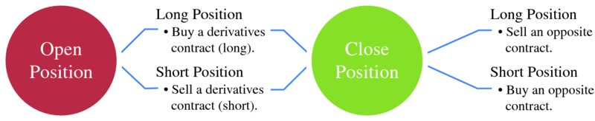
Forward markets: Continuous trading
Traders take up forward positions based on market expectations but can reverse them later up until delivery by offsetting (back-to-back) purchases or sales.
Buy a contract to cancel out an earlier sale (cover a short).
Sell a contract to close an earlier purchase (cover a long).
Source: Mack, Energy trading and risk management, 2014
Notes:
Buying a commodity at a price a year from now is a short position.
Purchasing a commodity at a market price and selling it at a fixed price: two

Slide 9
Forward markets: Long and short positions
Long position: trader benefits from a price increase.
E.g. trader buys electricity forward at today’s market price. If the market price rises, the trader will be able to sell the contract later at a higher price and realise a profit.
Short position: trader benefits from a price decrease.
E.g. trader sells electricity forward at today‘s market price. If the market price goes down, the trader will be able to buy the same product later at a lower price and realise a profit.
But: Long ≠ Buy, and Short ≠ Sell For example:
1. Buying a commodity at a price a year from now is a short position. The position benefits the trader only if the current market higher than the market price in one year (i.e. in falling price case)
2. Purchasing a commodity at the market price and selling it at a fixed price (both short) is an open position, rather than a closed one. Trader benefits from selling at a fixed price (other than the current market price) if the price falls.
See: Edwards, Energy trading & investing, 2010, p. 5

Slide 10
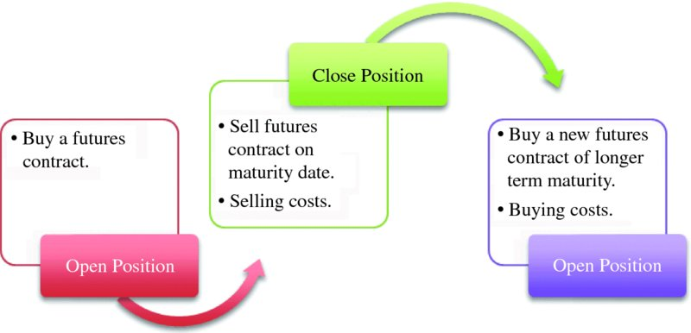
Rolling of futures
A futures trader has two options:
closing the contract on or before the maturity date (delivery period) by selling or
rolling over the contract
Source: Mack, Energy trading and risk management, 2014

Slide 11
Rolling of futures (continued)
At the beginning of the delivery period, the initial product splits into a set of equivalent shorter-term products.
Longer maturities cascade into corresponding shorter marturities.
„
„
Source: EEX Contract Specifications
Notes:
Forward=Term trading

Slide 12
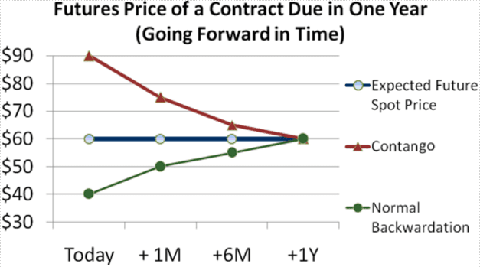
Forward market: Price development patterns
Contango: forward price exceeds the spot price.
Backwardation: spot price exceeds the forward price.
Market participants are driving the forward price up/down in line with their expectations.
Source: Mack, Energy trading and risk management, 2014
Notes:
Contango: Traders anticipate decrease in supply or increase in demand. Trading activities to hedge against the potential price increase drives the forward price up.
Backwardation: traders anticipate price decline and drive the forward price down.

Slide 13
Sample power purchase portfolio
Standardised futures do not match with typical load schedules.
© Prof. Dr. Georg Erdmann
Notes:
Flat deliveries (blocks) under forward/futures contracts are matched with actual load profile by trading in the day-ahead and intraday market (or by balancing power).

Slide 14

Portfolio management of a power retailer
© Prof. Dr. Georg Erdmann
Notes:
Flat deliveries (blocks) under forward/futures contracts are matched with actual load profile by trading in the day-ahead and intraday market (or by balancing power).

Slide 15

Day-ahead contracts for singular hours
© Prof. Dr. Georg Erdmann
Notes:
Flat deliveries (blocks) under forward/futures contracts are matched with actual load profile by trading in the day-ahead and intraday market (or by balancing power).

Slide 16
Market liquidity
Churn rate is the ratio of traded volume to physically delivered volume.
i.e. how many times the electricity generated/consumed has been traded before delivery
Bid-ask spread is the difference between the ask price (sell side) and the bid price (buy side).
Market depth is the volume of buy and sell orders.
Liquidity impacts:
the intermediation costs and the bid/ask spread
the time horizon and costs for closing a position
Notes:
Liquidity is an indicator of the market quality.
A liquid market is where you can buy or sell quickly.
Mor illiquid/thinner markets are more volatile.
The more liquid a market it, the more reliable the technical patterns.

Slide 17
EPEX Spot Day-ahead auction
Double-sided auction: bid and ask order book (order book trading)
Uniform price auction: market clearing price for each product (hour or block)
Hourly contracts and blocks (base, peak etc.)
Occurs daily at 12h for delivery on the following day (0-24h)
Price publication time: asap from 12:42h
Volume tick (min order amount/amount increment): 0,1 MWh
Min price: -500 €/MWh; Max price: 3.000 €/MWh
Notes:
Auction market is a centrally managed market (central clearing house) under uniform rules.

Slide 18
Auction design
Goal of an auction is the least-cost dispatch of generation.
Source: Morey, Power market auction design, EEI, 2001, p. 20.
Notes:
Supply offer reflects the seller’s individual supply schedule.
Demand bid reflects the buyer’s individual demand schedule.

Slide 19
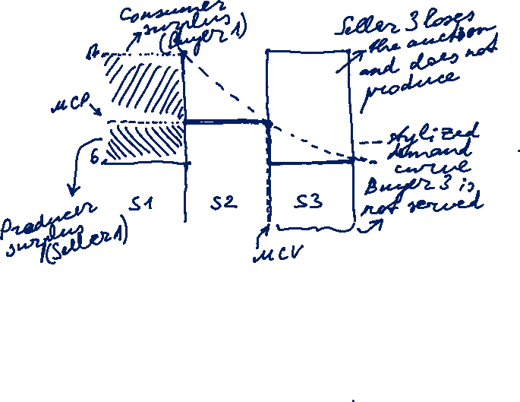
Power auction: Stylised example
$
Uniform price: market clearing price
vs Pay-as-bid: units are sold at different prices (e.g. control power)
Revenue equivalence theorem: equal outcome in both settings under the assumption that all bidders know each other’s cost (perfect information) and adjust their bidding behaviour to auction rules.
 | No. of units | Price [$/unit]
Buyer 1 | 5 | 17
Buyer 2 | 5 | 10
Buyer 3 | 5 | 6
Seller 1 | 5 | 6
Seller 2 | 5 | 10
Seller 3 | 5 | 17
15
10
5
5
10
15
Volume [units]
Source: Morey, EEI, 2001, p. 21-22.
Notes:
Supply offer reflects the seller’s individual supply schedule.
Demand bid reflects the buyer’s individual demand schedule.
At the market equilibrium point, the value of the last unit purchased equals the cost of the last unit supplied.

Slide 20
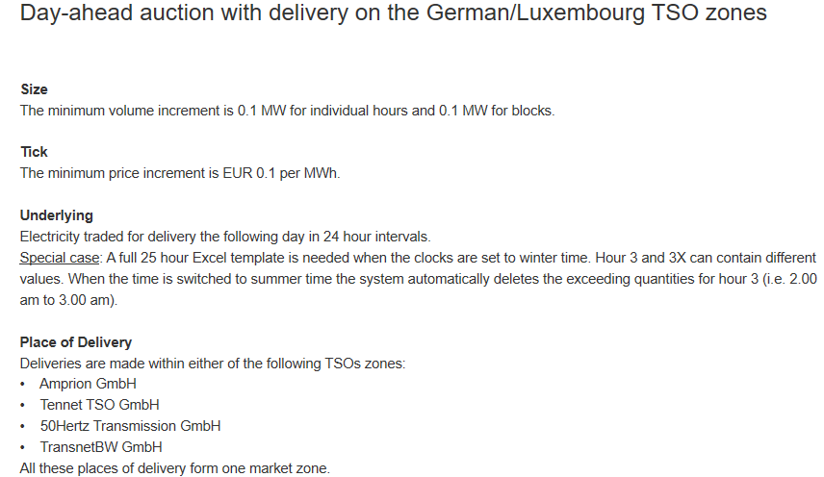
EPEX Spot Day-ahead auction: Product description
https://www.epexspot.com/en/product-info/auction/germany-luxembourg

Slide 21
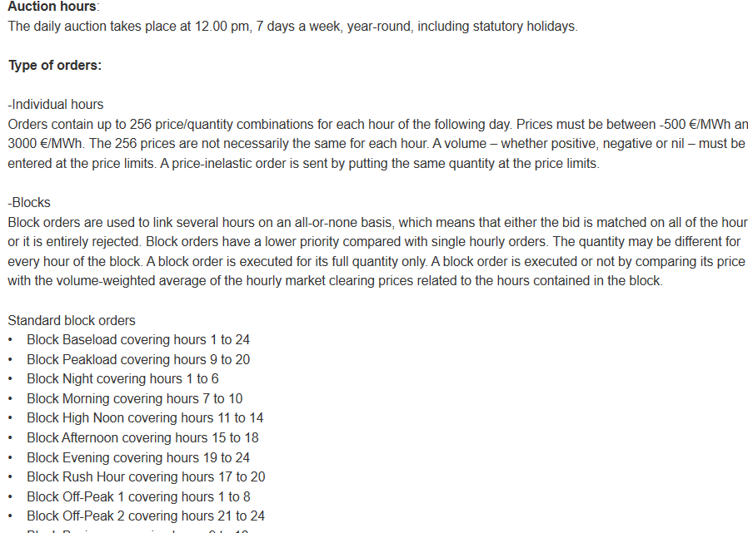
Product description (continued)

Slide 22
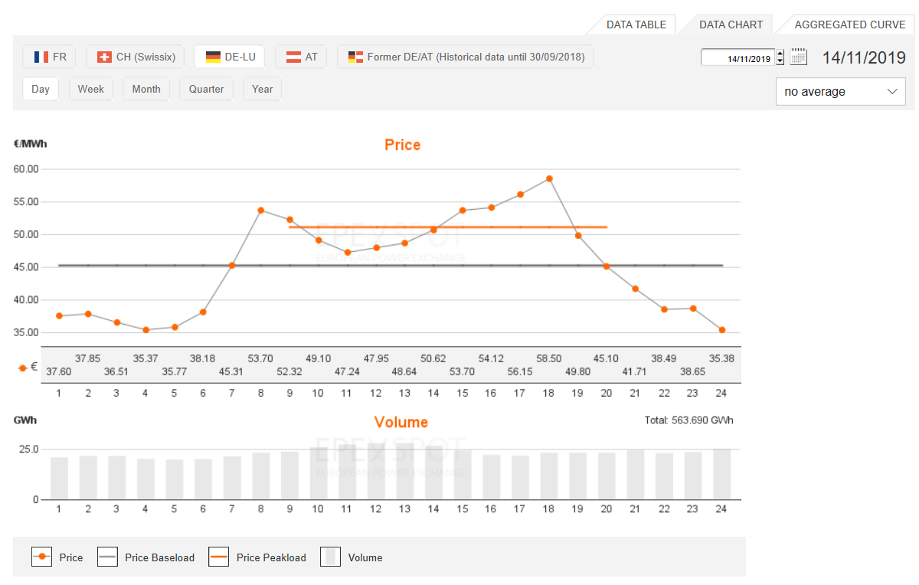
EPEX Spot Day-ahead auction

Slide 23
Intraday market
Intraday market reflects a growing need for flexibility close to delivery due to a growing share of volatile renewables.
Intraday market serves for adjusting trading positions based on corrected forecasts closer to real-time.
uniform price auction for hourly products; daily at 3 pm (d-1)
uniform price auction for 15-min products; daily at 4 pm (d-1)
continuous intraday market for hourly products
The German spot power market for hourly contracts
Source: Balardy, 2018
Notes:
Less liquid than day-ahead markets
Price range: -9.999€ to 9.999€
Intraday market reduces imbalance costs, helps to optimise production and consumption and promotes flexibility.

Slide 24
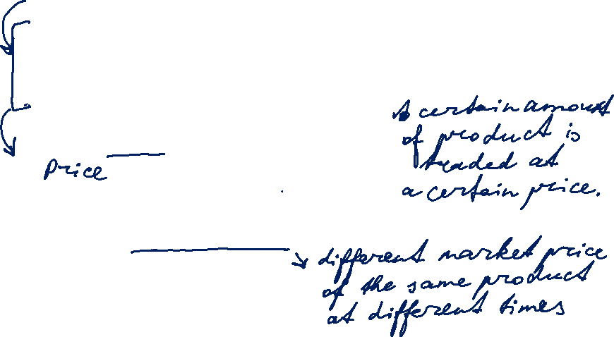

What is a trading product
Trading product is combination of transaction features:
Underlying asset electricity
Delivery point TSO control area
Delivery period start date / end date
Delivery amount contract capacity [MW]
  contract quantity [MWh]
A bid (offer to buy) or ask (offer to sell) is characterised by: product, price, trading day and time.

Slide 25
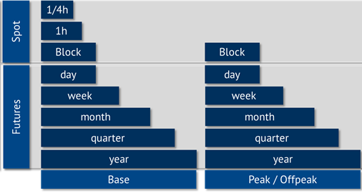
Electricity product types based on delivery period
Source: Energy Brainpool

Slide 26
Product types
Physical vs. Financial
Physical product implies physical delivery of the underlying (i.e. electricity).
Financial product implies exchange of cash without physical delivery (no set-up with TSO required) → Swap
Fixed-price vs. floating price (index-based)
Fixed price is stated as an amount of money per unit of underlying
Floating price is determined by reference to a price index publication at a time point after deal conclusion.
Fixed-amount vs. options

Slide 27
Product types: Swaps
Swaps is a general category of financial products
fixed-for-floating swap: Party A is fixed price payer; Party B is floating price payer (=reference price based on a price index published in the future → market price); only the difference is exchanged each month
e.g. large consumer (as Party A – fixed price payer) hedging price risk from their long-term supply contract with an index-based price
floating-for-floating swap: both Party A and Party B pay their respective floating price
swaption: option to enter into a swap
floor, cap, collar etc.

Slide 28
Options: Terminology
An option gives the holder the right, but not the obligation, to buy or sell a specified quantity of an underlying on (or before) a specified future date, at a predetermined price.
Excercising the option is buying or selling the underlying.
- Call option is a right to buy.
- Put option is a right to sell.
Expiry (expiration/maturity date) is the date on (or until) which the option can be excercised.
- European options can be excercised only at expiry.
- American options can be excercised at any time up to expiry.
Strike (excercise) price is the pre-agreed buy or sell price.
Option premium is a fixed amount paid by the holder (option buyer) to the writer (option seller) upon concluding an option.

