Slide 1
Integrated course „Energy Economics“
- Economics of Electricity Generation
Chair of Energy Systems
Prof. Dr. Boris Heinz | Dr. Elena Timofeeva
elena.timofeeva@tu-berlin.de

Slide 2
Outline
Cost structures of generation technologies
Generation technologies in the merit order
Market power in electricity generation
Renewables support schemes

Slide 3
Task 2) Merit Order and Dispatch Decisions
Excercise continued from the previous class

Slide 4
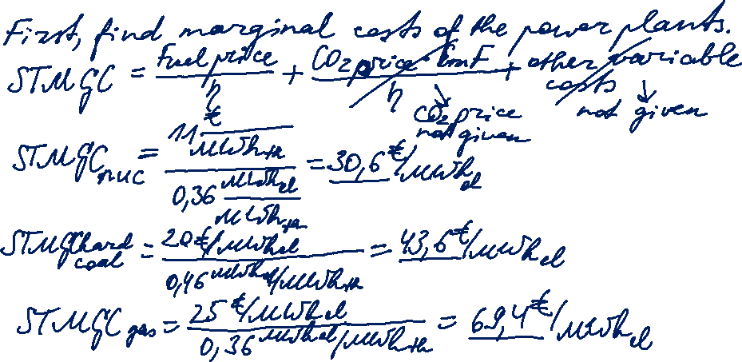

Task 2)
Dispatch Decisions
Assume the power plants given in table 2 have been constructed already. Sketch the merit order for these power plants. What is the electricity price at a load of 1.7 GW?

Slide 5
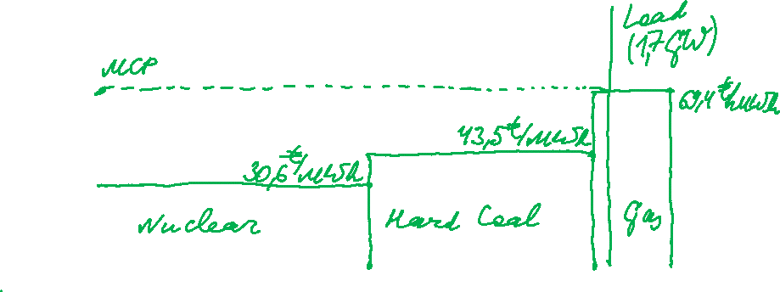
Task 2)
Dispatch Decisions
Assume the power plants given in table 2 have been constructed already. Sketch the merit order for these power plants. What is the electricity price at a load of 1.7 GW?

Slide 6
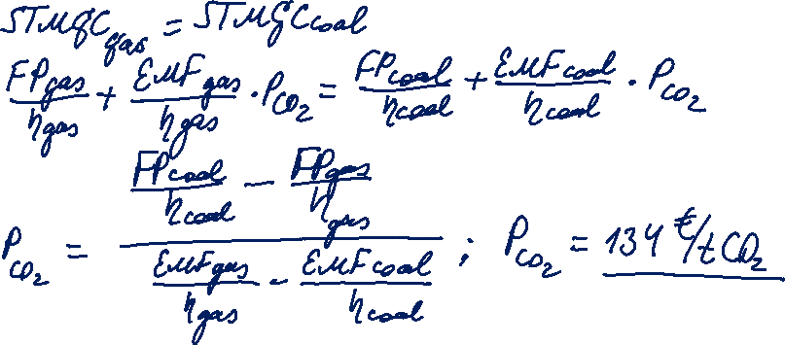
Task 2)
Dispatch Decisions
Now assume that there is a CO2 trading system. Calculate the emissions price (€/t CO2) at which the coal fired units show the same short-term marginal generation costs as the gas fired ones.

Slide 7
Technologies and cost structures: Overview
Across technologies, the main cost components are:
Capital and investment cost (incl. equipment components, installation, grid connection costs)
Operation and maintenance (O&M)
Fuel
CO₂ emissions

Slide 8
Technologies: Wind
Main cost components:
Economic depreciation of capital equipment
Interest paid on the borrowed capital
Operation and maintenance cost
Taxes (local / federal)
Royalties paid to landowners
Payment for electricity used on a standby mode (own consumption)
Energy storage components (if used)
Source: Ragheb in: Wind Energy Engineering (ed. Letcher), 2017, p.539

Slide 9
Technologies: Wind (continued)
Intermittence factor
25% - 40% depending on the location
Annual electricity output [kWh/a] = Cap [kW] * 8.760 h/a * IF
Exceedance probability (Pxx) of annual energy production:
P50: The probability of reaching at least the stated annual energy production is 50. P70, P90 etc.
Grid connection has a particular focus in the wind industry. Required grid expansion has to be synchronised with the start of operation.

Slide 10
Technologies: Hydropower
Extremely high investment cost, mainly in the construction phase
Substantial risk associated with construction and operation
Low operation and maintenance costs
Near zero fuel costs
Typically, high grid connection costs for large-scale projects
Low cost variability
Highly dispatchable
Availability of resource is highly seasonal.
Source: Bradford, The energy system, 2018, p. 301
Notes:
In nothern hemisphere: highest availability in November to April.
Problem of safe decommissioning and major dam failures.

Slide 11
Technologies: Nuclear power plants
Extremely high investment cost
High completion risk
No CO₂ cost
Fuel cost
Safety, security and waste management considerations
Notes:
In nothern hemisphere: highest availability in November to April.
Problem of safe decommissioning and major dam failures.

Slide 12
Technologies: Coal power plants
Capital costs are characterised by economies of scale
Low fuel cost
Higher CO₂ emissions compared to gas
Technical limits of operation: low operational flexibility

Slide 13
Technologies: Gas-fired power plants
Relatively high investment costs
Fuel cost has relatively high contribution to LCOE
Highly dispatchable
Suitable both for peakload and baseload (when relative gas price allows)
Important role in system stability

Slide 14
Technologies: Summary
Source: Zweifel / Praktiknjo / Erdmann, 2017, p. 276
Notes:
Cost of additional fuel consumption caused by shut-on and shut-off processes

Slide 15
Ramp rates and start-up times of termal power plants
Source: Agora Energiewende, 2017, with ref. to: Fichtner (2017), VDE (2012), Steck & Mauch (2008), Balling (2010)
Notes:
Flexible: fast ramp-up / ramp-down

Slide 16
Power plants in the merit order
Power plant types based on their place in merit order:
Power plant type | FLH [h/a] | Operation features | Technologies
Baseload | > 7.000 | continuous | lignite
Intermedium load | 4.500 – 5.500 | during peak hours (wd 8-8) | hard coal
Peak load | < 1.250 | at times of peak demand | pumped-storage hydro, gas
Reserve |  | during power plant shut-downs | old power plants
Source: Konstantin, 2017

Slide 17
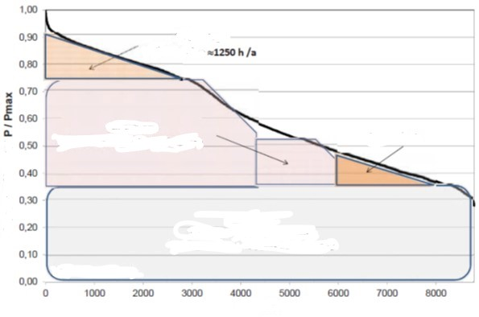
Power plants in the merit order
Peak load 1250 h/a
Intermedium load
FLH 4500-5500 h/a
Base load
FLH 7500 to 8000 h/a
Hours
Source: Konstantin, 2017

Slide 18
Merit Order: Future trends
FLH of conventional power plants will decline with increasing RES share.
This – along with higher prices of fuel and CO₂ certificates – will lead to higher LCOE.
Conventional powerplants with the highest flexibility for ramping up/ramping down have the best chances to stay in the market – not necessarily the least expensive ones → gas power plants.
Source: Fraunhofer ISE, 2018

Slide 19
Market power
Perfect competition requires a large number of independent generators.
Electricity generation tends to market concentration: few market participants → oligopoly.
Cournot competition model
Incumbent generators have an incentive for:
withdrawing generation capacities
preventing market entry by newcomers
horizontal mergers
→ price control by antitrust authority
→ non-discriminatory access to grid controlled by antitrust/regulatory authority
→ merger control by antitrust authority

