Slide 1
Integrated course „Energy Economics“
- Economics of Generation (continued)
Chair of Energy Systems
Prof. Dr. Boris Heinz | Dr. Elena Timofeeva
elena.timofeeva@tu-berlin.de

Slide 2
Outline
Market Power (continued)
Merit Order Effect

Slide 3
Market structures - 1
Market is a group of sellers and a group of buyers of a particular good or service.
Perfect competition:
many buyers and many sellers > cannot influence the price
goods at exactly the same (homogeneous)
consumers have perfect information
no entry or exit barriers
Monopoly:
seller is the sole producer and can influence the price of its output
Market power is the ability to maintain a price above the price under competition.

Slide 4
Market structures - 2
Cournot oligopoly:
More than one firm
All firms produce one homogeneous product (no product differentiation)
No cooperation among firms (no collusion)
Firms have market power - each firm's output decision affects the good's price
Fixed number of firms
Firms compete in quantities, and choose them simultaneously
Economically rational and strategically acting firms, seeking to maximize profit given their competitors' decisions

Slide 5

Supply and pricing – profit maximization of the firm
Π Profit (per period)
p Sales price
Q Output (Quantity)
C Production costs
Competitive markets
„Marginal cost = Price rule“
Monopoly markets
„Marginal costs = marginal revenue rule“

Slide 6
Perfect competition - pricing

Slide 7
Monopoly - pricing 1

Slide 8
Monopoly - pricing 2

Slide 9
Cournot oligopoly - pricing 1

Slide 10
Cournot oligopoly - pricing 2

Slide 11
Cournot oligopoly - pricing 3

Slide 12
Comparison

Slide 13
Cournot oligopoly - pricing 5
Comparison

Slide 14

Task 3) Offer of a price taker: competitive market
A price taker has the following cost function:
$C\left(Q\right)=\frac{1}{3}Q^{3}−2Q^{2}+5Q+15$
What are the total costs, the variable costs and the fixed costs?
How much will the company offer if the market price is 10?
What is the price for break-even?
What is the price for production threshold (shut-down)?

Slide 15

Task 3) Offer of a price taker: competitive market
A price taker has the following cost function:
$C\left(Q\right)=\frac{1}{3}Q^{3}−2Q^{2}+5Q+15$
What are the total costs, the variable costs and the fixed costs?

Slide 16

Task 3) Offer of a price taker: competitive market
A price taker has the following cost function:
$C\left(Q\right)=\frac{1}{3}Q^{3}−2Q^{2}+5Q+15$
How much will the company offer if the market price is 10?

Slide 17

Task 3) Offer of a price taker: competitive market
A price taker has the following cost function:
$C\left(Q\right)=\frac{1}{3}Q^{3}−2Q^{2}+5Q+15$
What is the price for break-even?

Slide 18

Task 3) Offer of a price taker: competitive market
A price taker has the following cost function:
$C\left(Q\right)=\frac{1}{3}Q^{3}−2Q^{2}+5Q+15$
What is the price for production threshold (shut-down)?

Slide 19
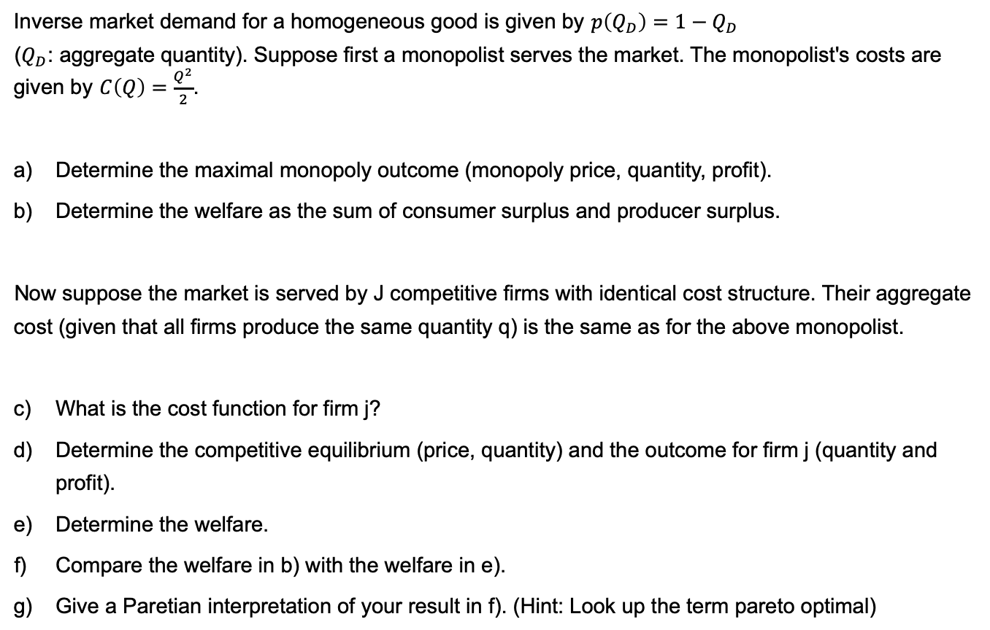
Task 4) Monopoly
Inverse market demand for a homogeneous good is given by $p\left(Q_{D}\right)=1−Q_{D}$
($Q_{D}$: aggregate quantity). Suppose first a monopolist serves the market. The monopolist's costs are given by $C\left(Q\right)=\frac{Q^{2}}{2}$.
Determine the maximal monopoly outcome (monopoly price, quantity, profit).
Determine the welfare as the sum of consumer surplus and producer surplus.
Now suppose the market is served by J competitive firms with identical cost structure. Their aggregate cost (given that all firms produce the same quantity q) is the same as for the above monopolist.
What is the cost function for firm j?
Determine the competitive equilibrium (price, quantity) and the outcome for firm j (quantity and profit).
Determine the welfare.
Compare the welfare in b) with the welfare in e).
Give a Paretian interpretation of your result in f). (Hint: Look up the term pareto optimal)

Slide 20

Task 4) Monopoly
Inverse market demand for a homogeneous good is given by $p\left(Q_{D}\right)=1−Q_{D}$ ($Q_{D}$: aggregate quantity). Suppose first a monopolist serves the market. The monopolist's costs are given by $C\left(Q\right)=\frac{Q^{2}}{2}$.
Determine the maximal monopoly outcome (monopoly price, quantity, profit).

Slide 21

Task 4) Monopoly
Inverse market demand for a homogeneous good is given by $p\left(Q_{D}\right)=1−Q_{D}$ ($Q_{D}$: aggregate quantity). Suppose first a monopolist serves the market. The monopolist's costs are given by $C\left(Q\right)=\frac{Q^{2}}{2}$.
Determine the welfare as the sum of consumer surplus and producer surplus.

Slide 22

Task 4) Monopoly
Inverse market demand for a homogeneous good is given by $p\left(Q_{D}\right)=1−Q_{D}$ ($Q_{D}$: aggregate quantity). Suppose first a monopolist serves the market. The monopolist's costs are given by $C\left(Q\right)=\frac{Q^{2}}{2}$.
Now suppose the market is served by J competitive firms with identical cost structure. Their aggregate cost (given that all firms produce the same quantity q) is the same as for the above monopolist.
What is the cost function for firm j?

Slide 23

Task 4) Monopoly
Inverse market demand for a homogeneous good is given by $p\left(Q_{D}\right)=1−Q_{D}$ ($Q_{D}$: aggregate quantity). Suppose first a monopolist serves the market. The monopolist's costs are given by $C\left(Q\right)=\frac{Q^{2}}{2}$.
Now suppose the market is served by J competitive firms with identical cost structure. Their aggregate cost (given that all firms produce the same quantity q) is the same as for the above monopolist.
Determine the competitive equilibrium (price, quantity) and the outcome for firm j (quantity and profit).

Slide 24
Task 4) Monopoly

Slide 25

Task 4) Monopoly
Inverse market demand for a homogeneous good is given by $p\left(Q_{D}\right)=1−Q_{D}$ ($Q_{D}$: aggregate quantity). Suppose first a monopolist serves the market. The monopolist's costs are given by $C\left(Q\right)=\frac{Q^{2}}{2}$.
Now suppose the market is served by J competitive firms with identical cost structure. Their aggregate cost (given that all firms produce the same quantity q) is the same as for the above monopolist.
Determine the welfare.

Slide 26

Task 4) Monopoly
Inverse market demand for a homogeneous good is given by $p\left(Q_{D}\right)=1−Q_{D}$ ($Q_{D}$: aggregate quantity). Suppose first a monopolist serves the market. The monopolist's costs are given by $C\left(Q\right)=\frac{Q^{2}}{2}$.
Now suppose the market is served by J competitive firms with identical cost structure. Their aggregate cost (given that all firms produce the same quantity q) is the same as for the above monopolist.
Compare the welfare in b) with the welfare in e).

Slide 27

Task 4) Monopoly
Inverse market demand for a homogeneous good is given by $p\left(Q_{D}\right)=1−Q_{D}$ ($Q_{D}$: aggregate quantity). Suppose first a monopolist serves the market. The monopolist's costs are given by $C\left(Q\right)=\frac{Q^{2}}{2}$.
Now suppose the market is served by J competitive firms with identical cost structure. Their aggregate cost (given that all firms produce the same quantity q) is the same as for the above monopolist.
Give a Paretian interpretation of your result in f). (Hint: Look up the term pareto optimal)

Slide 28
Load Curve and Load Duration Curve
P[MW]
P[MW]
Load Curve
Load Duration Curve
1
1
P_{max}
2
2+3
3
4
4
P_{min}
Time of day
Cumulative hours

Slide 29
Load and Residual Load
to be covered by
adjustable generation
storage discharge
Load
reduced by must-run
(RES, inflexible conventional technologies)
Demand
Residual Load
Surplus
applicable for
storage charge
additional consumption: intersectoral technologies

Slide 30
Merit Order
Load
Oil
Marginal costs
Gas
Coal
Nuclear
Hydro
Installed Capacity
Notes:
The merit order is a way of ranking available sources of energy, especially electrical generation, based on ascending order of price (which may reflect the order of their short-run marginal costs of production) together with amount of energy that will be generated. In a centralized management, the ranking is so that those with the lowest marginal costs are the first ones to be brought online to meet demand, and the plants with the highest marginal costs are the last to be brought on line. Dispatching generation in this way minimizes the cost of production of electricity

Slide 31
Merit Order Effect of Renewables
Load
Oil
Marginal costs
Gas
Coal
Nuclear
Renewables
Hydro
Installed Capacity
Notes:
Merit Order Effect of the Renewables can be shown by changing the load curve or the generation curve.
In this case: Load is uncanged, Renewables shift the conventional merit order to the right, since they have the lowest marginal generation costs.
The merit order effect of renewable energy sources (RES) describes the impact of feed-in of renewable (must run) electricity on electricity prices. As renewable electricity feed-in such as wind or photovoltaic virtually comes at zero costs, the demand for conventional generation capacity is reduced by the amount of renewable feed-in. As a result the prices for electricity decrease: the merit order effect

Slide 32
Merit Order
Residual Load
Load
Oil
Renewables
Marginal costs
Gas
Coal
Nuclear
Hydro
Installed Capacity
Notes:
Residual Load = Load of consumers, reduced by RES, and inflexible must-run capacities

Slide 33
Merit Order - Impact of CO₂ – Prices
Load
CO₂-
Price
Oil
Marginal costs
Windfall-
Profit
Windfall-Profit
CO₂-Price
CO₂-Price
Gas
Coal
Nuclear
Hydro
Installed Capacity
Notes:
CO2-Price has to be priced into the marginal generation costs. Thereby changing the merit order.
There is a CO2 price at which generation technologies switch position in the merit order.

Slide 34
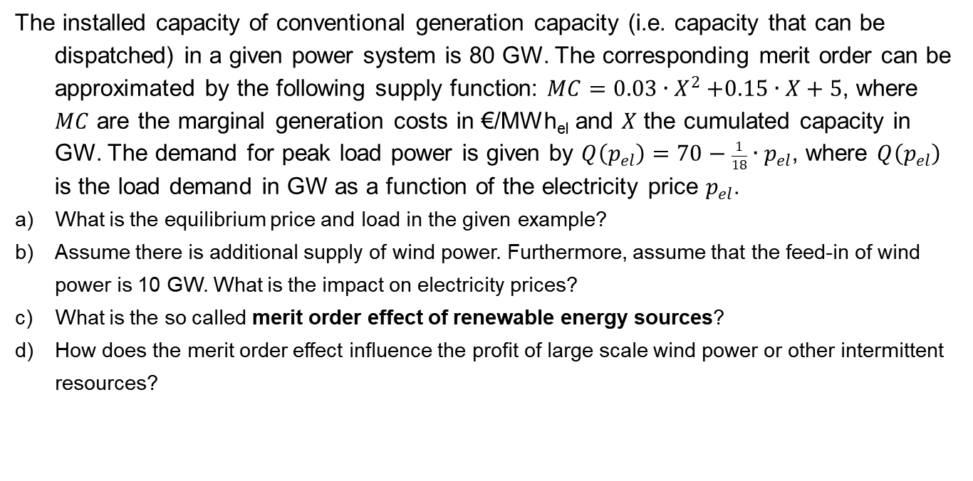
Task 5) Merit Order Effect of Renewables
The installed capacity of conventional generation capacity (i.e. capacity that can be dispatched) in a given power system is 80 GW. The corresponding merit order can be approximated by the following supply function: $MC=0.03{∙X}^{2}+0.15∙X+5$, where $MC$ are the marginal generation costs in €/MWh_{el} and $X$ the cumulated capacity in GW. The demand for peak load power is given by $Q\left(p_{el}\right)=70−\frac{1}{18}∙p_{el}$, where $Q\left(p_{el}\right)$ is the load demand in GW as a function of the electricity price $p_{el}$.
What is the equilibrium price and load in the given example?
Assume there is additional supply of wind power. Furthermore, assume that the feed-in of wind power is 10 GW. What is the impact on electricity prices?
What is the so called merit order effect of renewable energy sources?
How does the merit order effect influence the profit of large scale wind power or other intermittent resources?

Slide 35
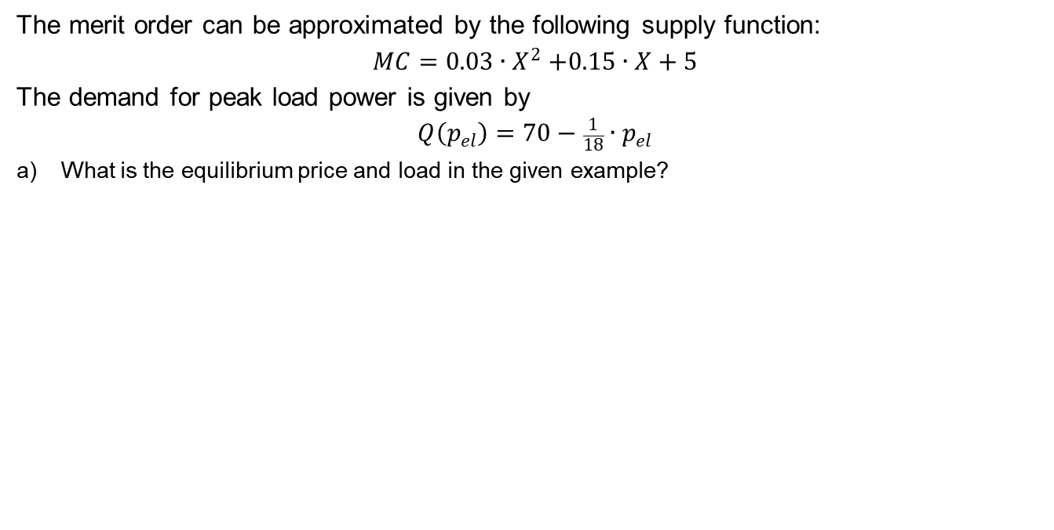
Task 5) Merit Order Effect of Renewables
The merit order can be approximated by the following supply function:
$$MC=0.03{∙X}^{2}+0.15∙X+5$$
The demand for peak load power is given by
$$Q\left(p_{el}\right)=70−\frac{1}{18}∙p_{el}$$
What is the equilibrium price and load in the given example?

Slide 36
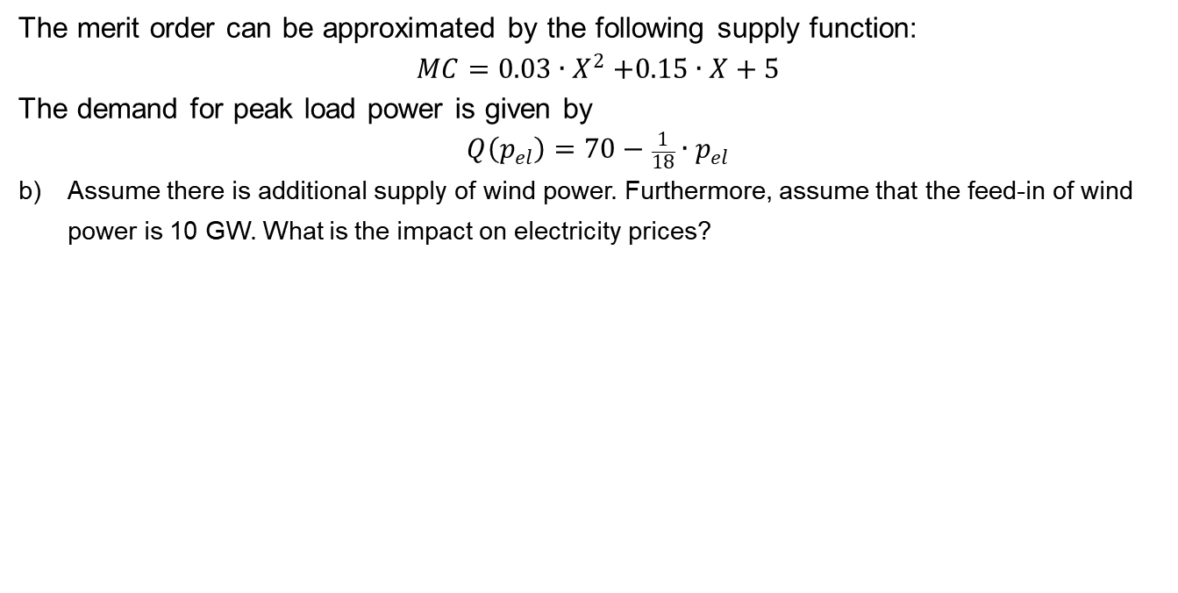
Task 5) Merit Order Effect of Renewables
The merit order can be approximated by the following supply function:
$$MC=0.03{∙X}^{2}+0.15∙X+5$$
The demand for peak load power is given by
$$Q\left(p_{el}\right)=70−\frac{1}{18}∙p_{el}$$
Assume there is additional supply of wind power. Furthermore, assume that the feed-in of wind power is 10 GW. What is the impact on electricity prices?

Slide 37
Task 5) Merit Order Effect of Renewables

Slide 38
Task 5) Merit Order Effect of Renewables
What is the so called merit order effect of renewable energy sources?
How does the merit order effect influence the profit of large scale wind power or other intermittent resources in a purely market-based system?
Notes:
c) See slide 11

