Slide 1

Integrated course „Energy Economics“
- Markets for CO₂ Emission Allowances
Chair of Energy Systems
Prof. Dr. Boris Heinz | Dr. Elena Timofeeva
elena.timofeeva@tu-berlin.de

Slide 2
Outline
External costs
Quantification of external costs
Greenhouse gas problem
European Cap-and-Trade system

Slide 3
Definitions
Emissions: Substances exhausted from a facility into the atmosphere, the hydrosphere etc. Likewise noise, tremor, odour, contamination, and radiation
Immissions: distribution, transformation and metamorphosis of the emitted substances in the receiving ecosphere media
Damages: Impacts of immissions that are somehow negatively valued by humans
External effects: Impacts of economic activities on outsiders without compensation. In the case of damages, these impacts are “negative external effects”; if the impacts represent advantages, they are called “positive external effects”
External cost: Negative external effects expressed in money units

Slide 4
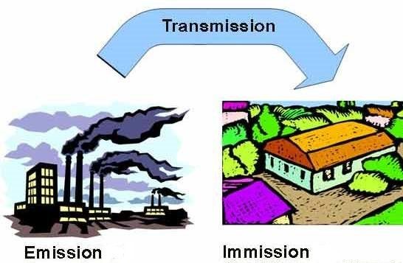
Definitions

Slide 5

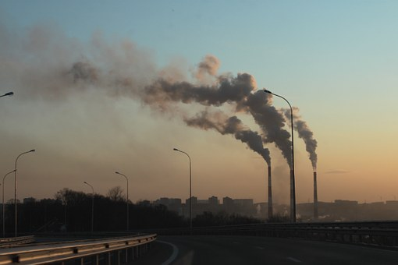
Coase Theorem
If private parties can negotiate about allocation of resources at no cost, the market will solve the problem of externalities and allocate resources efficiently.
Pareto efficiency: outcome where no player can be made better off without hurting at least one other player.

Slide 6
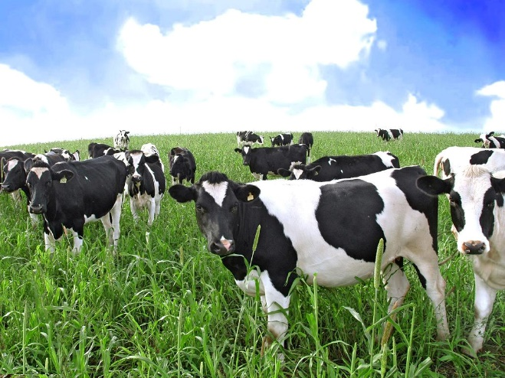


Coase Theorem: Rancher vs Farmer
The problem is reciprocal: meat or crops.
Put up a fence:
rancher pays
farmer pays
Allow crops damage:
rancher reimburses
farmer absorbs
Rancher stops raising cattle.
Farmer stops growing crops.

Slide 7
Coase Theorem: Rancher vs Farmer
More crops get damaged as the herd count increases.
Annual cost of fencing: $9
Price of crop: $1 per ton
Value of crops: $12
Cost of cultivation: $10
Value of damaged crops: $1
Source: Coase (1960)

Slide 8
Optimal Emmission Levels
Profit Π
External Costs C_{ext}
External Costs C_{ext}
Maximize
C_{ext,0}
Π*
Π₀
Profit Π
0
Em*
Em₀
Emissions Em

Slide 9
Marginal Damages and Marginal Abatement Costs
Marginal Profits,
External Marginal Costs
0
Em*
Em₀
Emissions Em

Slide 10
Assumptions and Limitations
Property rights are clearly allocated and enforceable.
Areas with no property rights – e.g. oceans.
Monitoring is not always possible.
No transaction costs
Small number of parties affected
Equal bargaining power
Cost for future generations

Slide 11
External Costs and Market Failure
Individuals may suffer economic losses from emissions associated with energy activities that are not included in energy prices and thus are not compensated by the polluter
No Pareto-Optimum (some individuals can be better off without negatively affecting the situation of any other individual)
Coase-Theorem: Negotiations between polluters and affected parties could produce the Pareto-optimal condition, but negotiations may not be possible or successful due to
many perpetrators and victims
unclear cause-effect relationships
high transaction costs
⇒ Market Failure

Slide 12
Strategies to Correct Market Failure
Voluntary agreement with sanctions (Klemmer et al. 1999): Polluters voluntarily agree to reduce emissions; the government threatens to apply other instruments if the agreement fails to be honored
Environmental Liability
  with mandatory insurance; insurance premiums provide the internalization of external cost
  Lawmakers and courts determine the admissible amount of external effects beyond which the injurer must come up with a compensation

Slide 13
Strategies to Correct Market Failure (Cont.)
Emission standards and norms (e.g. mandatory emission controls)
Emission taxes (Pigou-Tax). By taxing emissions, the government puts a price on them
Standard Price Approach (Baumol, Oates 1988)
  Government auctions tradable allowances (fiscal instrument)
  Free allocation of tradable allowances by government (Grandfathering, Benchmarking)

Slide 14
Emission Taxes versus Standard Price
Energy price
Energy price
Pigovian
Tax
Price in a
standard price model
Time
Time

Slide 15
GHG Abatement Costs and a Pigou Tax
Euro/t CO₂
CO₂ tax rate
Starting point
Implicit CO₂ emissions
CO₂ emissions

Slide 16
Uncertain GHG Abatement Costs Under Cap and Trade
Euro/t CO₂
Required GHG
reductions
Implicit price
of the
emission allowance
CO₂ cap
CO₂ emissions

Slide 17
Unknown GHG Abatement Costs and Pigou Tax
Euro/t CO₂
CO₂ tax rate
Starting point
Implicit CO₂ emissions
CO₂ emissions

Slide 18
Pigou Tax
Optimal tax rate must be equal to the marginal cost of emissions.
Without technology differences, all companies reduce their emissions to the same optimal level.
In case of technology differences, the company with lower abatement costs has a higher optimal emissions level.
→ Tax needs to be higher.

Slide 19
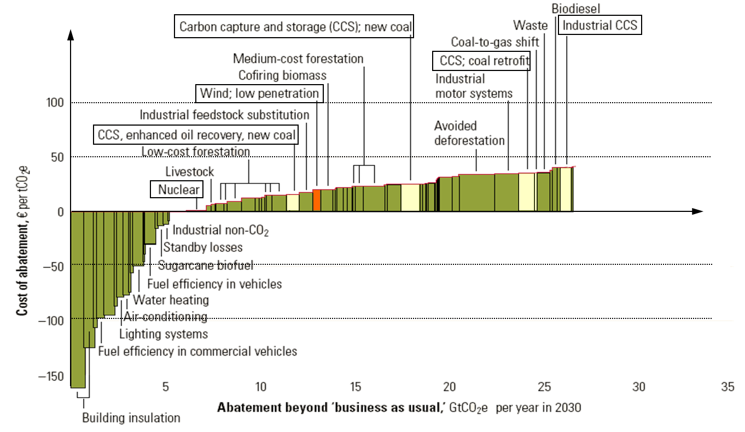
Costs of abating CO₂-Emissions
(Source: McKinsey & Company 2007)

Slide 20
Content of the Lecture
External costs
Quantification of external costs
Greenhouse gas problem
European Cap-and-Trade system

Slide 21
Quantification of External Costs
Emissions
Immissions: Atmospheric chemistry, Water Chemistry, …
Damages depending on Dose Response Functions:
initial level of other substances, duration, delay until the damage appears, presence of receptors
Monetization of damages

Slide 22
Categories of Damages [VDI-directive No. 3780]
Economic damages in the narrow sense: destruction of physical assets that cause income losses, cleanup and repair costs
Losses to human life and health: number of concerned persons, number of years of life lost, duration and degree of medical treatment
Losses of environmental assets and environmental quality as far as not yet captured by category “economic damages”
Losses of quality of life: exposure to noise and vibration, but also fear of catastrophes, reduced autonomy and self-fulfilment;
Social institutions that are temporarily prevented from normal functioning (civil protection, health system, …): number of days times number of concerned persons

Slide 23
Monetization of Damages
Cost of repair
Human capital approach (cost of education and training, present value of future labor income forgone)
Hedonic price approach (market transactions): individuals who expose themselves to a risk to life, noisy environment etc. for a financial return
Contingent Valuation: Survey on individual willingness to pay for avoiding an environmental damage (strategic responses)
Contingent Valuation (Cummings et al. 1986): Evaluation of alternatives to the status quo in order to determine the individual indifference curve through the status quo. Because the alternatives are associated with financial effects, they can be determined from the slope of the interpolated indifference curve

Slide 24
External Costs [Source: ExternE 2003]
 | Hard Coal | Lignite | Natural Gas CCPP | Nuclear Energy | PV (multi) | PV amorph | Wind Energy | Hydro
Damage Costs [Euro-Cent/kWh]
Noise |  |  |  |  |  |  | 0,01
Health | 0,7 | 0,97 | 0,33 | 0,16 | 0,62 | 0,44 | 0,07 | 0,05
Material | 0,02 | 0,02 | 0,007 | 0,002 | 0,02 | 0,012 | 0,002 | 0,001
Field Crops |  |  |  | 0,0007 |  |  | 0,0007 | 0,0002
Sum | 0,7 | 1,0 | 0,3 | 0,2 | 0,6 | 0,5 | 0,1 | 0,1
Abatement costs [Standard-Price-Approach; Euro-Cent/kWh]
Ecosystem | 0,2 | 0,77 | 0,04 | 0,05 | 0,41 | 0,04 | 0,04 | 0,03
Greenhouse Gas Effect | 1,57 | 1,96 | 0,72 | 0,03 | 0,59 | 0,33 | 0,04 | 0,03
Total | 2,5 | 3,7 | 1,1 | ,2 | 1,6 | 0,8 | 0,2 | 0,1

Slide 25
Content of the Lecture
External costs
Quantification of external costs
Greenhouse gas problem
European Cap-and-Trade system

Slide 26
The Greenhouse Gas Problem
[Data Source IPCC 1990; 2014]
 | Carbon dioxide CO₂ | Methane CH₄ | Nitrous oxide N₂O
Pre industrial concentration [ppmv] | 280 | 0.7–0.8 | 0.23
Average atmospheric lifetime [years] | 5–200 | 9-15 | 120
Global warming potential in 20 years | 1 | 72 | 289
Global warming potential in 100 years | 1 | 25 | 298
Contribution to the GHG problem [%] | 77 | 14 | 8
Reduction target of the IPCC 1990 [%] | 60–80 | 15–20 | 70–80

Slide 27
Global CO₂ Emissions [Source: BP 2010]
Global CO₂ emissions [bn. tons]
40
30
20
Rest of the world
10
North America
Europe
0
1990
1995
2000
2005
2010

Slide 28
Global Coal Extraction [source: BP]
4000
Coal extraction [Mt.c.e.]
3000
2000
ROW
China
1000
Australia
FSU
USA
0
1980
1990
2000
2010

Slide 29
Characteristics of the Greehouse Problem
Globalism: The location of emissions does not matter (Leakage problem)
Timeline: Damages affect future generations while the current generation has relatively minor impairments
Unavailability of reliable abatement technologies
Politics against Free riding: Solutions require an internationally coordinated and future-oriented approach: Who should provide what contributions? (International and intra-national distributive conflicts; Developing countries against grandfathering)
Measurement, Reporting and Verification

Slide 30
The Greenhouse Gas Problem
[Data Source IPCC 1990; 2014]
 | Carbon dioxide CO₂ | Methane CH₄ | Nitrous oxide N₂O
Pre industrial concentration [ppmv] | 280 | 0.7–0.8 | 0.23
Average atmospheric lifetime [years] | 5–200 | 9-15 | 120
Global warming potential in 20 years | 1 | 72 | 289
Global warming potential in 100 years | 1 | 25 | 298
Contribution to the GHG problem [%] | 77 | 14 | 8
Reduction target of the IPCC 1990 [%] | 60–80 | 15–20 | 70–80

Slide 31
Integrated course „Energy Economics“
- Markets for CO₂ Emission Allowances
Chair of Energy Systems
Prof. Dr. Boris Heinz | Dr. Elena Timofeeva
elena.timofeeva@tu-berlin.de

Slide 32
Outline
External costs
Quantification of external costs
Greenhouse gas problem
European Cap-and-Trade system

Slide 33
International Framework on Climate Change
1979 World Climate Conference in Geneva
1988 UN Intergovernmental Panel on Climate Change (IPCC)
1992 (1994) UN Framework Convention on Climate Change (UNFCCC)
Annex I countries: Industrialised countries that have agreed to reduce their greenhouse gas emissions
Annex II counties: Developed countries that are responsible for bearing the costs of climate change mitigation in developing countries (subset of Annex I c.)
Developing countries: These countries have no immediate responsibilities.
1999 (2005) Kyoto Protocol to UNFCCC
Binding CO2 reduction targets:
1st commitment period 2008-2012
2012 Doha Amendment: 2nd commitment period 2013-2020
COP – annual Conference of Parties of Kyoto Protocol
Notes:
Countries have common but differetiated responsibilities.

Slide 34
Kyoto Protocol
Greenhouse gases:
Sector and source categories:
Energy
Industrial processes
Solvents and other product uses
Agriculture
Waste
+ Impact of Land-Use, Land-Use Change and Ferestry (LULUCF)

Slide 35
The Greenhouse Gas Problem
[Data Source IPCC 1990; 2014]
 | Carbon dioxide CO₂ | Methane CH₄ | Nitrous oxide N₂O
Pre industrial concentration [ppmv] | 280 | 0.7–0.8 | 0.23
Average atmospheric lifetime [years] | 5–200 | 9-15 | 120
Global warming potential in 20 years | 1 | 72 | 289
Global warming potential in 100 years | 1 | 25 | 298
Contribution to the GHG problem [%] | 77 | 14 | 8
Reduction target of the IPCC 1990 [%] | 60–80 | 15–20 | 70–80

Slide 36
Committed Emission Limits under Kyoto Protocol
Source: Burger / Graeber / Schindlmayr (2014)

Slide 37
Kyoto Protocol: Flexible Mechanisms
Cost-effective options for reducing emissions or removing CO₂
in other countries
Clean Development Mechanism
Project-based reduction of CO₂ emissions between non-Annex 1 countries and Annex 1 countries
Emission reductions must be additional (compared to baseline).
Independent certification
Joint Implementation Mechanism
Project-based reduction of emissions between two Annex 1 countries
International Emissions Trading
Emissions trading among Annex B countries
Not in use

Slide 38
Emission Allowances: Terminology
AAU: Assigned Amount Unit or Kyoto unit. An AAU permit to emit 1 t of CO₂ or 1 t CO₂ equivalent of greenhouse gases.
ERU: Emission Reduction Unit. An ERU is a certified emission reduction of 1 t of CO₂ resulting from a Joint Implementation project.
CER: Certified Emission Reduction. A CER is a certified emission reduction of 1 t of CO₂ resulting from a CDM project.
EUA: EU Allowance. An EUA permit operators of an industry installation or electricity generation unit to emit 1 t of CO₂ under the EU emissions trading system.
EUAA: EU Aviation Allowance. An EUAA permit airlines to emit 1 t of CO₂ under the EU emissions trading system.

Slide 39
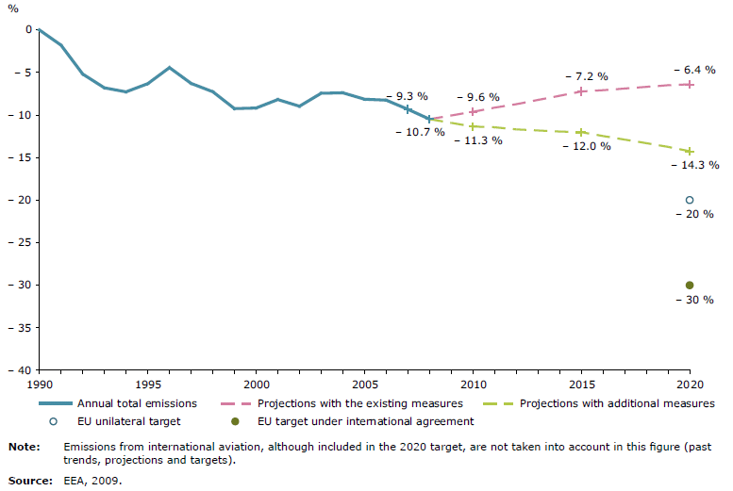
GHG-Emissions in the EU-27 [Source EEA 2009]
Unilateral target: -20% in 2020 compared to 1990
Source: European Environment Agency EEA 2009

Slide 40
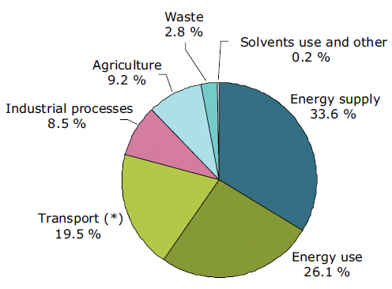
EU-27 Composition of GHG Emissions 2007
[Source EEA 2009]
(*) 24 % with intl. aviation
and intl. maritime navigation

Slide 41
EU Emission Trading System (ETS)
For tax issues all EU member states must agree,
but majority vote is sufficient for ETS system
Mandatory “CO₂ Cap and Trade” system for
  Installations of power, refinery, steel, glass, cement industries (2071 mio t CO₂ verified emissions in 2005)
  airline business (after 2011)
EU wide annual cap of tradable CO₂ Allowances (EUA)
Almost free allocation of emission rights in the first two
trading periods 2005/7 and 2008/12 → Windfall profits
System is intended to become the prototype for a global
“cap and trade” system

Slide 42
Task 1) External costs and internalisation
Explain the term externality in the context of GHG emissions.
Why does the externatily of GHG emissions lead to insufficient energy markets?
Which policy instruments can correct this market failure in energy markets?

Slide 43

Optimal Emmision Levels
Profit Π
External Costs C_{ext}
External Costs C_{ext}
Maximize
C_{ext,0}
Π*
Π₀
Profit Π
0
Em*
Em₀
Emissions Em

Slide 44
Marginal Damages and Marginal Abatement Costs
Marginal Profits,
External Marginal Costs
0
Em*
Em₀
Emissions Em

Slide 45
Task 1) External costs and internalisation
Explain the term externality in the context of GHG emissions.
Why does the externatily of GHG emissions lead to insufficient energy markets?
Which policy instruments can correct this market failure in energy markets?
Explain the quantity risk and price risk in context of these policy instruments.

Slide 46
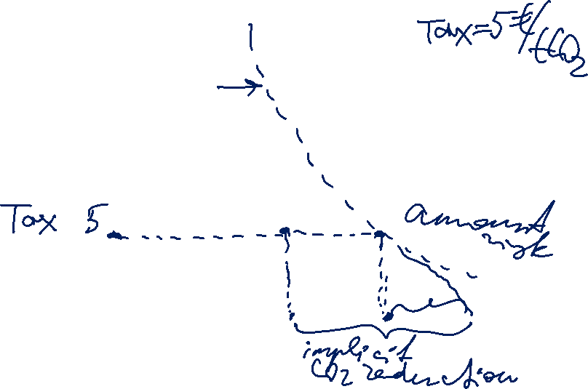
GHG Abatement Costs and a Pigou Tax
Marginal GHG abatement costs
[Euro/t CO₂]
Starting point
CO₂ emissions

Slide 47
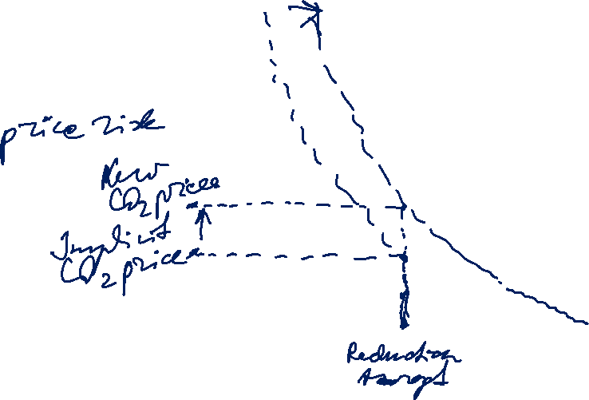
GHG Abatement Costs under Cap and Trade
Marginal GHG abatement costs
[Euro/t CO₂]
Starting point
CO₂ emissions

Slide 48
Emission Allowances and Abatement Cost
Abatement cost of company 1 (marginal cost)
Emission reduction requirements for company 1
Emissions of
company 1
Alllocated emissions Em₁
CO₂ emissions

Slide 49
Trade of Emission Allowances
Abatement cost of company 1
Abatement cost of company 2
Reductions of company 2
Reductions of company 1
ARBITRAGE
Emission
right EM₁
CO₂ Emissions
Emission right EM₂
CO₂ Emissions

Slide 50
Trade of Emission Allowances
Abatement cost of company 1 (marginal cost)
Abatement cost of company 2 (marginal cost)
ARBITRAGE
Allocated rights
Emission trade

Slide 51
Trade of Emission Allowances
Effects of the trade:
The given emissions target can be attained at a lower cost.
At a given cost, a more ambitious emissions target can be achieved.

Slide 52
Designing Emissions Trading System
Trading period length:
If the trading period is too long, the incentives are weak.
If the trading period is too short, there is lack of certainty for investments.
Allocation of emissions allowances:
Grandfathering – free allocation → windfall profits
CO₂ prices are opportunity costs of power plant operators
Auctioning
Government redistributes the auctioning revenues.

Slide 53
Exercise in „Energy Economics“
- Markets for CO₂ Emission Allowances
Chair of Energy Systems
Prof. Dr. Boris Heinz | Dr. Elena Timofeeva
elena.timofeeva@tu-berlin.de

Slide 54
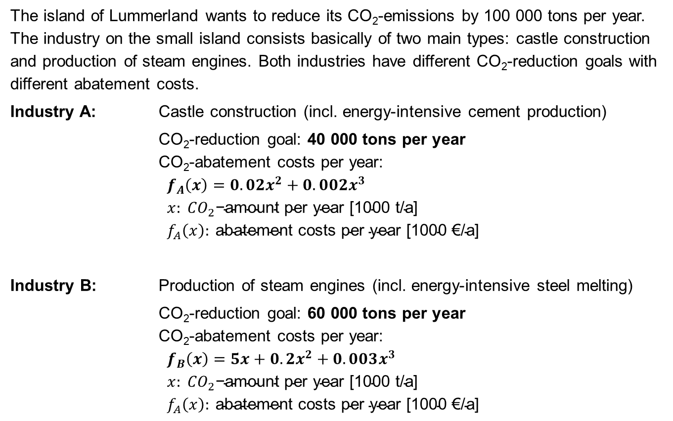
Task 1) CO₂ Reduction in Lummerland
The island of Lummerland wants to reduce its CO₂-emissions by 100 000 tons per year. The industry on the small island consists basically of two main types: castle construction and production of steam engines. Both industries have different CO₂-reduction goals with different abatement costs.
Industry A: Castle construction (incl. energy-intensive cement production)
CO₂-reduction goal: 40 000 tons per year
CO₂-abatement costs per year:
$$f_{A}\left(x\right)=0.02x^{2}+0.002x^{3} \\ x: {CO}_{2}\text{−}\text{amount} \text{per} \text{year}\text{ [1000 }\text{t}\text{/}\text{a}\text{] } \\ f_{A}\left(x\right): \text{abatement} \text{costs} \text{per} \text{year}\text{ [1000 €/}\text{a}\text{]}$$
Industry B: Production of steam engines (incl. energy-intensive steel melting)
CO₂-reduction goal: 60 000 tons per year
CO₂-abatement costs per year:
$$f_{B}\left(x\right)=5x+0.2x^{2}+0.003x^{3} \\ x: {CO}_{2}\text{−}\text{amount} \text{per} \text{year}\text{ [1000 }\text{t}\text{/}\text{a}\text{] } \\ f_{A}\left(x\right): \text{abatement} \text{costs} \text{per} \text{year}\text{ [1000 €/}\text{a}\text{]}$$

Slide 55
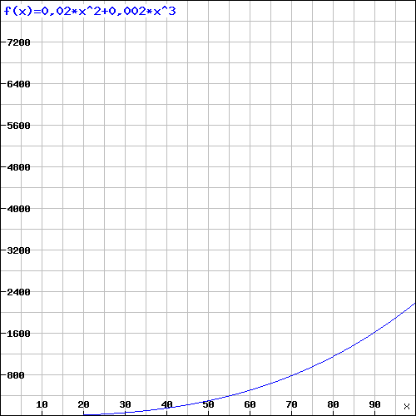
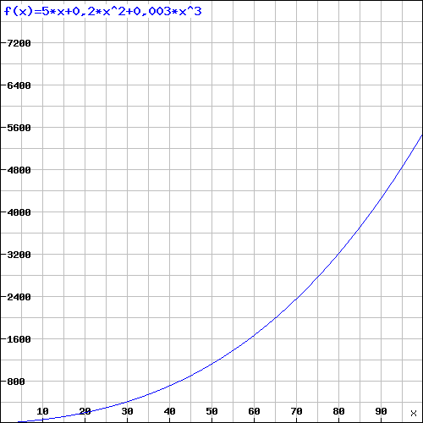
CO₂ Reduction in Lummerland
Industry A’s annual CO₂ abatement costs
Industry B’s annual CO₂ abatement costs
T €
T €
CO₂ reduction amount p.a. [1000 t CO₂]
CO₂ reduction amount p.a. [1000 t CO₂]

Slide 56
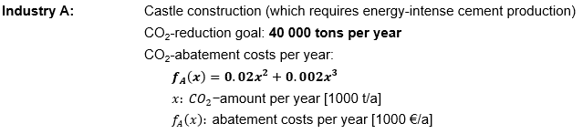

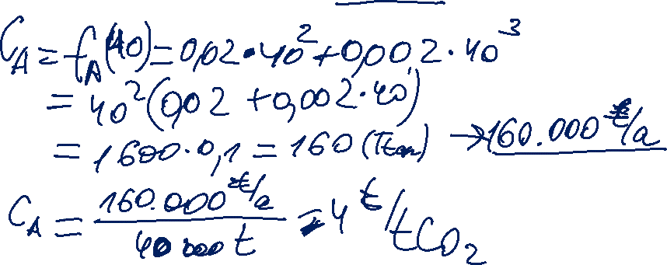
CO₂ Reduction in Lummerland
What are the abatement costs per ton CO₂ for Industry A?

Slide 57
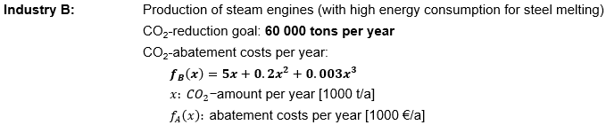

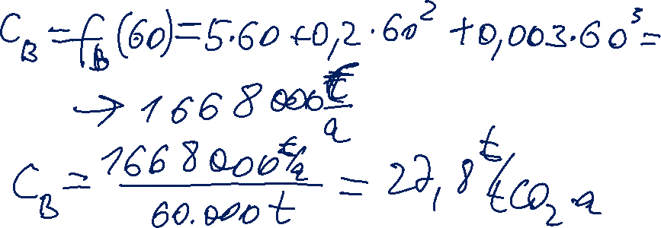
CO₂ Reduction in Lummerland
What are the abatement costs per ton CO₂ for Industry B?

Slide 58

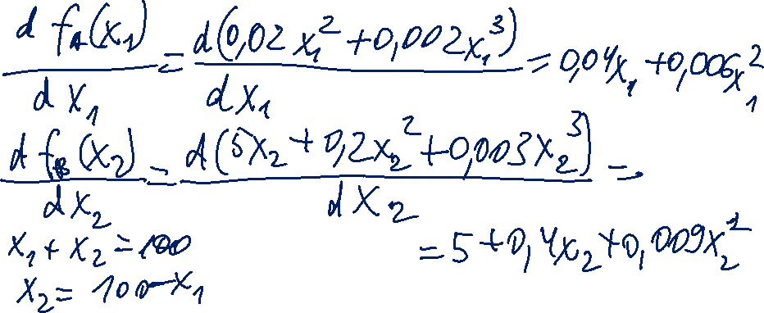
CO₂ Reduction in Lummerland
In order to lower the costs for CO2 abatement, the government of Lummerland introduces a new emissions trading mechanism. What is the theoretical volume traded?
Find the volume at which the marginal abatement costs of both industries are equal.
Given functions are for annual abatement costs as a function of the annual amount of CO₂ reduction.
Total required reduction for both industries is 100.000 tons.

Slide 59
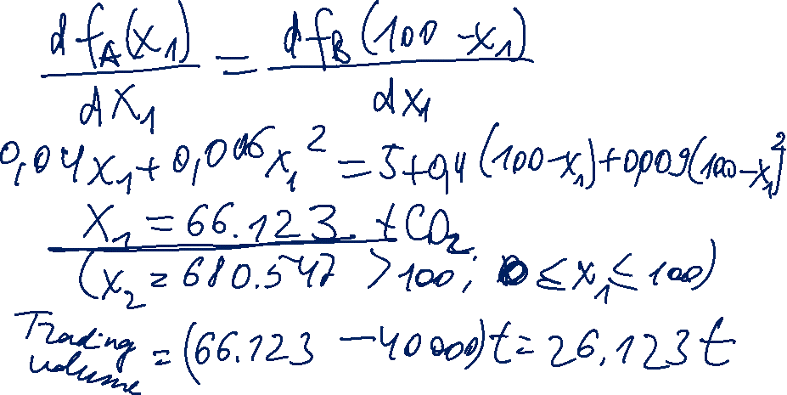
Second root does not meet the condition (just a matematical solution).
Under perfect market conditions 66.123 t CO₂ will be abated by industry A.
The difference between industry A’s abated amount and its reduction target will be traded.

Slide 60
CO₂ Reduction in Lummerland
Cap B
Cap A
Arbitrage

Slide 61

CO₂ Reduction in Lummerland
Cap A + Cap B = 100
Cap B
Cap A

Slide 62

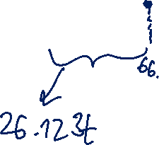
CO₂ Reduction in Lummerland
60.000 t CO₂
40.000 t CO₂
Abatement Costs A
Abatement Costs B

Slide 63
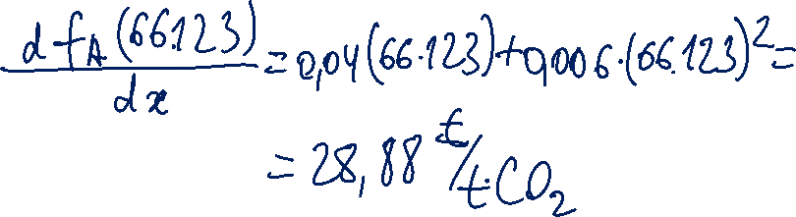
CO₂ Reduction in Lummerland
What is the system price in the emissions trading system?

Slide 64
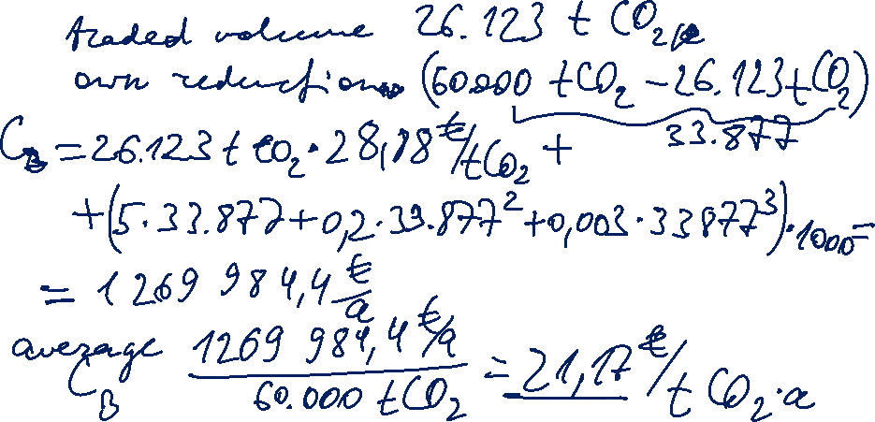
CO₂ Reduction in Lummerland
What are the new overall abatement costs per ton CO2 for Industry B?

Slide 65

CO₂ Reduction in Lummerland
26.123 t CO₂
33.877 t CO₂
40.000 t CO₂
Emissions Trade Volume
Abatement Costs A
Abatement Costs B
Notes:
Industrie A vermeidet zusätzlich 26.123 t CO₂ und würde die dadurch nicht benötigten Zertifikate an Industrie B zu einem Preis von 28,88 Euro/t verkaufen

Slide 66
EU Emissions Trading System
28 EU member states + Norway, Island and Liechtenstein
40% of EU emissions
4% of the world’s GHG emissions (approx. 2 billion GHG as of 2014)

Slide 67
EU Emissions Trading System
A quantitative limit is put on the aggregate annual amount of emissions for all plants participating in ETS (cap).
  a single EU-wide cap
  declining by 1,74% annually
Emission allowances are issued in an amount corresponding to the cap.
EUA (EU Allowance): An EUA permits operators of an industry installation or electricity generation unit to emit 1 t of CO₂ under the EU emissions trading system.
Auctioning as the main allocation principle:
for energy utilities – since 2013
for other industries – growing %, to be fully phased in by 2027
free allocation to industries threatened by carbon leakage
Each regulated operator must surrender every year the amount of EUA corresponding to the amount of its emissions. (→ 100 €/t CO₂)

Slide 68
Trends in Emissions and Economic Activity
%
Source: Ellerman / Marcatonini / Zaklan (2016)

Slide 69
Conventional Economic Theory
EUA price = abatement cost of the last project that is necessary to meet the cap (marginal abatement cost)
For understanding the EUA price, the distribution of the marginal abatement cost for the “Kyoto period” has to be quantified.

Slide 70
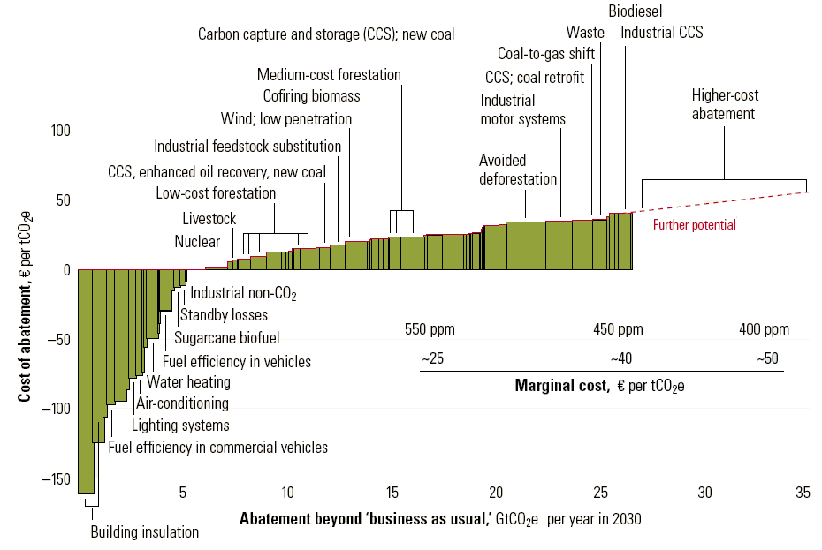
GHG Abatement Costs [Source: McKinsey&Co. 2007]
CO₂-emissions
2008 = 30.2 Gt

